Slide 1
EGU2015-6985: Exploring the response of West Siberian wetland methane emissions to potential future changes in climate, vegetation, and soil microbial metabolism
T. J. Bohn, J. O. Kaplan, and D. P. Lettenmaier
EGU General Assembly, Vienna, Austria, April 14, 2015

Slide 2
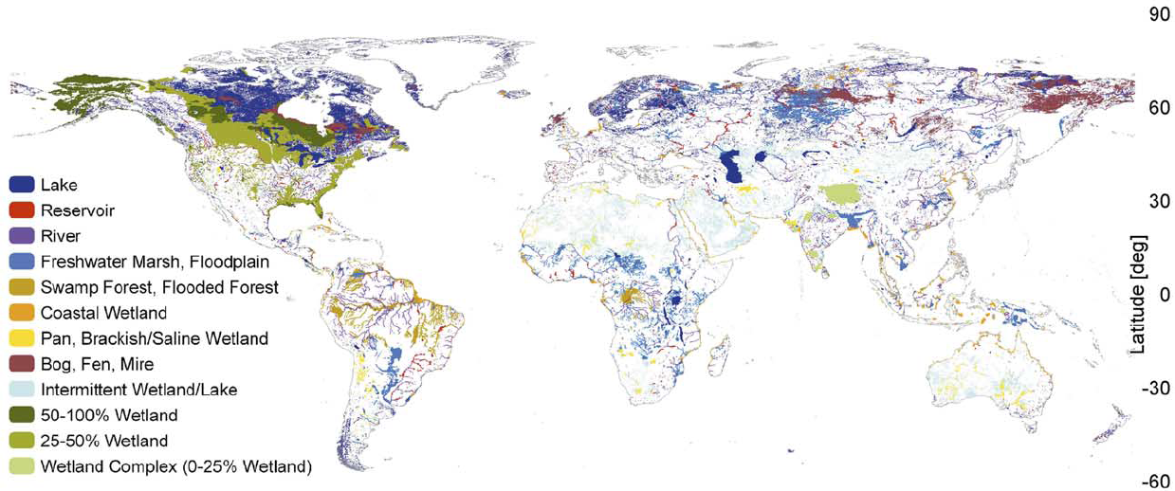
Importance of Northern Wetlands
Wetlands:
Largest natural global source of CH₄
Large C sink
Wetland carbon emissions are sensitive to climate
High latitudes experiencing pronounced climate change
50% of world’s wetlands are at high latitudes
West Siberian Lowland
(WSL)
Lehner and Doll, 2004
Potential positive feedback to warming climate

Slide 3

Controls on CH4 Emissions
Vegetation Species
Plant-Aided Transport
Carbon Inputs
[CO₂]
LAI
CO₂
CH₄
CH₄
CO₂
NPP
NPP
Living Biomass
methano-
trophy
Peat
Root Exudates
Litter
Soil Microbes
Aerobic R_{h}
Water Table
Metabolic Rates
Soil Temperature
Anoxia
Inundation
Water Table
Soil Microbes
Anaerobic R_{h} (methanogenesis)
All of these factors depend on climate
Notes:
Here, don’t explain whole schematic; just say that there are 4 main types of controls: carbon inputs ([CO2] and LAI), the extent of anoxic zones (soil moisture), metabolic rates (soil temperature), and vegetation species (plant-aided transport). All of these factors depend on climate.

Slide 4
Modeling Future CH4 Emissions
Models have explored effects of:
Changes in [CO2] and LAI
  Increased productivity
  Lower water tables (Ringeval et al., 2011; Koven et al., 2011)
Changes in inundation and water table depth
  T-P interactions (Bohn et al., 2007; 2010; 2013)
  Conversion from temperature- to water-limited regimes (Chen et al., 2015)
Changes in microbial metabolism
  Acclimatization (Koven et al., 2011)
Notes:
Combine slides 3 and 4? The main thing to emphasize is that the factors on slide 3 have been studied more than future vegetation changes. Probably no need to mention the examples (sub-bullets)

Slide 5
Changes in Wetland Vegetation
Future upland vegetation changes have been studied extensively
  Northward shifts of biomes (Kaplan and New, 2006)
Future wetland vegetation changes not well studied
Notes:
Combine slides 3 and 4?

Slide 6
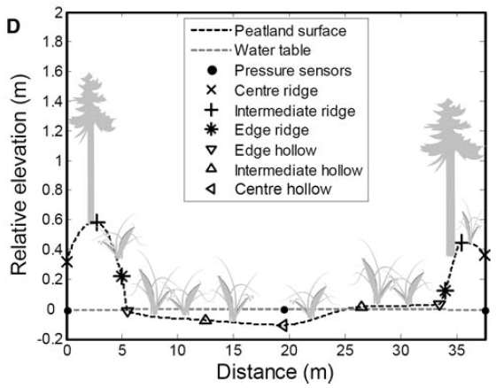
Wetland Plant Zonation
Trees and Shrubs
Higher LAI
Drier Environments
Areas covered by trees and sedges might change in response to long-term changes in inundation and water table depth.
This might affect CH4 emissions.
Sedges
Plant-Aided Transport
Wetter Environments
Ridge
Hollow
Eppinga et al., (2008)

Slide 7
Science Questions
How will the distributions of wetland plant functional groups (sedges, mosses, shrubs, trees) change in response to climate change over the next century?
How will these changes affect methane emissions?
How will these effects compare to the effects of changes in:
  Carbon input
  Soil moisture
  Soil temperature
  Microbial metabolism

Slide 8
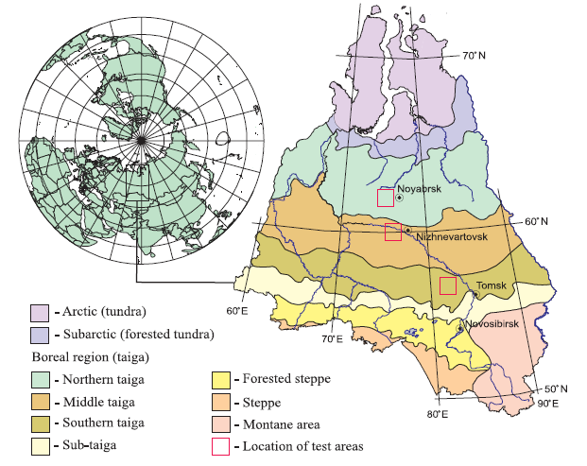
West Siberian Lowland (WSL)
Tundra
Few Trees
Continuous Permafrost
Taiga
Boreal Forest Belt
Discont. Permafrost/ Permafrost-Free
Steppe
Grasslands
Permafrost-Free
Observations:
  Wetland maps
  In situ CH4, T, water table, NPP
  (Sheng et al., 2004; Peregon et al., 2008; Glagolev et al., 2011)
Peregon et al. (2008)

Slide 9
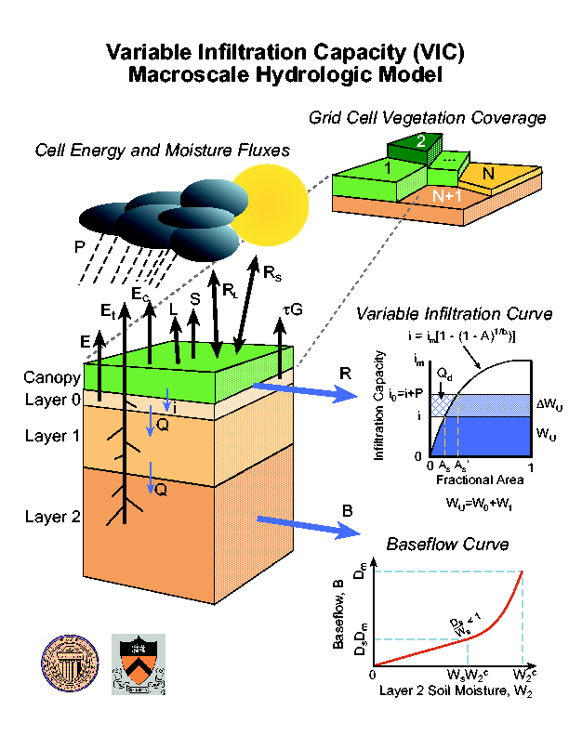
Modeling Framework
VIC hydrology model
  Large, “flat” grid cells (e.g. 100x100 km)
  On hourly time step, simulate:
    Soil T profile
    Water table depth Z_{WT}
    NPP
    Soil Respiration
    Other hydrologic variables…

Slide 10
Inundation and Water Tables
Dynamic lake/ wetland model (Bowling and Lettenmaier, 2010)
Topo. information from 1-km DEM drives dynamic inundation
Water table distribution accounts for microtopography
Linked to methane emissions model of Walter and Heimann (2000)

Slide 11
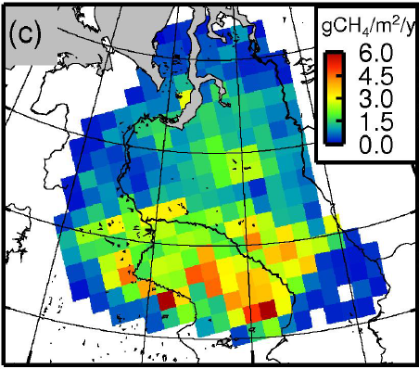
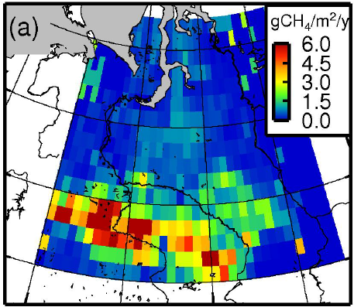
Historic CH4 Emissions, 1949-2010
Glagolev et al. (2011):
3.9 Tg CH4/year
VIC: 3.6 Tg CH4/year
Notes:
Glagolev et al is a collection of chamber measurements from summers 2006-2010 (but most places only sampled once; it just took multiple years to cover all of WSL). 3.9 Tg is about 10-15% of the pan-Arctic total, depending on the estimate (although Glagolev's upcoming update will make it closer to 6 Tg, or 20-25% of the pan-Arctic)

Slide 12
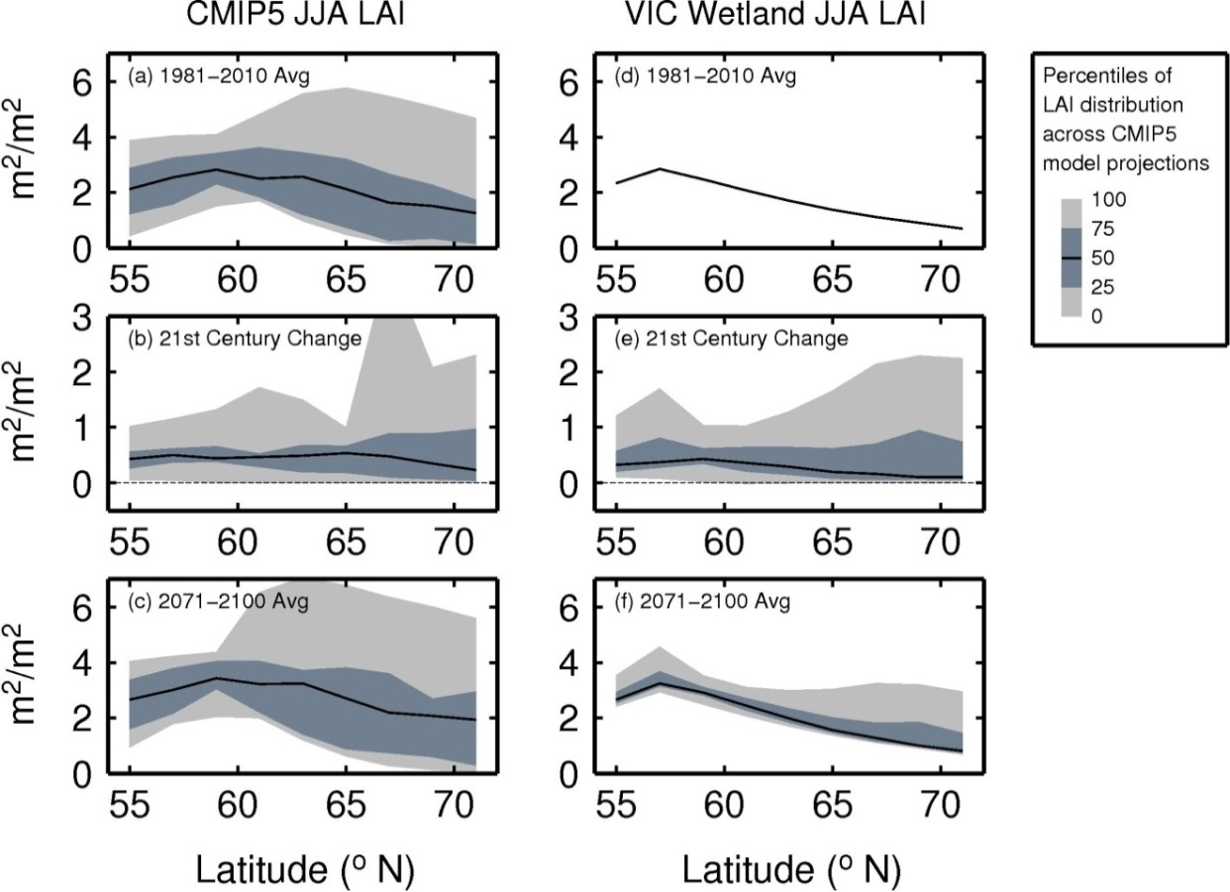
Simulations – Handling of Climate and LAI
CMIP5 whole-gridcell LAI vs. MODIS LAI for just wetland
Drive VIC with CMIP5 projections, 2010-2100
T, P: delta method, applied to 1980-2010
CO2: CMIP5 ensemble mean
LAI: quantile-mapping, applied to MODIS
Notes:
I downscaled CMIP5 projected LAI via quantile-mapping to historical MODIS LAI. So, during the historical period, LAI is MODIS. Future LAI is downscaled from CMIP5.

Slide 13
Simulations – Handling of Microbial Response
Acclimatization: Tmean = 10-year moving average soil temperature

Slide 14
Simulations – Handling of Species Abundances
Link current sedge and tree fractions to mean June-July-August water table position
As spatial mean water table position changes, areas of dominance of these species will change
Apply different CH4 parameters to sedge, non-sedge area fractions:
  Sedge: higher plant-aided transport, lower Q10
  Non-sedge: lower plant-aided transport, higher Q10
These simulations are in progress…
Notes:
I felt I had to address our strategy for doing vegetation since vegetation is the most novel part of the project and it's in the title of the talk. Perhaps you could move this slide to near the end to say that this is a "next step" (right before slide 16)?

Slide 15
Simulations
Simulation | N | Climate (T,P) | Soil Moisture | LAI
Historical | 1 | Adam et al. (2006) | Prognostic | MODIS (Myneni et al., 2002)
Warming+Drying+LAI | 32 | CMIP5 | Prognostic | CMIP5
Warming+Drying | 32 | CMIP5 | Prognostic | MODIS
Warming+LAI | 1 | CMIP5 EnsMean | Prescribed | CMIP5
Warming | 1 | CMIP5 EnsMean | Prescribed | MODIS
Microbial Response Cases
Case | Acclimatization
NoAcc | No
Acc | Yes
Changes in Species Abundances Not Yet Finished

Slide 16
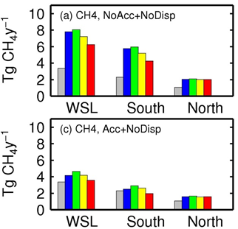
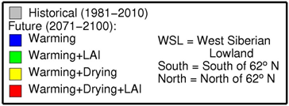
Effects of Warming, Drying, LAI, Acclimatization, 2071-2100
Without acclimatization:
  Warming effect on metabolic rates (blue) causes CH4 emissions to more than double, in both the South and North halves of the domain
  Drying of soils due to warming (yellow) and increased LAI (red) cuts the increase of emissions in half, in the South only
  LAI’s contribution of more carbon (green) causes only minor increases in CH4
With acclimatization:
  Warming effect on metabolic rates (blue) nearly disappears
  End-of-century CH4 falls to 20% lower than present in South, cancelling out increases in North
Notes:
The upper panel is no acclimatization; the lower panel is acclimatization. So, the bar colors are the same in both panels; there aren't separate bars for acclimatization - instead, it's a separate panel. The bars are:
grey = historical
blue = warming while holding water table and inundation and LAI/NPP at historical levels; this gets at the effects of warming on metabolism alone
green = same as blue, but LAI and NPP are allowed to vary with CMIP5
yellow = warming including the effects on the water table and inundation, so that we see the drying effect of climate; but LAI still kept at historical levels
red = same as yellow but LAI/NPP are allowed to vary with CMIP5 - now we see the total effect of everything (except changing sedge/tree fractions)

Slide 17
Likely Effects of Vegetation Change
Simulations in progress, but…
Sedge coverage will likely decline in South as water tables fall
This will lower CH4 emissions further
Relative size of this effect unknown
Thermokarst not accounted for; might initially cause increase in wet depressions (sedge habitat) followed by decrease
Notes:
Right, so you can maybe say this information while on the slide that shows my sedge fraction strategy) I'm currently running monte carlo simulations to identify the optimal parameter values for sedge-dominated, moss-dominated, and mixed sites - parameters include those for plant-aided transport (which sedges should be really good at), root zone oxidation (mosses have no roots) and metabolism temperature dependence (research has shown that temperature dependence is different at sedge- vs moss-dominated sites). Next steps: compute the threshold water table depth for sedge dominance; apply the optimal parameters for sedge-dominated and non-sedge to the sedge and non-sedge area fractions, and do this again in the future projections to see how they changed. Of course, we will have distributions of likely parameter values and distributions of future climate, so we'll be able to report uncertainties in all of these predictions.

Slide 18
Conclusions
Warming effect on metabolic rates is the largest of the effects we considered: causes more than doubling of emissions by 2100
Microbial acclimatization can nearly eliminate these increases
Drying effects are smaller than warming effect and concentrated in the South, which is relatively water-limited
Effects of drying on sedge abundances not yet known but likely will cause further decrease in CH4

Slide 19
Thank You
T. Bohn was supported by NSF SEES Grant 1216037
Northern Eurasia Earth Science Partnership Initiative (NEESPI)

Slide 20
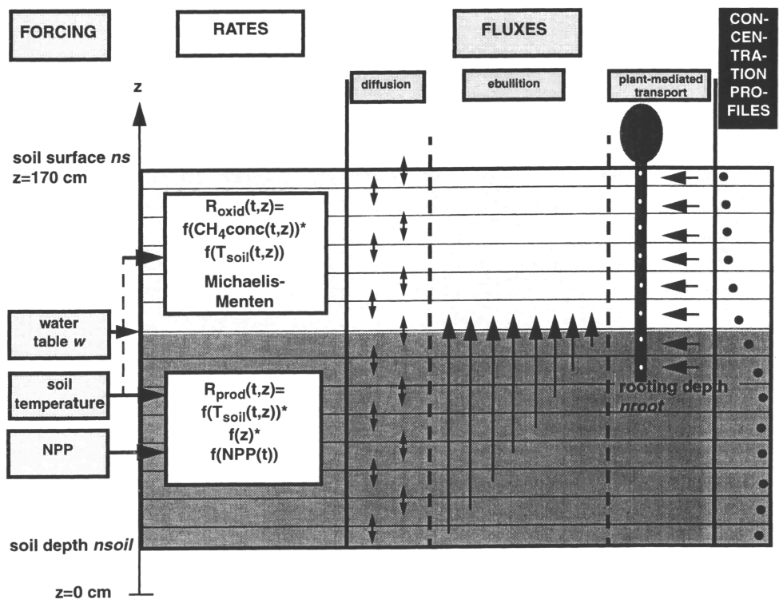
Methane Emissions Model
Walter and Heimann (2000)
CH4 flux = production – oxidation
CH4 production depends on:
  NPP
  Soil Temperature (Q10)
  Anoxic conditions (below water table)
CH4 oxidation depends on:
  CH4 concentration
  Soil Temperature (Q10)
  Oxic conditions (above water table)
3 pathways to surface:
  Diffusion
  Plant-aided transport
  Ebullition

Slide 21
CH4 Emissions depend strongly on vegetation
Temperature dependence (Q10) (Lupascu et al., 2012):
  higher in sphagnum moss-dominated wetlands
  lower in sedge-dominated wetlands
Plant-aided transport (Walter and Heimann, 2000):
  High in sedge-dominated wetlands
  Low in shrubby/treed wetlands
  0 in sphagnum moss-dominated wetlands

Slide 22
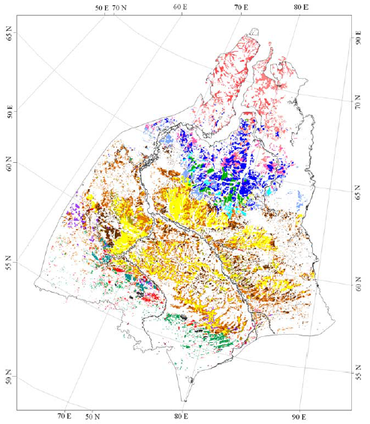
Wetland vegetation controlled by climate
Tundra and Forest-Tundra:
Few trees
Permafrost (ice lenses) influences microtopography
Sedges in wet depressions
Taiga:
Trees present
Large expanses of Sphagnum-dominated “uplands” (bogs)
Sedges in wet depressions (hollows, fens)
Sub-Taiga and Forest-Steppe:
Few Trees
Wetlands primarily occupy depressions
Primarily sedge-dominated
Peregon et al. (2008)

Slide 23
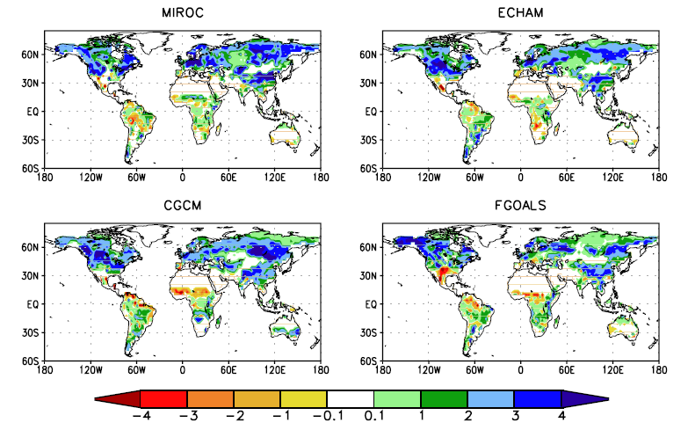
Northward Veg. Shift
Southern biomes will migrate northward over next century (Kaplan and New, 2006)
  Forest will displace tundra
  General increase in LAI
Possible Effects:
Higher LAI = Higher NPP = Increase in CH4
Higher LAI = Greater ET, Drying of soil = Decrease in CH4
Change in LAI, 1900 to 2100
(Alo and Wang, 2008)

Slide 24
Other Veg Changes
Warming/Drying:
Lower water tables may reduce areas of sedge-dominated depressions
  Additional reduction in CH4 emissions
Encroachment of shrubs and trees into sphagnum-dominated bogs in Taiga zone
  Small increase in plant-aided transport?
  Replacement of wetlands with forest?

Slide 25
