Slide 1
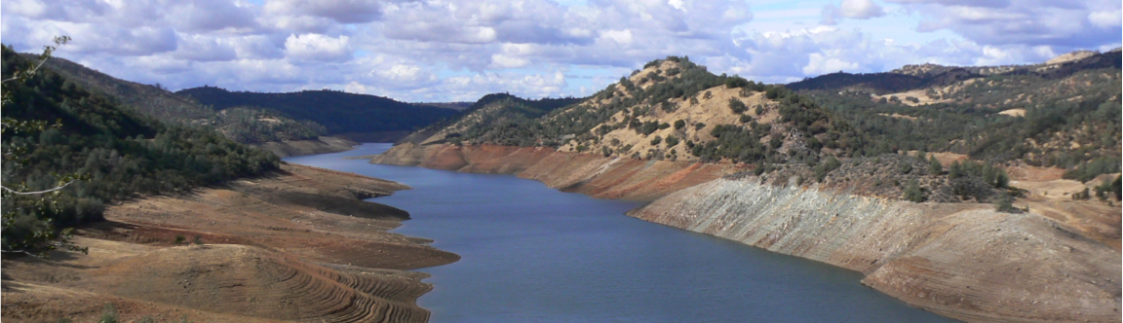

Comparison of precipitation products and hydrologic simulations over the OLYMPEX domain
Dennis P. Lettenmaierª, Qian Caoª, Ali Mehranª, Cliff Mass^{b}, and Neal Johnson^{b}
ªUniversity of California, Los Angeles
^{b}University of Washington
July 16, 2015
PMM PI Meeting
Baltimore, MD

Slide 2
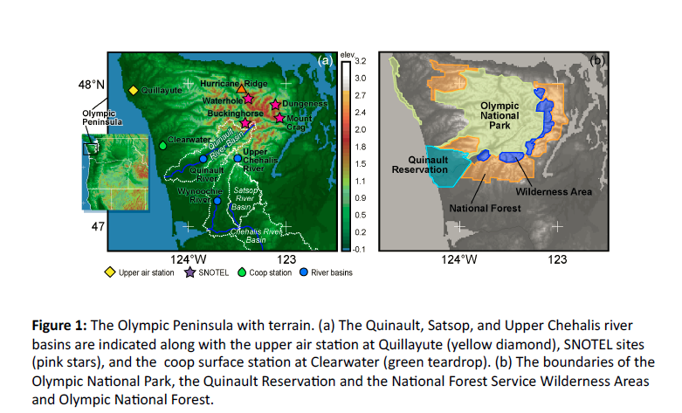
OLYMPEX domain (per Implementation Plan)

Slide 3
Outline
Comparison of precipitation products over the OLYMPEX domain
Gridded station data set of Livneh et al. (2013)
Drought Monitoring System for the Pacific Northwest
UWWRF real time forecast
Radar Level III and Stage IV
TMPA-RT
PERSIANN
Evaluation of extreme streamflow simulations for the Chehalis River Basin using updated gridded station data set
Airborne Snow Observatory and its role

Slide 4
Precipitation Data Sets
Dataset | Start Date | End Date
Radar(Level 3) | 09/22/2011 | 05/15/2015
WRF (4Km)* | 01/01/2009 | 12/31/2014
TMPA - RT | 01/01/2009 | 04/26/2015
IMERG | 03/12/2014 | 02/28/2015
Livneh et al. | 01/01/2009 | 12/31/2014
PERSIANN | 01/01/2009 | 12/31/2014
ST – IV | 01/01/2011 | 03/31/2015
Drought Monitoring | 01/01/2014 | 05/01/2015
* Not available in February and March 2014
Notes:
Radar (Level 3) does not cover the whole Olympic peninsula
IMERG has the shortest temporal coverage over Olympic peninsula
WRF forecasts is an hourly forecast in 1.33 Km spatial resolution
All the datasets in this slide are interpolated to 1/16 degree daily cumulative precipitation

Slide 5
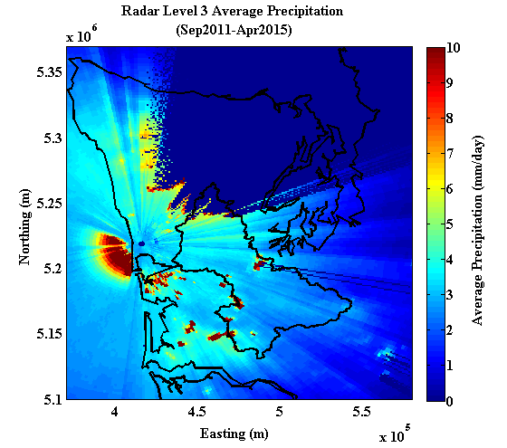
Langley Hill (NWS WSR-88D) Radar Level III Precipitation Map
Langley Hill Radar
Location:
124.11W, 47.12N
Notes:
Dark blue color indicates the terrain blockage with beam angle of 0.5 degree
Even with the smallest beam angle (the beam can tilt to 0.5, 1, 1.5 … degrees), the Chehalis Basin was blocked only a little in North region

Slide 6
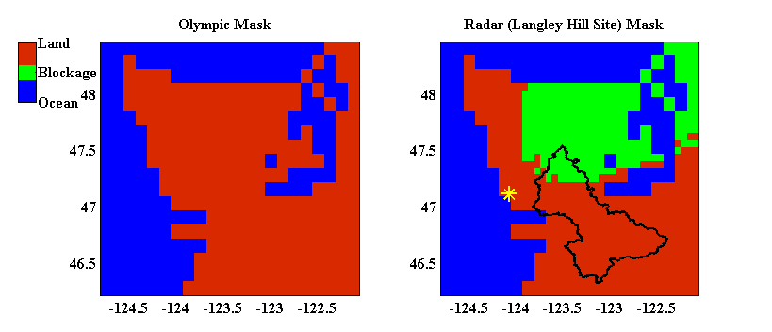
Langley Hill radar terrain blockage over OLYMPEX domain
Notes:
Radar (Level3) coverage map over Olympic peninsula
A 1/16th degree pixel is considered blocked if there was over 50% blockage in it.
Red is the covered area and the green color is out of Radar coverage
Lack of coverage on north part of peninsula is because of Olympic mountains (west peak)

Slide 7
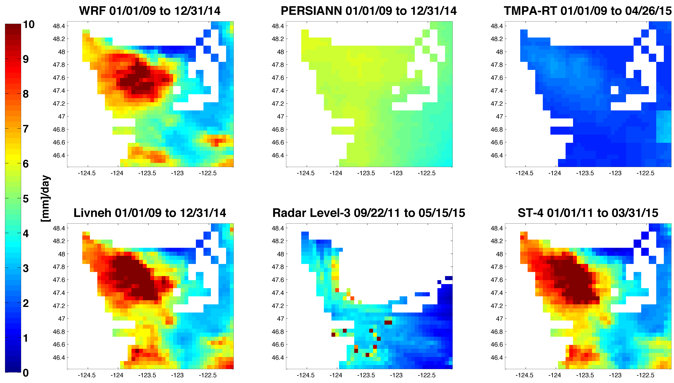
Average Daily Precipitation Comparison Over Olympic Peninsula
Notes:
These 6 datasets have longer temporal coverage over Olympic peninsula
WRF and Livneh and ST-4 are consistent in trend and extremes
PERSIANN and TMPA-RT are underestimating average daily precipitation
Radar Level 3 does not cover extreme precipitations and there seems to be some noises in the data as several pixels are showing extreme precipitation

Slide 8
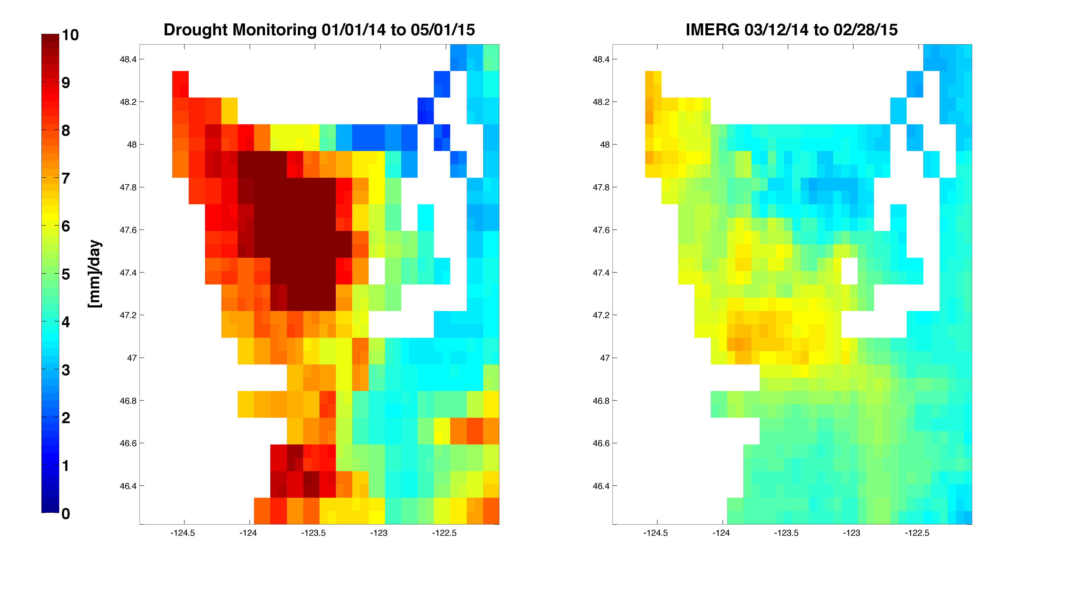
Average Daily Precipitation Comparison – UW DM and IMERG
Notes:
IMERG seems to underestimate the mean daily precipitation
Drought monitoring dataset is very consistent with Livneh and ST-IV data

Slide 9
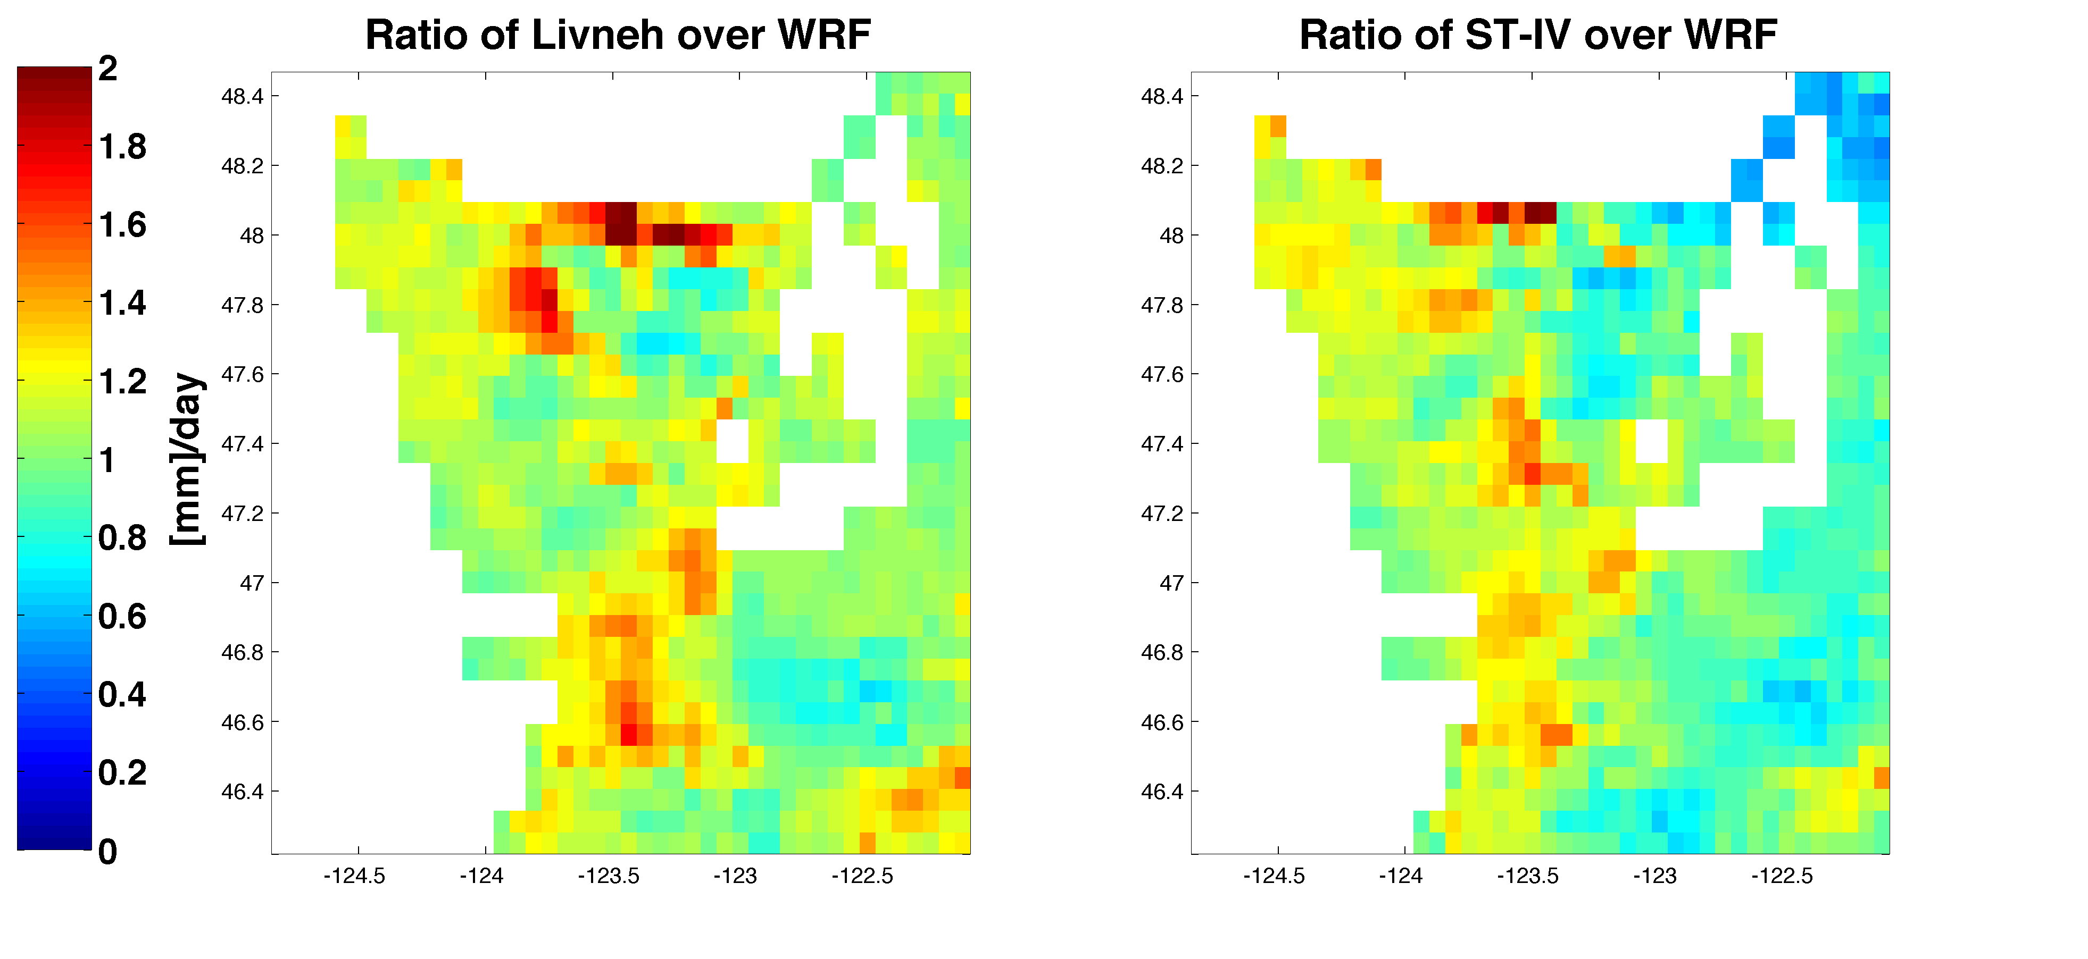
Comparison of Daily Average ST-IV and Livneh Datasets Against WRF
Notes:
Left map shows Mean daily precipitation of Livneh divided by mean daily precipitation of WRF
Right map shows Mean daily precipitation of ST-IV divided by mean daily precipitation of WRF
Overall both maps are not that different from each other except several pixels at north of the Olympic peninsula on Livneh dataset
On northeast pixels of ST-IV, there is an underestimation of almost 50%

Slide 10
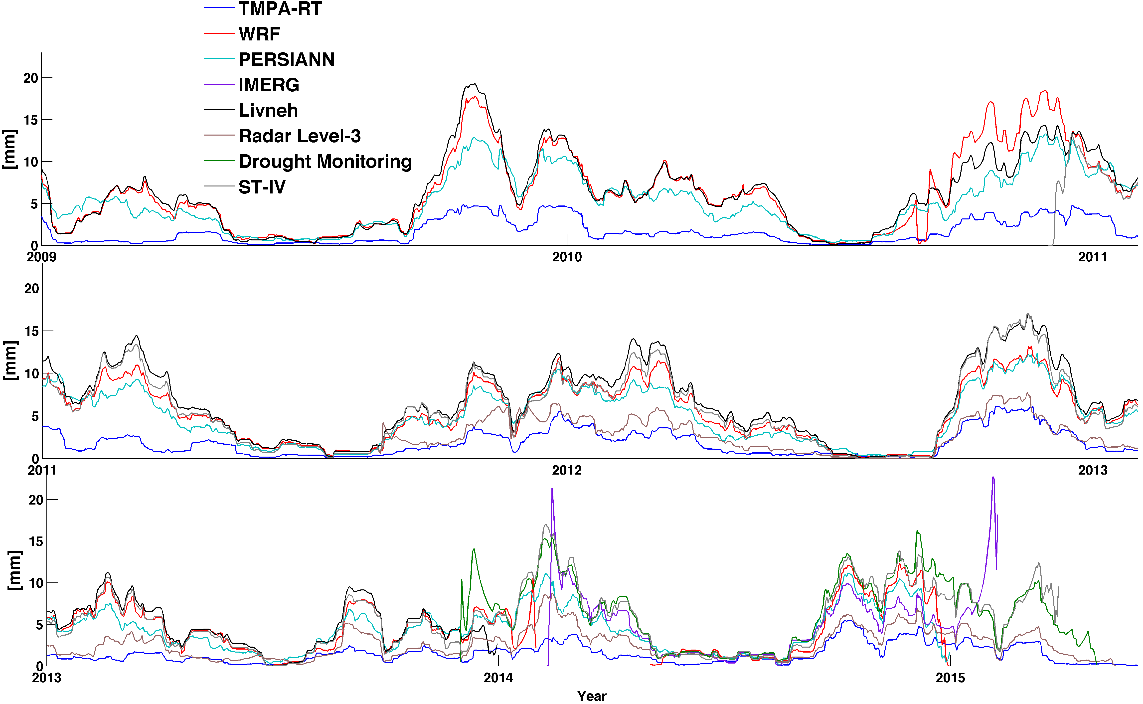
30 Days Moving Average Comparison (OLYMPEX domain average)
Notes:
Livneh and WRF forecasts are in really good agreement with each other and later in 2011 ST-IV data confirms them too
PERSIANN follows the trend of WRF, Livneh and ST-IV but in general it is underestimating the daily average precipitation.
Drought monitoring precipitation data is in good agreement with ST-IV and WRF
IMERG seem to overestimate precipitation in several days of late February

Slide 11
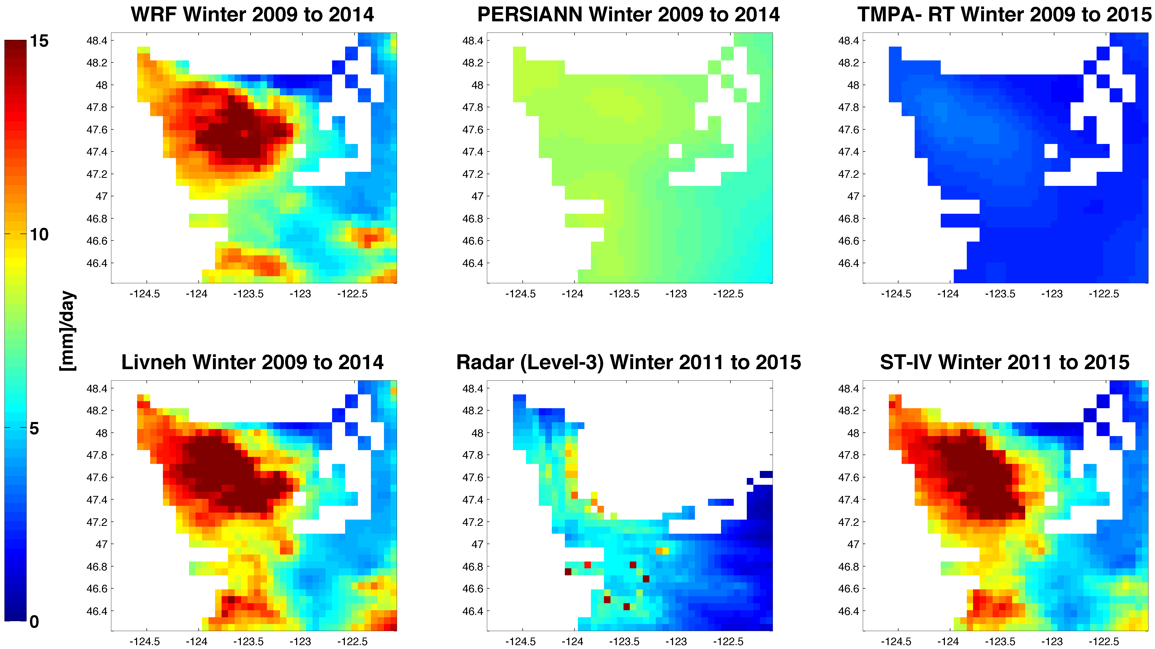
Winter (November to March) Daily Precipitation Comparison Over Olympic Peninsula
Notes:
Winter maps of the datasets over Olympic covers the extreme precipitations (colorbar is from 0 to 15 mm/day)
Radar (Level3) although covers the southern part of the peninsula, poorly can show the winter precipitations
PERSIANN and TMPA-RT are underestimating the extreme precipitations
WRF, Livneh, and ST-IV are in very good agreement with each other in trend and in extreme precipitation pixels (North west of peninsula)

Slide 12
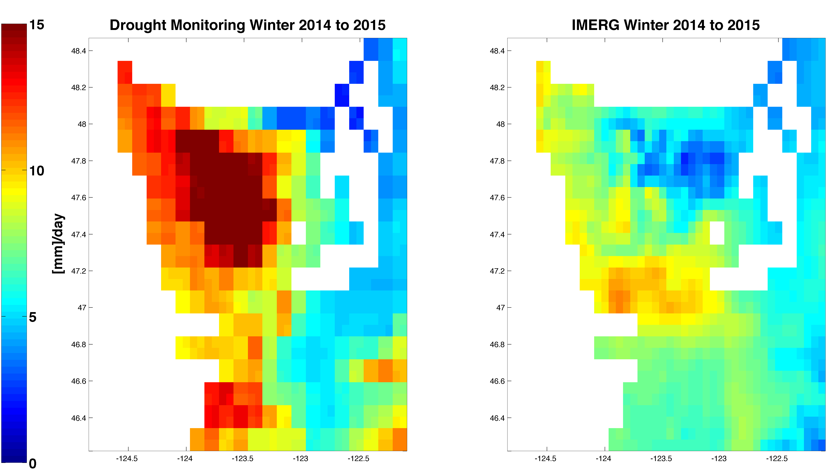
Winter (November to March) Daily Precipitation Comparison Over Olympic Peninsula
Notes:
Drought Monitoring precipitation dataset for winter is in good agreement with ST-IV, Livneh and WRF but not IMERG
IMERG winter precipitation dataset is showing a different trend in precipitation over Olympic peninsula
IMERG shows the maximum precipitation in the center of the map but the minimum is right in the northern region
IMERG underestimates winter precipitation

Slide 13
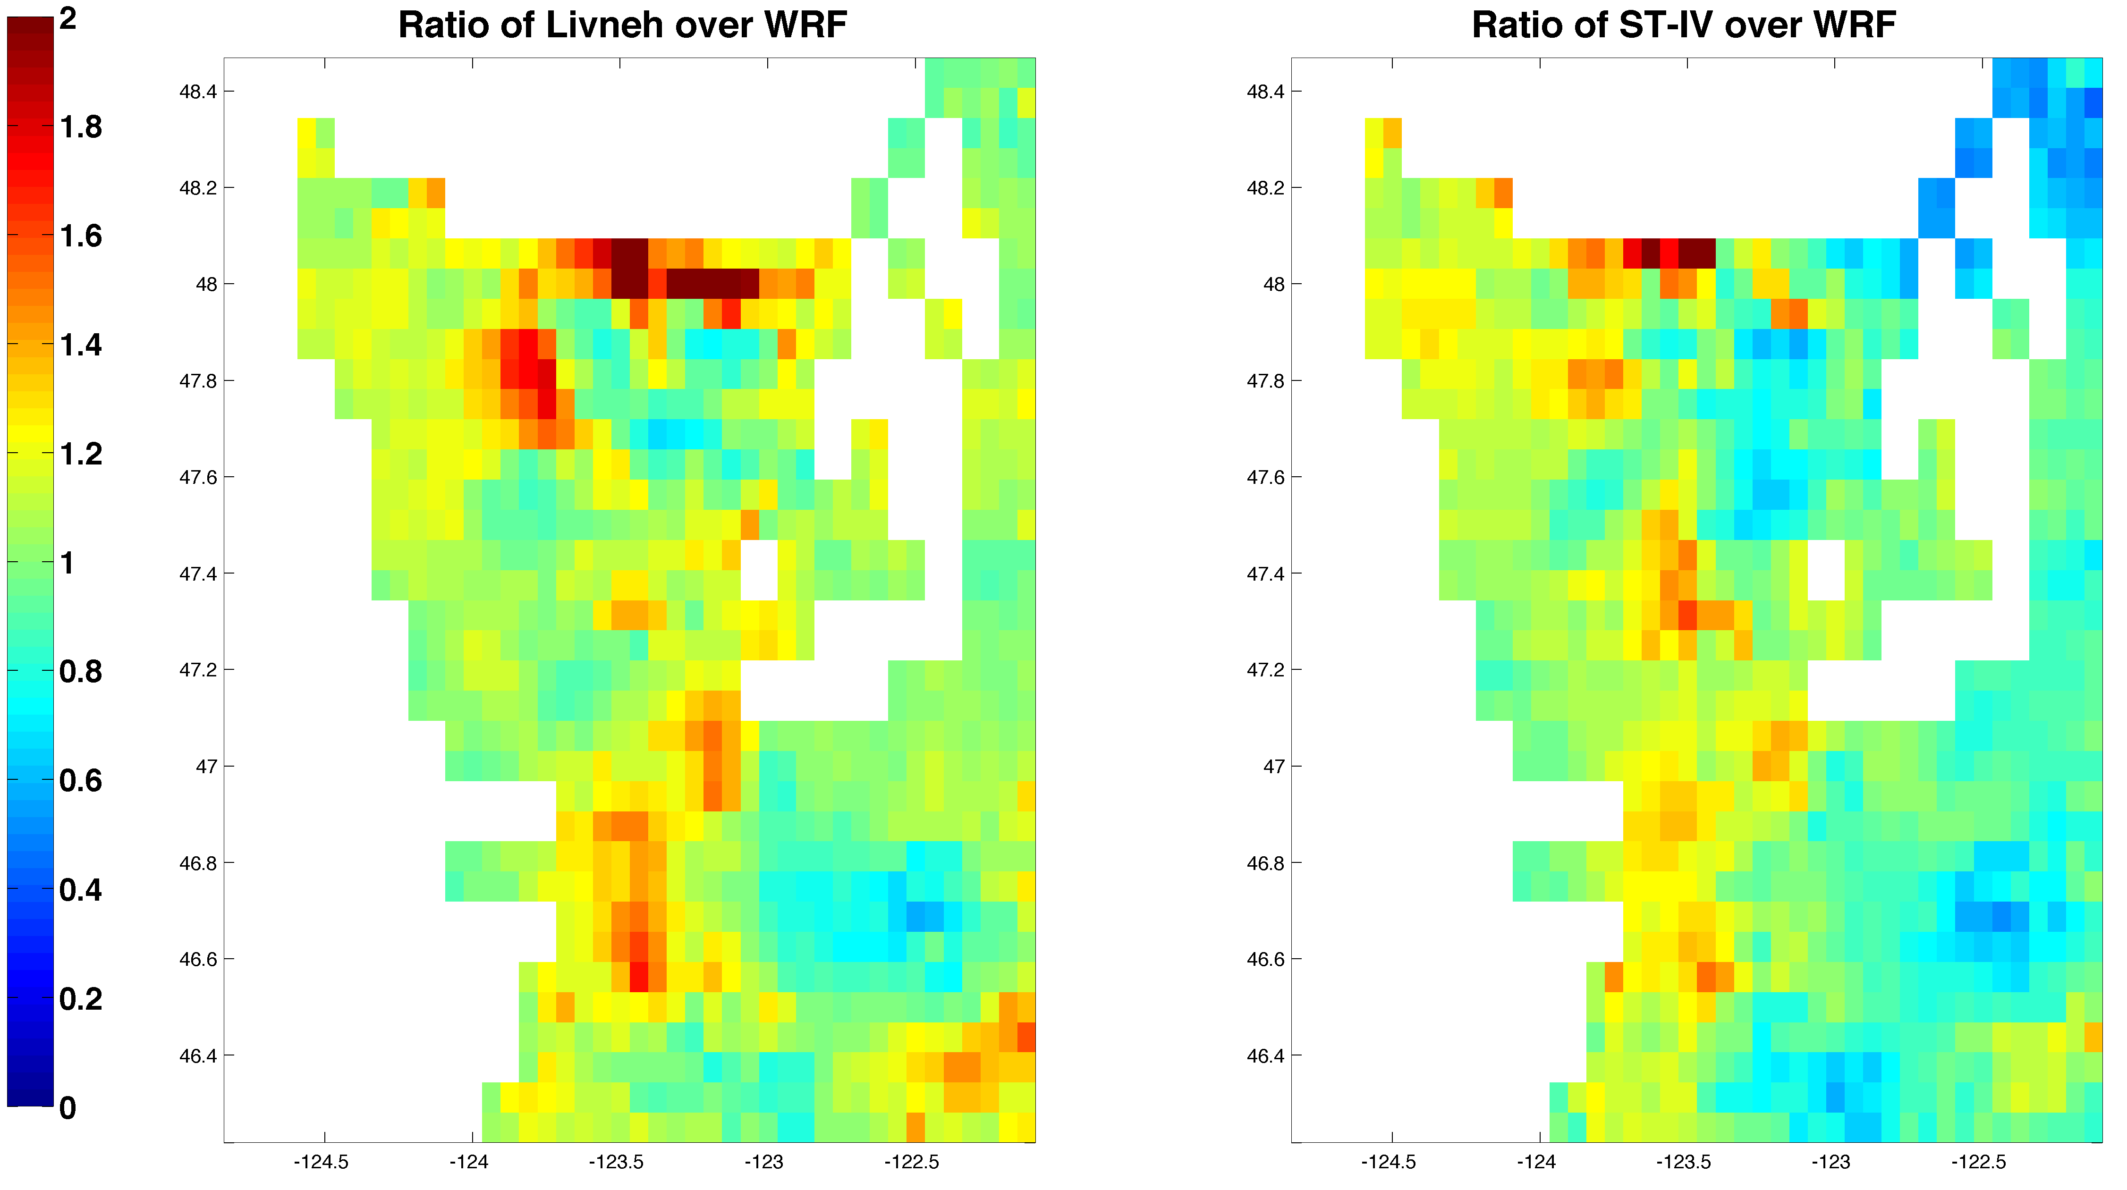
Comparison of Winter Daily Average ST-IV and Livneh Datasets Against WRF
Notes:
Livneh and ST-IV datasets are divided by WRF
Livneh versus WRF shows a little overestimation on the north of the peninsula (green means neutral, red means overestimation)
ST-IV versus WRF shows underestimation on Northeast pixels of the peninsula

Slide 14
Test Site: Chehalis Basin
Notes:
Chehalis Basin is the primary test basin

Slide 15
Map of Rain Gauges in Chehalis Basin
Notes:
Livneh et al. (2013) used COOP stations;
CocoRahs, HADS and RAWS gauges were added, but almost all of them have records shorter than 10 years.
The Wynoochee Gauges (blue dots) will be installed.

Slide 16
Generating Reference Precipitation Data Set
Gridded data set of Livneh et al. (2013)
Gridding Method: Synergraphic Mapping System (SYMAP);
Spatial resolution: 1/16th degree;
Observation Gauges: NOAA Cooperative Observer (COOP) stations;
Scaled on a monthly basis to match the long-term mean of PRISM (1981-2010);
Data set period: 1915~2013
Updated data set
The data set was extended to May, 2015 following the gridding method of Livneh et al. (2013) but with more gauges (CocoRahs, HADS and RAWS).
Notes:
Comparing the basin and gauge elevation distribution, there should be more gauges over 400 m.

Slide 17
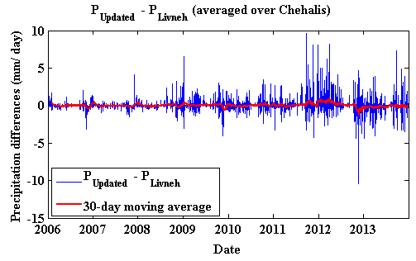
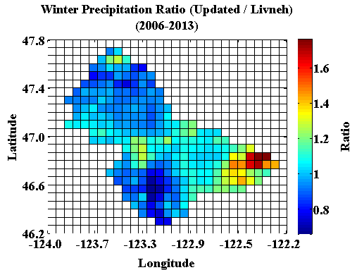
Comparison of Livneh’s and Updated Data Sets
Notes:
The updated data set (with more rain gauges) has higher winter precipitation over the eastern mountain areas but lower winter precipitation over the north and south regions compared with Livneh’s data set.

Slide 18
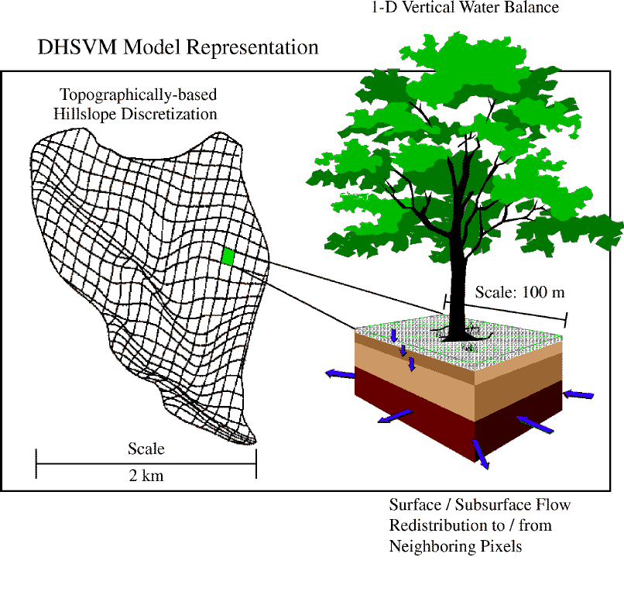
The Distributed Hydrology-Soil-Vegetation Model (DHSVM)

Slide 19
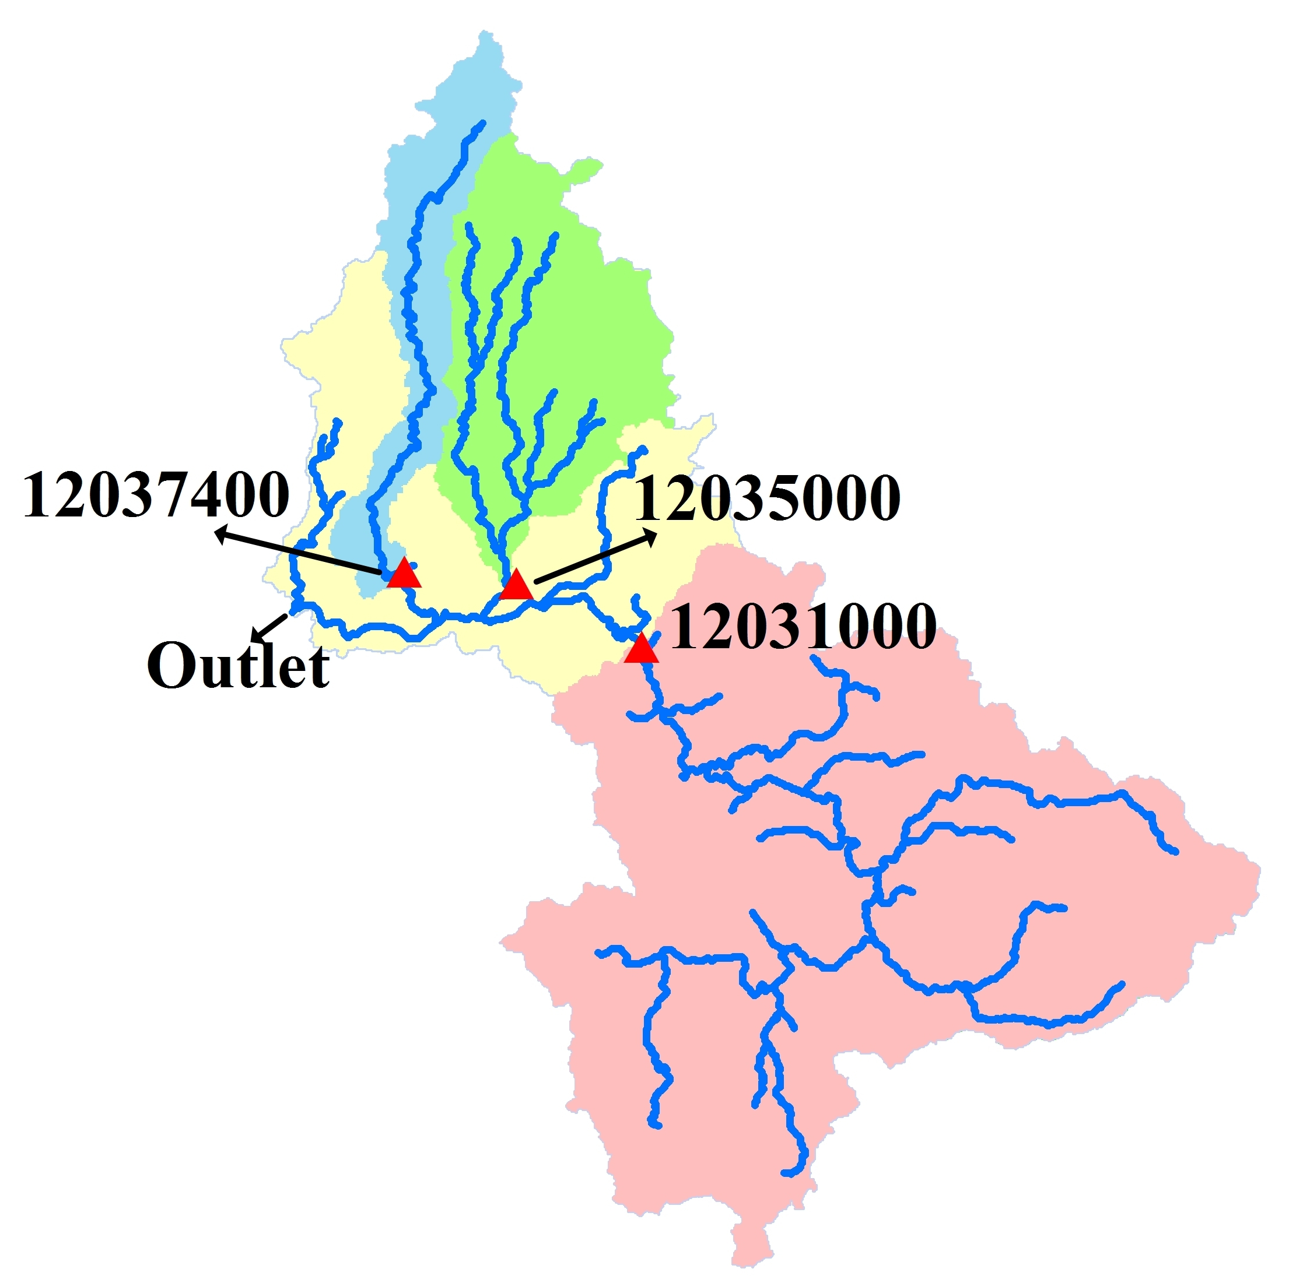
Streamflow simulation using updated data set
Notes:
The simulation results of the updated data set are acceptable over sub-basins (Wynoochee, Satsop and upper Chehalis).

Slide 20
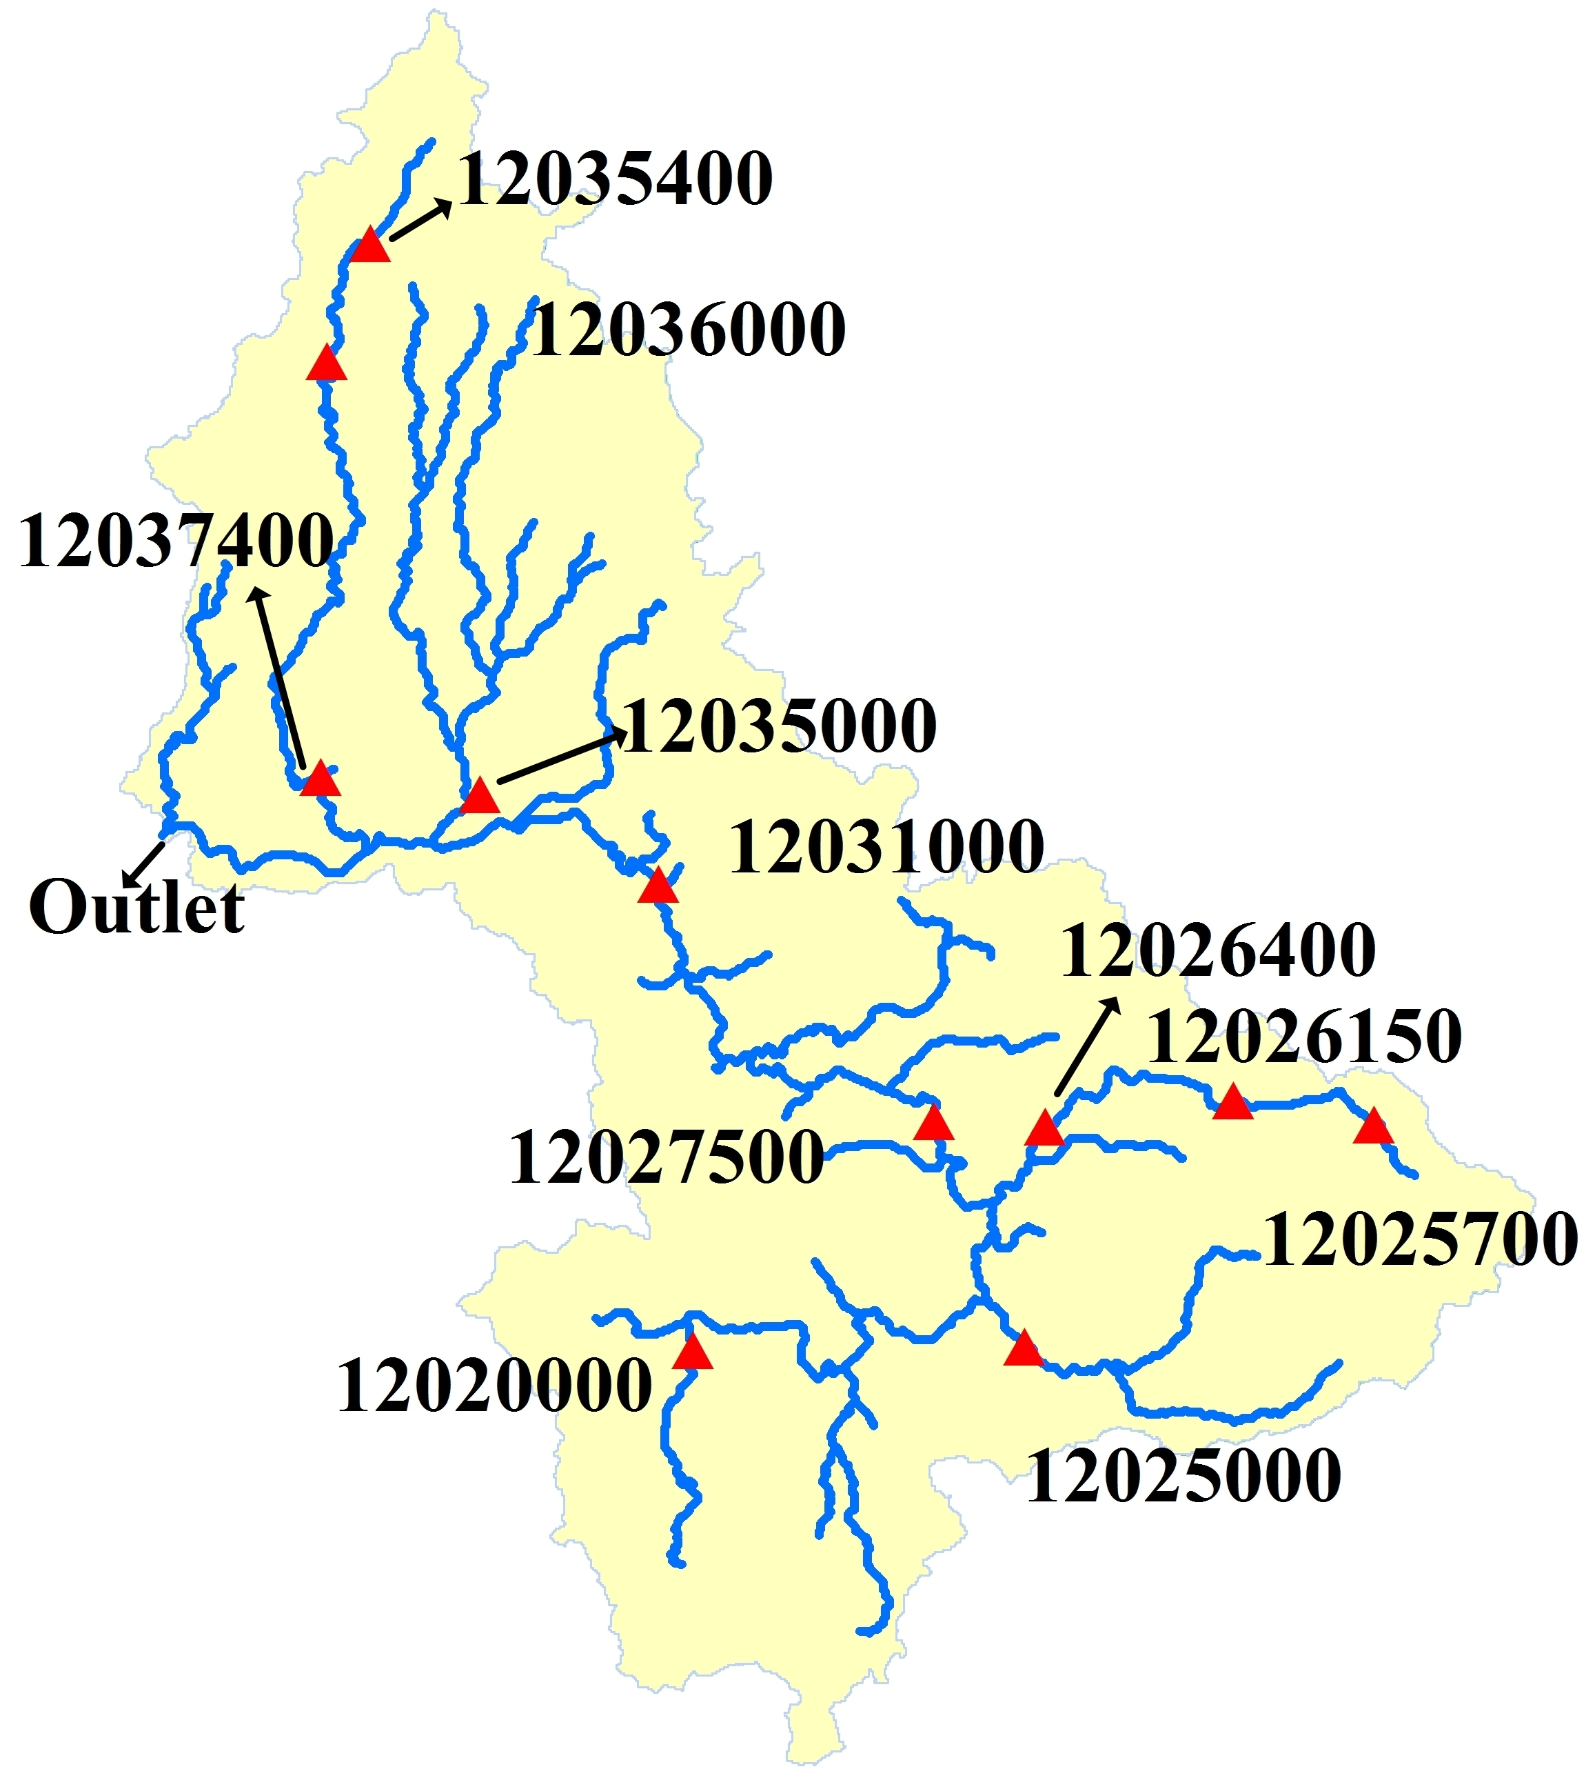
Evaluation of the simulation of stream flow extremes with updated data set
Largest 1% streamflow over 2006~2015
Notes:
The largest 1% observed streamflow over 2006~2015 (31 events in total) were picked out and compared with simulated flow on the corresponding days.
Average Relative Error ranges from -14.2% to 4.5% over 11 active usgs gauges.
Gauge 12035400 and Gauge 12035000 have largest average relative errors of -14% and -11% respectively.

Slide 22
Comparison of Livneh’s and updated Data Sets in Extreme Streamflow Simulation
Table 1. Average relative error of largest 1% streamflow simulation over 2006~2015
USGS Gauge | Average Relative Error
 | Livneh et al. (2013) | Updated data set
12020000 | 18.3% | -2.0%
12025000 | 8.5% | 3.6%
12025700 | -4.7% | -6.2%
12026150 | -5.4% | -6.6%
12026400 | -3.4% | 0.7%
12027500 | 5.2% | -1.3%
12031000 | 6.4% | -9.7%
12035000 | -1.0% | -11.1%
12035400 | -1.7% | -14.2%
12036000 | 8.3% | -2.7%
12037400 | -34.0% | 4.5%
max | 18.3% | 4.5%
min | -34.0% | -14.2%
Notes:
The updated data set performs better than Livneh’s data set at over half of the usgs gauges in flood simulation.

Slide 23
Airborne Snow Observatory (ASO)
LIDAR-based surface elevation at high (o(meters)) spatial resolution
Background flown for snow-free conditions (Sep 2014)
Plan to fly several (~3) times during winter 15-16
Provides maps of snow dept (by difference from background); conversion to Snow Water Equivalent (SWE) based on limited density obs + modeling; variability in depth is generally much > than in density
Flight lines are over that portion of OLYMPEX domain with elevation > ~2000 ft

Slide 24
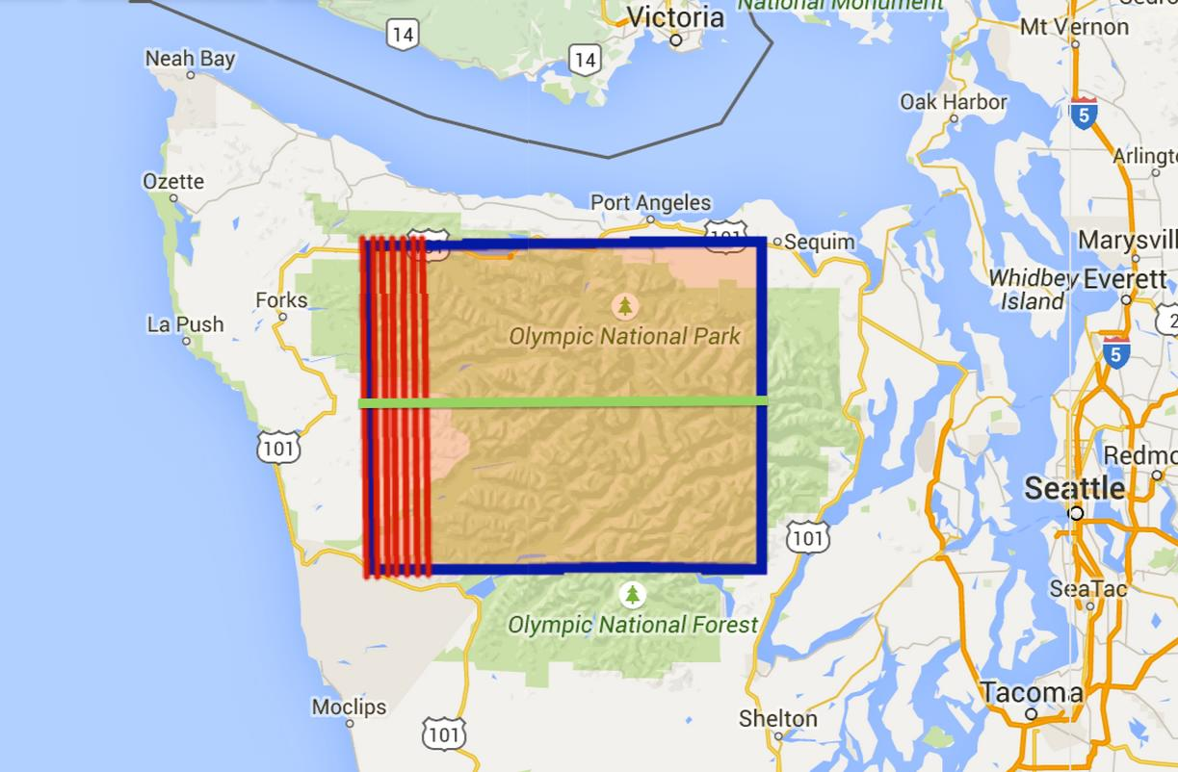
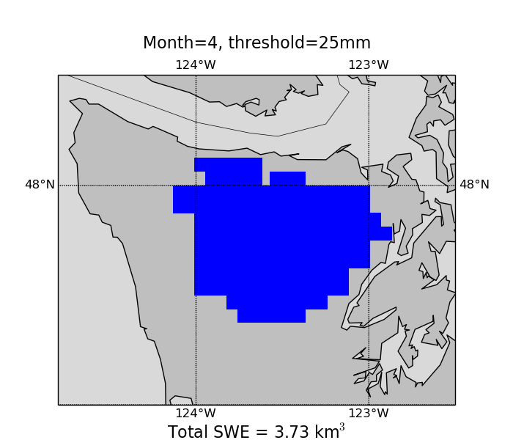
ASO flight lines Sep 2014

Slide 25
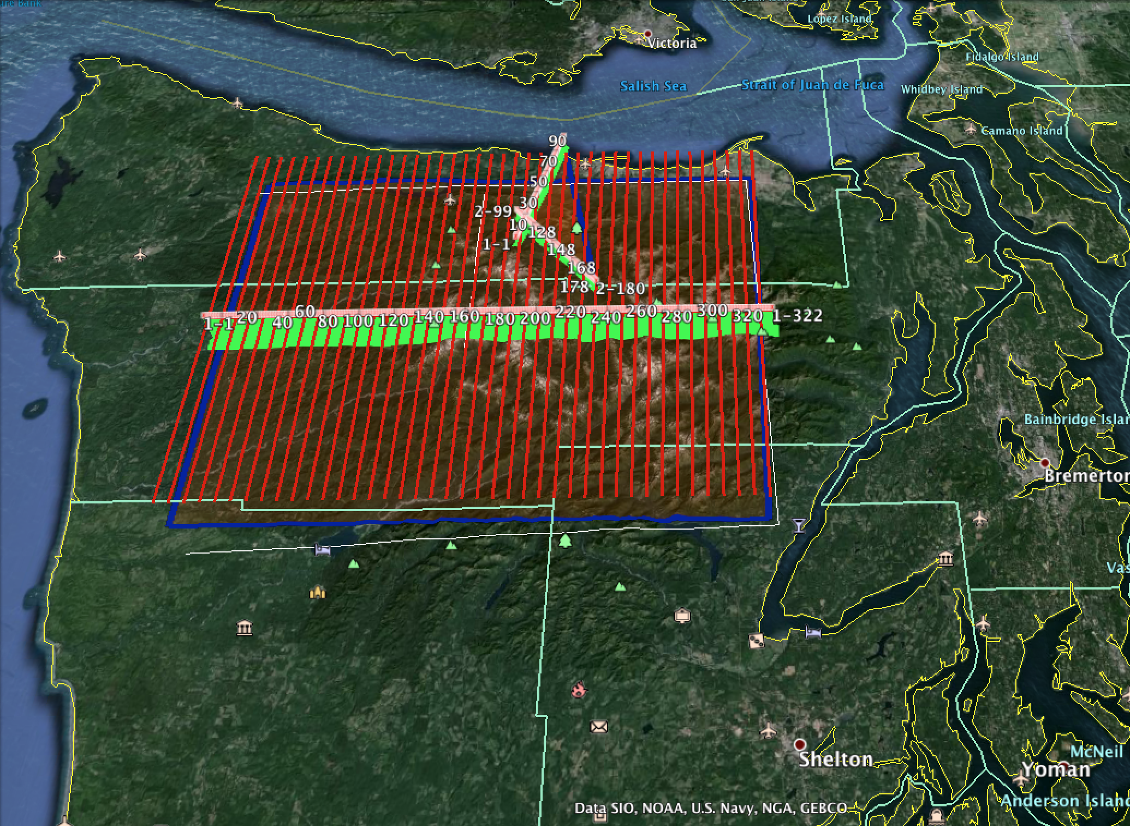
ASO flight lines Sep 2014

Slide 26
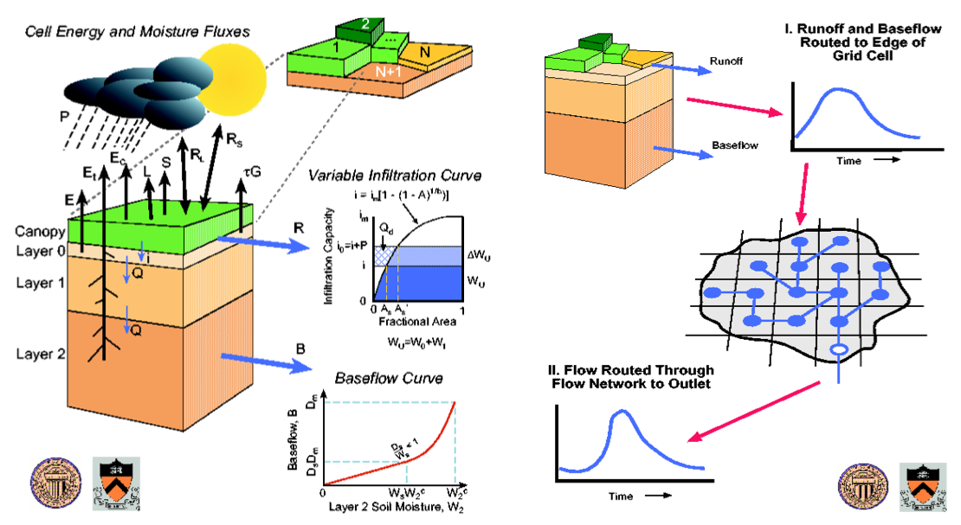
Variable Infiltration Capacity land surface (hydrology) model

Slide 27
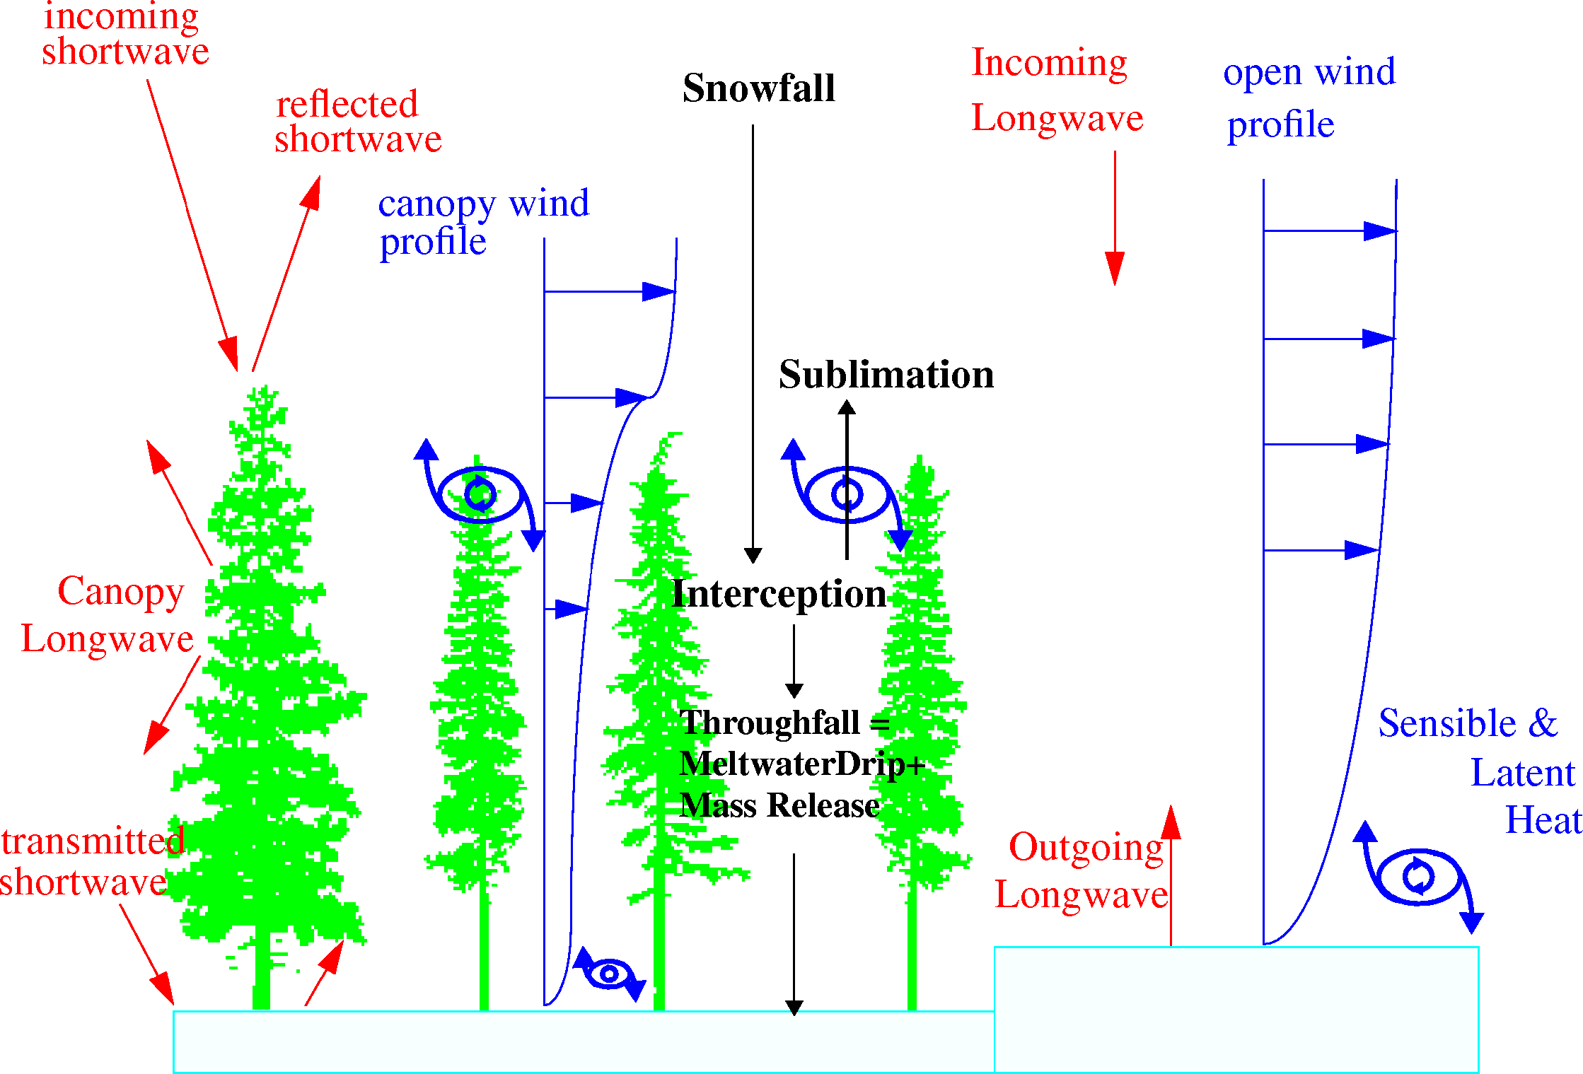
Snow processes in a forest environment

Slide 28
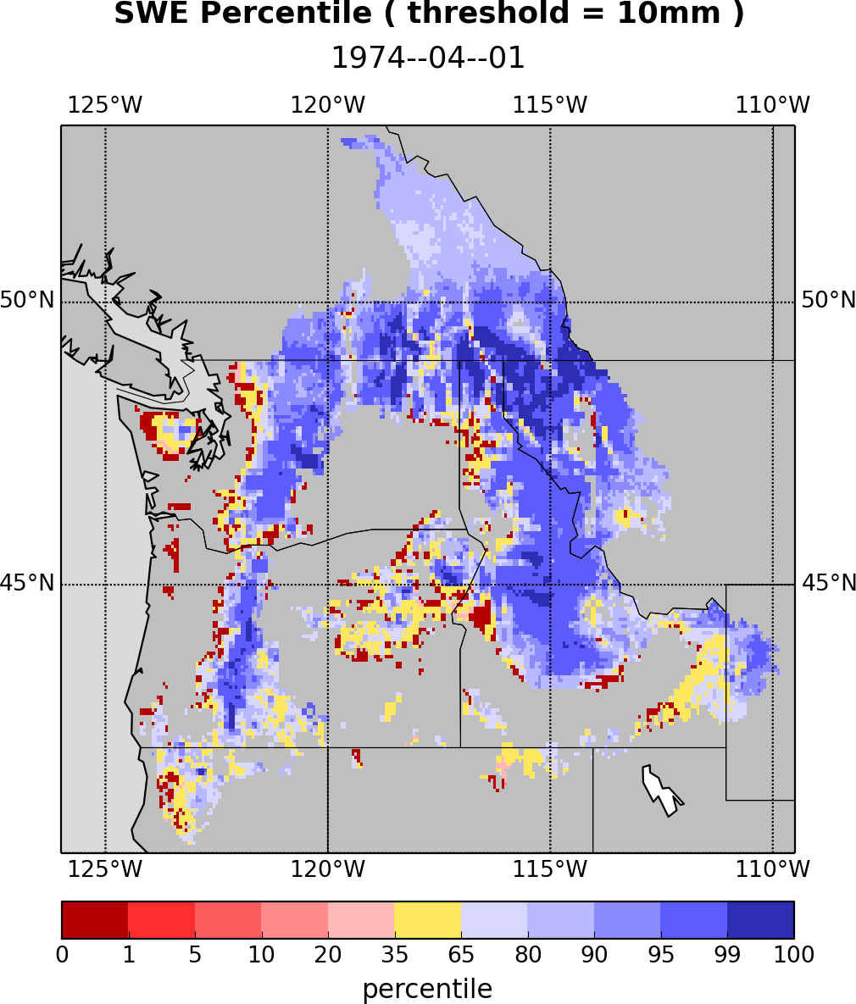
VIC model SWE Apr 1, 1974 (from PWN drought monitor archive)

Slide 29
Next Steps
Integrate radar Level 3 products with the updated station data as the reference data set
Evaluate the performance of PMM products in extreme streamflow simulation
Diagnose streamflow forecast errors

