Slide 1
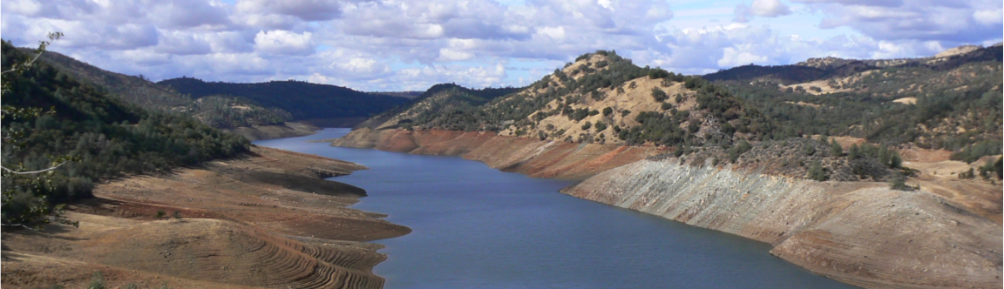

Climate change impacts on the hydrology and water resources of the Western U.S.
Dennis P. Lettenmaier
Department of Geography
University of California, Los Angeles
presented at
U.S. – Iran symposium on climate change: Impacts and mitigation
February 26, 2015

Slide 2
Outline of this talk
Evidence of climate change in the Western U.S.
Predictions of future Western U.S. hydrology and water resources
  EPA Reports to Congress late 1980s (California)
  Accelerated Climate Prediction Initiative early 2000s (Colorado)
  Washington Climate Change Impacts Assessment late 2000s (Pacific Northwest and Columbia River basin)
  Integrated scenarios (climate change in the PNW and Western U.S.; ongoing)

Slide 3
1) Signature of climate change on the Western U.S.

Slide 4
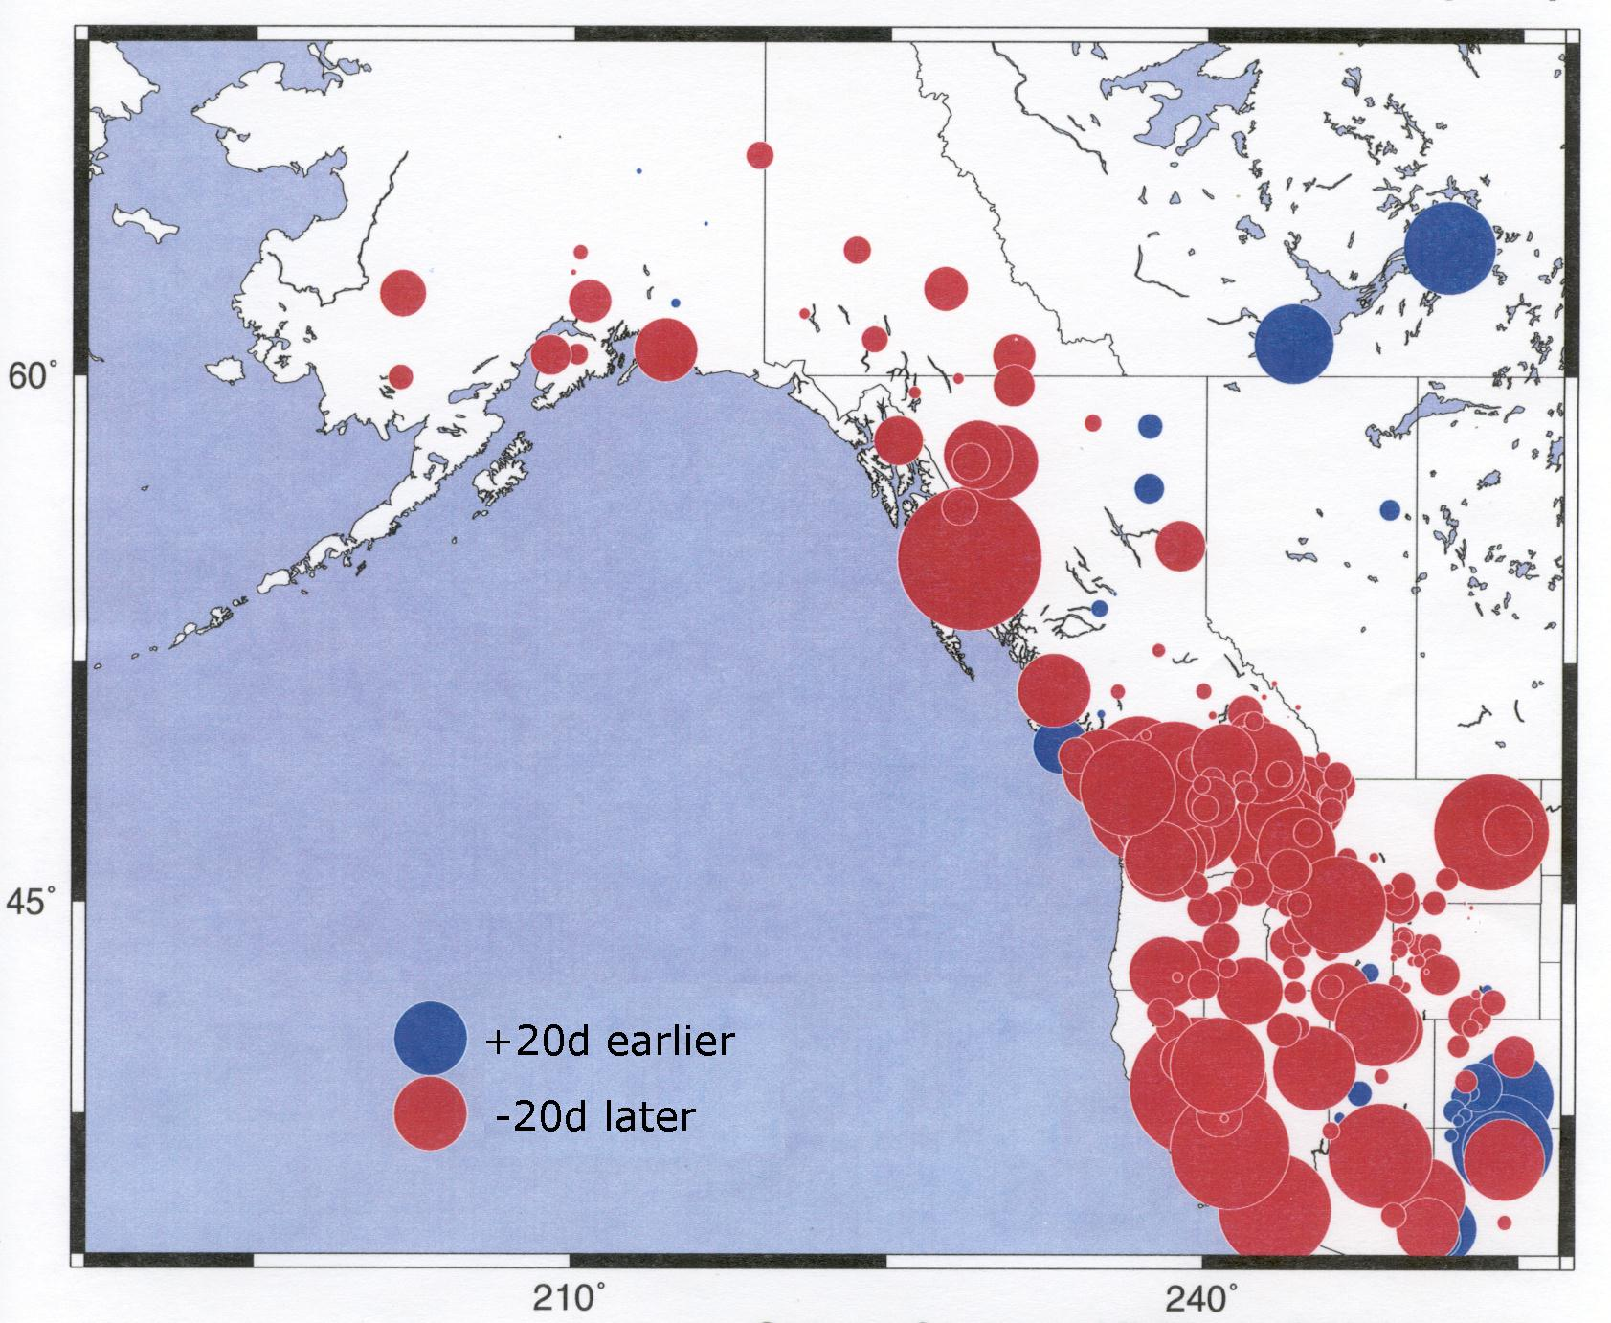
Trends in timing of spring snowmelt (1948-2000)
+20d later
–20d earlier
Courtesy of Mike Dettinger, Iris Stewart, Dan Cayan

Slide 5
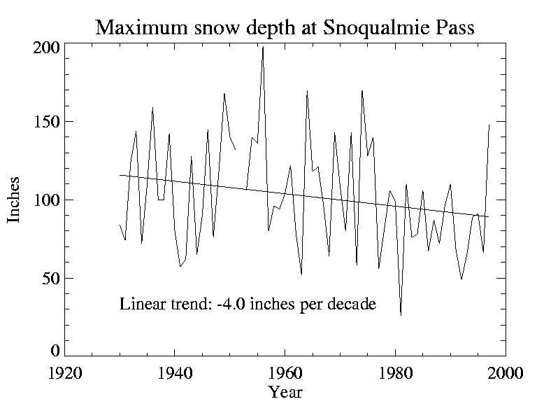
Trends in snowpack

Slide 6
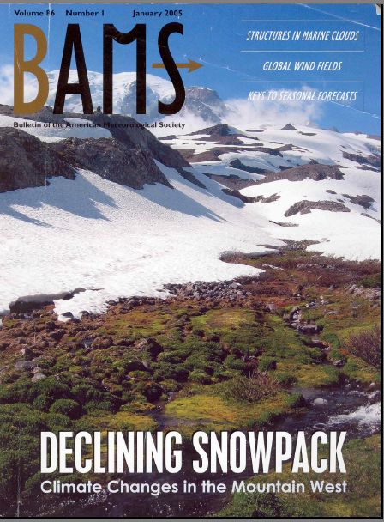

Slide 7
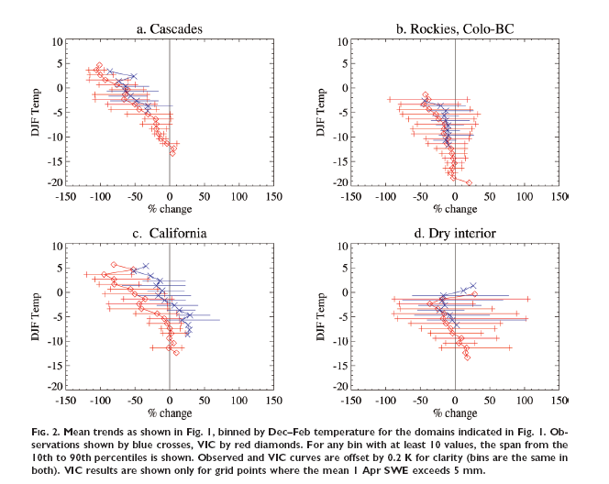
Source: Mote et al, 2005

Slide 8
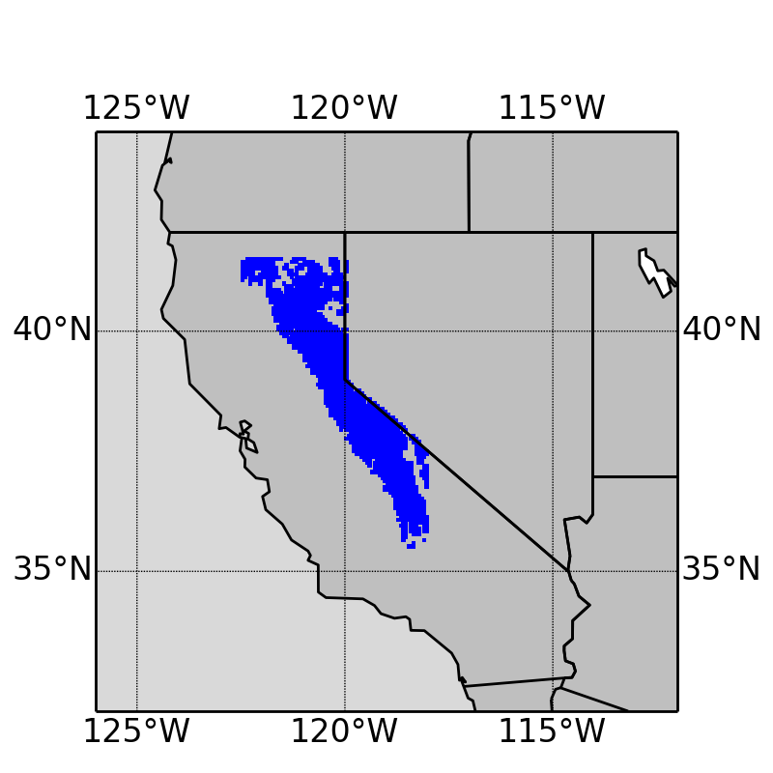
Study area and period
Sierra Nevada mountain range
- Long-term Apr 1 SWE > 10 mm
1920-2014
from Mao et al., 2015
Notes:
All the subsequent analyses are based on this blue area

Slide 9
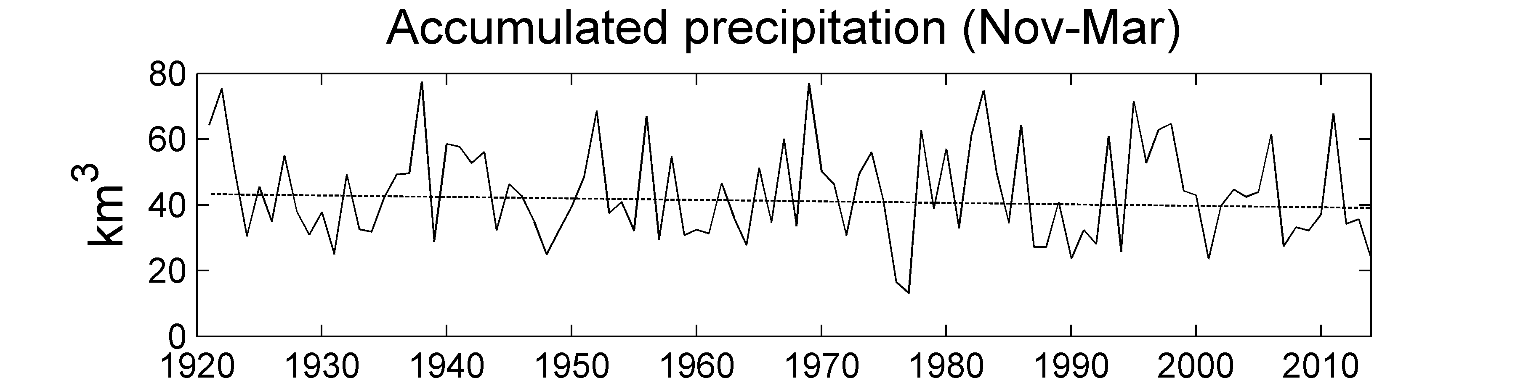
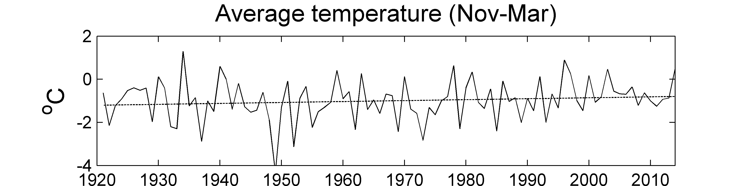
Winter (Nov 1 – Mar 31) precipitation and temperature, 1920-14
No trend
Increasing trend
+0.4 ºC/100 years
p-value=0.10
Notes:
Precipitation - accumulated, aggregated over the entire study area; no trend
Temperature – increasing trend

Slide 10
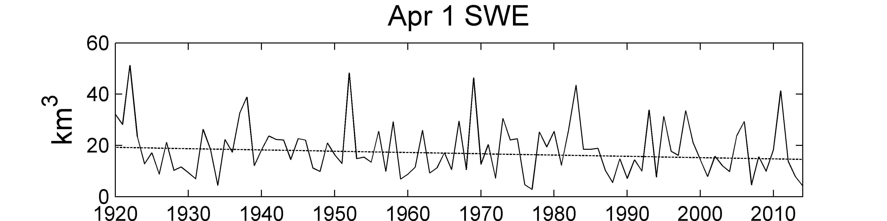
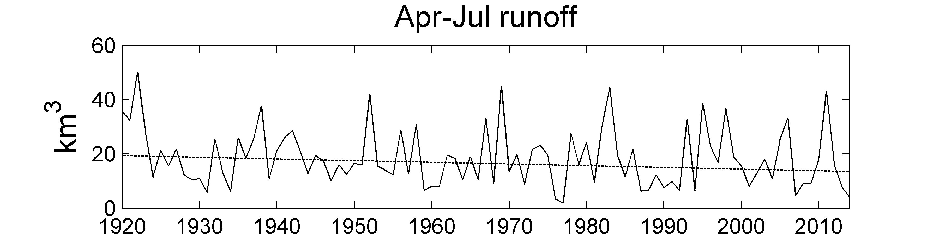
Decreasing trend
-5.0 km³/100years
p-value=0.07
Decreasing trend
-6.2 km³/100years
p-value=0.03
Notes:
SWE – decreasing trend -> let us think that the increasing T trend might be a cause of the decreasing snowpack; further prove it later
Runoff – mostly from snowmelt, so similar dicreasing trend

Slide 11
2) Assessments and projections: a) EPA Reports to Congress c. 1987

Slide 12
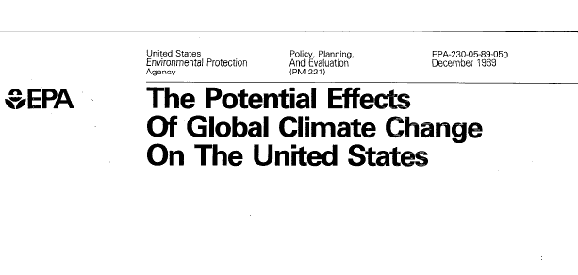

Slide 13
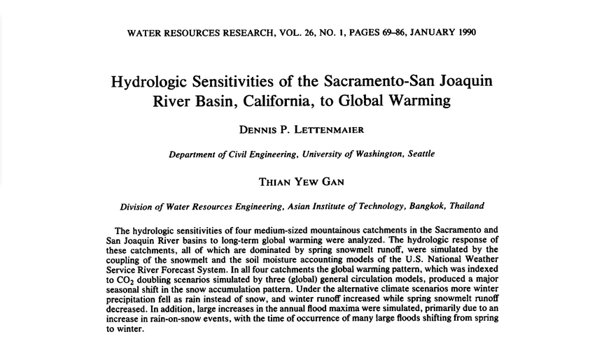

Slide 14
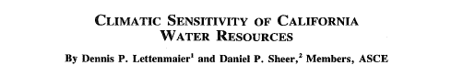
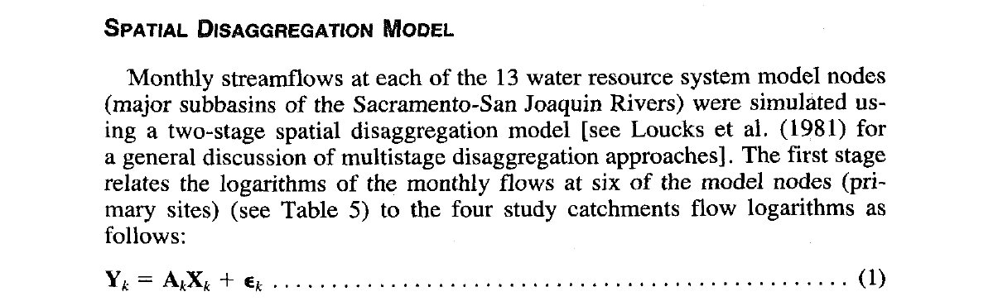

Slide 15
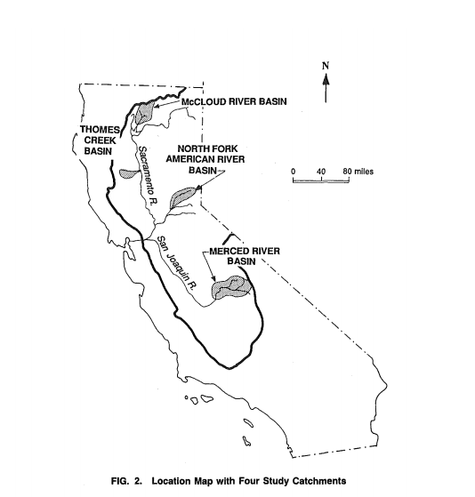

Slide 16
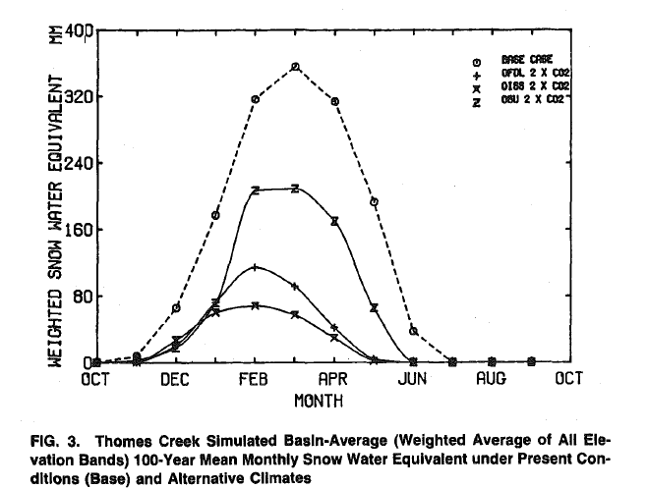

Slide 17
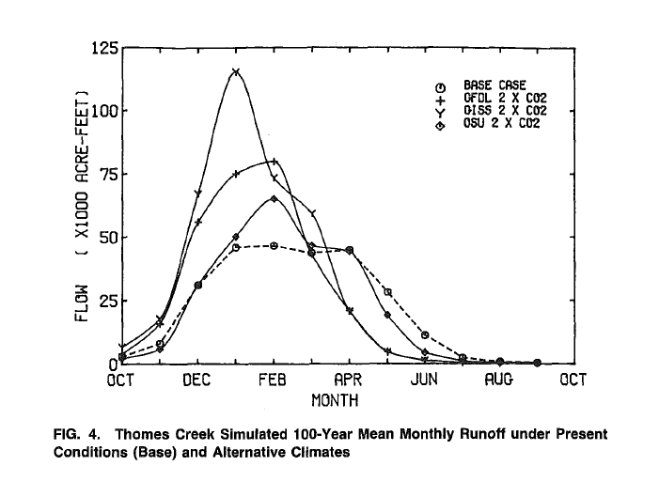

Slide 18
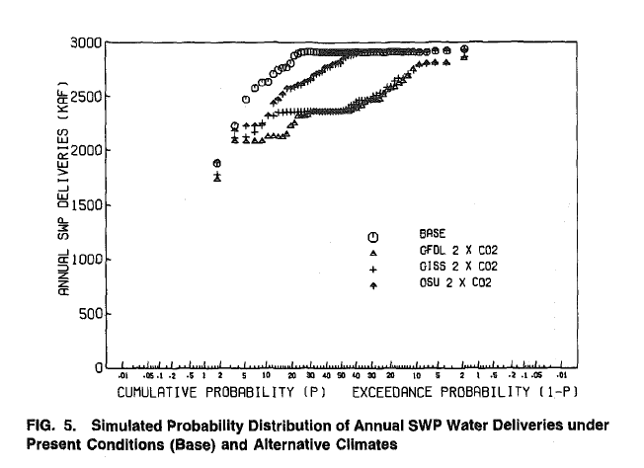

Slide 19
2) Assessments and projections: b) Accelerated Climate Prediction Initiative (ACPI) c. 2002 (Colorado, Columbia, and Sacramento/San Joaquin River basins

Slide 20
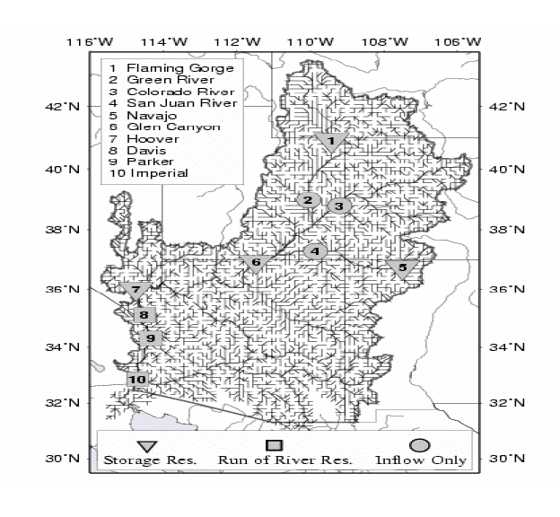
Christensen et al. Climatic Change, 2004

Slide 21
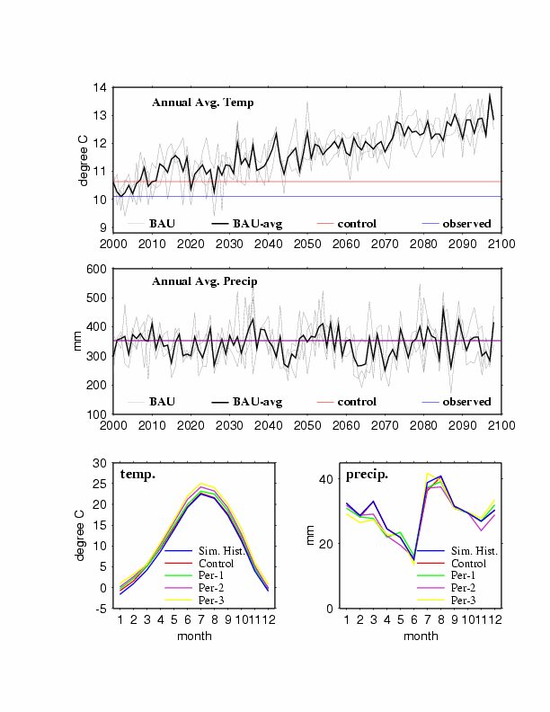
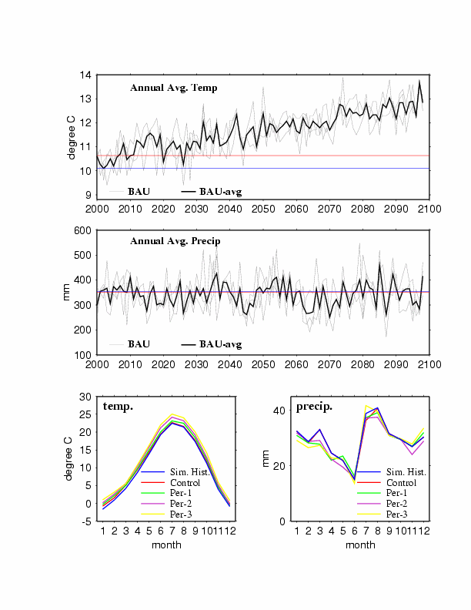
Timeseries Annual Average
PCM Projected Colorado R. Temperature
ctrl. avg.
hist. avg.
Period 1 2010-2039 Period 2 2040-2069 Period 3 2070-2098

Slide 22
Timeseries Annual Average
PCM Projected Colorado R. Temperature
ctrl. avg.
hist. avg.
Period 1 2010-2039 Period 2 2040-2069 Period 3 2070-2098

Slide 23
Timeseries Annual Average
PCM Projected Colorado R. Precipitation
hist. avg.
ctrl. avg.
Period 1 2010-2039 Period 2 2040-2069 Period 3 2070-2098

Slide 24
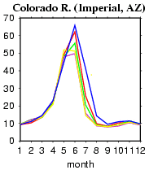
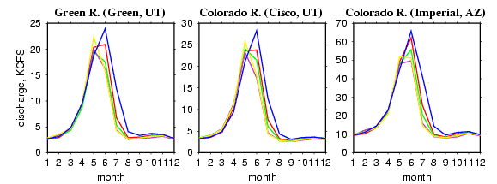
Annual Average Hydrograph
Simulated Historic (1950-1999) Period 1 (2010-2039)
Control (static 1995 climate) Period 2 (2040-2069)
Period 3 (2070-2098)

Slide 25
Total Basin Storage

Slide 26
Annual Releases to the Lower Basin
target release

Slide 27
2) Assessments and projections: c) Washington Climate Change Impacts Assessment (c. 2008)

Slide 28
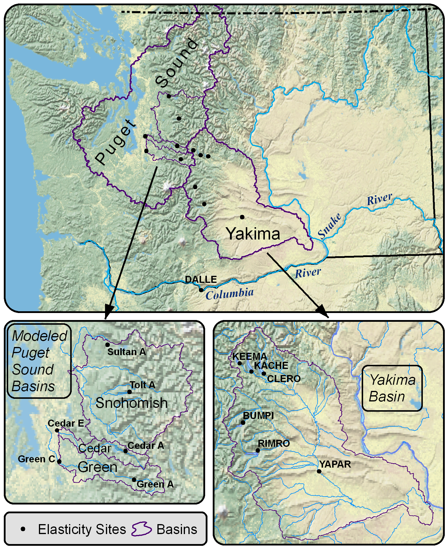
Focus Watersheds
Puget Sound
  Green River
  Snohomish River
  Cedar River
  Tolt River
Yakima River
Notes:
28

Slide 29
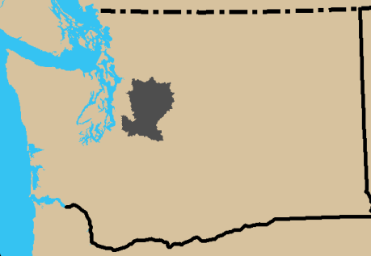
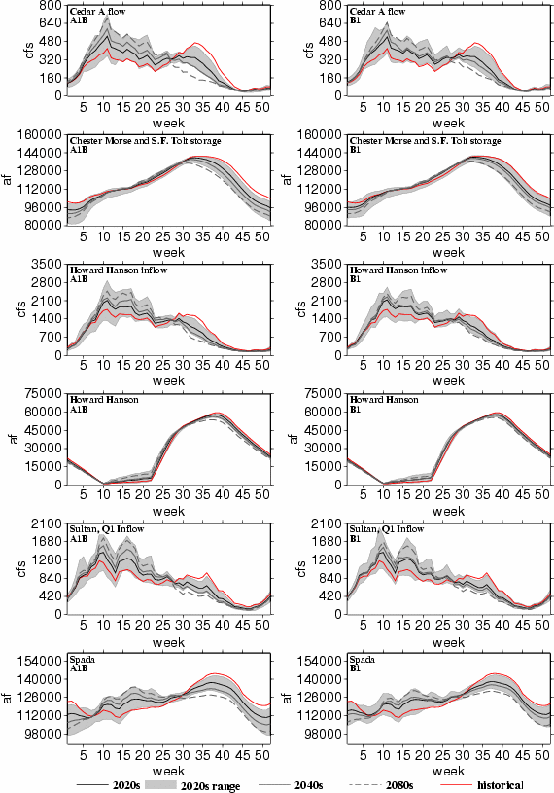
Puget Sound Basin
Seattle
Tacoma
Everett
Variations in impacts within and between systems (A1B)
Seattle, M&I and environmental flows
Tacoma, flood control, more constrained storage
Everett, hydropower, more interannual variability
Notes:
Transition basins. Lower parts of basin already rain dominate. Upper, more snow dominated.

Slide 30
Puget Sound Basin municipal supply - current demand
M&I reliability measures, differ for all systems
Current demand, reliability little impact from future change (A1B)
Tacoma, water allocations closer to current system capacity
Everett, largest system capacity
Note: simulations prior to adaptations
1%
7%
0%

Slide 31
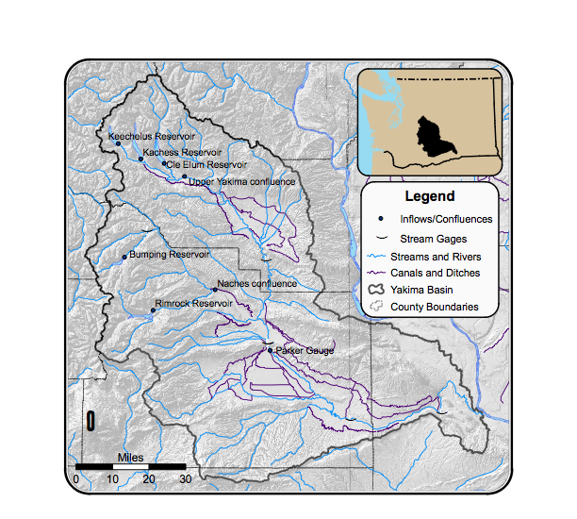
Case study 2: Yakima River Basin
Irrigated crops largest agriculture value in the state
Precipitation (fall-winter), growing season (spring-summer)
Five USBR reservoirs with storage capacity of ~1 million acre-ft, ~30% unregulated annual runoff
Snowpack sixth reservoir
Water-short years impact water entitlements
Notes:
Elevation 8184 ft to 340 ft
Historic Temp and precip
22°-76°F, 80 in-140 in at 2300 ft, 27°-90°F, 0 in-10 in at 350 ft
61% -81% precip in October-March
This water is used in many ways…
-TWSA: multiple regression analysis uses correlations with precipitation, streamflow, snow measures, forecasts are made for precipitation levels of 50, 100 and %150 normal.
Elevation 8184 ft to 340 ft
Historic Temp and precip
22°-76°F, 80 in-140 in at 2300 ft, 27°-90°F, 0 in-10 in at 350 ft
61% -81% precip in October-March
Water supply during growing season in lower basin primarily from snowmelt, depends on reservoirs for storage
Six USBR reservoirs with storage capacity of ~1 million acre-ft, ~25% unregulated runoff
Managed system vulnerable to drought with increasing water use and changing snowpack
DETAILS ON TWSA:
Max, Min, and Avg all from 1981-2000 and 2007 values of:
(1) System Unregulated Flow Volume (system of reservoirs, sum of inflows),
(2) Observed Flow Volume (system of reservoirs, sum of outflows),
(3) Parker Unregulated Flow Volume (Yakima River NR Parker mean daily natural discharge),
(4) Parker Observed Flow Volume (Yakima River NR Parker mean daily regulated discharge)
(5) Yakima System Diversions (5 major irrigation diversions above Parker)
(6) Yakima System Storage (Reservoir system storage, mean daily reservoir volume)
REFERENCES:
(USBR, 2002)
http://www.wrcc.dri.edu/cgi-bin/cliMAIN.pl?wa4154: KENNEWICK, WASHINGTON (454154)
http://www.wrcc.dri.edu/cgi-bin/cliMAIN.pl?wa4406: LAKE KACHESS, WASHINGTON (454406)
Precipitation varies considerably across the basin throughout the year. Mean-annual precipitation ranges from 140 inches in the higher mountains of the northwestern part of the basin to less than 10 inches throughout the lower Yakima Valley. The amount of precipitation that occurs during the period of Oct ober to March period, both the arid and alpine parts of the basin ranges from 61-81% of the annual precipitation. The variation in annual precipitation can be large. The geographic variability of mean annual precip 1951-1980 in high mts between 80-140 inches in lower between 0-10 inches (USBR 2002, pg 2-2)
Water quality, generally high in upper basin. Degrades downstream. Many reaches in Federal Clean Water Act 303(d) list. Issues of turbidity, pesticides, low dissolved oxygen, elevated temperatures, metals, fecal coliform, low flows, and pH.
Air temps, inversely related to altitude. Min and Max occur in Jan and July. Values above from LAKE KACHESS (1971-2000 Monthly Climate Summary, Average Min in Jan and Average Max in July)
-Reserviors been in place since 1930s
-Irrigation project serves 465,000 acres
-Basin drains about 4 million acres (Basin drains about 6150 sq miles)
-Yakima River flows about 215 miles
-Estimated unregulated runoff of Yakima Basin (1961-1990) is 3.97 million acre-ft
FROM POSTER, AGU 2006
-The USBR Yakima Project supports approximately 464,000 irrigated acres (via four irrigation districts -- Roza, Yakima-Tieton, Sunnyside Valley and Kittitas -- and the Wapato Division).
-Most of the water in the Yakima River comes from snowmelt, and is caught in a series of reservoirs to ensure sufficient water supply throughout the season.

Slide 32
Yakima River Basin
Unregulated

Slide 33
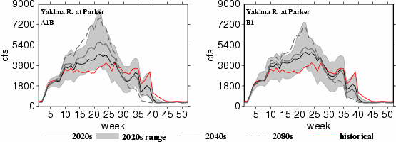
Yakima River Basin
management
model
Unregulated
Regulated
Basin shifts from snow to more rain dominant

Slide 34
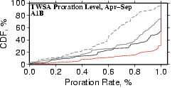
Yakima River Basin
Basin shifts from snow to more rain dominant
  Water prorating, junior water users receive 75% of allocation

Slide 35
Yakima River Basin
2080s
2020s
historical
Basin shifts from snow to more rain dominant
  Water prorating, junior water users receive 75% of allocation
  Junior irrigators less than 75% prorating (current operations):
    14% historically
    32% in 2020s A1B (15% to 54% range of ensemble members)
    36% in 2040s A1B
    77% in 2080s A1B

Slide 36
2) Assessments and projections: d) Pacific Northwest Integrated Scenarios Project (ongoing)

Slide 37
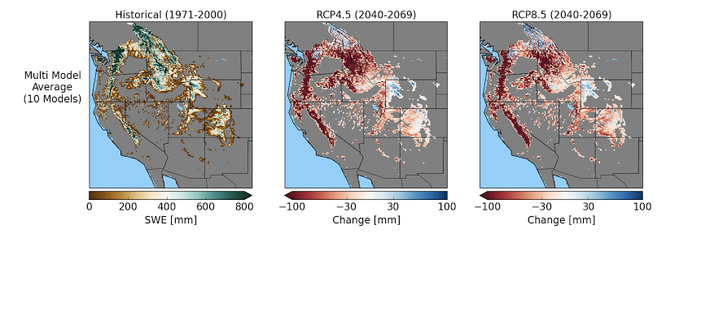
Western U.S. Integrated hydroclimate scenarios (UW/OSU/UI; ongoing)
Snow water equivalent (SWE), changes in mm
“Type a quote here.”
historical
RCP 4.5 ~2050
RCP 4.5 ~2050
–Johnny Appleseed

Slide 38
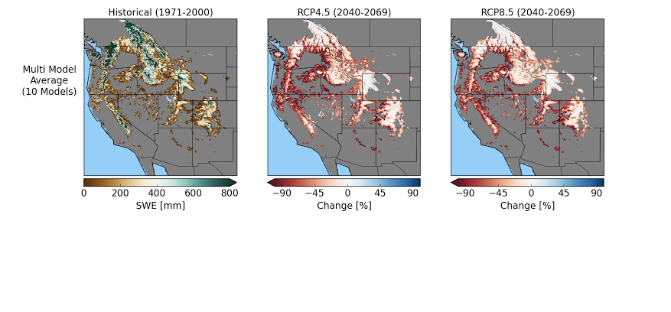
Apr 1 snow water equivalent (SWE), changes in percent
“Type a quote here.”
–Johnny Appleseed
historical
RCP 4.5 ~2050
RCP 4.5 ~2050

Slide 39
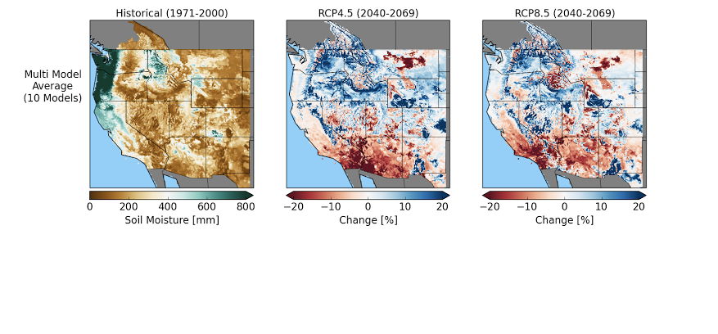
March soil moisture (total column), changes in percent
“Type a quote here.”
–Johnny Appleseed
historical
RCP 4.5 ~2050
RCP 4.5 ~2050

Slide 40
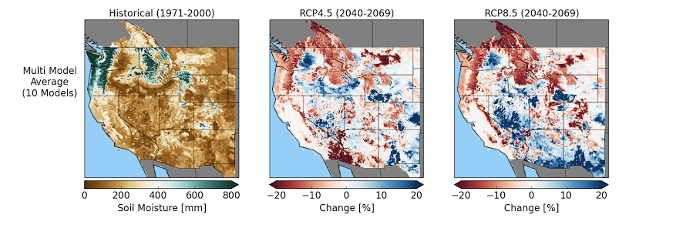
August soil moisture (total column), changes in percent
“Type a quote here.”
–Johnny Appleseed
historical
RCP 4.5 ~2050
RCP 4.5 ~2050

Slide 41
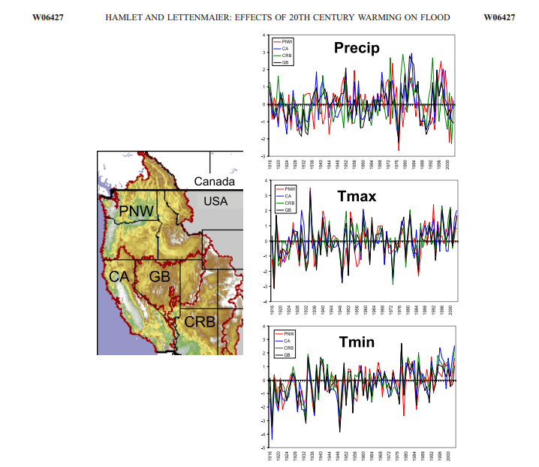
from Hamlet and Lettenmaier, 2007

Slide 42
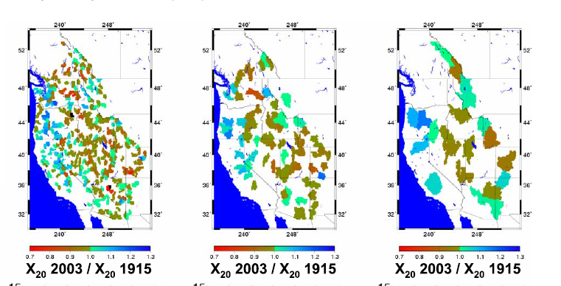
from Hamlet and Lettenmaier, 2007

Slide 43
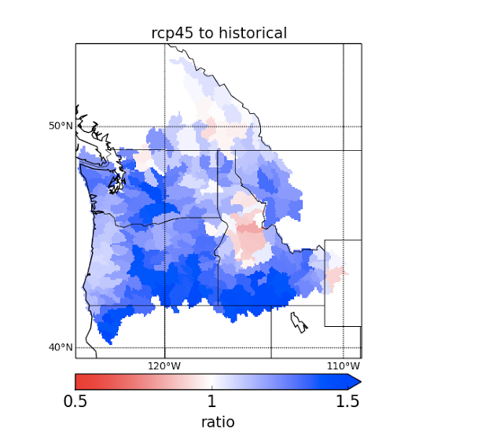
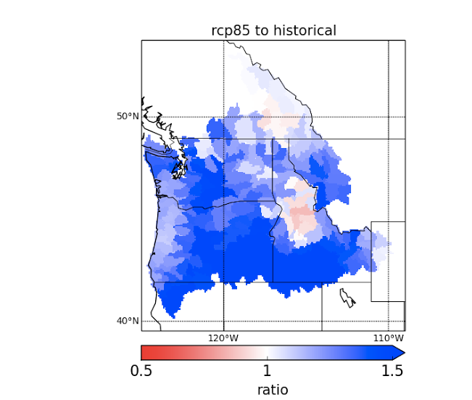
Future Changes in the Annual Maximum Flood
Notes:
discuss time periods.

Slide 44
Summary
Snow is the dominant driver of runoff seasonality in the Western U.S. (and is highly sensitive to warming)
Interaction of built system (reservoir storage) and seasonal runoff distribution is key to understanding water management implications of global change (e.g., Colorado vs. Yakima)
Not much has changed in our understanding of implications of climate change for water supply reliability, but understanding of extremes (e.g. flooding) is more sensitive to space-time scale issues

Slide 45
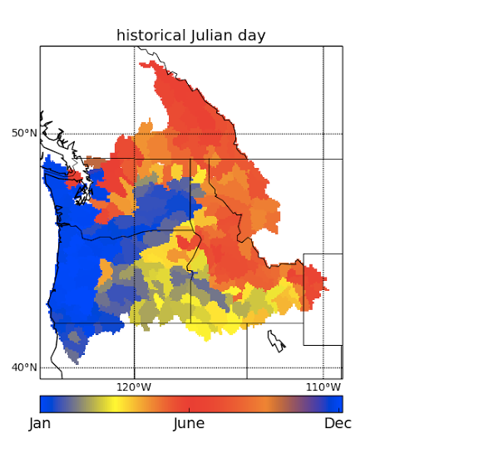
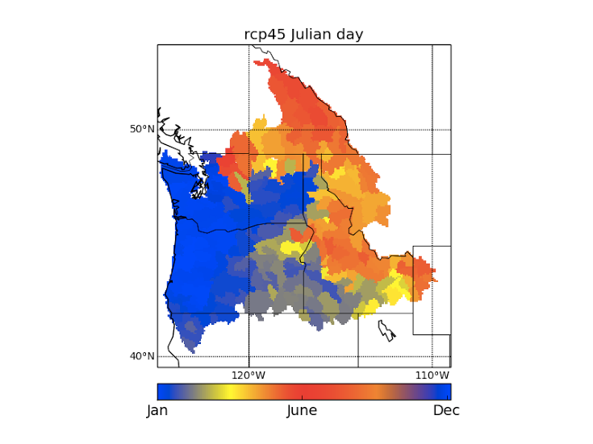
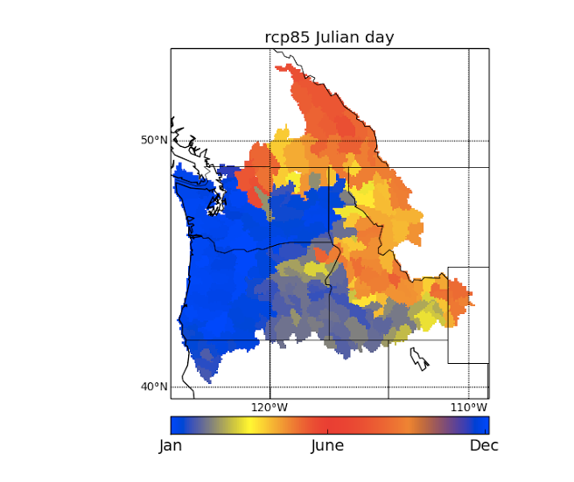
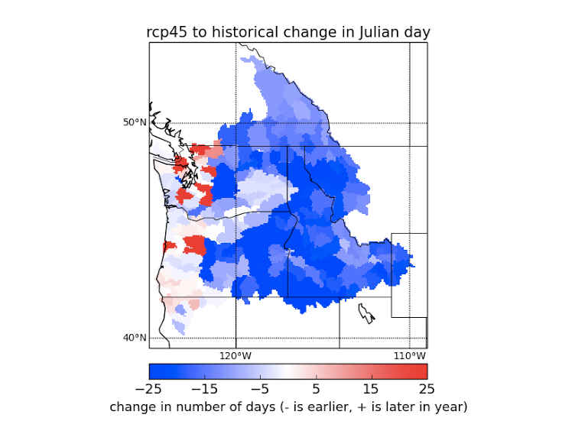
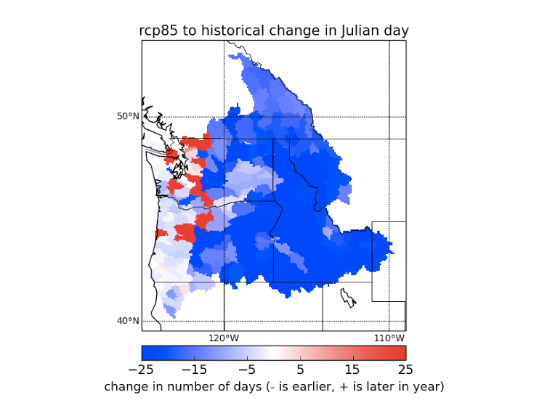
Timing of Annual Maximum Flood
Notes:
keep historical on left, then add in changes in julian day plots (red blue colorbar with white rep no change)

