Slide 1
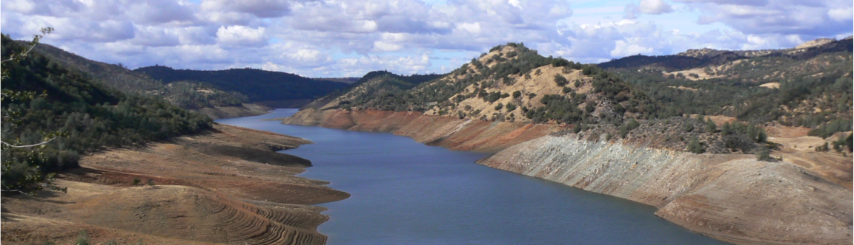
Opportunities for UCLA/JPL water-related collaborations: Western U.S. focus
Dennis P. Lettenmaier
Department of Geography
University of California, Los Angeles
UCLA/JPL Workshop
Feb 2, 2015

Slide 2
Topics
West coast U.S. drought monitor
California drought and hydrologic reconstructions
Western U.S. climate projections

Slide 3
1) Drought monitor

Slide 4
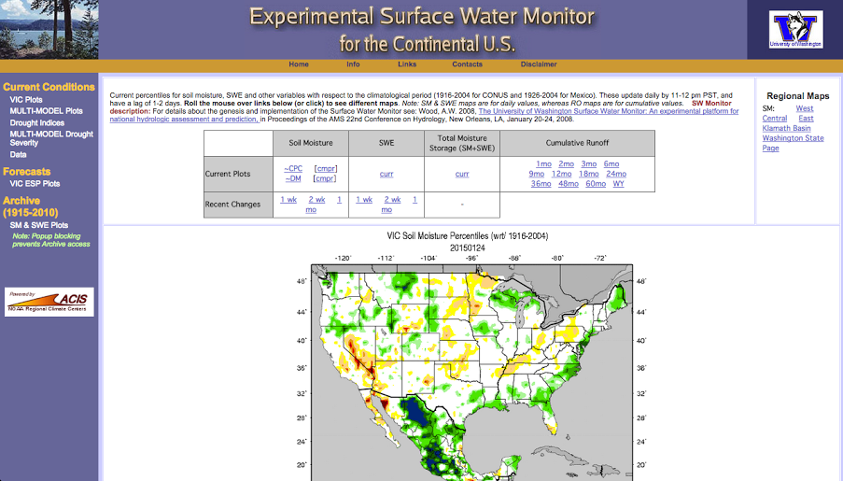

Slide 5
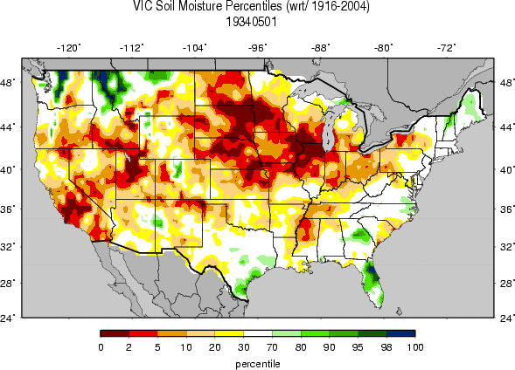
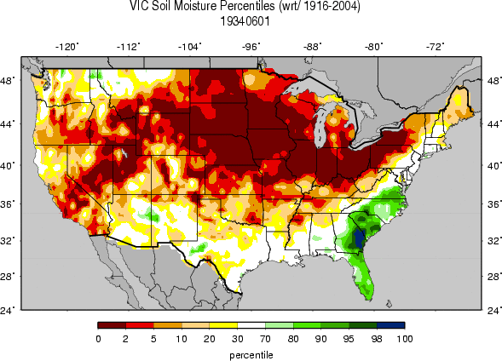
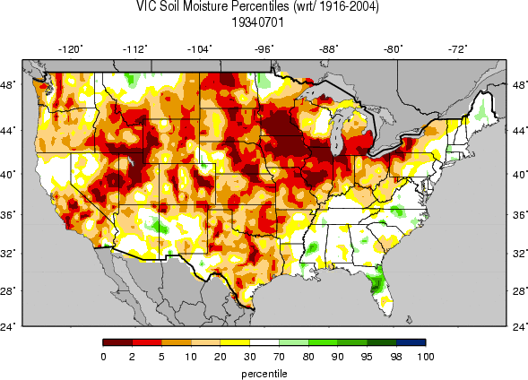
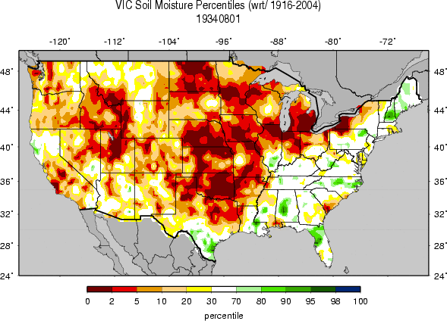

Slide 6
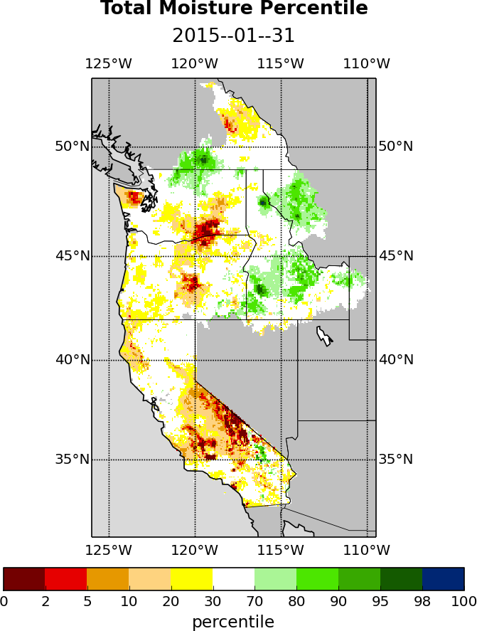
Western U.S. total (soil moisture + SWE) moisture 4/8/14, as simulated by VIC model (from University of Washington Drought Monitoring System for the West Coast)

Slide 7
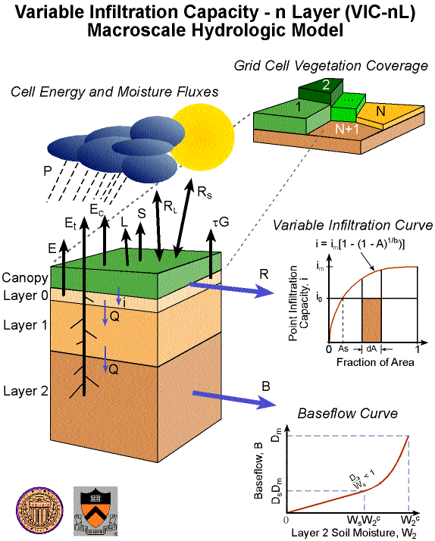
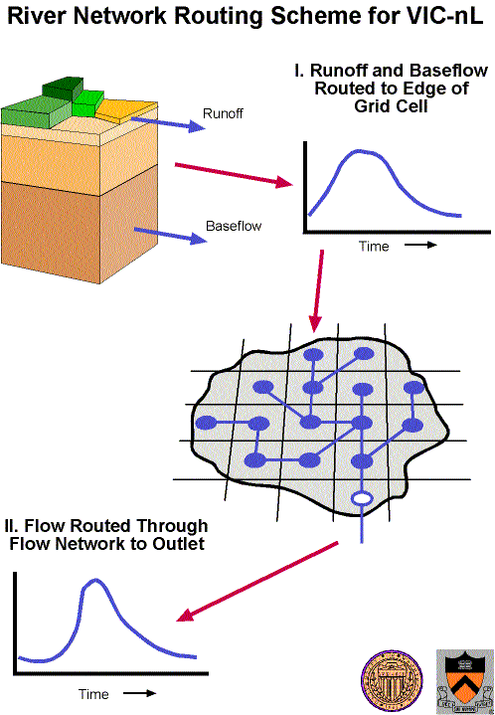
Macroscale hydrology modeling construct

Slide 8
2) Hydrologic reconstructions

Slide 9
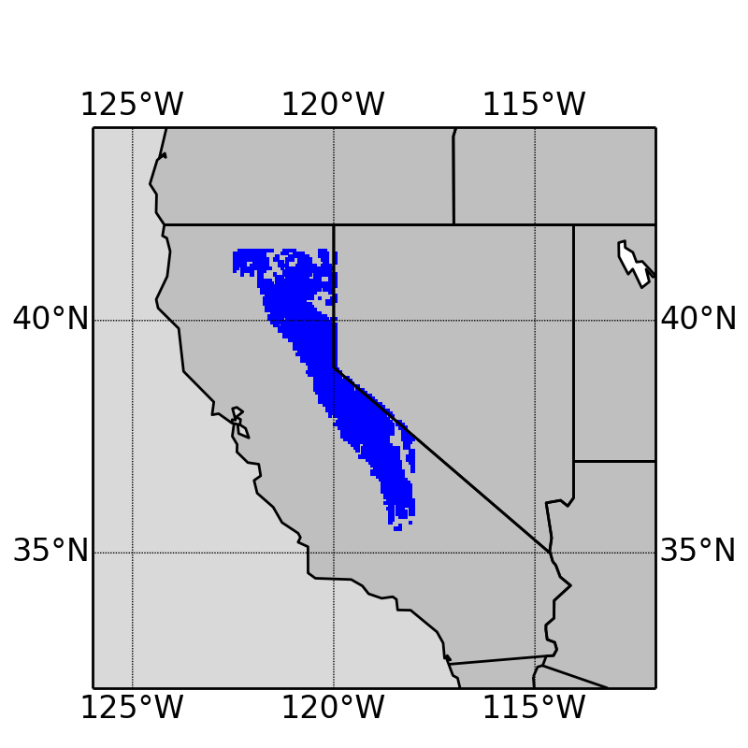
Methodology - Study area and period
Sierra Nevada mountain range
- Long-term Apr 1 SWE > 10 mm
1920-2014
Notes:
All the subsequent analyses are based on this blue area

Slide 10
1. How has the climate changed in California?
No trend
Increasing trend
+0.4 ºC/100 years
p-value=0.10
Notes:
Precipitation - accumulated, aggregated over the entire study area; no trend
Temperature – increasing trend

Slide 11
1. How has the climate changed in California?
Decreasing trend
-5.0 km³/100years
p-value=0.07
Decreasing trend
-6.2 km³/100years
p-value=0.03
Notes:
SWE – decreasing trend -> let us think that the increasing T trend might be a cause of the decreasing snowpack; further prove it later
Runoff – mostly from snowmelt, so similar decreasing trend

Slide 12
2. How dry was California in 2013-2014?
Apr 1 SWE
Notes:
2014 the second driest in terms of SWE; 1977 again the lowest

Slide 13
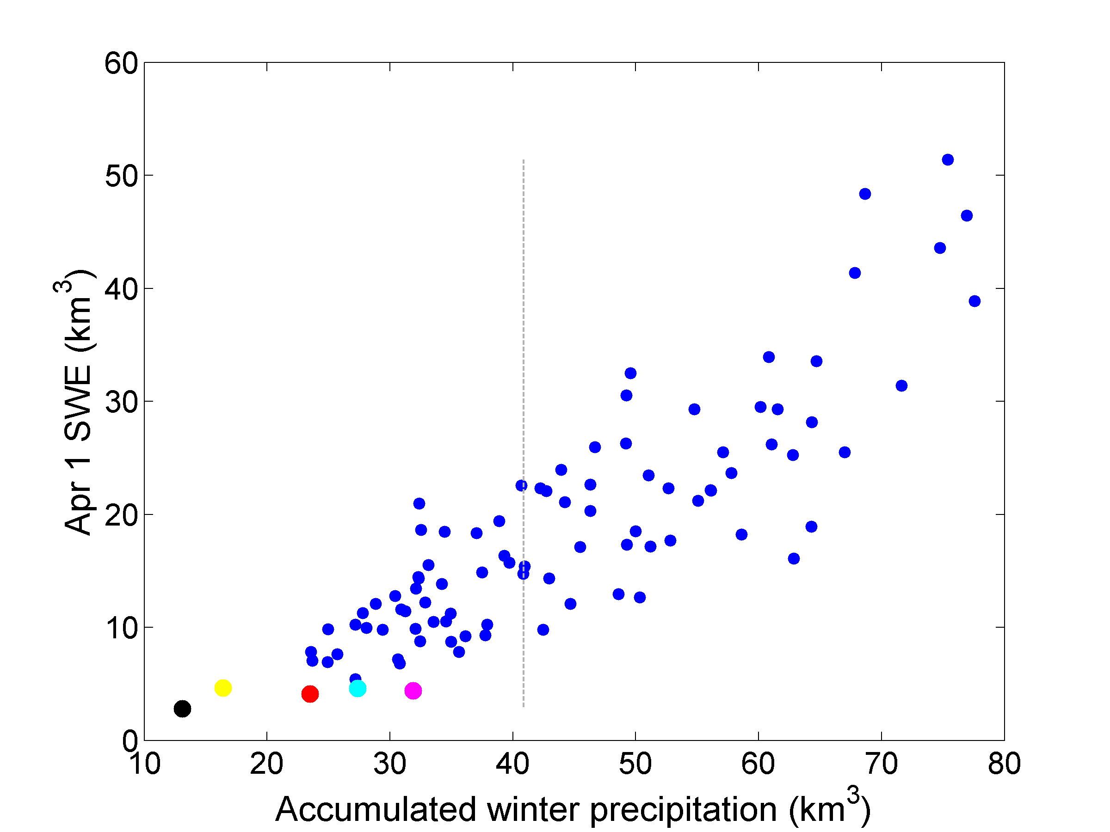
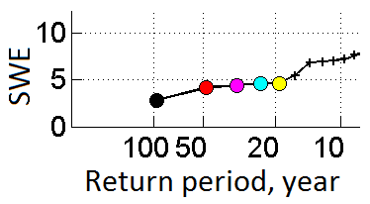
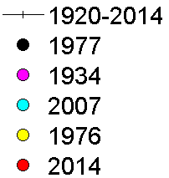
3. Is there a link between climate change and drought events in California?
Method 1 - Correlation analysis
Correlation coefficient: 0.86
median
Notes:
Strong positive correlation
All the five years with the lowest SWE are located at the very low end of winter precipitation

Slide 14
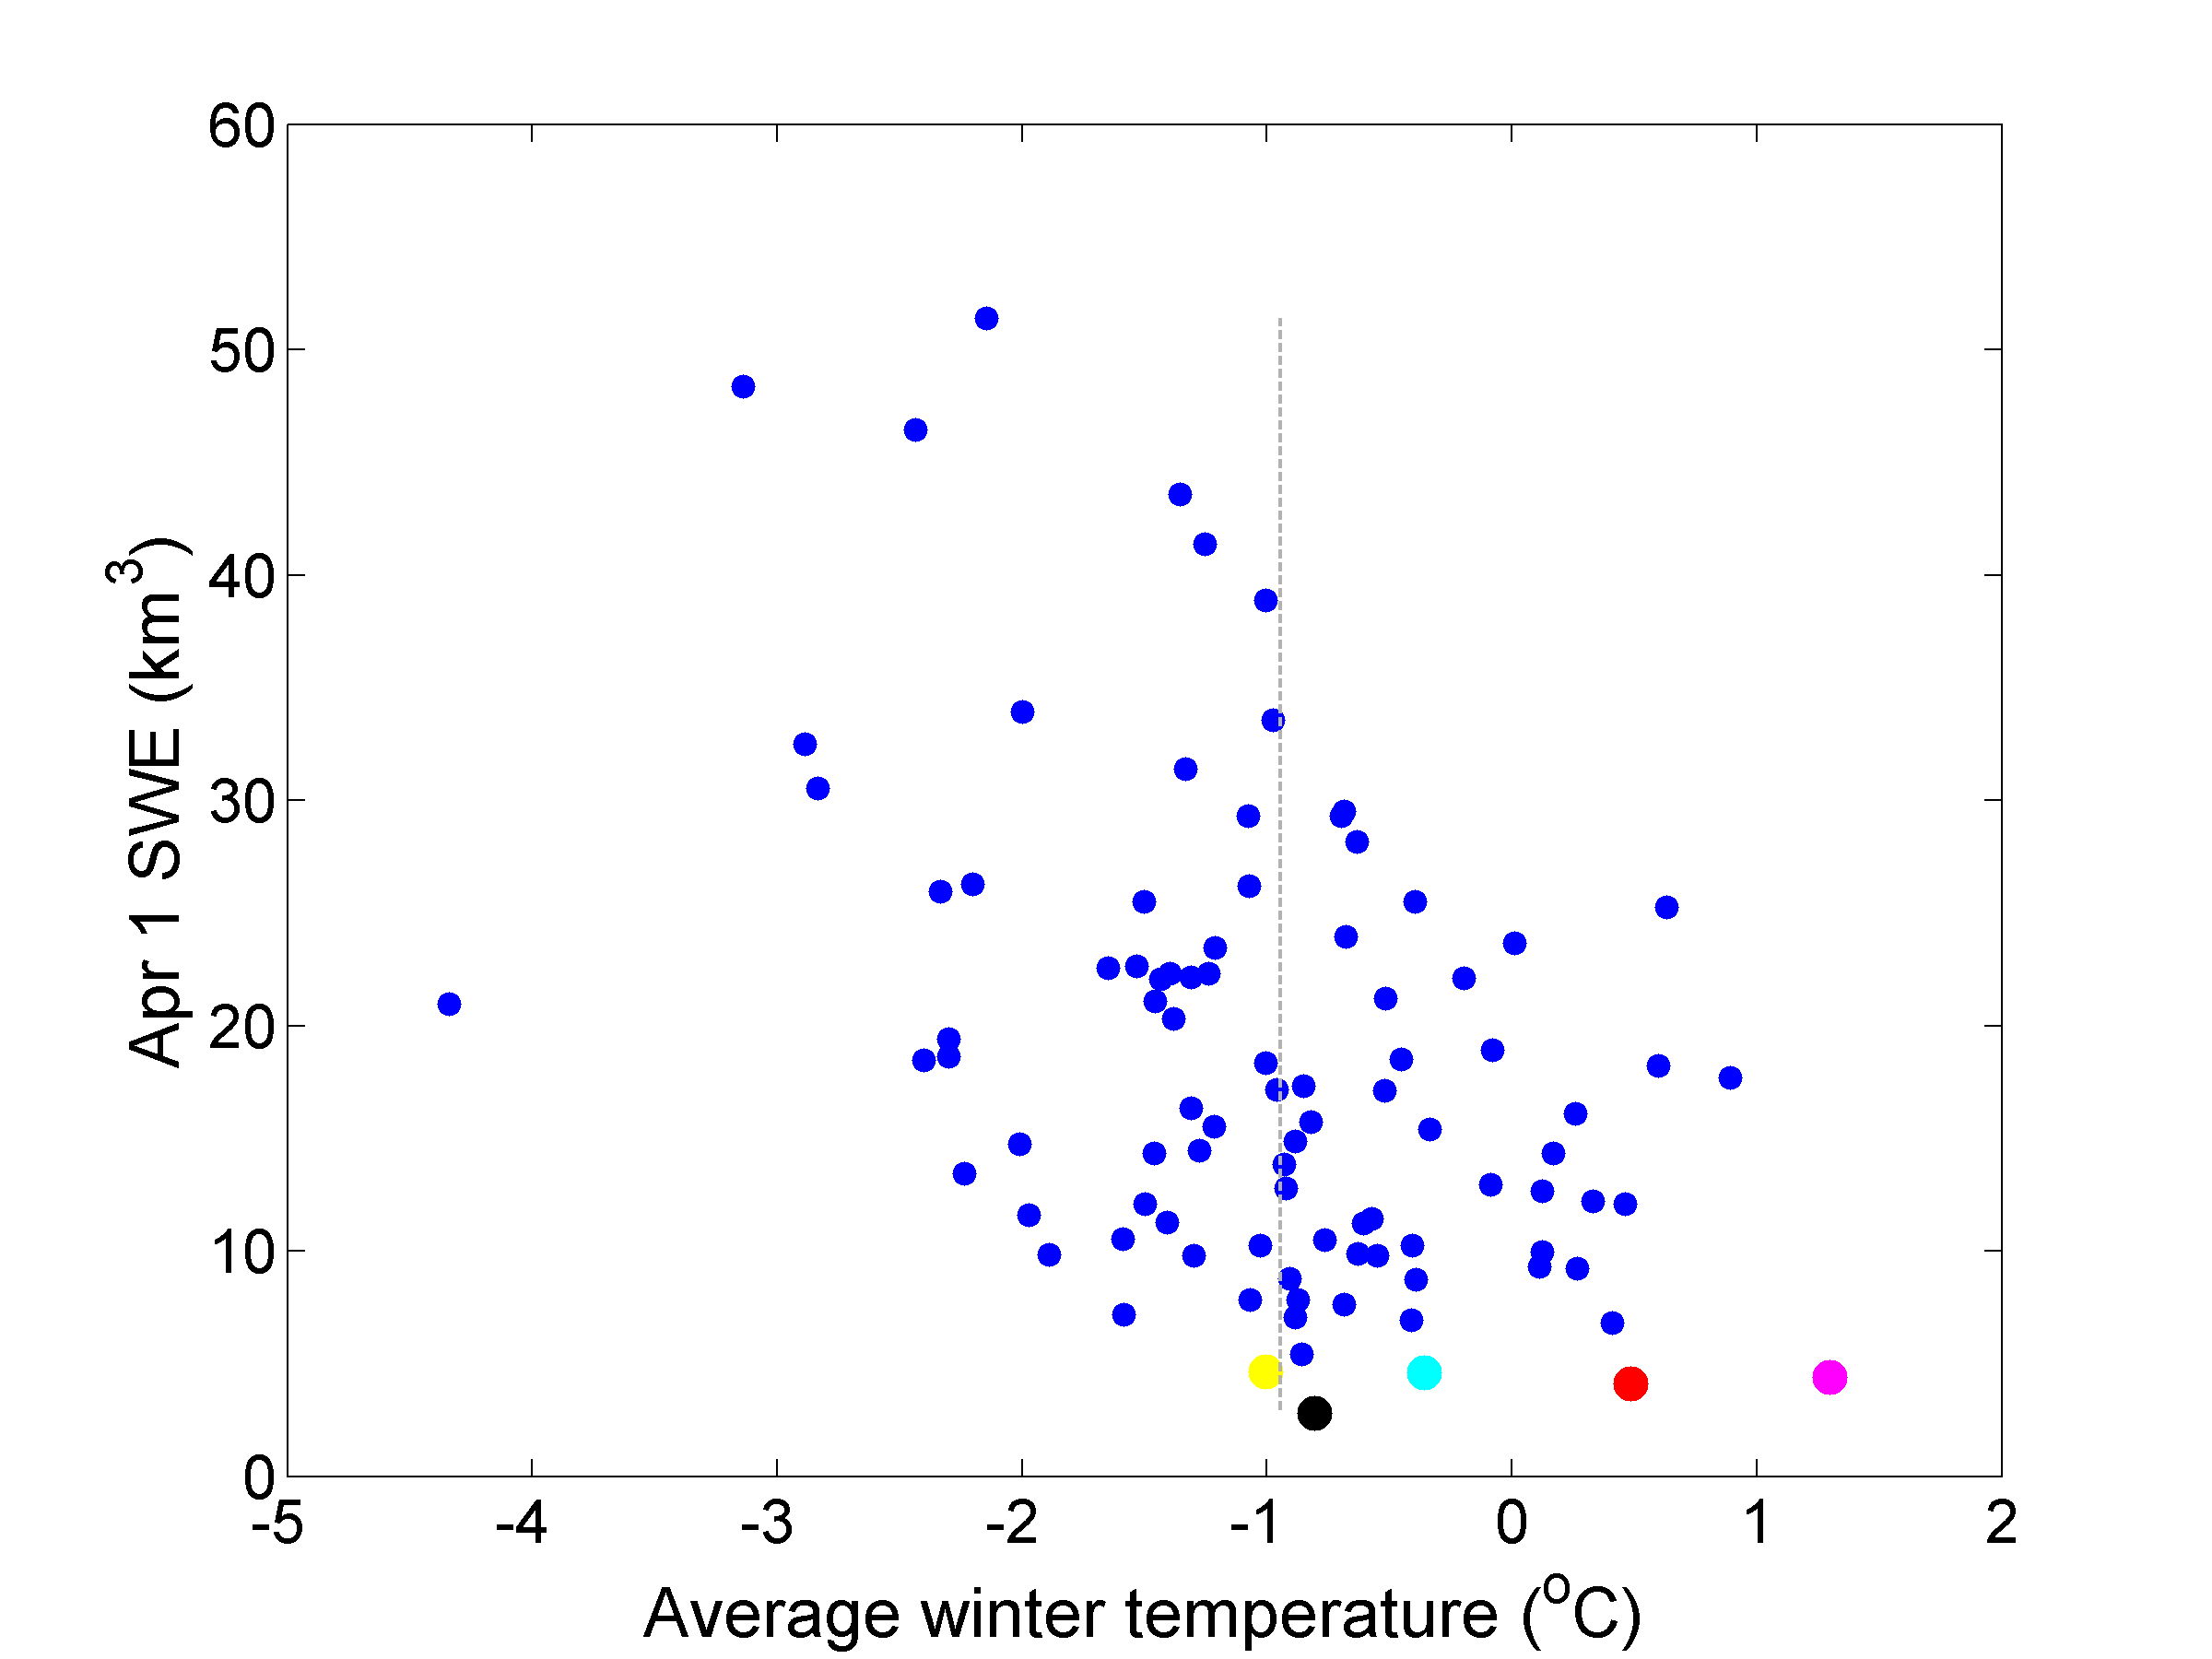
3. Is there a link between climate change and drought events in California?
Method 1 - Correlation analysis
Correlation coefficient: -0.42
median
Notes:
Vague negative correlation -> the warmer the winter, the lower the SWE
Lowest-SWE years generally happened in warmer winters
But 1977 -> around the median of winter temperature, but the lowest SWE; similar to 1976 and 2007

Slide 15
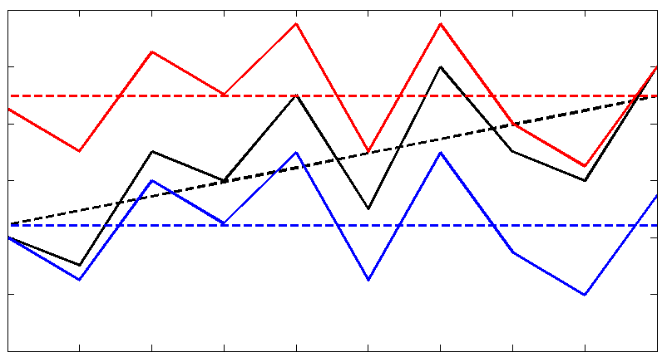
3. Is there a link between climate change and drought events in California?
Method 2 – Detrended-T scenarios
In addition to the reconstructed time series (the ‘base scenario’), we removed the warming trend and simulate hydrological conditions using the VIC model (‘Detrended-T scenarios’, without climate change)
Removing long-term Tmin trend for each grid cell (Tmax does not have significant trend); preserving daily variation
Two detrended-T scenarios:
Warm scenario
Cold scenario
Notes:
Detrended-T scenarios
Introduce the illustration -> detrending in two ways; long-term trend removed and daily variation preserved

Slide 16
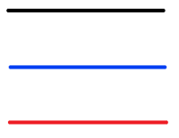
Apr 1 SWE
No trend without warming
Base scenario
Cold scenario
Warm scenario
Notes:
Original decreasing trend disappeared -> strongly suggests that the warming climate is the main cause for the decreasing SWE

Slide 17
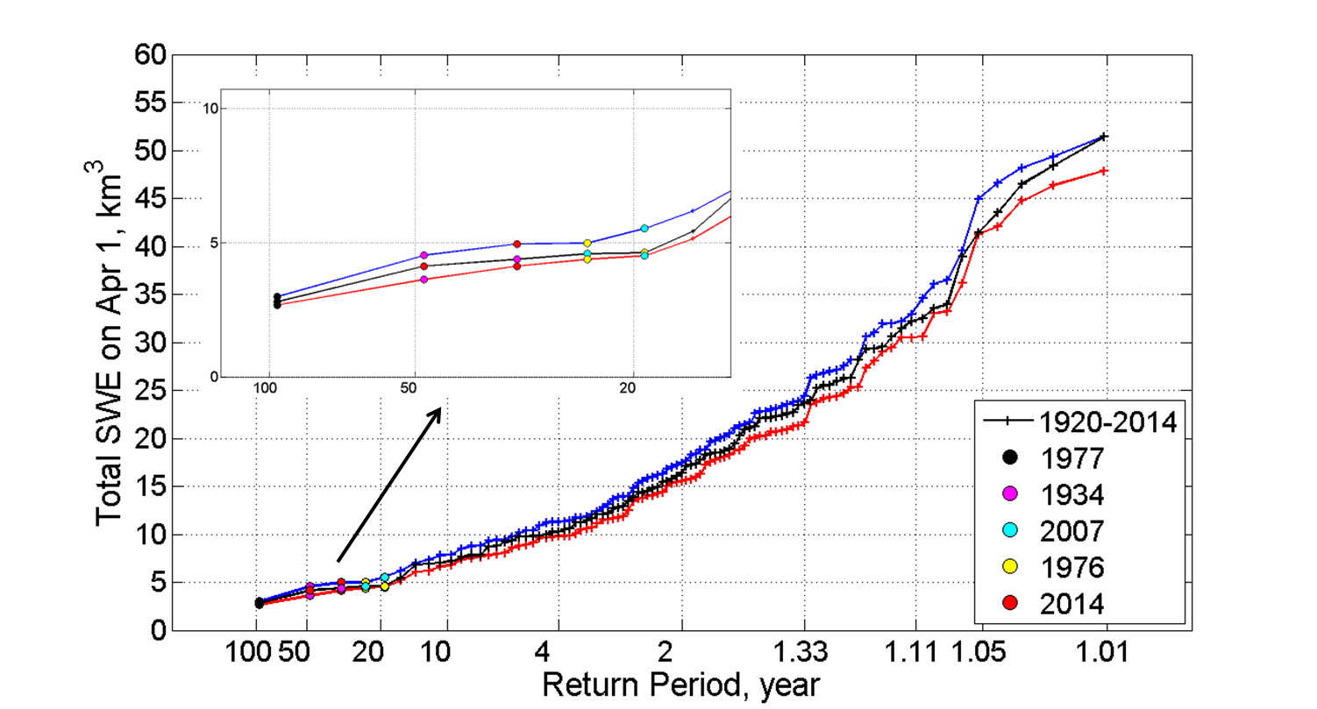
Apr 1 SWE
No trend without warming
Base scenario
Cold scenario
Warm scenario
Notes:
2014 goes up a little bit without climate change, but still among the five lowest years
Warming climate does not affect the extreme dry events too much
Seems to diverge in wetter years

Slide 18
“… the combination of extreme precipitation and temperature conditions observed in 2014 in California appears to be a 200 year extreme event.” AghaKouchak et al., 2014

Slide 19
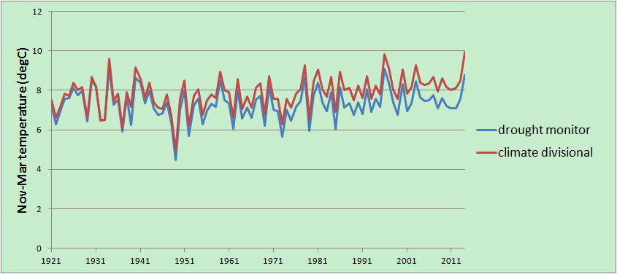
Drought monitor and NCDC climate division data, winters (Nov-Mar) 1915-2014

Slide 20
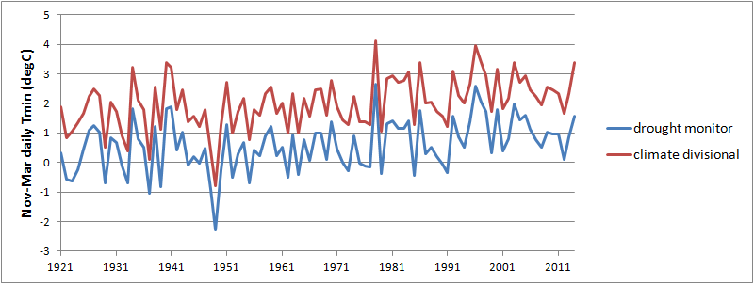
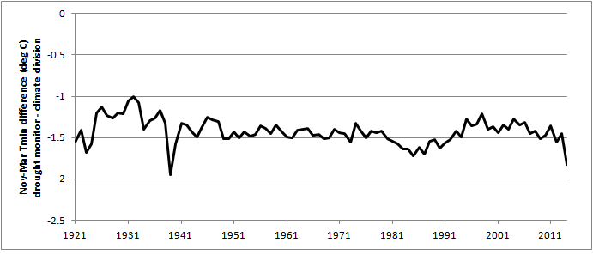
Winter Tmin, SWM and NCDC Climate Division

Slide 21
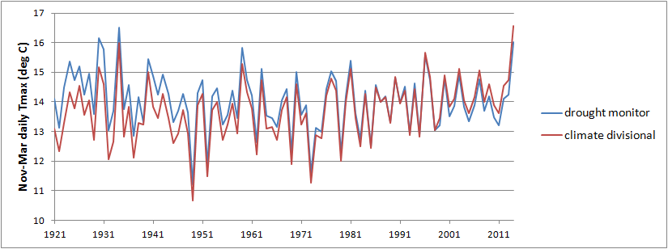
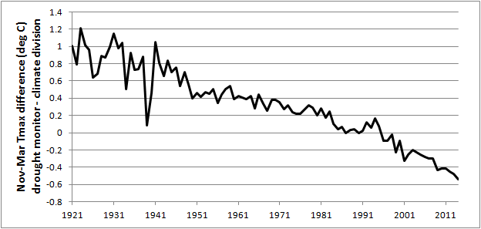
Winter Tmax, SWM and NCDC Climate Division

Slide 22
3) Western U.S. climate projections

Slide 23
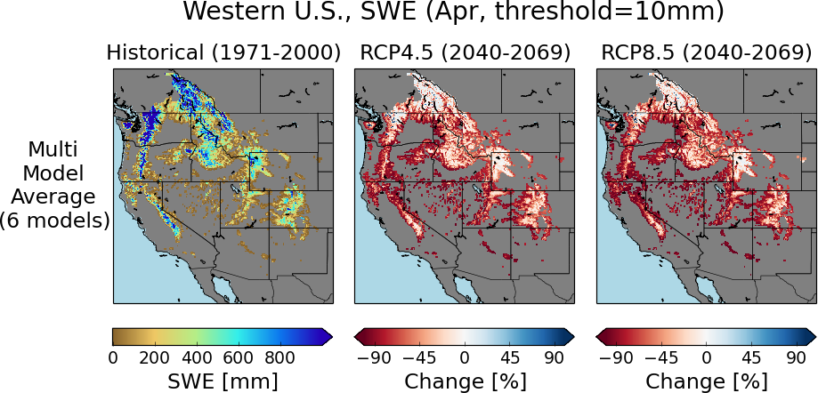

Slide 24
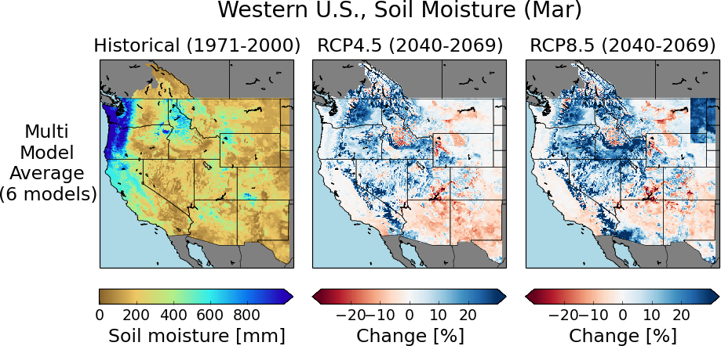

Slide 25
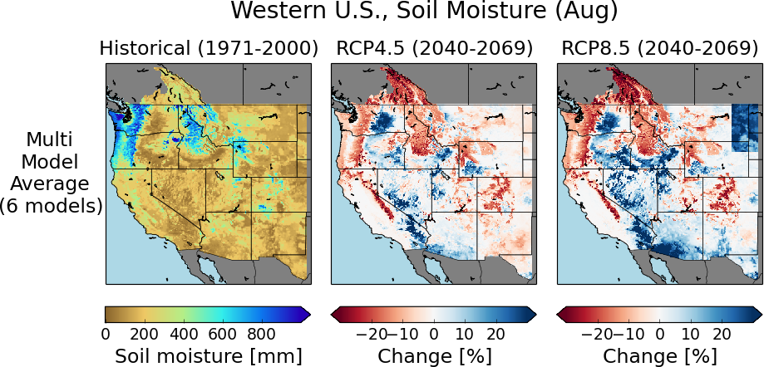

Slide 26
Collaboration opportunities (examples)
West coast drought monitor: SWE assimilation (e.g. ASO)
Hydrologic and climate reconstructions: Regional climate modeling; attribution (e.g., 1976-77 drought of historical record; better understanding of warming signature
Western U.S. projections: Regional climate modeling (major computing load; need to span space of CMIP5 GCMs)

