Slide 1
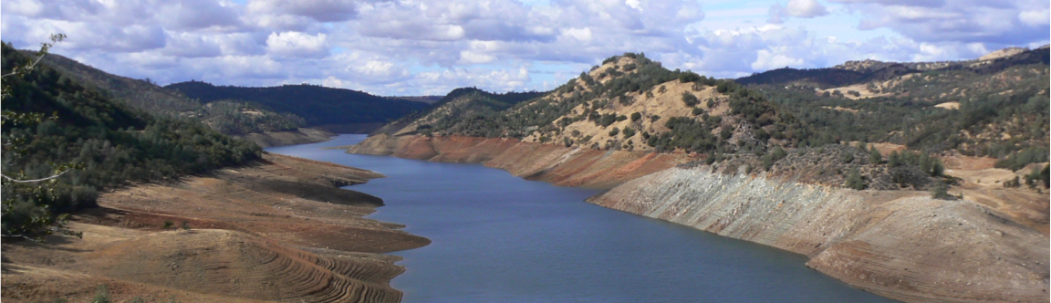

Terrestrial Water and Carbon Cycle Changes over Northern Eurasia: Past and future
Dennis P. Lettenmaierª
Theodore C. Bohn^{b}
ªUniversity of California, Los Angeles
^{b}Arizona State University
NEESPI Synthesis Workshop
Prague
Apr 9, 2015

Slide 2
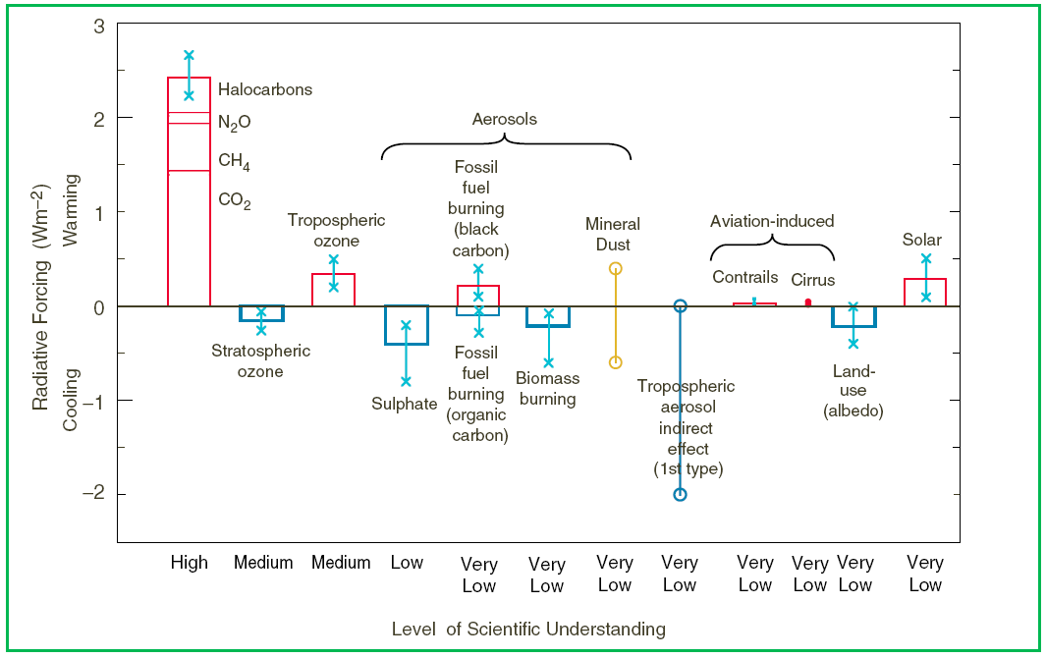
Global Carbon Cycle ↔ Global Climate
Increases in global mean radiative forcing over period 1750 to 2000 A.D.
(IPCC, 2001)
But CH4 is pretty bad too
  = 20% of greenhouse gas forcing
CO2 has a bad reputation
  = 60% of greenhouse gas forcing
Almost 1% of incoming solar energy
Both CO2 and CH4 are part of the global carbon cycle
CH4 is a MUCH stronger greenhouse gas than CO2

Slide 3
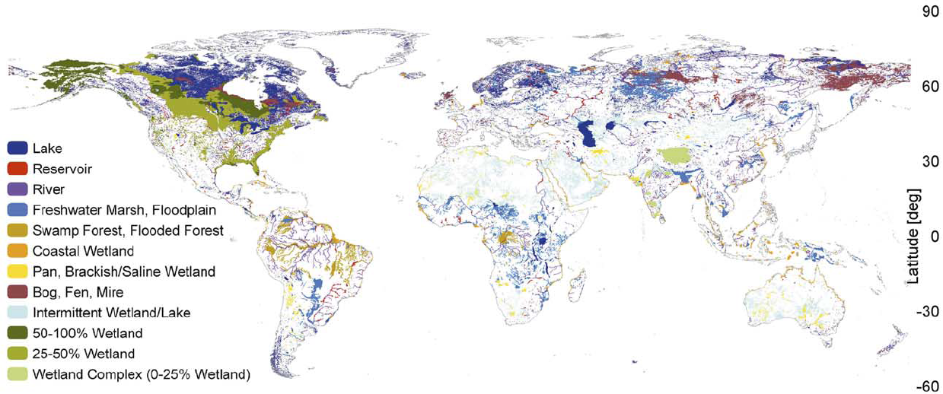
Importance of Wetlands
Wetlands:
Largest natural global source of CH₄
Large C sink
Wetland carbon emissions are sensitive to climate
High latitudes experiencing pronounced climate change
50% of world’s wetlands are at high latitudes
West Siberian Lowland
(WSL)
Lehner and Doll, 2004
Potential positive feedback to warming climate
Notes:
Note difference in wetland definition CA vs Siberia

Slide 4
Carbon Cycling
Temperature
(via metabolic rates)
CO₂
CH₄
CO₂
NPP
Living Biomass
methano-
trophy
Peat
Litter
Temperature
(via evaporation)
Aerobic R_{h}
Root Exudates
Soil Microbes
Water Table
Precipitation
Soil Microbes
Anaerobic R_{h} (methanogenesis)

Slide 5
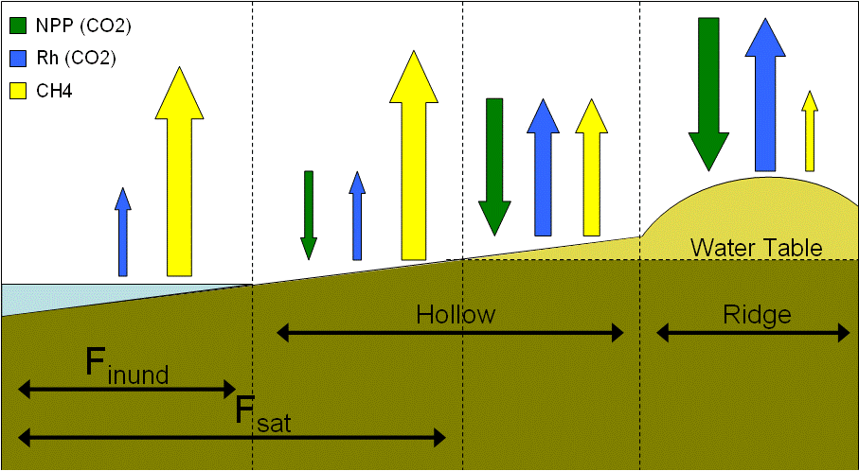
Effects of Microtopography
Water table variations on the scale of meters
Saturated soil inhibits NPP and Rh; promotes CH4
Areas vary seasonally
Inundated
Saturated Fraction
Unsaturated Fraction
Notes:
Relative size of arrows notional

Slide 6
Heterogeneity Ignored at Large Scale: 1. Moisture
Color-By-Numbers: constant emissions assigned to various land cover types (e.g., Fung et al., 1991).
CH4
Uniform Water Table: Entire grid cell has the same water table depth (e.g., Zhuang et al., 2004; most other land surface models).
Does not require information about microtopography
Cannot be compared to remote sensing
CH4
CH4
Wet-Dry: CH4 only emitted by inundated or saturated fraction (e.g., Ringeval et al., 2010).
Can be calibrated to match remote sensing
Ignores CH4 from unsaturated fraction
Do these simplifications lead to biases?
What do biases depend on?
Notes:
Olive = saturated, brown = unsaturated possibly delete

Slide 7
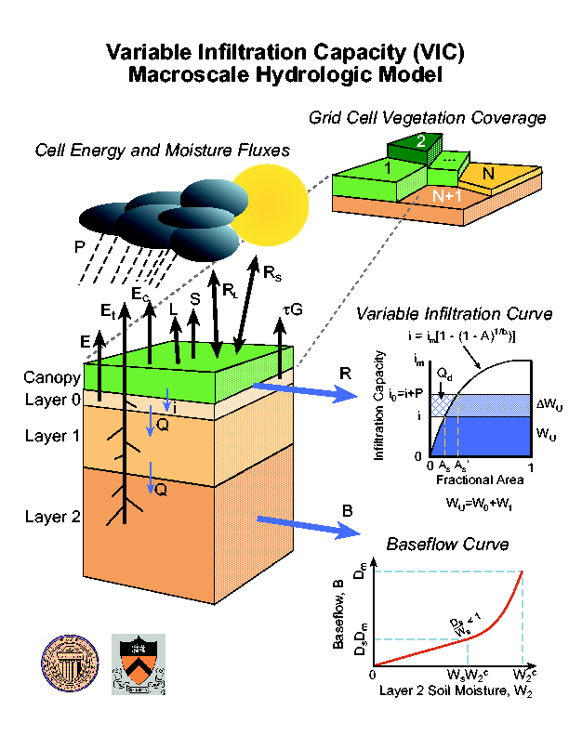
Modeling Framework
VIC hydrology model
  Large, “flat” grid cells (e.g. 100x100 km)
  On hourly time step, simulate:
    Soil T profile
    Water table depth Z_{WT}
    NPP
    Soil Respiration
    Other hydrologic variables…
Link to CH4 emissions model (Walter & Heimann 2000)
First attempt at water table distribution: TOPMODEL (Beven and Kirkby, 1979)
Notes:
Current version has microtopograph

Slide 8
New Model Formulation
Use VIC dynamic lake/wetland model (Bowling and Lettenmaier, 2010)
Topo. information from 1-km DEM NOT a good predictor of water table depth
Added water table distribution due to microtopography
Not considering lake C cycle

Slide 9
Response to Future Climate Change
Questions:
How will WSL wetland carbon fluxes respond to possible end-of-century climate?
Which mechanisms will dominate the response?
Notes:
Collaboration with S. Maksyutov, M. Glagolev, A. Peregon, J. Kaplan, R. Neumann, F. Aslkhodapasand (ongoing work)

Slide 10
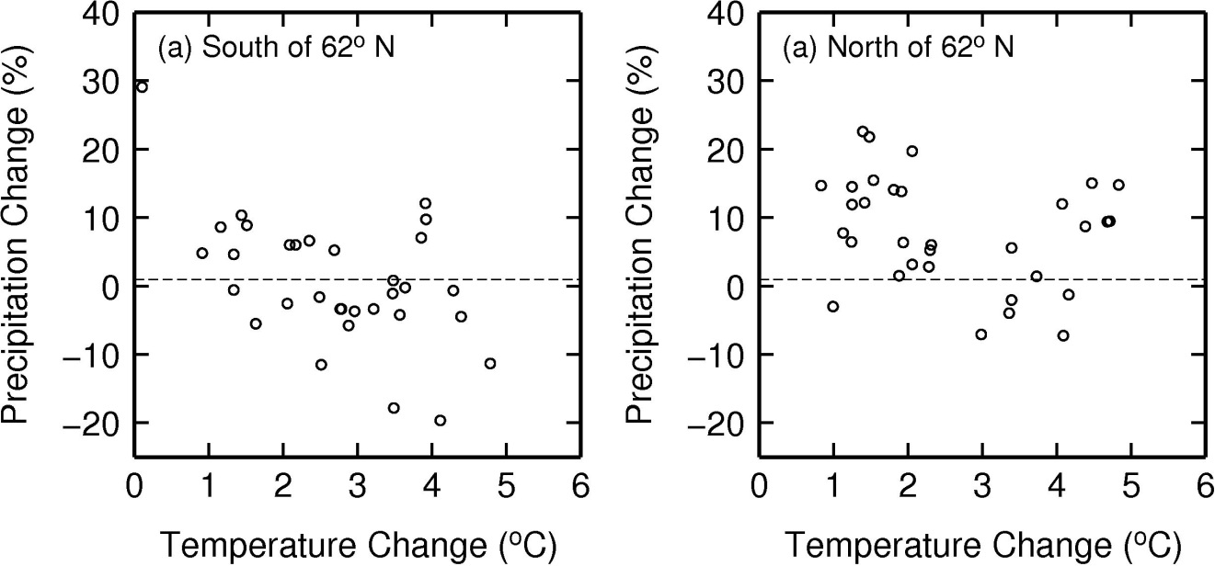
CMIP5 Model Projections, WSL
RCP 4.5 Scenario; 2071-2100 compared to 1981-2010
T-induced water table drawdown
Will P compensate?
T-induced increase in metabolic rates
Effect: possible increase or decrease in CH4
Notes:
Dots are cmip5 projections – increase vs decrease in ch4 depends on water table balance (P vs T)

Slide 11
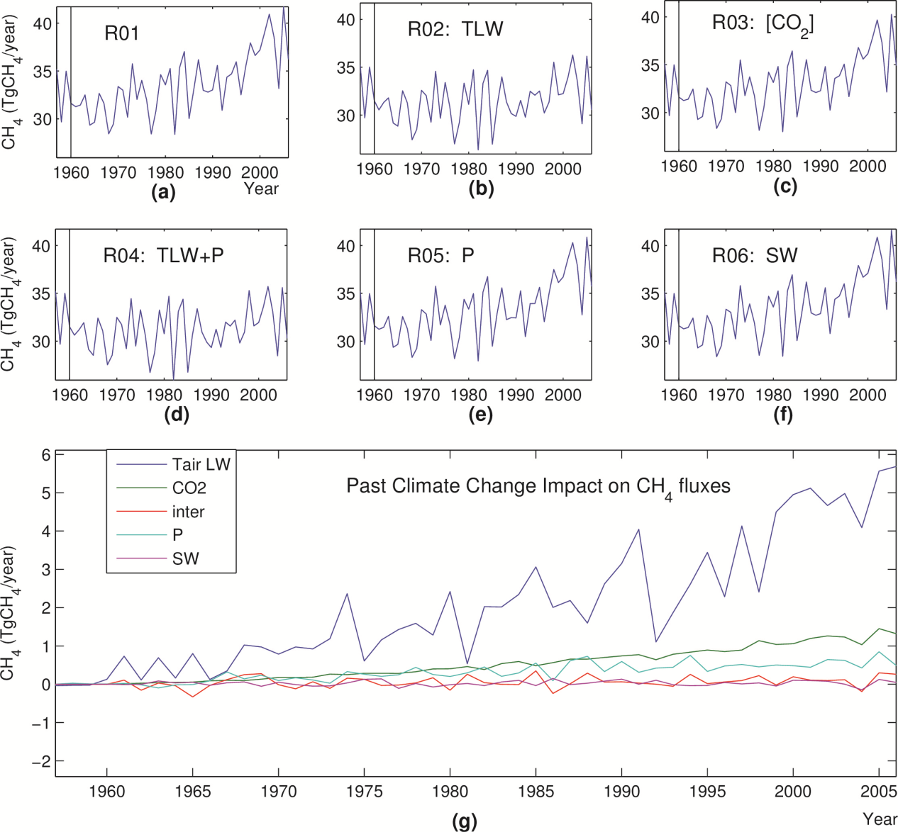
Current and Future Climate Controls on Pan-Arctic Methane Emissions
Over 1960-2006:
CH4 emissions increased by 20%
Temperature was the dominant factor
Notes:
R01 = historic simulation; indicated variables were detrended (note some local changes) Temp and LW are major forcings

Slide 12
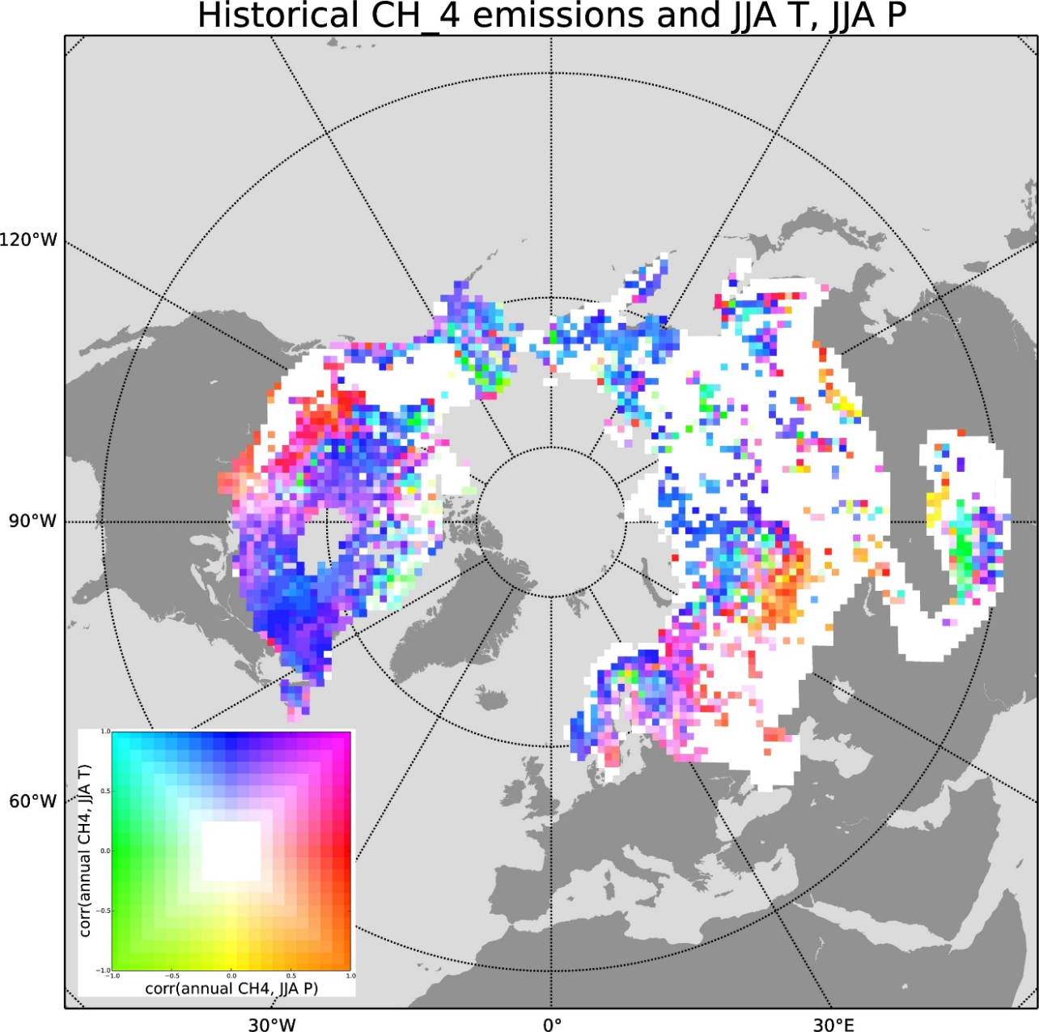
Dominant Drivers
Simulations over 1960-2006
Correlation with CRU Summer Tair
Blue to Yellow: +1 to -1
Correlation with UDel Summer P
Green to Red: +1 to -1
Blue = CH4 is temperature-limited
Red = CH4 is water-limited
Over most of domain, CH4 emissions are temperature-limited
But water-limited in South
Notes:
White mostly no wetland; southern boundaries are water limited; what are shown is correlations from interannual variations from historic run

Slide 13
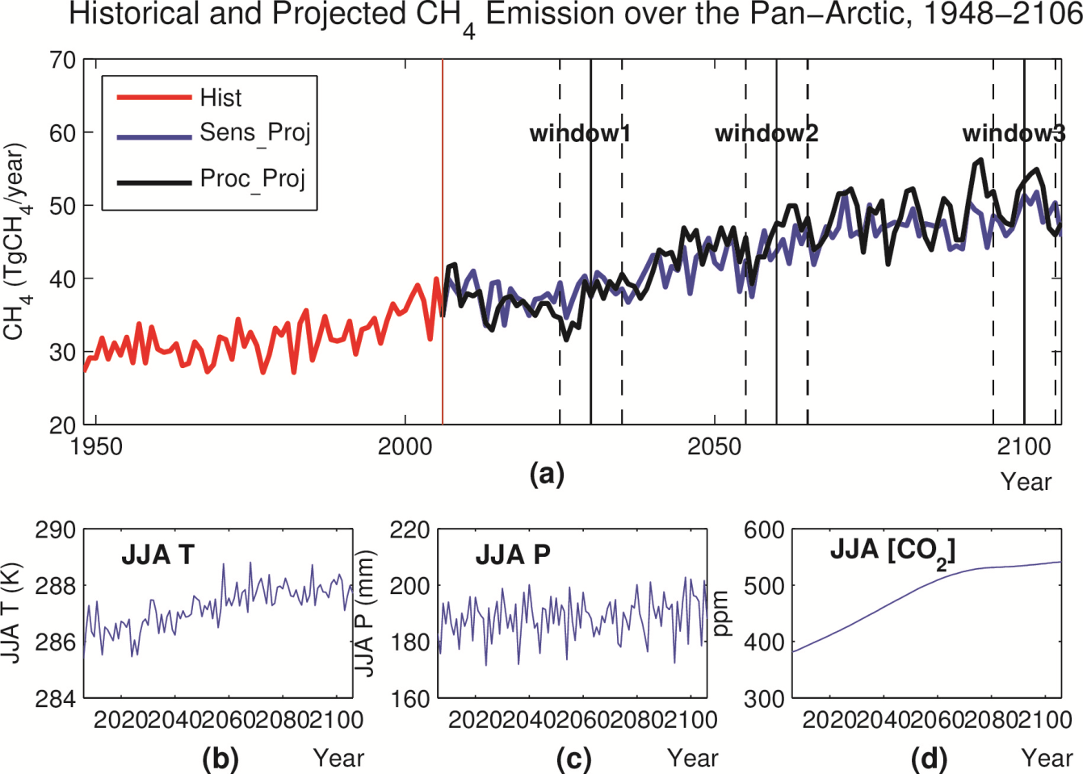
Future Emissions
Emissions will increase by 42% between 2000s and 2090s
Temperature is dominant driver again
But emissions increase less rapidly after 2050
Notes:
Results for RCP4.5; CCSM4 projection

Slide 14
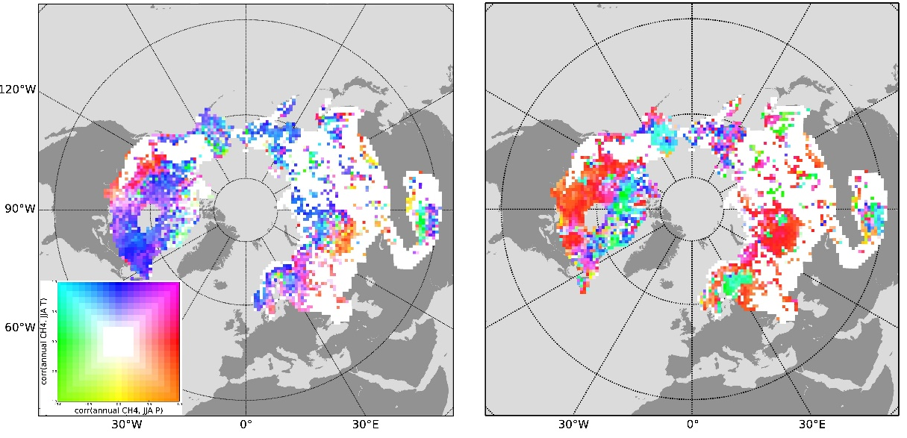
Future Roles of Drivers
Warming over next 85 years leads to expansion of water-limited zone
Further increases in temperature have relatively little effect
Emissions become driven by precipitation
2000s
2090s
Notes:
More of wetlands are water limited (key result)

Slide 15
CH4 Emissions depend strongly on vegetation
Temperature dependence (Q10) (Lupascu et al., 2012):
  higher in sphagnum moss-dominated wetlands
  lower in sedge-dominated wetlands
Plant-aided transport (Walter and Heimann, 2000):
  High in sedge-dominated wetlands
  Low in shrubby/treed wetlands
  0 in sphagnum moss-dominated wetlands

Slide 16
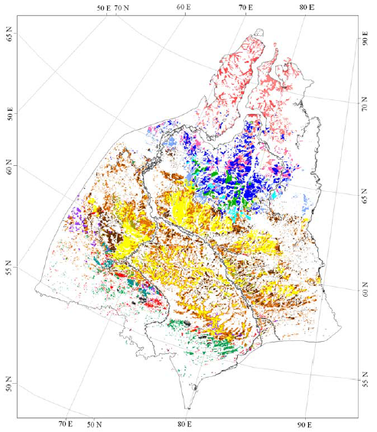
Wetland vegetation controlled by climate
Tundra and Forest-Tundra:
Few trees
Permafrost (ice lenses) influences microtopography
Sedges in wet depressions
Taiga:
Trees present
Large expanses of Sphagnum-dominated “uplands” (bogs)
Sedges in wet depressions (fens)
Sub-Taiga and Forest-Steppe:
Few Trees
Wetlands primarily occupy depressions
Primarily sedge-dominated
Peregon et al. (2008)
Notes:
CH4 parameters (fed to methane model) are strongly tied to vegetation

Slide 17
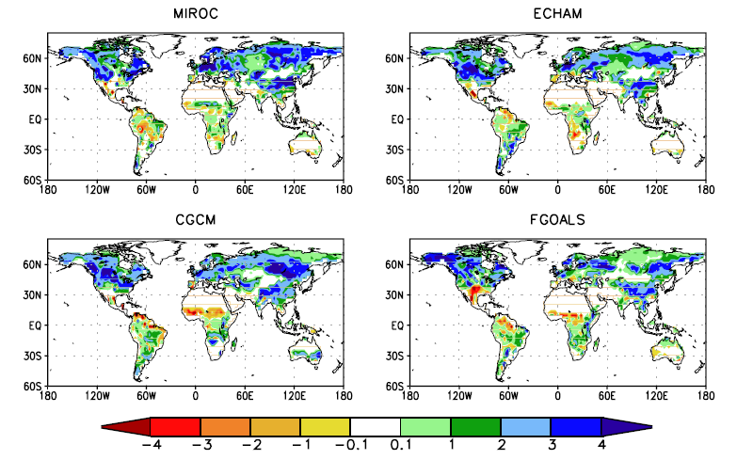
Northward Veg. Shift
Southern biomes will migrate northward over next century (Kaplan and New, 2006)
  Forest will displace tundra
  General increase in LAI
Possible Effects:
Higher LAI = Higher NPP = Increase in CH4
Higher LAI = Greater ET, Drying of soil = Decrease in CH4
Change in LAI, 1900 to 2100
(Alo and Wang, 2008)

Slide 18
Simulations
Simulation | N | Climate (T,P) | Soil Moisture | LAI
Historical | 1 | Adam et al. (2006) | Prognostic | MODIS (Myneni et al., 2002)
Warming+Drying+LAI | 32 | CMIP5 | Prognostic | CMIP5
Warming+Drying | 32 | CMIP5 | Prognostic | MODIS
Warming+LAI | 1 | CMIP5 EnsMean | Prescribed | CMIP5
Warming | 1 | CMIP5 EnsMean | Prescribed | MODIS
Microbial Response Cases
Case | Acclimatization
NoAcc | No
Acc | Yes
Changes in Species Abundances Not Yet Finished

Slide 19
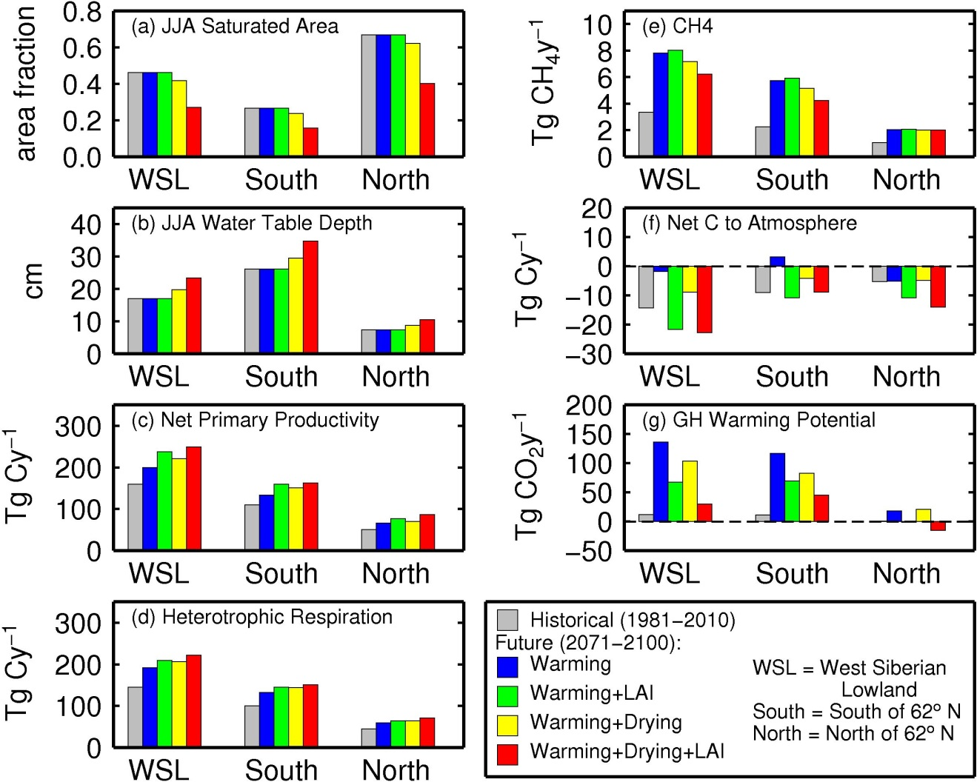
Effects of Warming, Drying, LAI
Warming without drying (blue) acts in opposition to drying (yellow, red)
  metabolism
Climate-CH4 feedback (red minus blue) about 50% the size of warming alone
Increased NPP due to LAI (green) more important than drying for Net C fluxes
Notes:
For WSL

Slide 20
Some thoughts on post-NEESPI directions
1) Constraining models with observations:
Need “benchmarks” with comprehensive observations – continued focus on WSL, revisit observation suites
2) Long-term observations:
Need long-term (multi-year) observations at relatively small number of representative sites, to help identify which drivers dominate wetland fluxes over time
Soil temperature
Water table position
CH4 emissions
Monitoring of disturbed (burned or drained) sites before/after disturbance (paired sites as feasible)

Slide 21
Future directions (cont.)
3) Spatial heterogeneity (intensive but not necessarily continuing)
Need intensive sampling of many points at each wetland “site”, sampling along the gradient of microtopography (hummocks/ridges to hollows) – perhaps a 50-m transect,intervals of 1 m:
Soil surface elevation
Water table position
Soil temperature profile
CH4 emissions – chamber and flux tower
These samplings need to happen at, for example, weekly intervals over a growing season
Ideally, do this at several sites in a 10x10-km region (within same larger wetland complex, for example Bakchar Bog), to also capture regional water table gradients

Slide 22
Future directions (cont.)
4) Spatio-temporal changes:
Monitoring of thermokarst (actively changing) sites – both multi-year and spatially intensive
Vegetation
Microtopography
Water table position
Soil temperatures
CH4 emissions
Role of Remote Sensing:
Inundation and saturation products (e.g. passive microwave – AMSR) and radar (e.g., PALSAR); role of SMAP to be determined)
  Model development (and testing):
Better representation of interactions between nitrogen, carbon, and water cycles
Dynamic peat models (like LPJ-MPI) to investigate rates of peat accumulation and loss (and effects on hydrology)
Better representation of lake carbon cycling, DOC transport (role of SWOT?)

Slide 24
Other Veg Changes
Warming/Drying:
Lower water tables may reduce areas of sedge-dominated depressions
  Additional reduction in CH4 emissions
Encroachment of shrubs and trees into sphagnum-dominated bogs in Taiga zone
  Small increase in plant-aided transport?
  Replacement of wetlands with forest?

Slide 25
Microbial Responses
Acclimatization (Koven et al., 2011)
Microbes adapt to new T
Poorly understood
T
Effect: smaller (or no) increase in CH4 emissions
CH4
Time

Slide 26
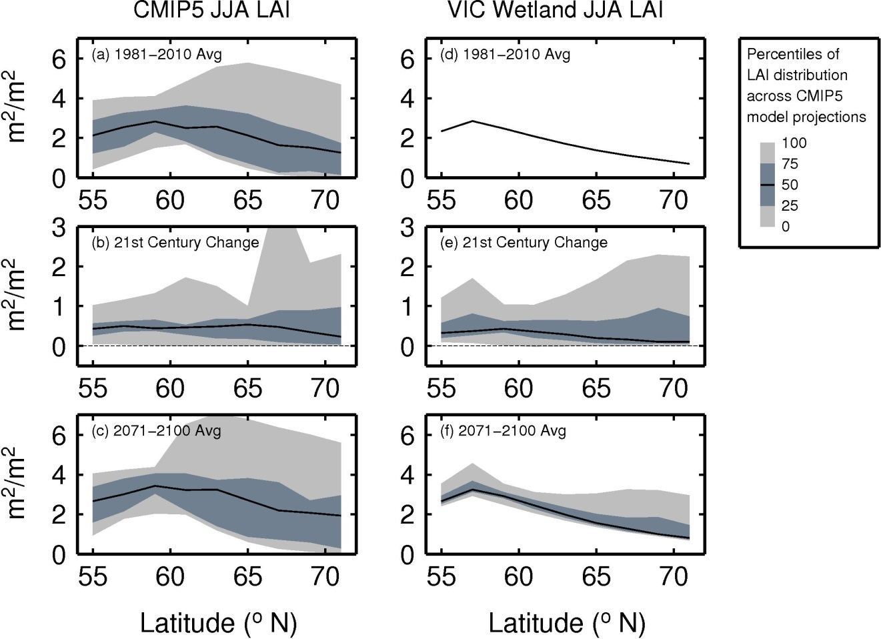
Simulations – Handling of Climate and LAI
T, P: delta method, applied to 1980-2010
CO2: CMIP5 ensemble mean
LAI: quantile-mapping, applied to MODIS
CMIP5 whole-gridcell LAI vs. MODIS LAI for just wetland

Slide 27
Simulations – Handling of Microbial Response
Acclimatization: Tmean = 10-year moving average soil temperature

Slide 28
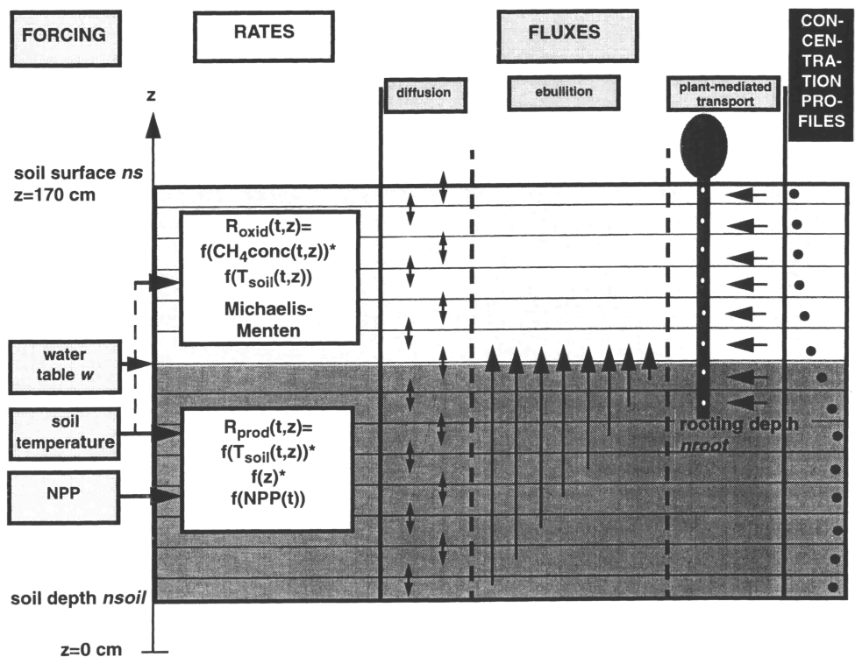
Methane Emissions Model
Walter and Heimann (2000)
CH4 flux = production – oxidation
CH4 production depends on:
  NPP
  Soil Temperature (Q10)
  Anoxic conditions (below water table)
CH4 oxidation depends on:
  CH4 concentration
  Soil Temperature (Q10)
  Oxic conditions (above water table)
3 pathways to surface:
  Diffusion
  Plant-aided transport
  Ebullition

