Slide 1
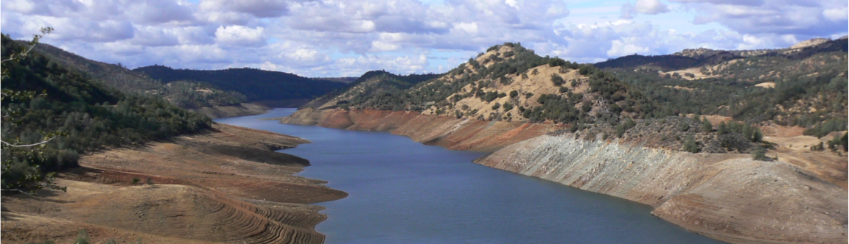

The impact of retreating glaciers on water supply
Dennis P. Lettenmaier
Department of Geography
University of California, Los Angeles
CAS-NASA Workshop on the use of earth observations to address
glacier change and associated hazards
Kathmandu
Jan 20, 2015

Slide 2
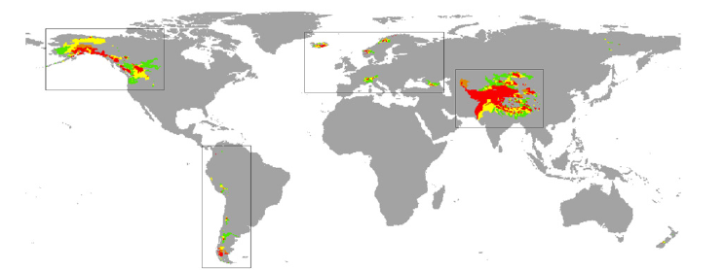
River basins for which at least 5% (green), 10% (yellow), 25% (orange), 50% (red) of discharge is derived from glaciers in at least one month.
“370 (140) million people live in river basins where glacier sources contribute at least 10% (25%) of river discharge... Most of this population is in the High Asia region”
from Schaner et al., ERL, 2012

Slide 3
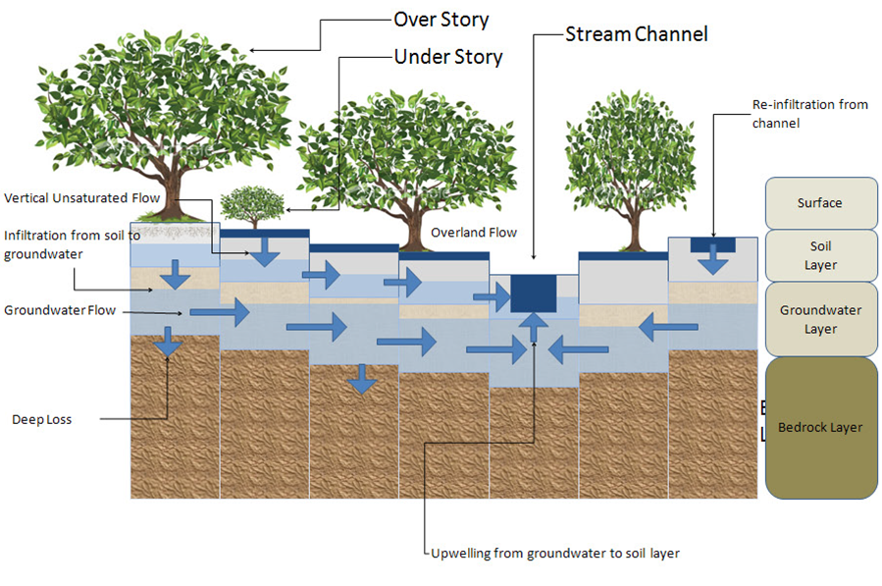
Distributed Hydrology Soil Vegetation Model (DHSVM)
from Wigmosta et al., WRR, 1994

Slide 4
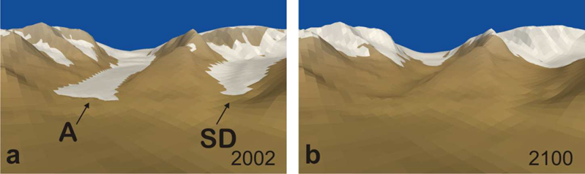
UBC Glacier Dynamics Model
Continuous simulation of glacier area and thickness through representation of dynamic ice flow in response to surface accumulation and ablation
from Jarosch et al., 2013

Slide 5
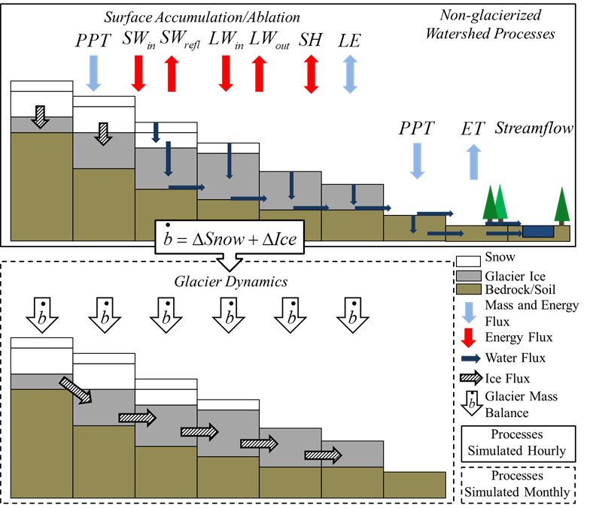
Integration of DHSVM (glacier-free watershed) and GDM (glacierized)
from Naz et al. (HESS, 2013)

Slide 6
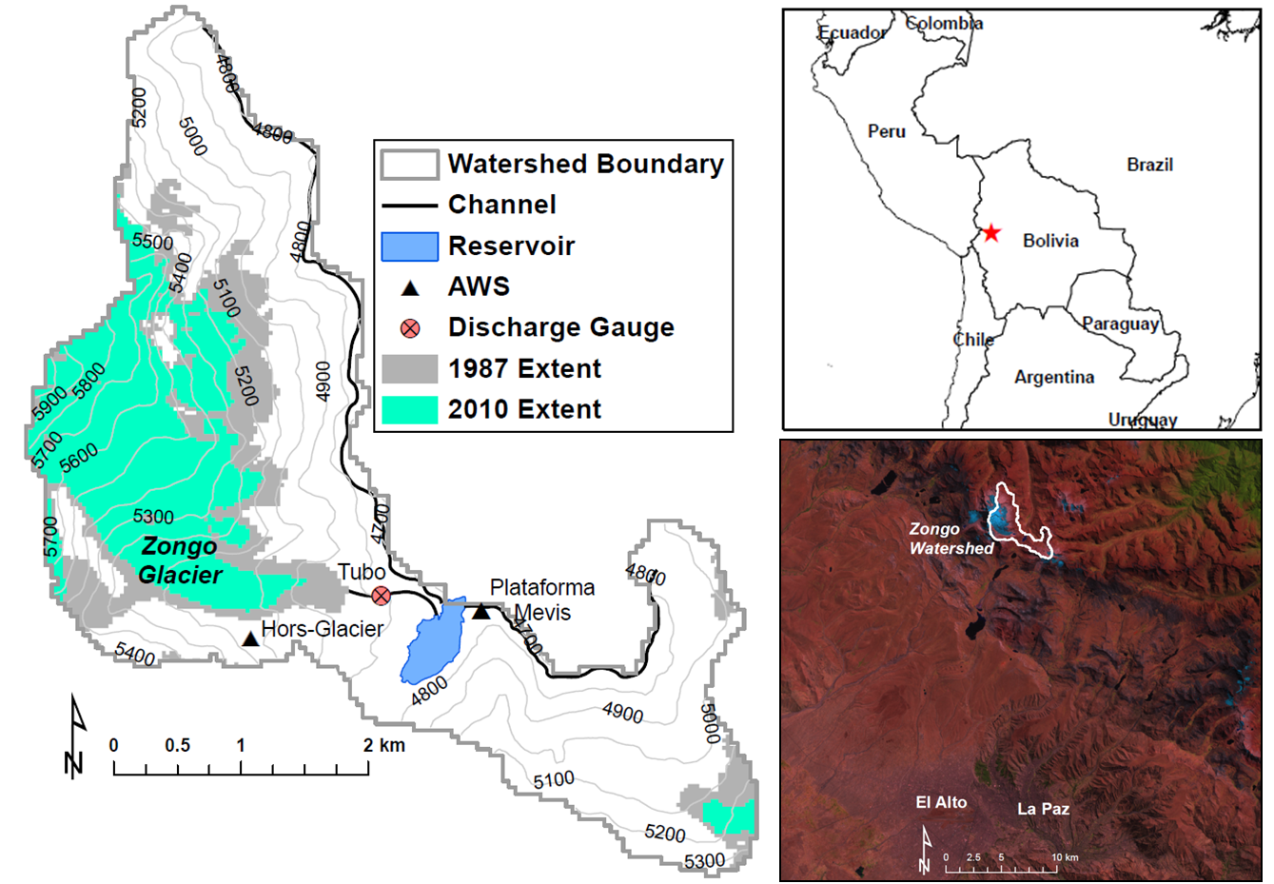
Zongo River (Bolivia) example
from Frans et al., oin review, WRR

Slide 7
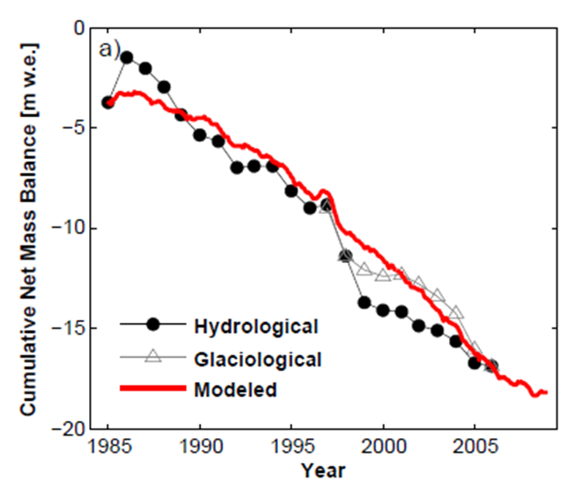
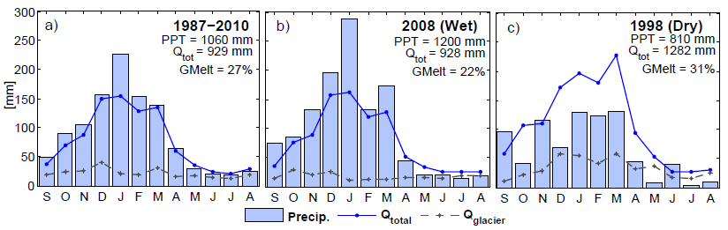
Zongo Glacier mass balance inferred from glaciological and hydrological observations, and DHSVM/GDM model
Model-reconstructed seasonal hydrographs 1987-2010, and 2008
(wet) and 1998 (dry) years
from Frans et al., WRR, in review

Slide 8
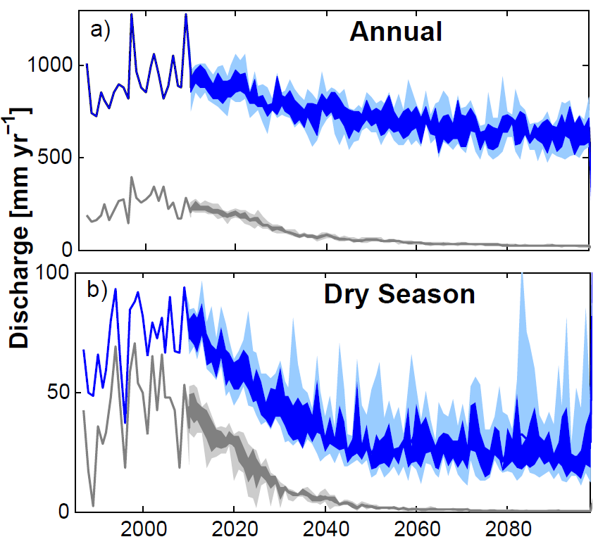
Projected watershed discharge changes,
1987-2100 (RCP4.5)
from Frans et al., WRR, in review

Slide 9
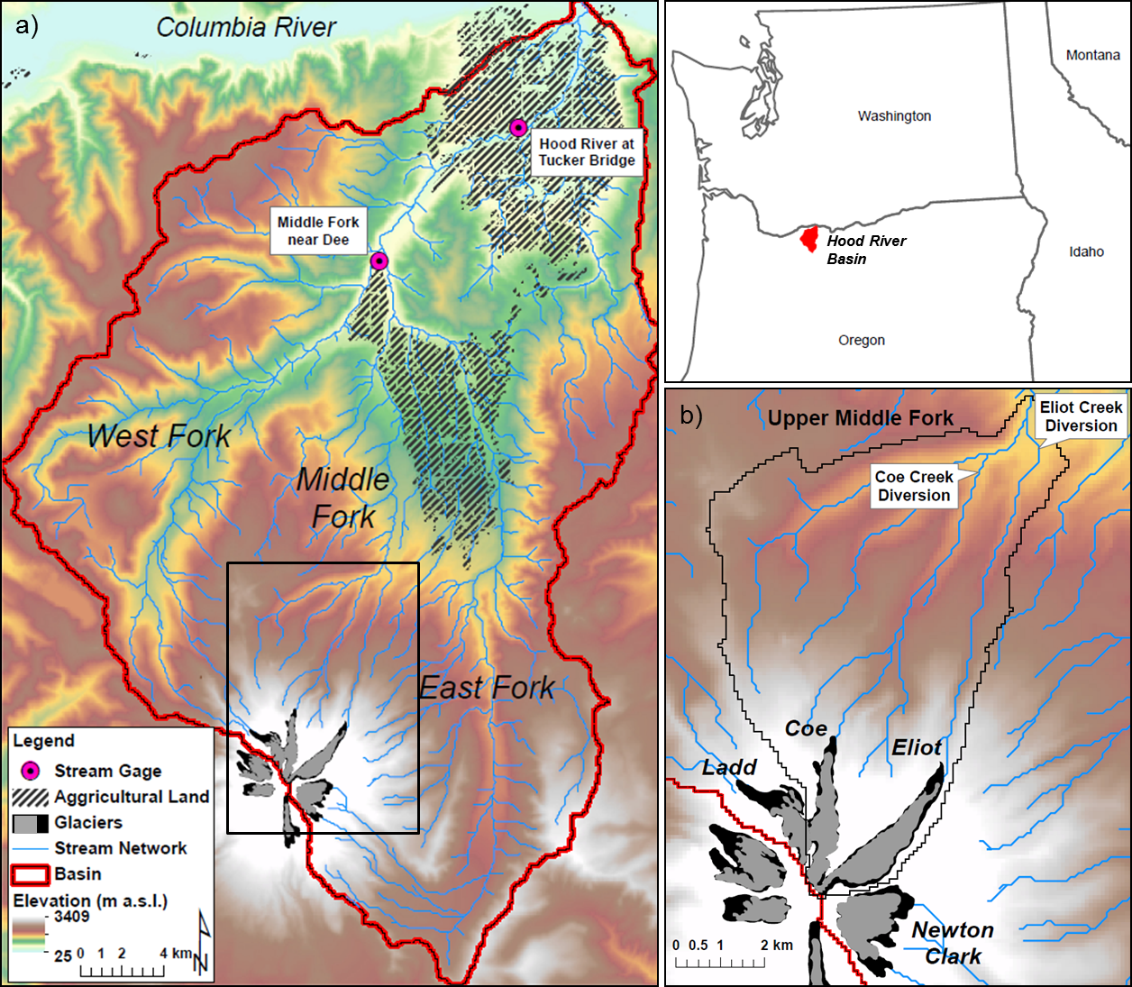
Hood River (OR) example

Slide 10
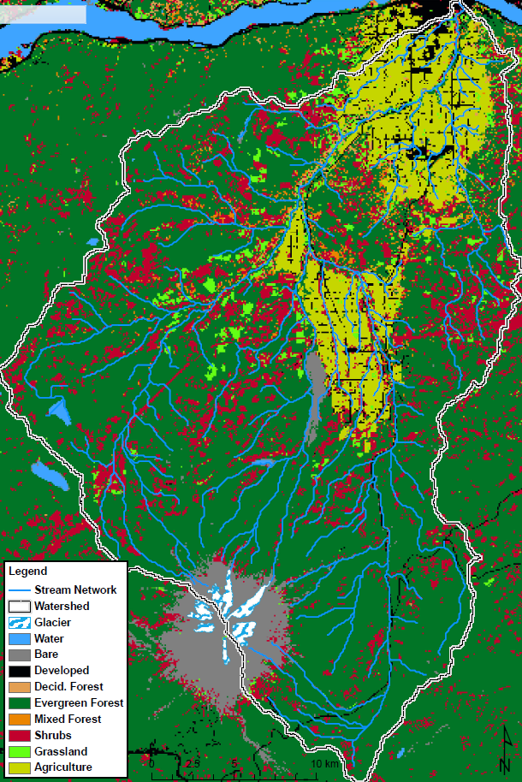
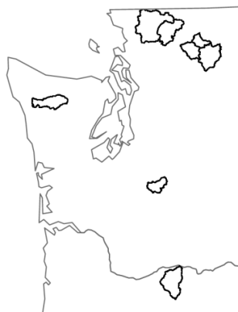
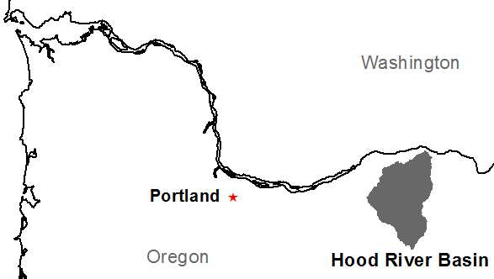
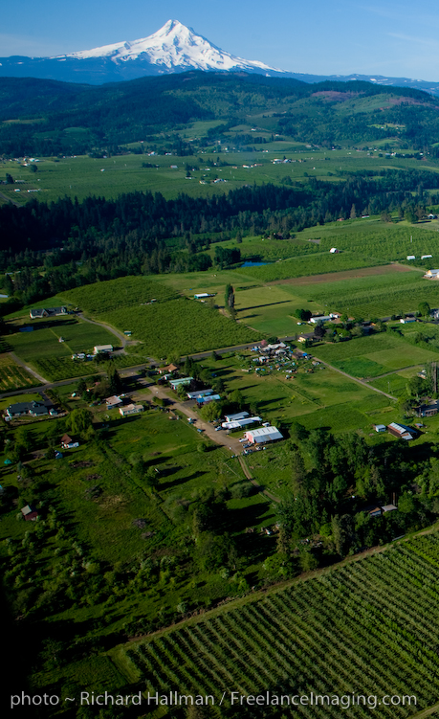
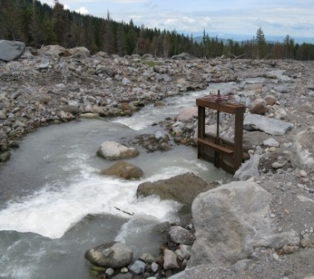
Model Application: Hood River, Oregon
Eliot Creek Diversion

Slide 11
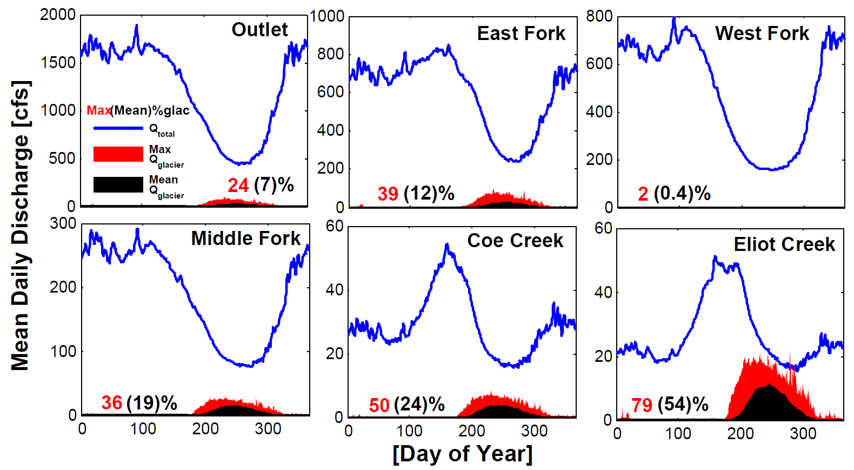
Historical (1916-2005) Contribution of Glacier Melt

Slide 12
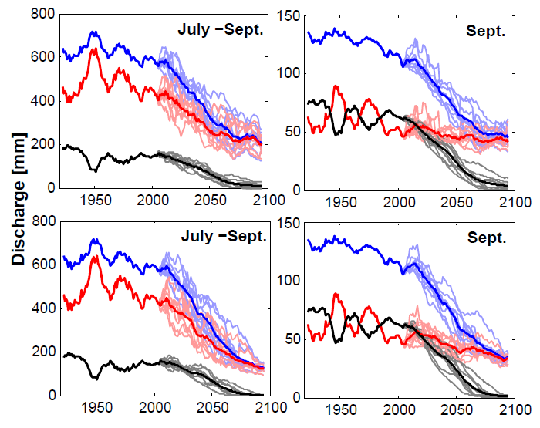
Projection of dry season discharge at
Eliot Creek diversion

Slide 13
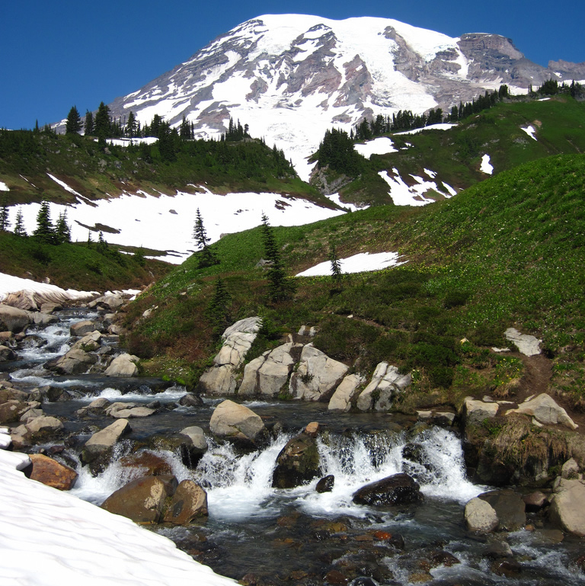
Evolving patterns of coupled glacio-hydrology across the Pacific Northwest Region, USA
Chris Frans¹
Erkan Istanbulluoglu¹
Andrew Fountain²
Matthew Bachmann³
Garry Clarke⁴
Dennis P. Lettenmaier⁵
¹ University of Washington, Seattle, WA
² Portland State University, Portland, OR
³ United States Geological Survey, Tacoma, WA
⁴ University of British Columbia, Vancouver, BC
⁵ University of California, Los Angeles, CA
from AGU, Dec., 2014

Slide 14
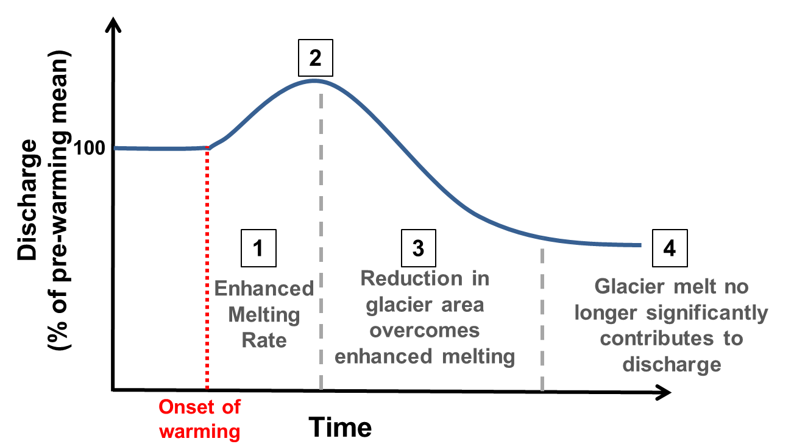
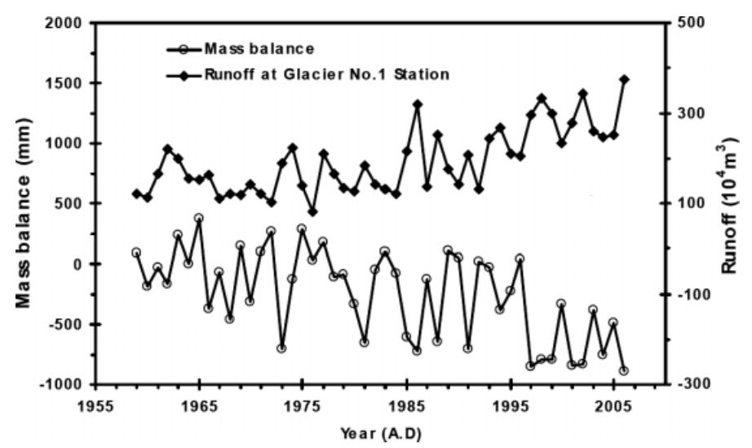
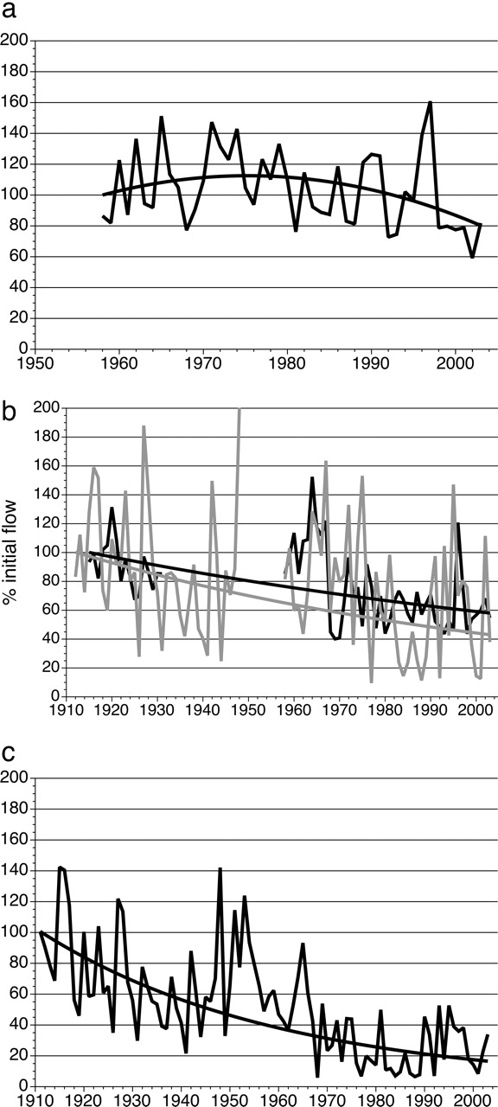
Hydrologic Response to Glacier Recession
Peace River
Urumqi Glacier
Oldman River
Casassa et al., Hyrdol. Process. (2009)
Schindler and Donahue, PNAS (2006)

Slide 15
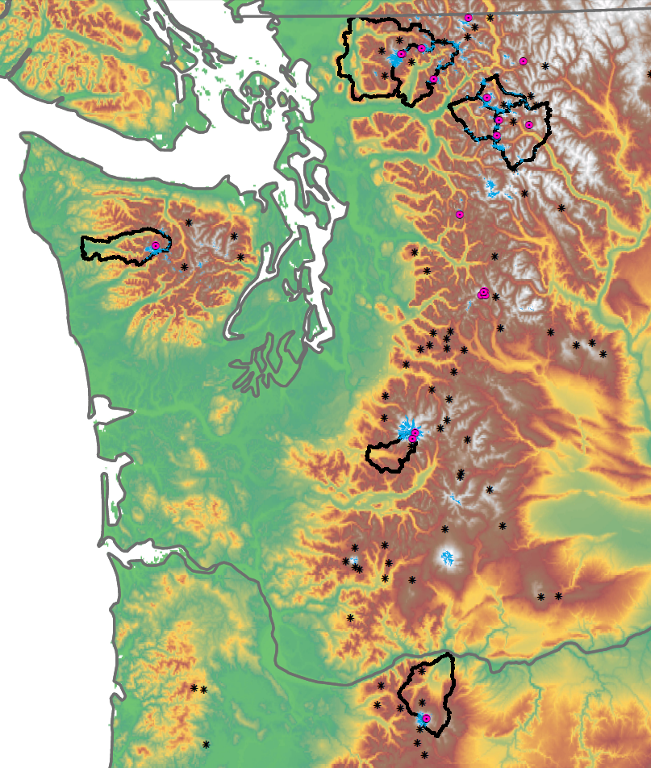
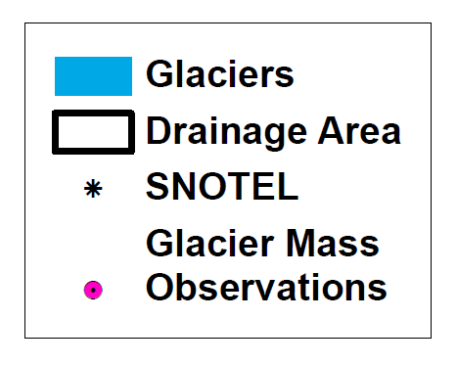
Glacier Area Change
Nooksack
Baker
Mount Baker
- 30% (1900-2006)
[Brown, 2010]
Thunder
North Cascades
- 50% (1900-2009)
[NPS unpublished; Dick, 2013]
Cascade
Stehekin
Hoh
Olympic Range
- 52% (1900-2009)
[Spicer, 1986; NPS]
Mount Rainier
- 22% (1913-2000)
[Nylen, 2002]
Nisqually
Mount Hood
- 33% (1916-2004)
[Jackson and Fountain, 2007]
Hood

Slide 16
Hydrologic Response to Glacier Recession
Diagnosing Present Phase of Hydrologic Response
Discharge
(% of pre-warming mean)
2
Nooksack
Hood
Baker
Thunder
Hoh
100
Nisqually
Cascade
Stehekin
1
3
4
Onset of warming
Phase

Slide 17
Hydrologic Response to Glacier Recession
Projecting Future (20XX) Phase of Hydrologic Response
Discharge
(% of pre-warming mean)
2
Thunder
Hood
Nooksack
100
Hoh
Baker
Nisqually
Cascade
Stehekin
1
3
4
Onset of warming
Phase

Slide 18
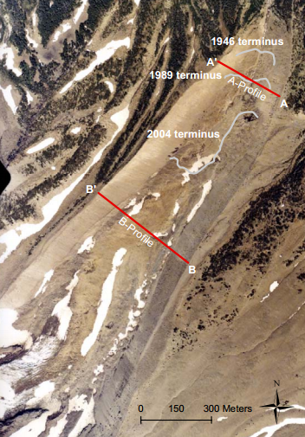
Debris Modulated Ablation: Mount Hood, OR
Observed Data: Jackson and Fountain (2007)
Image: http://www.glaciers.pdx.edu/Thesis/Jackson/KEITH_JACKSON_THESIS_FINAL.pdf

Slide 19
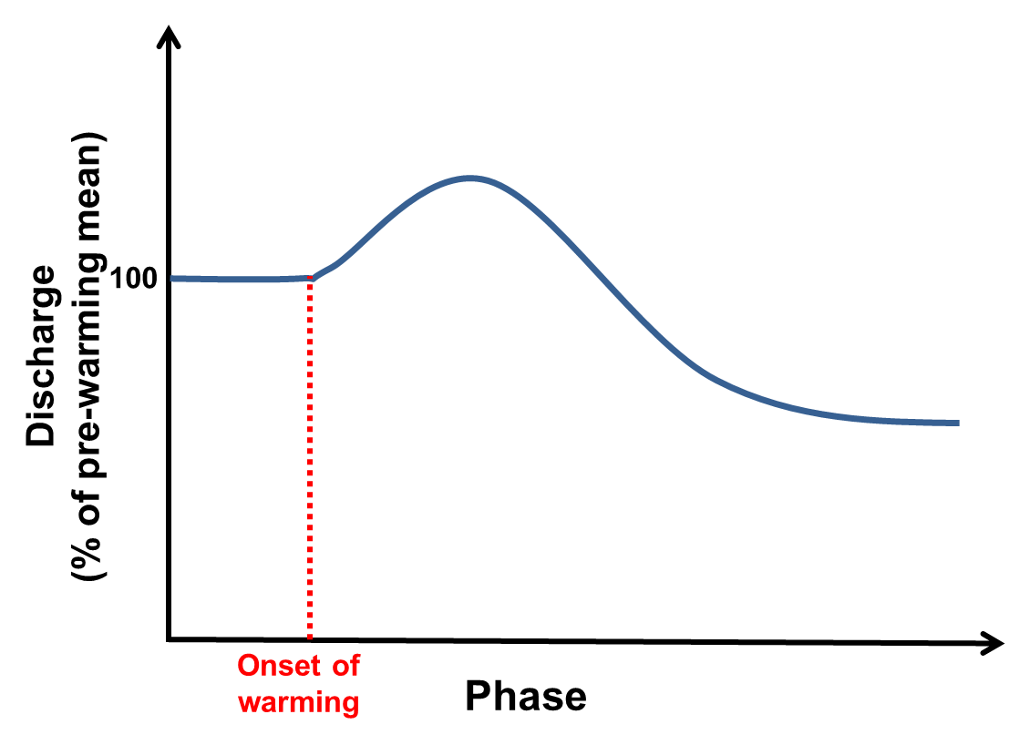
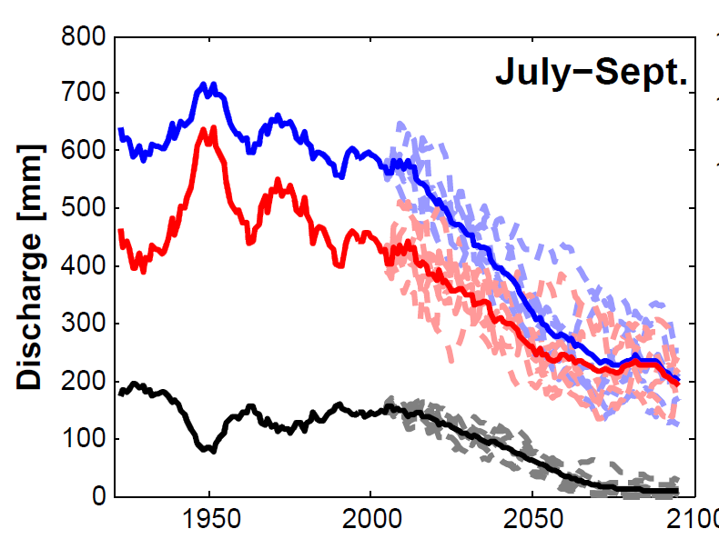
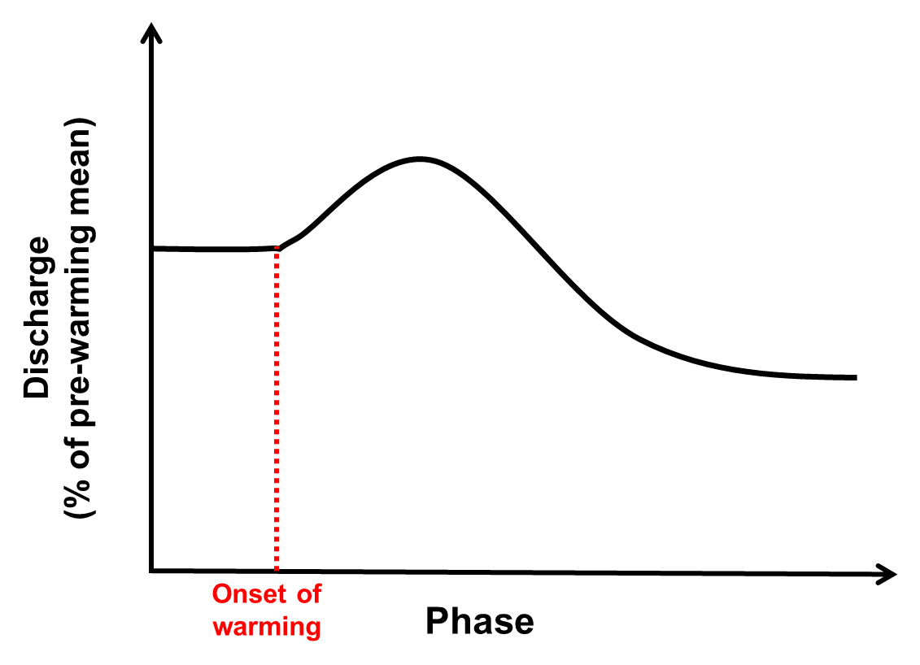
Theoretical Phases of Response: Dry Season
Total Runoff
1950
2075
Glacier Melt
2010
1920
2075
Muted “peak” response through influence of debris cover

Slide 20
Conclusions
A modeling framework for evaluating long-term hydrologic change in partially glacierized river basins is described.
An example analysis in the Hood River basin demonstrates dry season discharge started declining in the middle of the 20th century
These declines in discharge were partially buffered by sustained gradually increasing glacier melt discharge.
Declining glacier melt early in the 20th century exacerbates declines in total dry season discharge contributing to substantial losses in dry season discharge by the end of the 21st century
Ongoing and future work will characterize these patterns for different hydroclimatic and physiographic watershed descriptors across the PNW, USA

