Slide 1
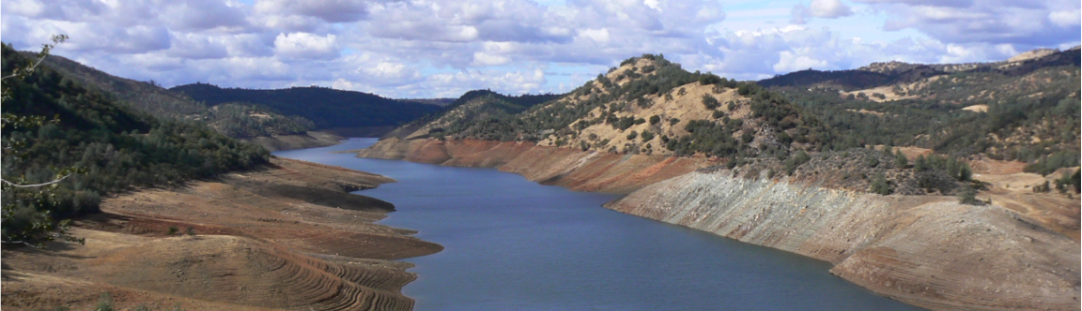

Progress in modeling high latitude land surface hydrological processes
Dennis P. Lettenmaier
Department of Geography
University of California, Los Angeles
Canadian Geophysical Union
Montreal
May 5, 2015

Slide 2
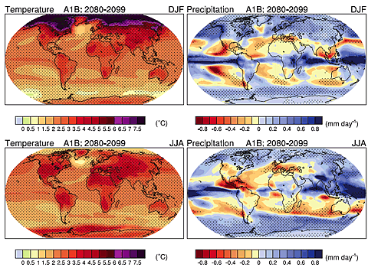
What is the overarching issue?
#1, 2, and 3: Global Change, and its manifestations at high latitudes
Source: IPCC AR4 WG1

Slide 3
Of specific concern to hydrology:
Changes in*:
Snow cover distribution and timing
Permafrost
Streamflow changes (volume and timing)
Vegetation change and associated effects
Energetics (e.g. albedo-related)
Surface water storage
*with many co-dependences

Slide 4
Spatial Distribution of Monthly Mean SCE
April
May
June
OBS
VIC
from Shi et al., J Clim. 2013

Slide 5
Long-term Trends in the Monthly Time Series of SCE
0.82
0.64
0.76
0.58
0.53
0.55
from Shi et al., J Clim. 2013

Slide 6
Latitudinal Variations of Monthly SCE
Trends and Area Fractions
We selected only those latitude bands within which SCE trends were statistically significant at the 90% confidence level for further analyses. For each month, we name these bands as the Snow Cover Sensitivity Zone (SCSZ).
from Shi et al., J Clim. 2013

Slide 7
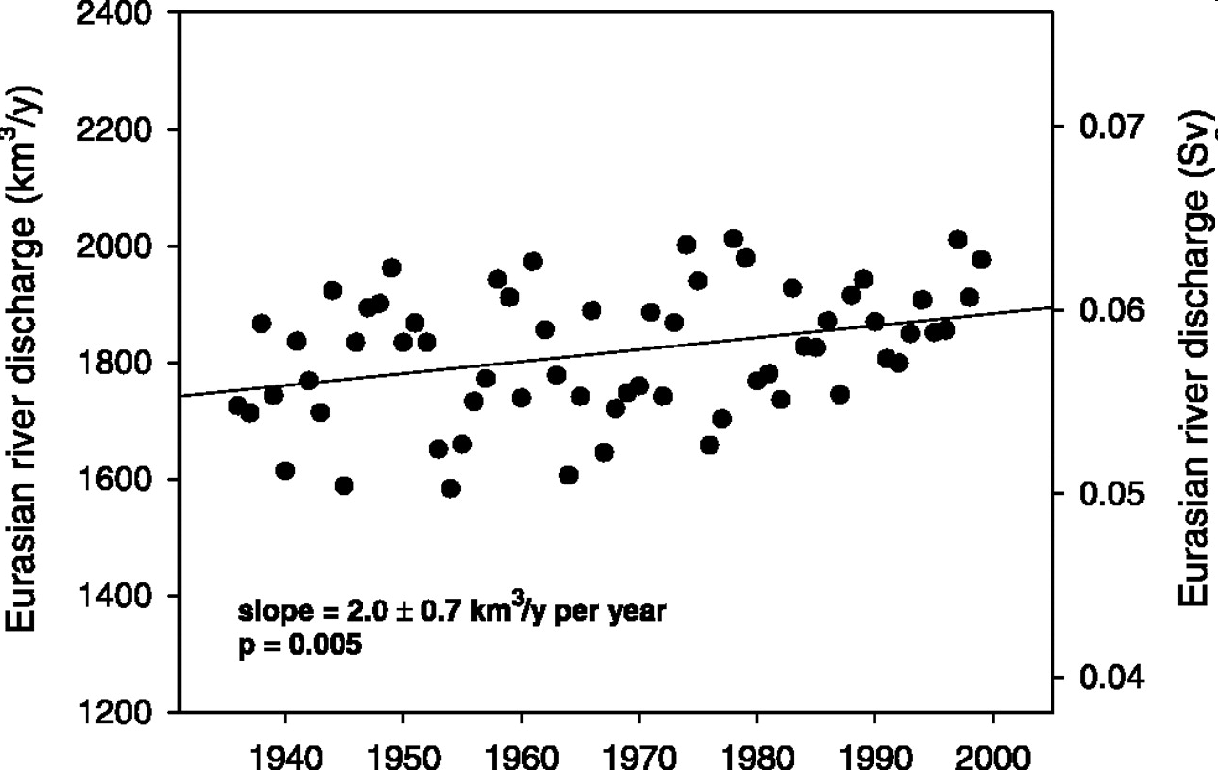
Eurasian Arctic river discharge trends
from Peterson et al., 2002

Slide 8
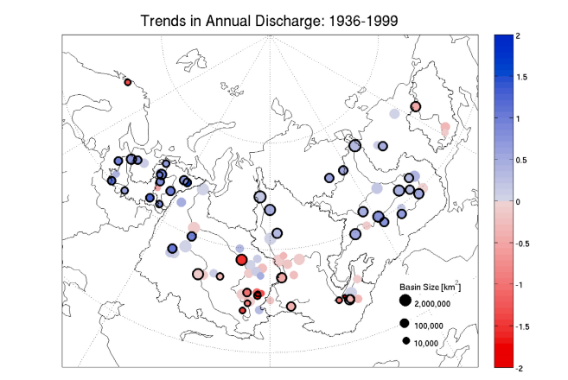
From Troy et al., JGR 2012

Slide 9
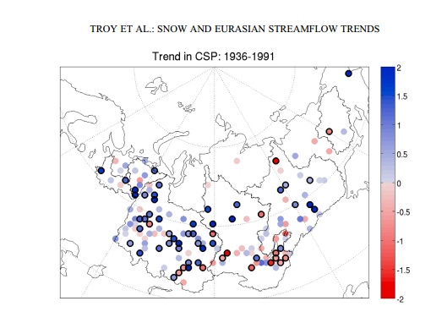
From Troy et al., JGR 2012

Slide 10
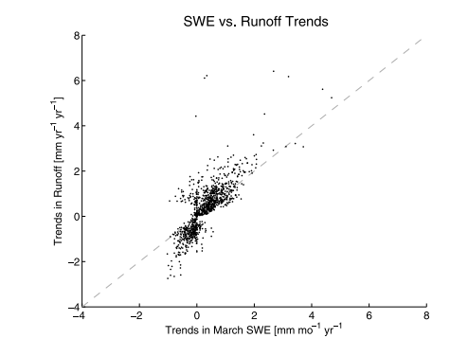
From Troy et al., JGR 2012

Slide 11
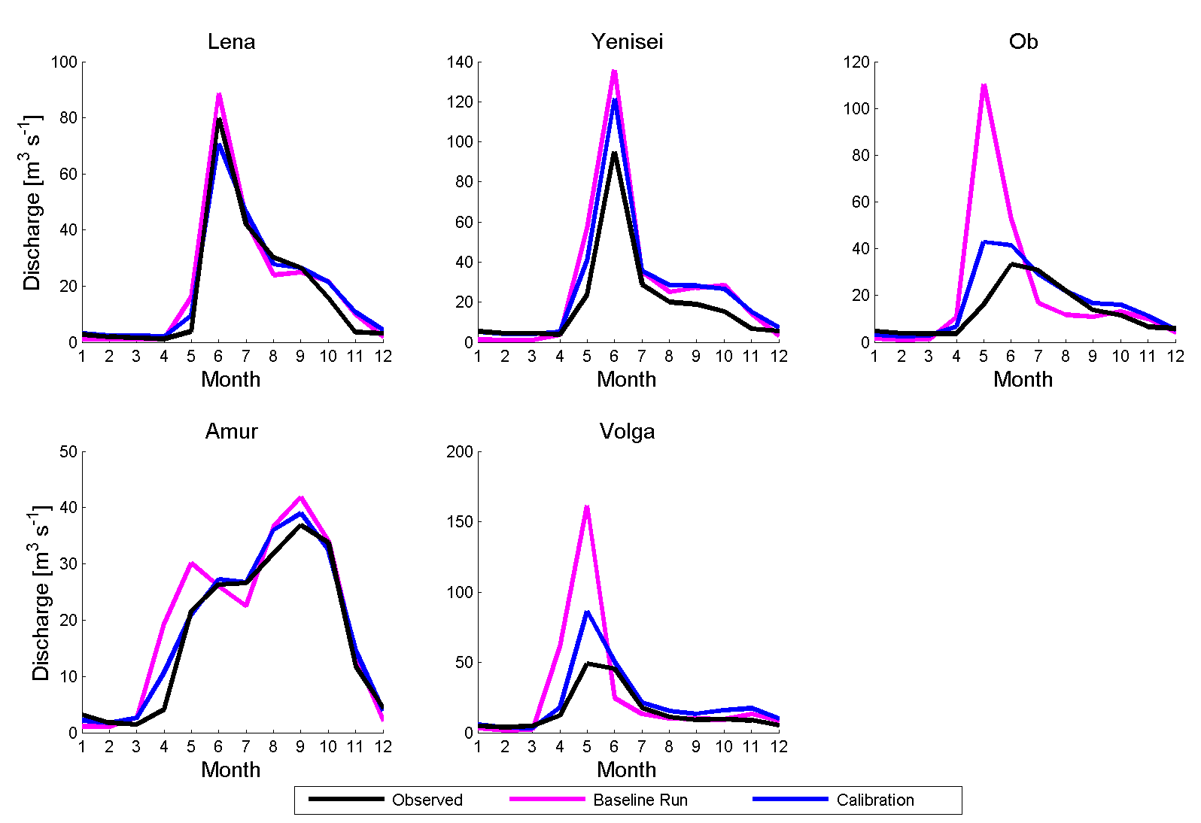
Validation of Streamflow
Troy, T.J., J. Sheffield, and E.F. Wood. 2011. Estimation of the terrestrial water budget over northern Eurasia through the use of multiple data sources, J. Climate, 24(13): 3272-3293, DOI: 10.1175/2011JCLI3936.1
Lena
Yenisei
Ob
Amur
Volga
Observed
Baseline run
Calibration

Slide 12
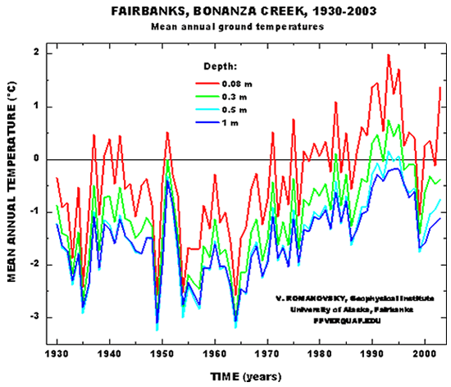
Visual courtesy Vladimir Romanovsky

Slide 13
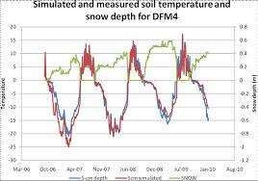
visual courtesy Vladimir Romanovsky

Slide 14
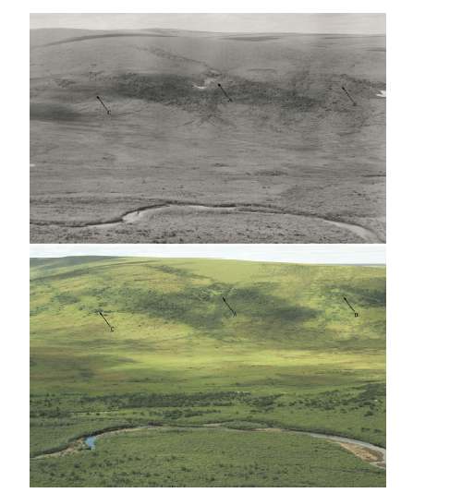
Vegetation change, Northern Alaska 1949-2002
from Tape et al., GCB 2006

Slide 15
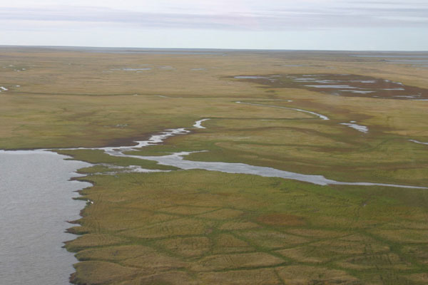
Changes in surface storage (“Dissapearing Arctic lakes”)
Visual courtesy Larry Smith

Slide 16
Where are we in terms of modeling?
For some/many of the key processes, we do reasonably well when we have local observations (including forcings)
Over large areas, hard to tell as the data often are not good enough (especially model forcings) to support our ability to predict change (not just reproduce past states, which often involves calibration
The upscaling problem is a key challenge, and probably won’t be solved without more reliance on remote sensing and better in situ observations. The community needs to do a better job of making the argument for why this should happen

Slide 17
