Slide 1
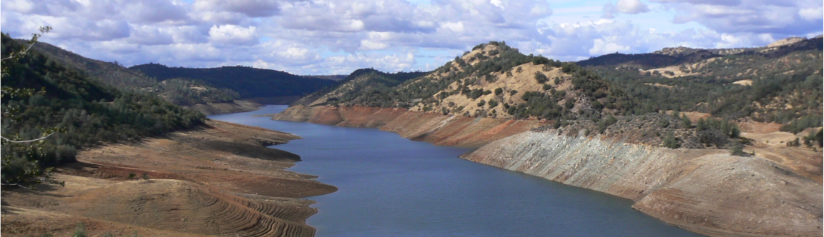
Some Reflections on the Evolution of Hydrology over the Last 40 Years
Dennis P. Lettenmaier
Department of Geography
University of California, Los Angeles
Steve and Sylvia Burges Lecture
Department of Civil and Environmental Engineering
University of Washington
February 27, 2015

Slide 2
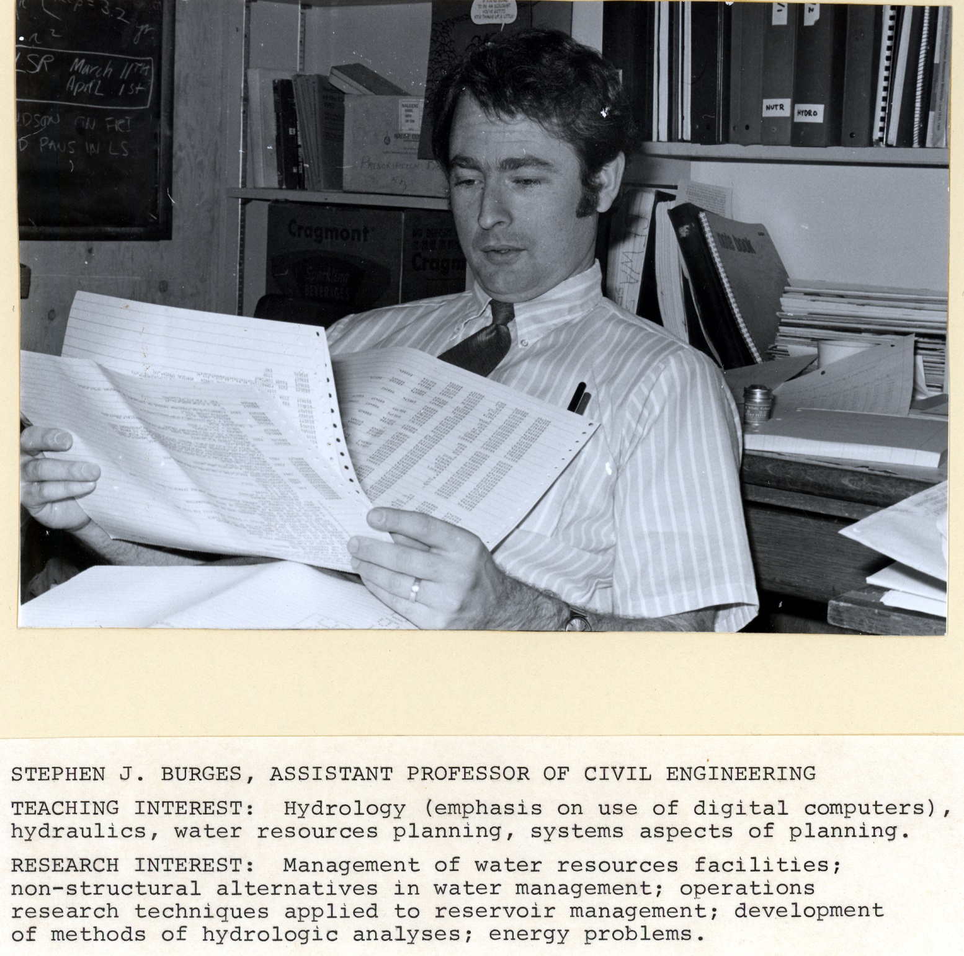

Slide 3
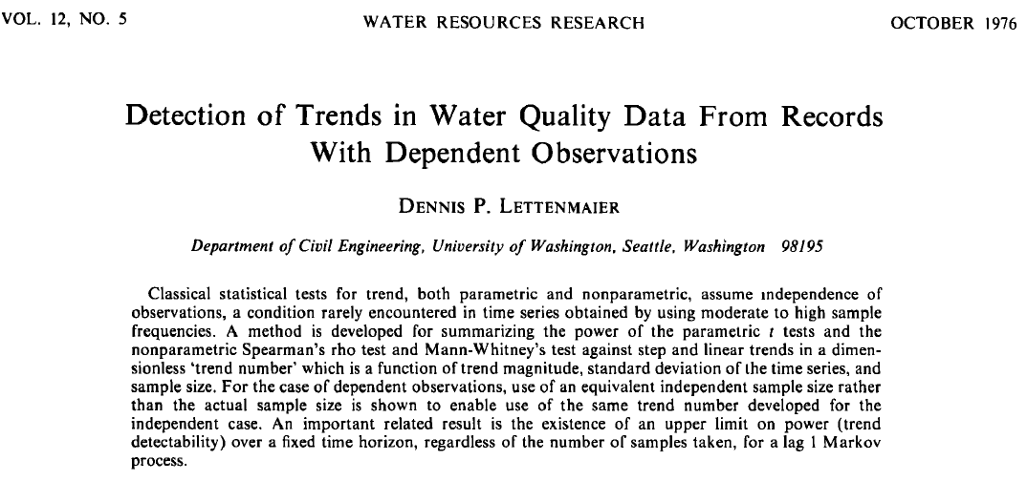

Slide 8
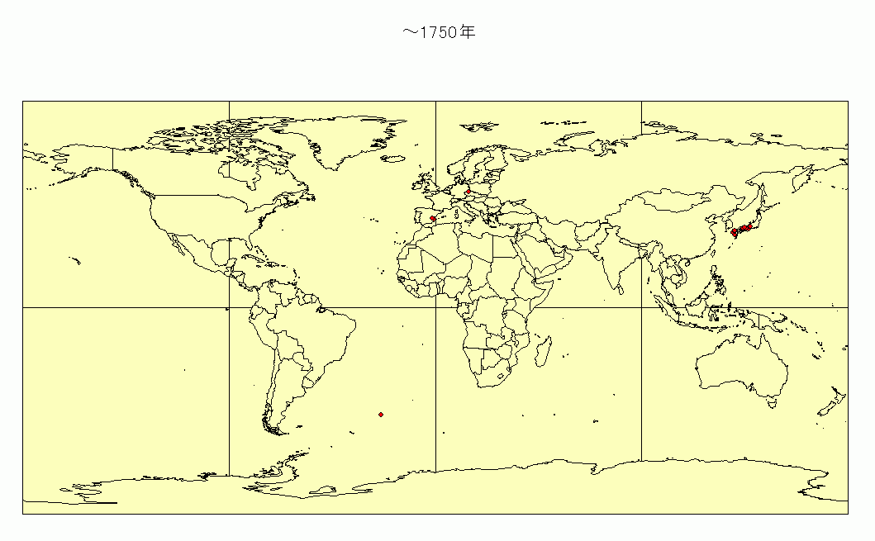
Global Reservoir Database
Location (lat./lon.), Storage capacity, Area of water surface,
Purpose of dam, Year of construction, …
13,382dams,
Visual courtesy of Kuni Takeuchi
Notes:
これは構築したデータベースを用いて、ダムの経年変化を示したものです。
これより、欧米を中心に次第にアジアへと広まっていることがわかります。

Slide 16
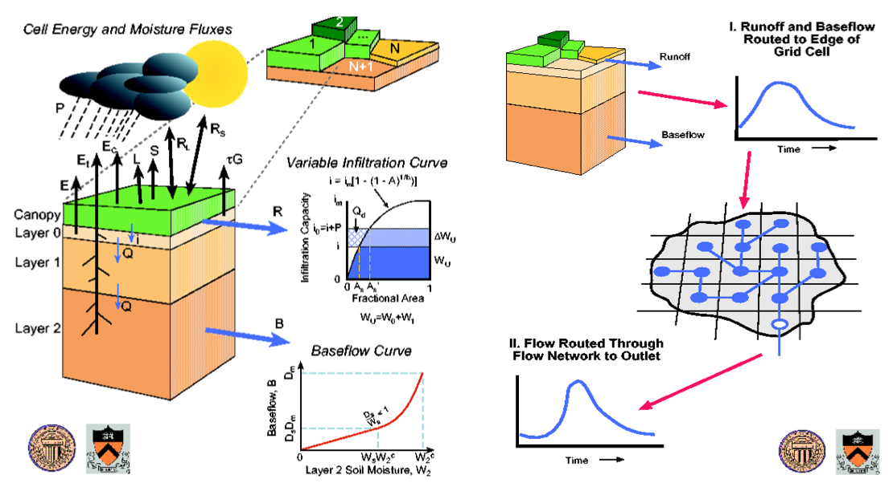

Slide 17
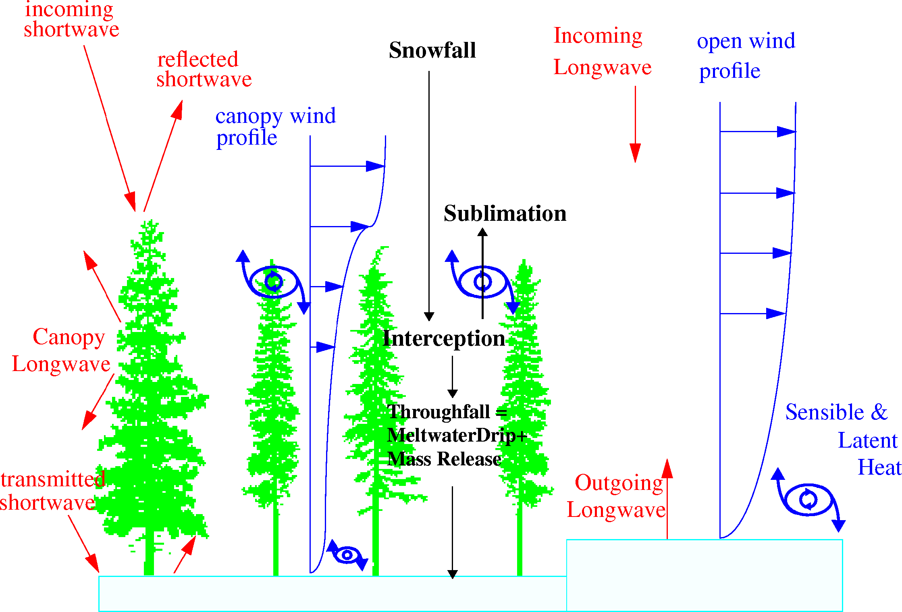
Snow processes in a forest environment

Slide 18
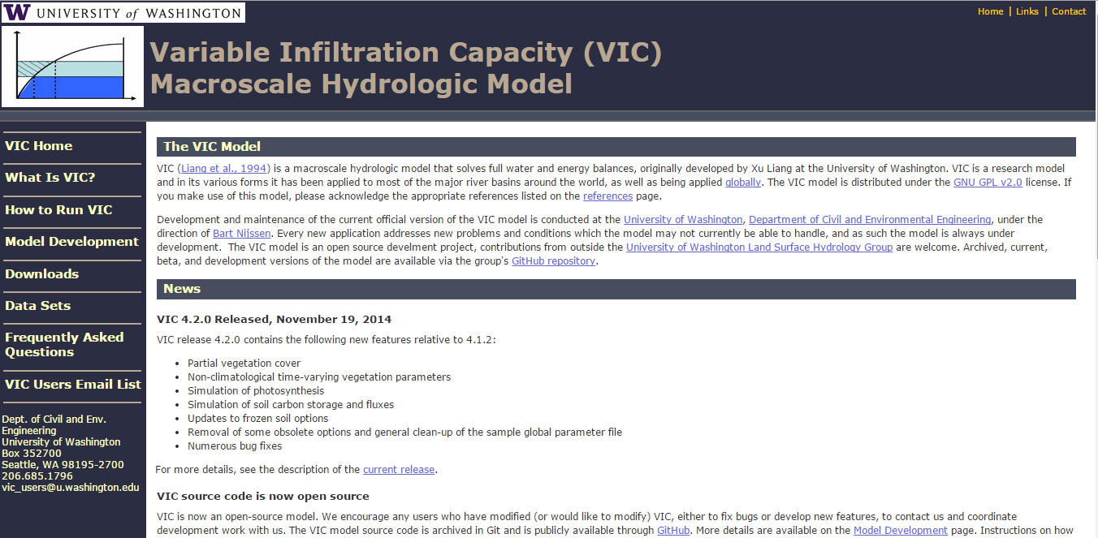

Slide 19
Some applications of the VIC model (and how they are different from “predict the streamflow at gauge XXX”)
Climate change
Hydrologic predictability
Hydroclimate reconstructions

Slide 20
1. Climate change
What will the water resources of the X basin be like Y years from now?

Slide 21
Christensen et al. Climatic Change, 2004

Slide 22
Timeseries Annual Average
PCM Projected Colorado R. Temperature
ctrl. avg.
hist. avg.
Period 1 2010-2039 Period 2 2040-2069 Period 3 2070-2098

Slide 23
Timeseries Annual Average
PCM Projected Colorado R. Precipitation
hist. avg.
ctrl. avg.
Period 1 2010-2039 Period 2 2040-2069 Period 3 2070-2098

Slide 24
Annual Average Hydrograph
Simulated Historic (1950-1999) Period 1 (2010-2039) Control (static 1995 climate) Period 2 (2040-2069) Period 3 (2070-2098)

Slide 25
Total Basin Storage

Slide 26
Annual Releases to the Lower Basin
target release

Slide 27
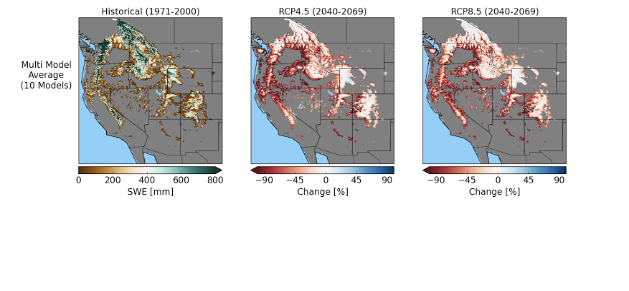
Apr 1 snow water equivalent (SWE), changes in percent
“Type a quote here.”
–Johnny Appleseed
historical
RCP 4.5 ~2050
RCP 4.5 ~2050

Slide 28
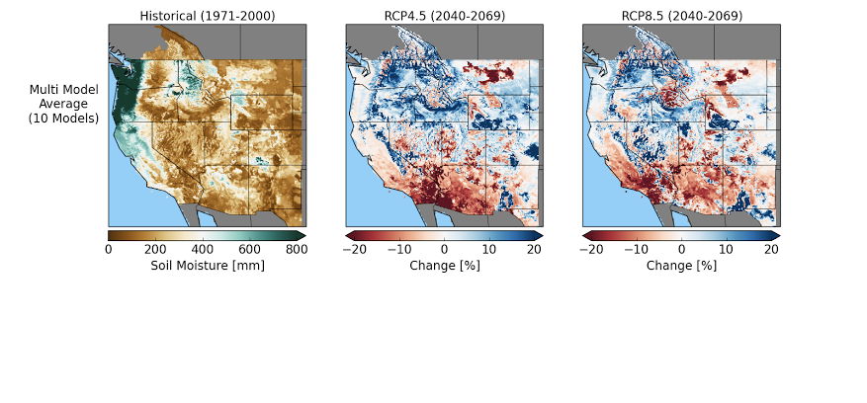
March soil moisture (total column), changes in percent
“Type a quote here.”
–Johnny Appleseed
historical
RCP 4.5 ~2050
RCP 4.5 ~2050

Slide 29
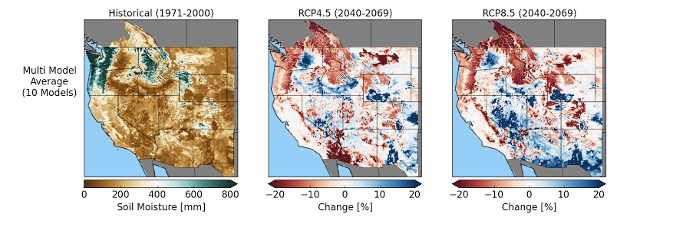
August soil moisture (total column), changes in percent
“Type a quote here.”
–Johnny Appleseed
historical
RCP 4.5 ~2050
RCP 4.5 ~2050

Slide 30
2. Hydrologic predictability
How well can we predict hydroclimatic variables at monthly to seasonal time scales, and what are the sources of that predictability?

Slide 31
Approach: Experimental setup for partitioning the role of IHCs and FS in seasonal hydrologic forecasts
Experiment 1: Ensemble Streamflow
Prediction (ESP)
Experiment 2: Reverse-ESP
(revESP)
Known IHC, Climatological forcings.
Derives skill solely from knowledge of the IHCs.
Known forcings (i.e. perfect climate forecasts skill) and climatological IHCs.
Derives skill solely from climate forecasts.
Wood and Lettenmaier, 2008

Slide 32
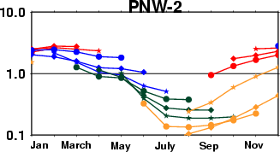
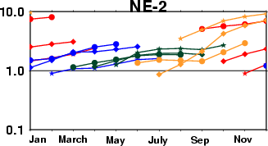
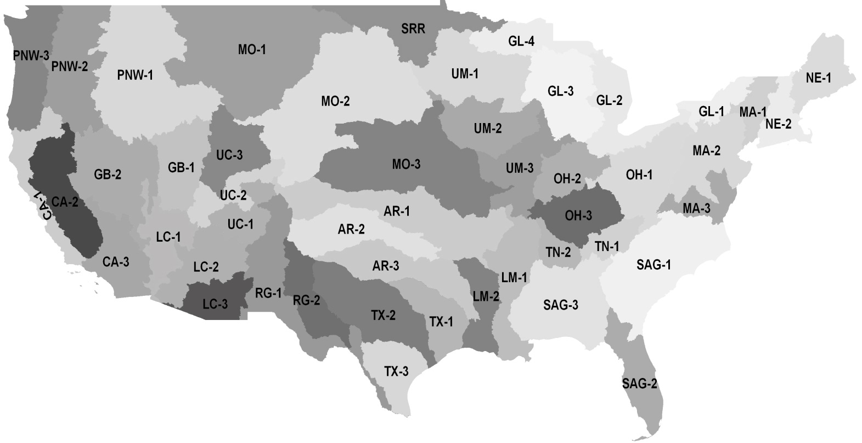
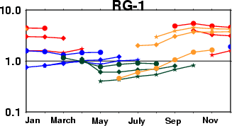
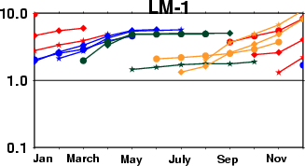
Variation of RMSE ratio for cumulative runoff forecast
RMSE ratio =
Climate forecast skill
dominates
IHCs dominate
Shukla and Lettenmaier, 2011, HESS

Slide 33
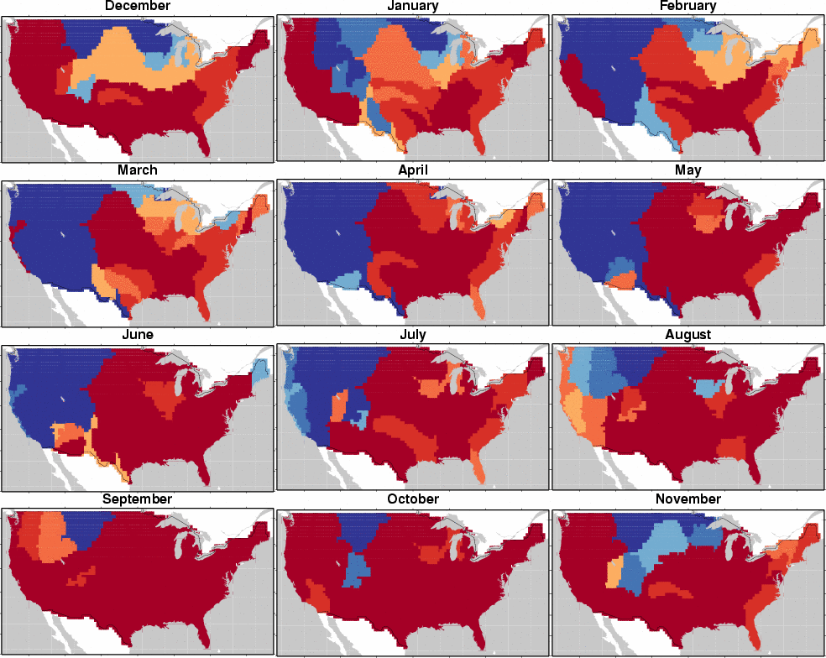
Shukla and Lettenmaier, 2011, HESS.
0
1
2
3
4
5
6
Plot of the maximum lead (in months) at which RMSE Ratio [RMSE(ESP)/RMSE(revESP)] is less than 1, for cumulative runoff forecasts, initialized on the beginning of each month.

Slide 34
Soil moisture forecast
(a) Initialization: 01 January
(b) Initialization: 01 July
Climate FS dominates
IHCs dominate
RMSE ratio of mean monthly soil moisture forecast at lead-1, -3 and -6 months for the forecast initialized on (a) 01 January and (b) 01 July. (masked areas had RMSE resp and esp =0)
Notes:
If you prefer showing a spatial map like this: feel free to use this. I have similar figures for SWE and CR predictability as well.

Slide 35
ESP (Ensemble streamflow prediction) vs NMME_VIC Fcsts
Starting date
ESP- P T inputs taken from randomly selected observations
Run VIC with observed P and Tsurf
Jan 1,1915 from UW
Jan 1, 1979
IC s
Fcst forward
Feb 5
Feb 6---→
NMME_VIC :forcings were taken from error corrected T P from CGCM
Both ESP and NMME_VIC have the same initial conditions, but ESP has no climate forecast information of P and Tsurf

Slide 36
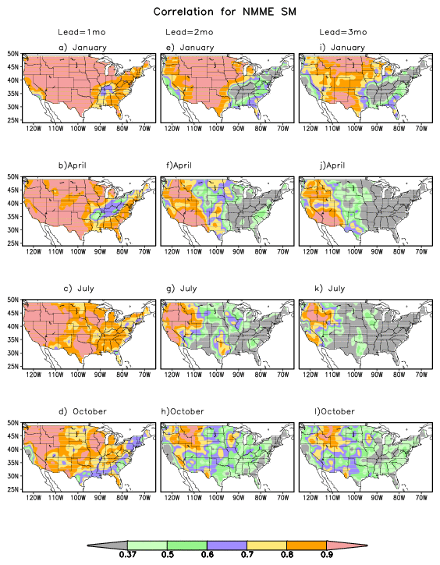
Fcst skill for SM
Lead-1 : correlation >0.8 (WOW!!!)
Lead-3: Over the western interior dry region, the fcsts are still skillful for all seasons and the North Central for January (high skill regions)
Low skill regions are circled

Slide 37
Differences btw NMME and ESP for Lead-3 months
No significant differences for Lead-1 and Lead-2
Only October and January forecasts pass a field significance test
Differences are in the areas that the skill is low and dynamically active areas
Oct fcsts are helped by some skill in P forecasts

Slide 38
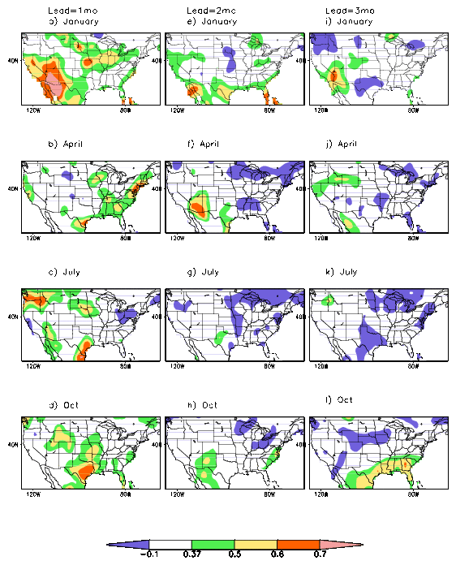
FCST skill for P
IC s dominates the contribution to fcst skill at Lead-1
When the CGCM forecasts start to contribute at Lead-2 or higher, the skill of P forecasts is so low, it does not make a difference
Areas with negative skill are colored purple.
No skill after Lead-1, Except the Southeast in Oct

Slide 39
3. Hydroclimate/drought reconstruction
How have hydroclimatic conditions varied historically (especially for variables like soil moisture that are not directly observed) and how do current/recent drought conditions fit in an historical context?

Slide 40
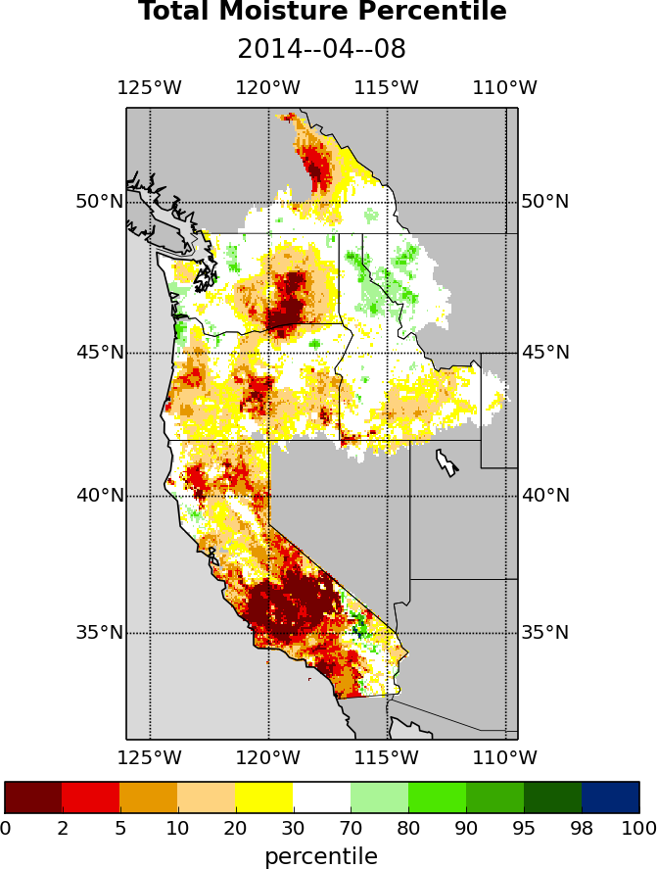
Western U.S. total (soil moisture + SWE) moisture 4/8/14, as simulated by VIC model (from University of Washington Drought Monitoring System for the West Coast)

Slide 41
California drought in 2013-2014
Notes:
One sentence

Slide 42
“A highly persistent large scale meteorological pattern over the northeastern Pacific led to observationally unprecedented geopotential height and precipitation anomalies over a broad region. The very strong ridging and highly amplified meridional flow near the West Coast of North America in 2013/14 was structurally similar to—but spatially and temporally more extensive than—atmospheric configurations that have been previously linked to extreme dryness in California. We find that extreme geopotential height values in this region, which are a defining metric of this type of atmospheric configuration, occur much more frequently in the present climate than in the absence of human emissions.” Swain et al., 2014

Slide 43
“Our model results [suggest] that atmospheric internal variability accounts for the extreme magnitude of this climate event. An assessment of the role of the long-term warming trend shows that it [results] in less North Pacific storms reaching California. The warming trend, however, also leads to increased atmospheric humidity over the northeast Pacific, thus, facilitating wetter events over California. The above two effects [lead to] no appreciable long-term change in the risk for dry climate extremes over California since the late 19th century.” Wang and Schubert, 2014

Slide 44
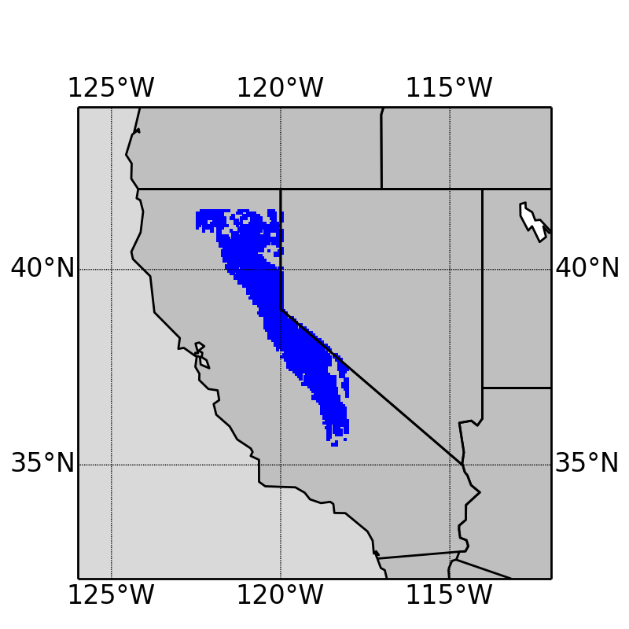
Study area and period
Sierra Nevada mountain range
- Long-term Apr 1 SWE > 10 mm
1920-2014
Notes:
All the subsequent analyses are based on this blue area

Slide 45
Winter (Nov 1 – Mar 31) precipitation and temperature, 1920-14
No trend
Increasing trend
+0.4 ºC/100 years
p-value=0.10
Notes:
Precipitation - accumulated, aggregated over the entire study area; no trend
Temperature – increasing trend

Slide 46
Decreasing trend
-5.0 km³/100years
p-value=0.07
Decreasing trend
-6.2 km³/100years
p-value=0.03
Notes:
SWE – decreasing trend -> let us think that the increasing T trend might be a cause of the decreasing snowpack; further prove it later
Runoff – mostly from snowmelt, so similar dicreasing trend

Slide 47
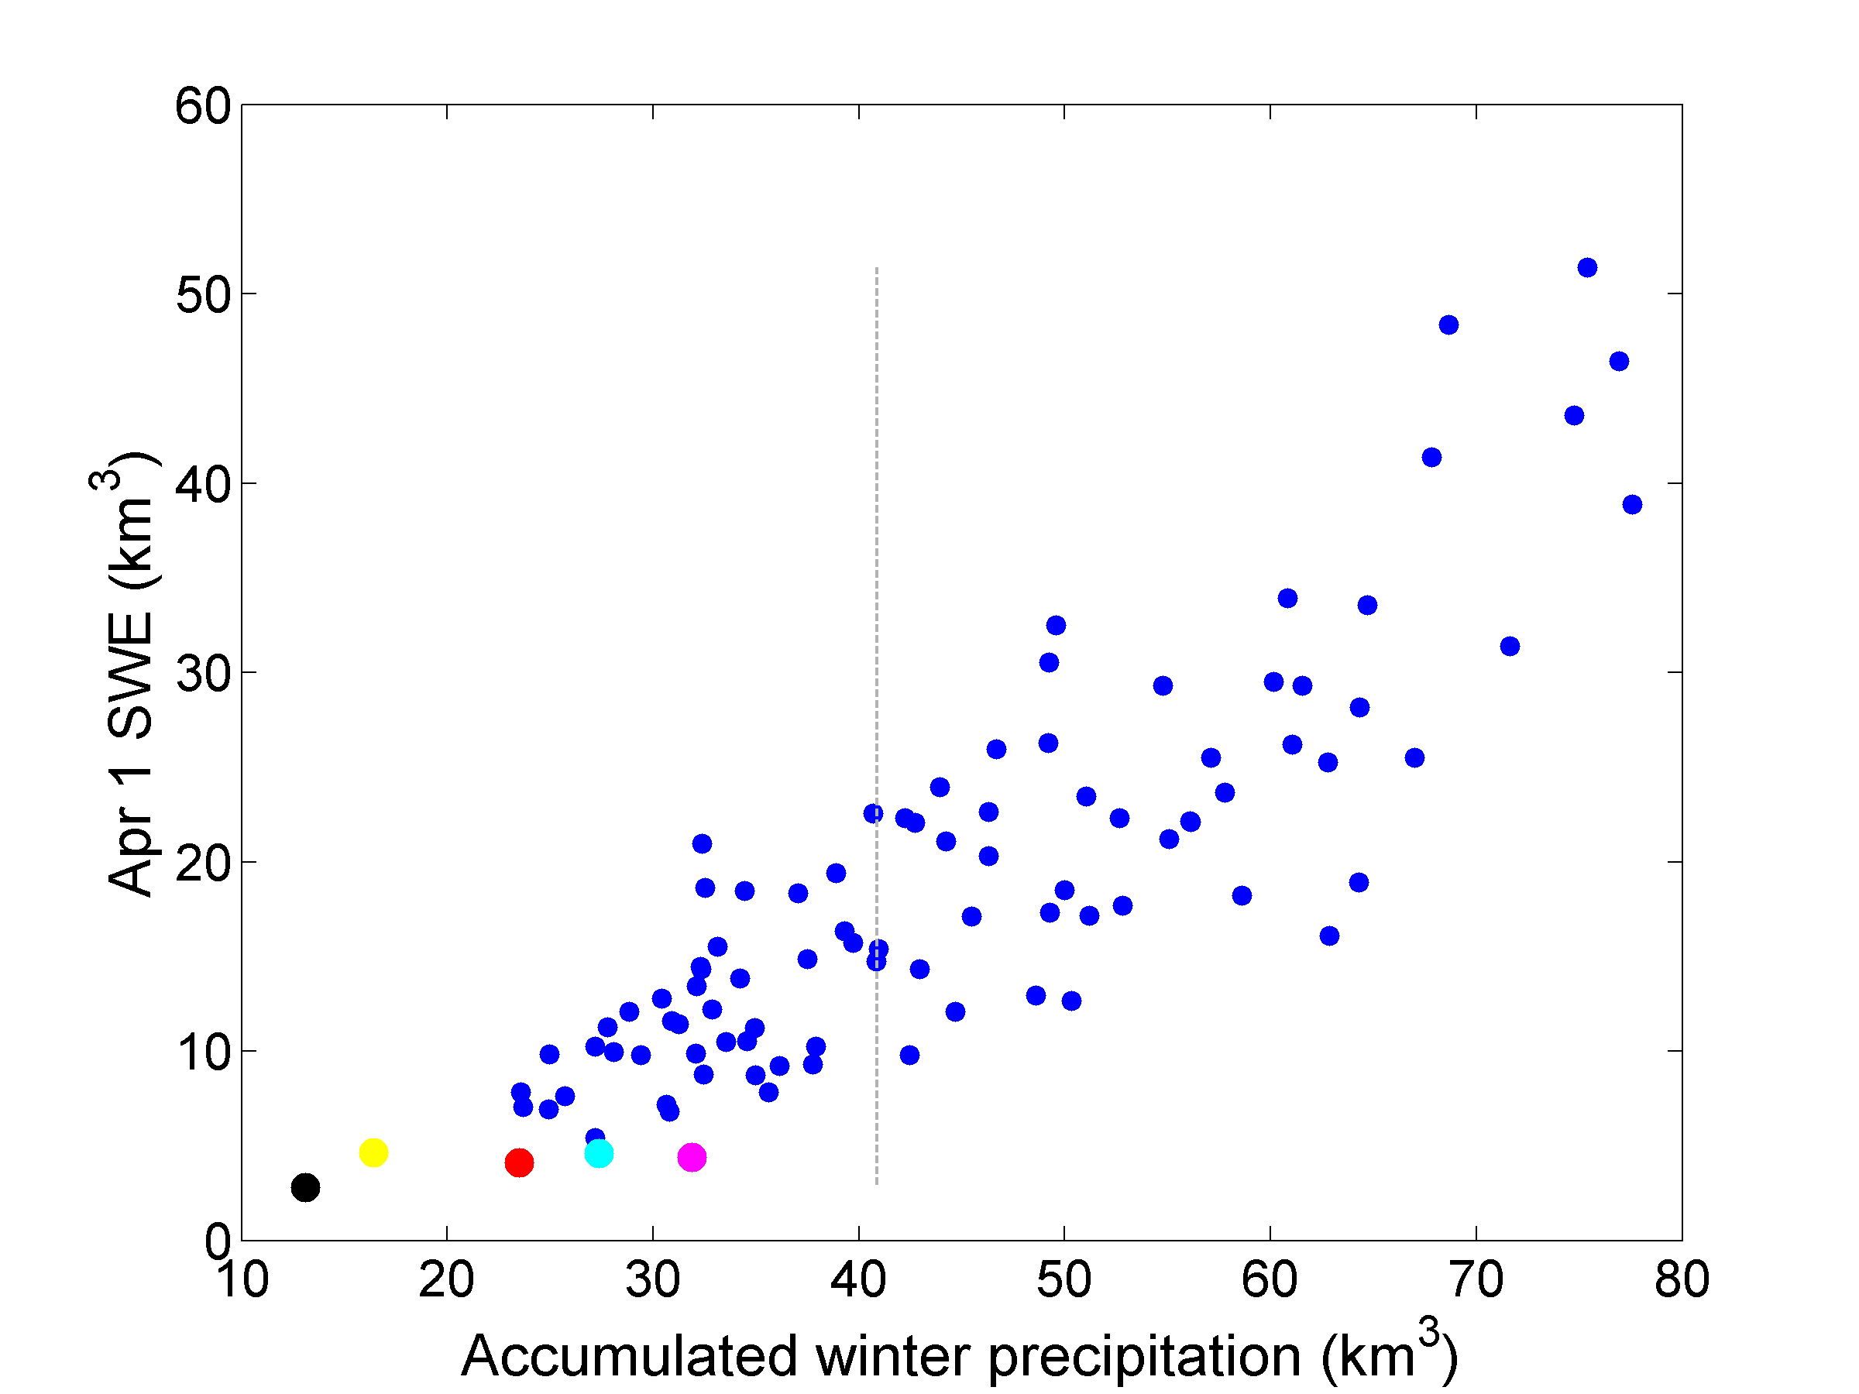
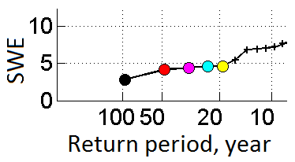
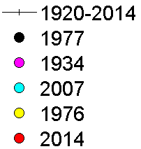
Correlation coefficient: 0.86
median
Notes:
Strong positive correlation
All the five years with the lowest SWE are located at the very low end of winter precipitation

Slide 48
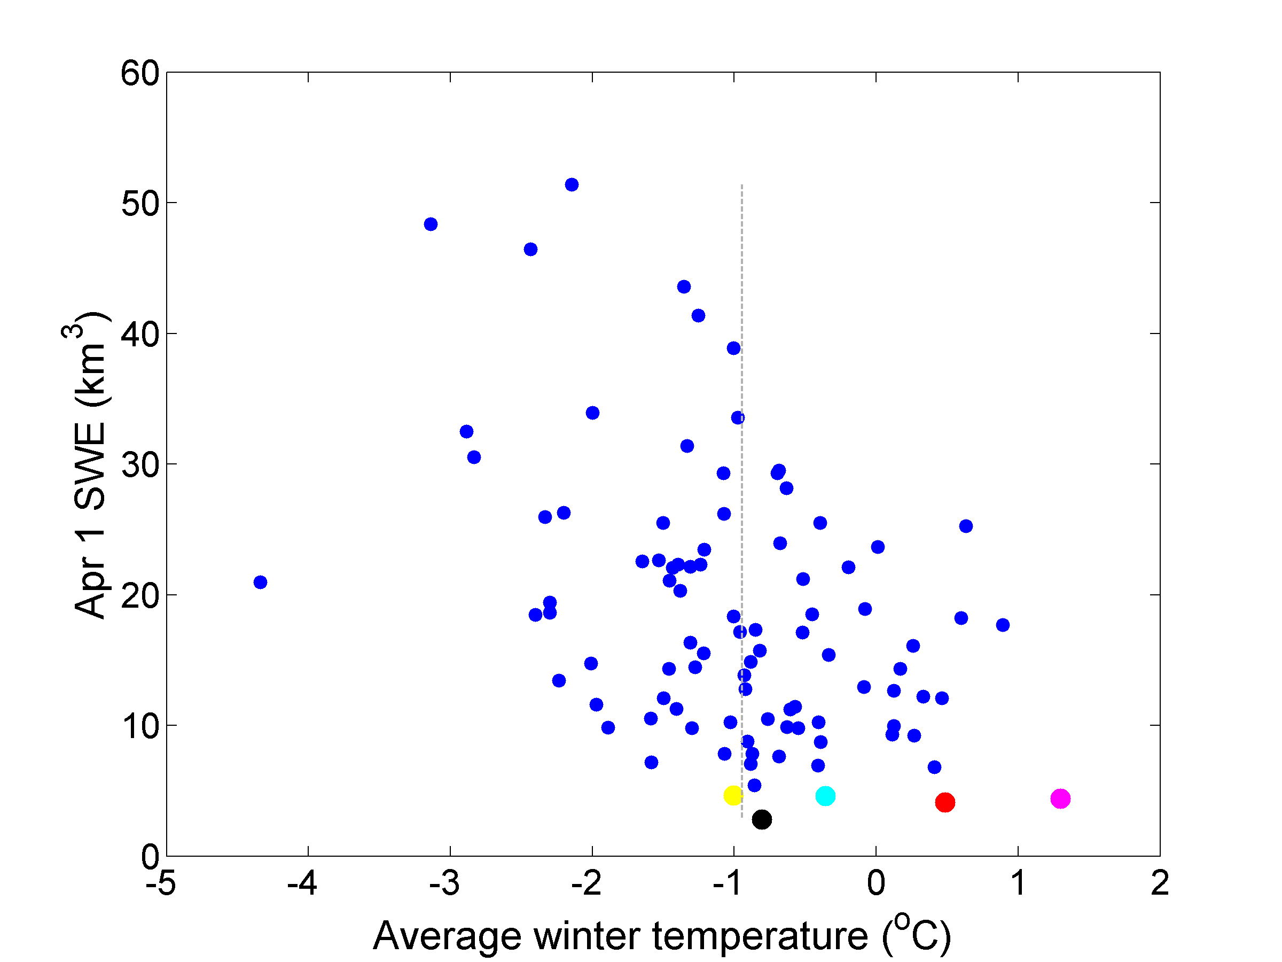
Correlation coefficient: -0.42
median
Notes:
Vague negative correlation -> the warmer the winter, the lower the SWE
Lowest-SWE years generally happened in warmer winters
But 1977 -> around the median of winter temperature, but the lowest SWE; similar to 1976 and 2007

Slide 49
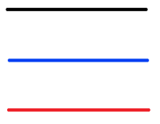
Apr 1 SWE
No trend without warming
Base scenario
Cold scenario
Warm scenario
Notes:
Original decreasing trend disappeared -> strongly suggests that the warming climate is the main cause for the decreasing SWE

Slide 50
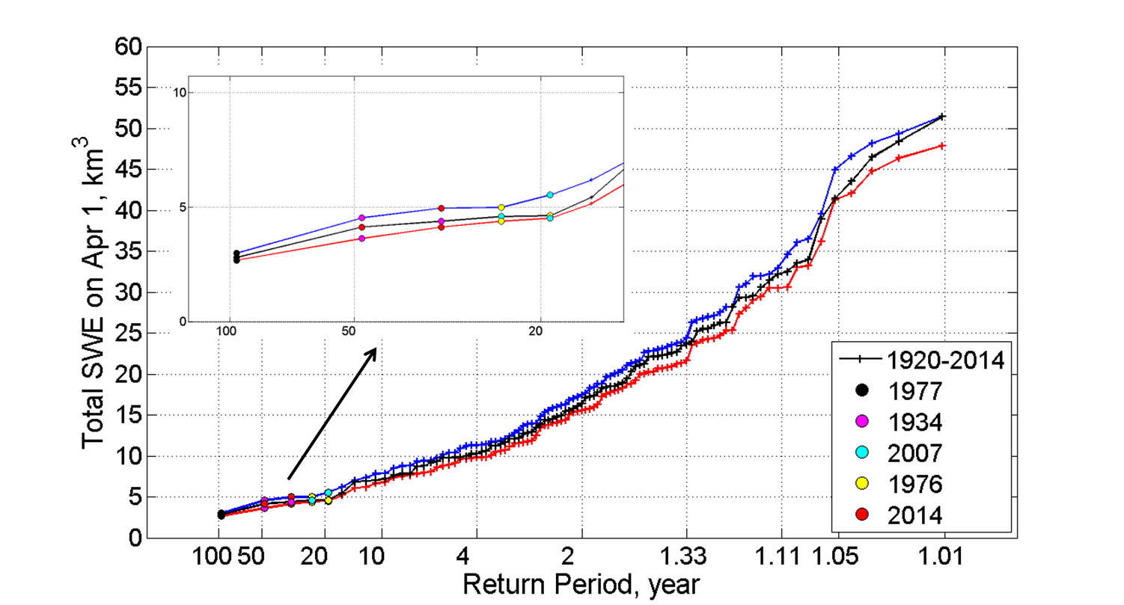
Apr 1 SWE
No trend without warming
Base scenario
Cold scenario
Warm scenario
Notes:
2014 goes up a little bit without climate change, but still among the five lowest years
Warming climate does not affect the extreme dry events too much
Seems to diverge in wetter years

Slide 51
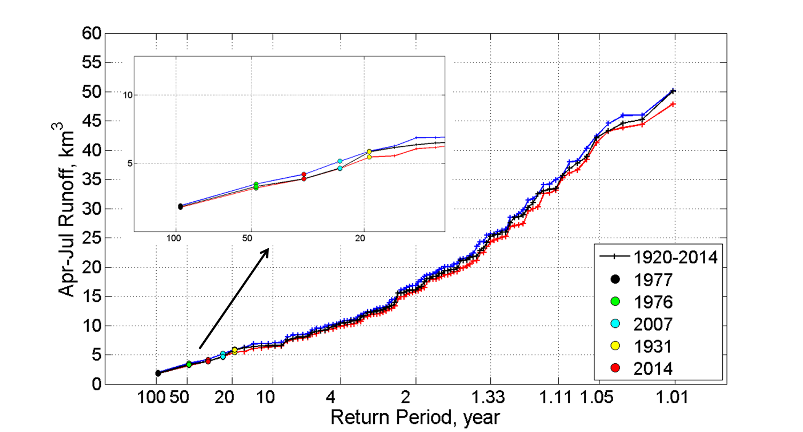
Spring runoff
Weaker decreasing trend without warming
Base scenario
Cold scenario
Warm scenario
Notes:
(don’t talk about the time series and trend)
Similar – warming climate doesn’t affect droughts too much; diverge as runoff goes up

Slide 52
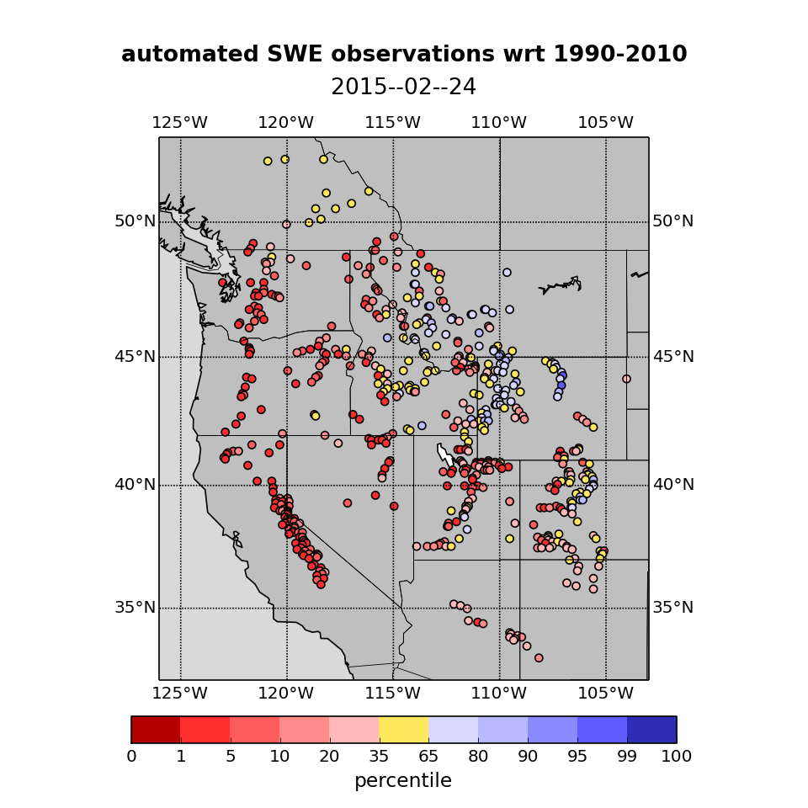
So what’s happening this year?

Slide 53
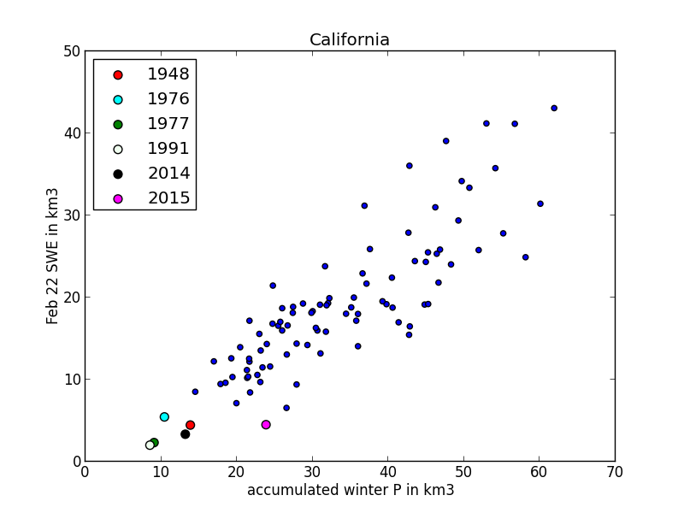

Slide 54
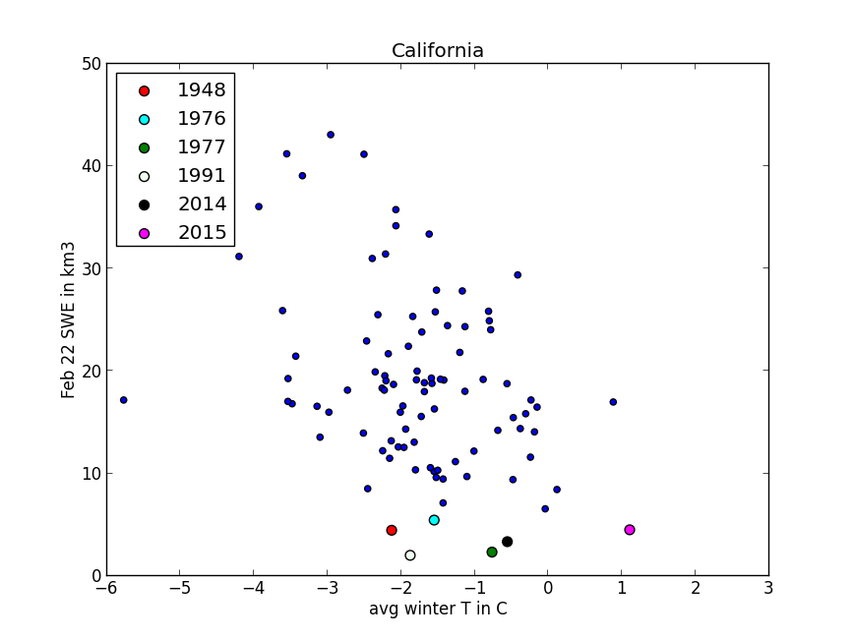

Slide 55
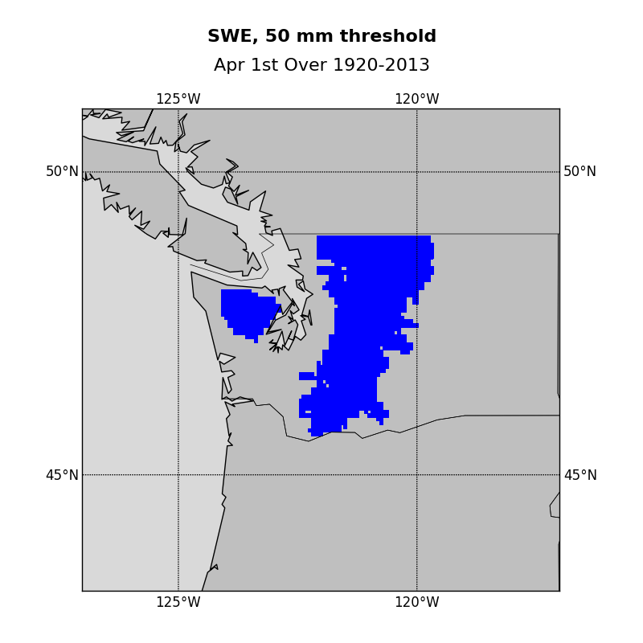

Slide 56
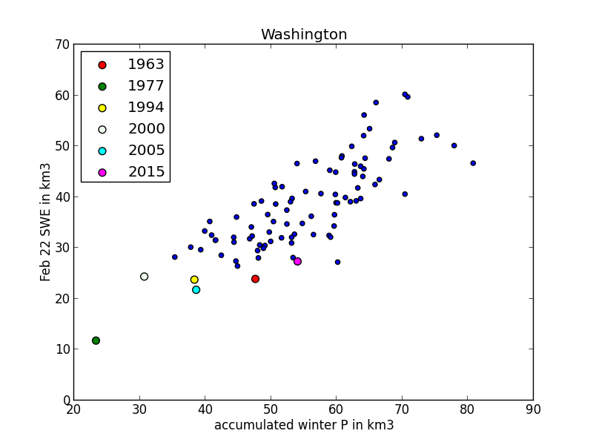

Slide 57
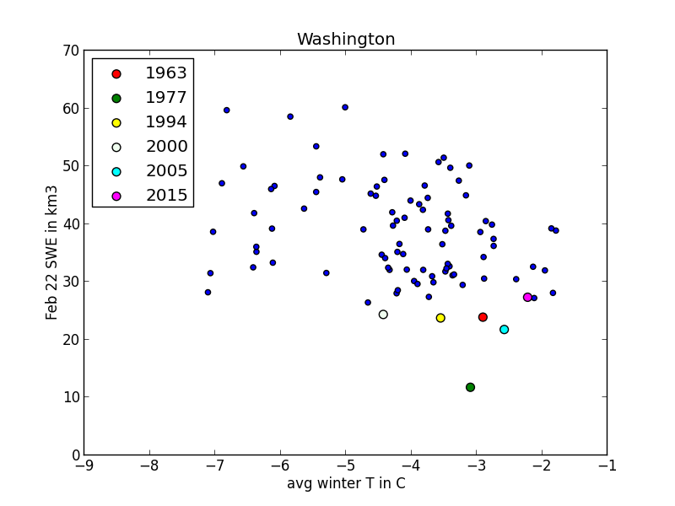

Slide 58
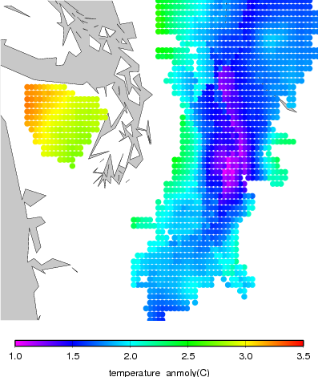

Slide 59
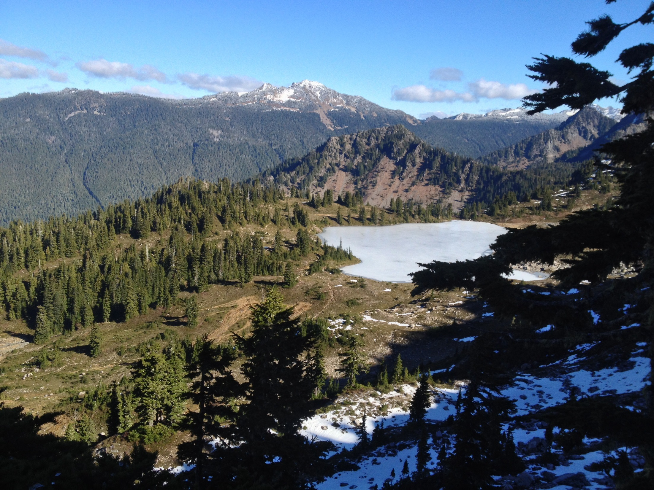

Slide 60
In summary …
The VIC enterprise has been remarkably successful because:
It’s enabled us to do science that we wouldn’t otherwise have been able to do (e.g. regional, continental, and global predictions and reconstructions;
The model has been freely available
But – it’s time to move on. the model construct is approaching 25 years old, and was motivated by problems dating to a different era
New pathways:
Higher (“hyper-resolution”) modeling; e.g. Chaney and Wood at Princeton; Reed Maxwell et al. at Colo. School Mines
Modular modeling framework; e.g. Martyn C lark at NCAR & Bart Nijssen at UW
Others??

Slide 61
Thanks to:
Diana Gergel and Yixin Mao (UW), and Kim Wang and Mu Xiao (UCLA) for contributions specific to this talk.
A legion of students, postdocs, staff, and faculty at UW for contributions over my 39 years there.

