Slide 1
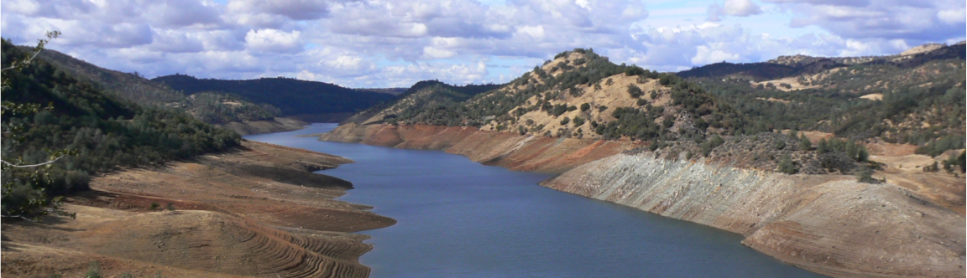

Natural and human induced changes in the water cycle: Relative magnitudes and trends
Dennis P. Lettenmaier
Department of Geography
University of California, Los Angeles
American Geophysical Union Fall Meeting
Dec 15, 2014

Slide 2
“Natural” water cycle trends
Over land (~30% of global surface area)
Some evidence of increased precipitation (esp. mid-latitude Northern Hemisphere)
Streamflow trends somewhat less apparent (but some evidence of trends in the mean and low flows over U.S.
ET – trends less clear (weak observation basis, results tend to be model dependent)
Snow – increasing temperature trends (strong evidence over land, esp. high latitude) are leading to earlier melt and reduced spatial extent (maximum storage trends less obvious)

Slide 3
But what does “natural” mean
For this presentation, not
land cover change (hence indirect possible effects on precipitation)
Climate change associated with greenhouse gas emissions
but rather:
direct movement (e.g., irrigation, municipal and industrial consumptive use) of water
or its storage (in reservoirs mostly)

Slide 4
Global land water balance (per Eric Wood)
P: 774 mm = 102,800 km³
ET: 488 mm = 64,800 km³
RO: 288 mm – 38,200 km³

Slide 5
Annual Water Balance for Major Continental Land Areas
source: unknown

Slide 6
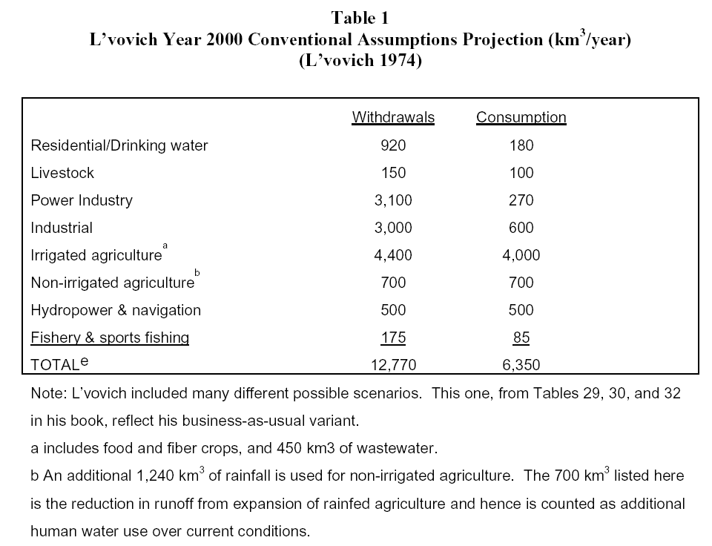
Table courtesy Peter Gleick

Slide 7
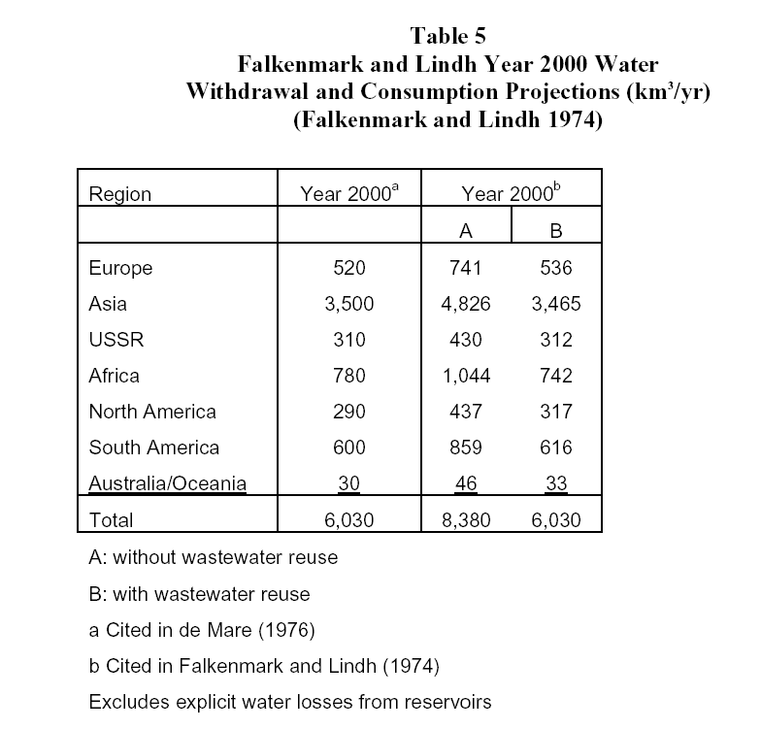
Table courtesy Peter Gleick

Slide 8
Irrigation water consumption
Per WATCH project, visual courtesy Ingjerd Haddeland

Slide 9
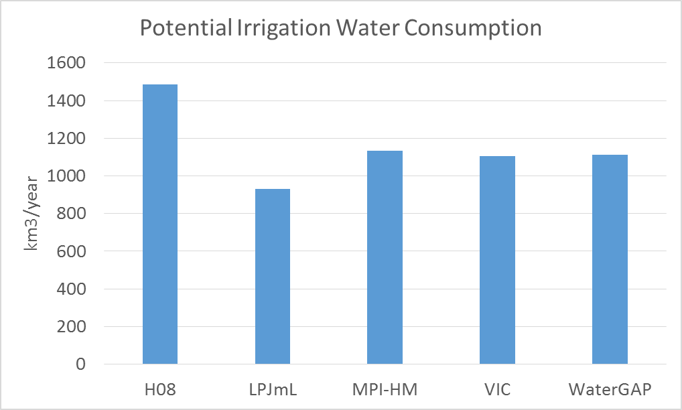
Potential global irrigation consumptive use (per WATCH project)
Per WATCH project, visual courtesy Ingjerd Haddeland

Slide 10
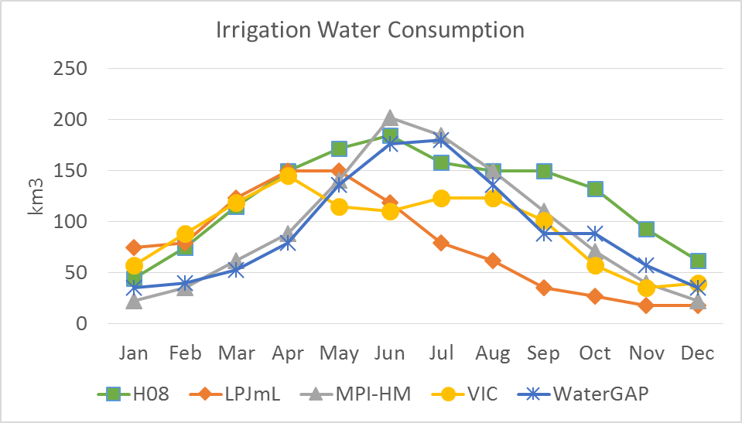
Irrigation consumptive use estimated seasonal cycle
Per WATCH project, visual courtesy Ingjerd Haddeland

Slide 11
Potential and actual irrigation consumptive use
Potential consumption
  LPjML: 930 km³ year⁻¹
  VIC: 1100 km³ year⁻¹
Actual consumption
  LPjML: 600 km³ year⁻¹
  VIC: 780 km³ year⁻¹
Per WATCH project, visual courtesy Ingjerd Haddeland

Slide 12
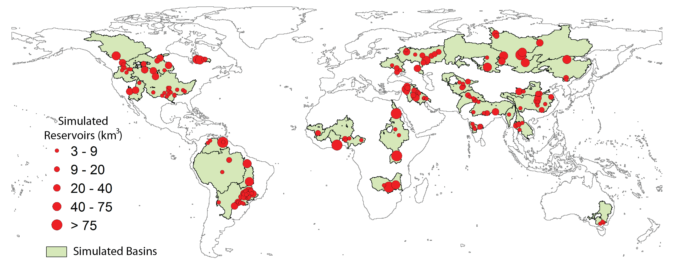
Location of the model simulated basins and reservoirs
32 basins, 166 large reservoirs with total capacity 3900 km³
From Zhou et al., 2014; see also poster GC13E-0684

Slide 13
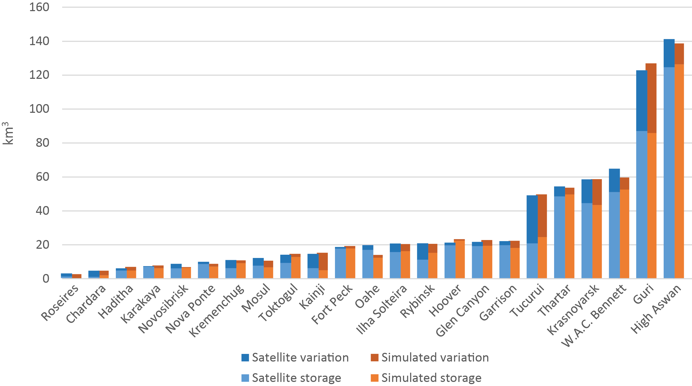
Seasonal reservoir storage variation ranges for 23 global reservoirs
Satellite observed (Gao et. al. 2012) vs Simulated (This study)
From Zhou et al., 2014; see also poster GC13E-0684

Slide 14
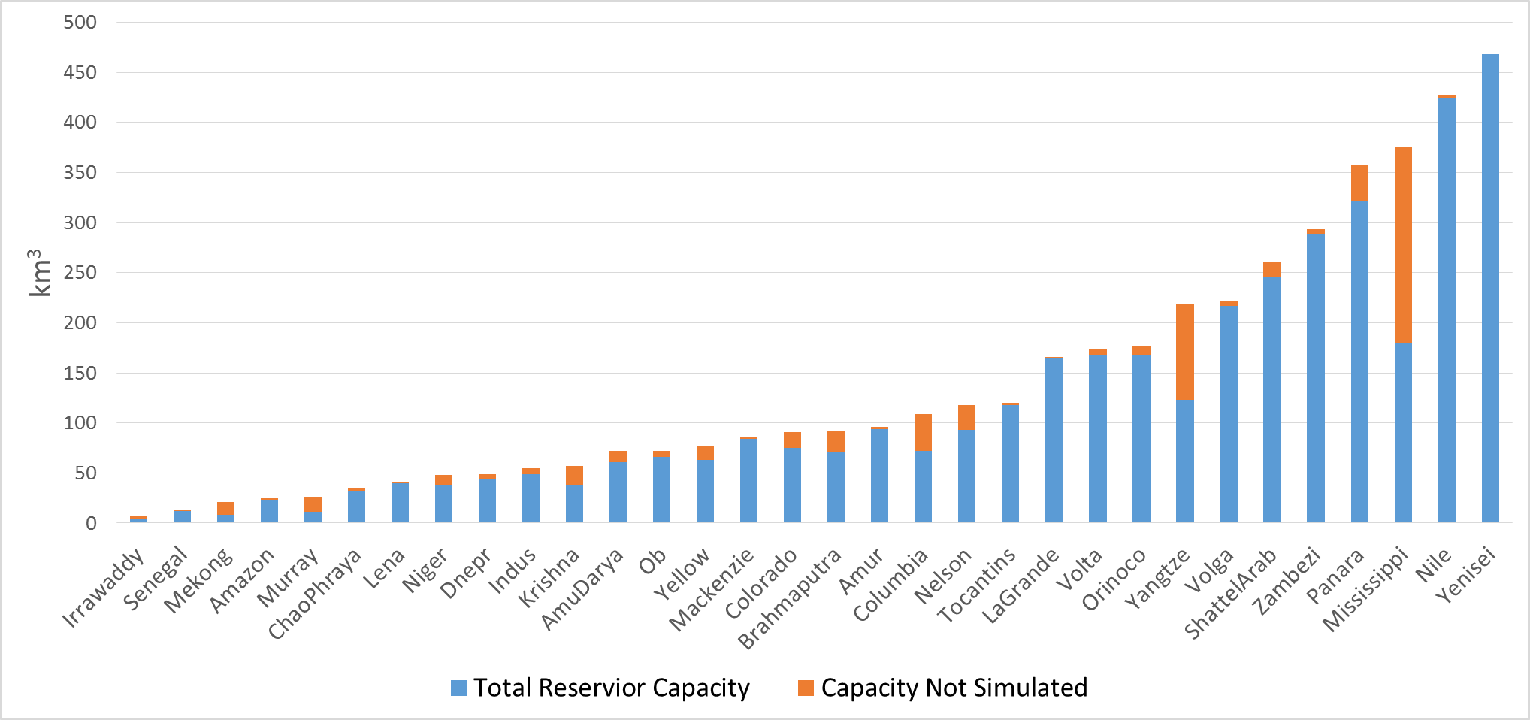
Simulated reservoir storage capacity for 32 global basins
From Zhou et al., 2014; see also poster GC13E-0684

Slide 15
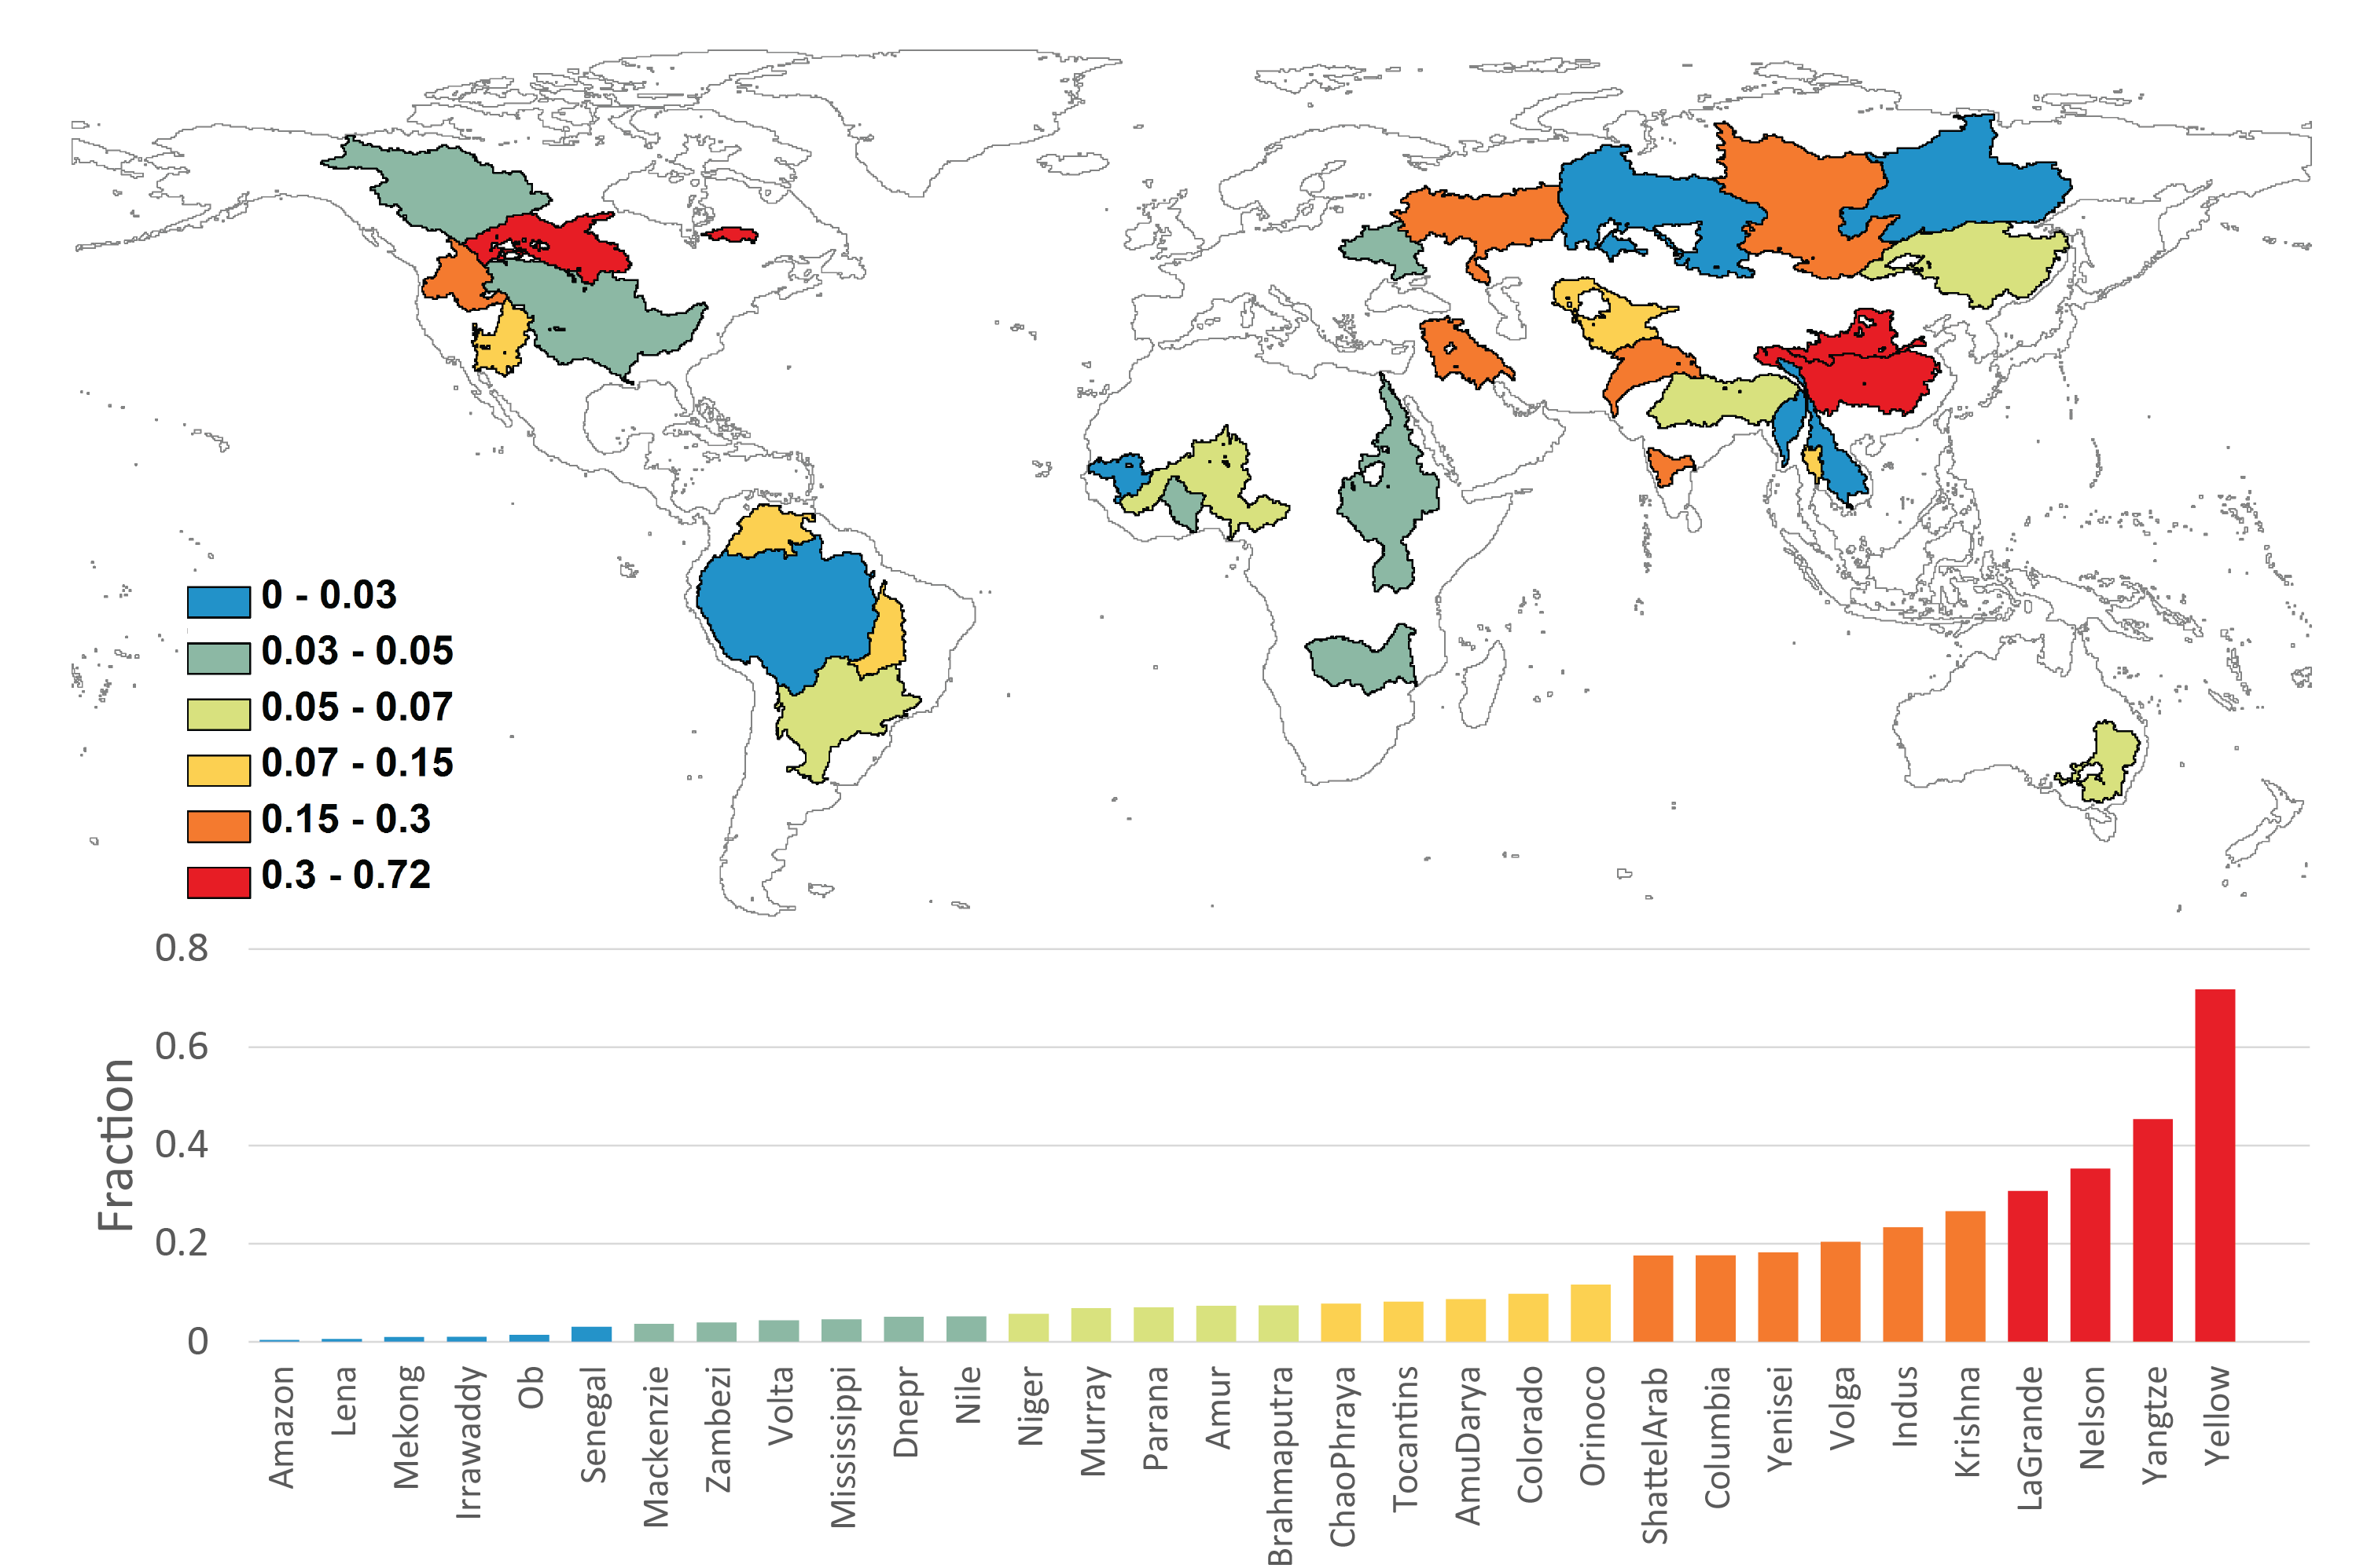
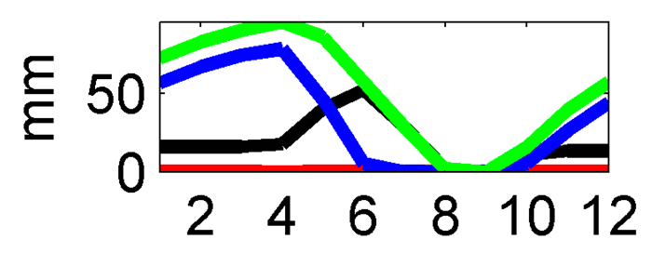
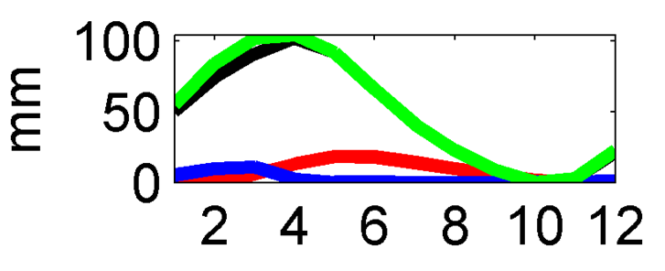
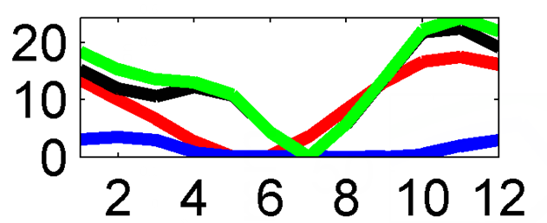
Reservoir storage seasonal variation as a fraction of (soil moisture + SWE) variation
Lena Shatt al Arab Yellow

Slide 16
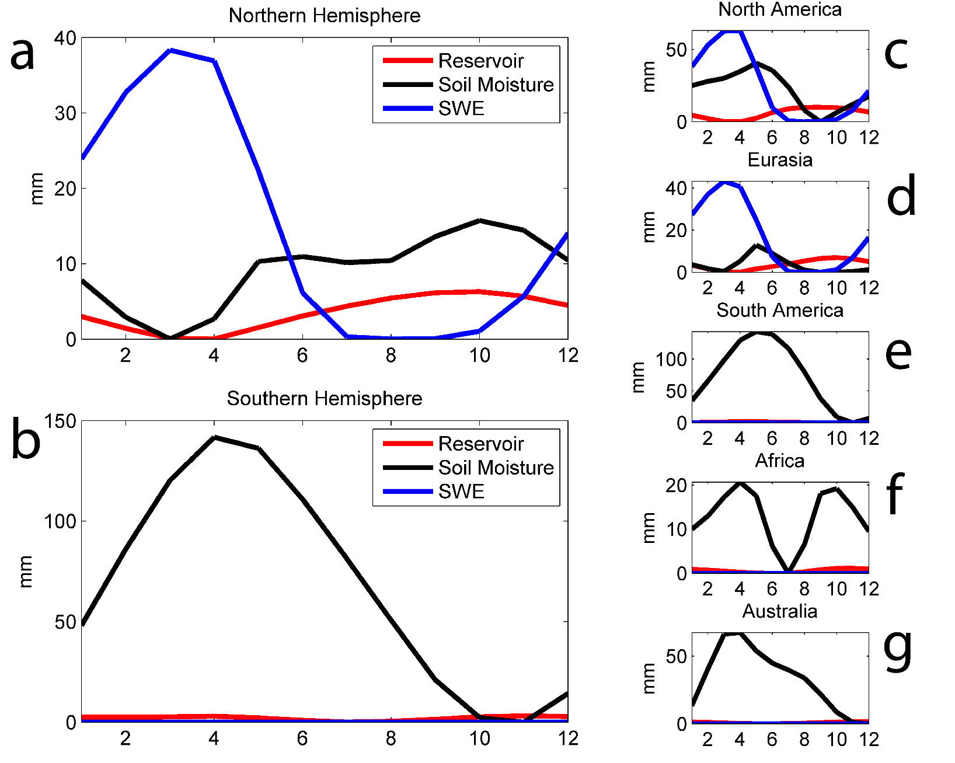
The seasonal reservoir storage variation range compared with seasonal SWE and soil moisture in Northern (a) and Southern (b) Hemisphere and five continents (c-g) (Normalized by subtracting the minimum value).
From Zhou et al., 2014; see also poster GC13E-0684

Slide 17
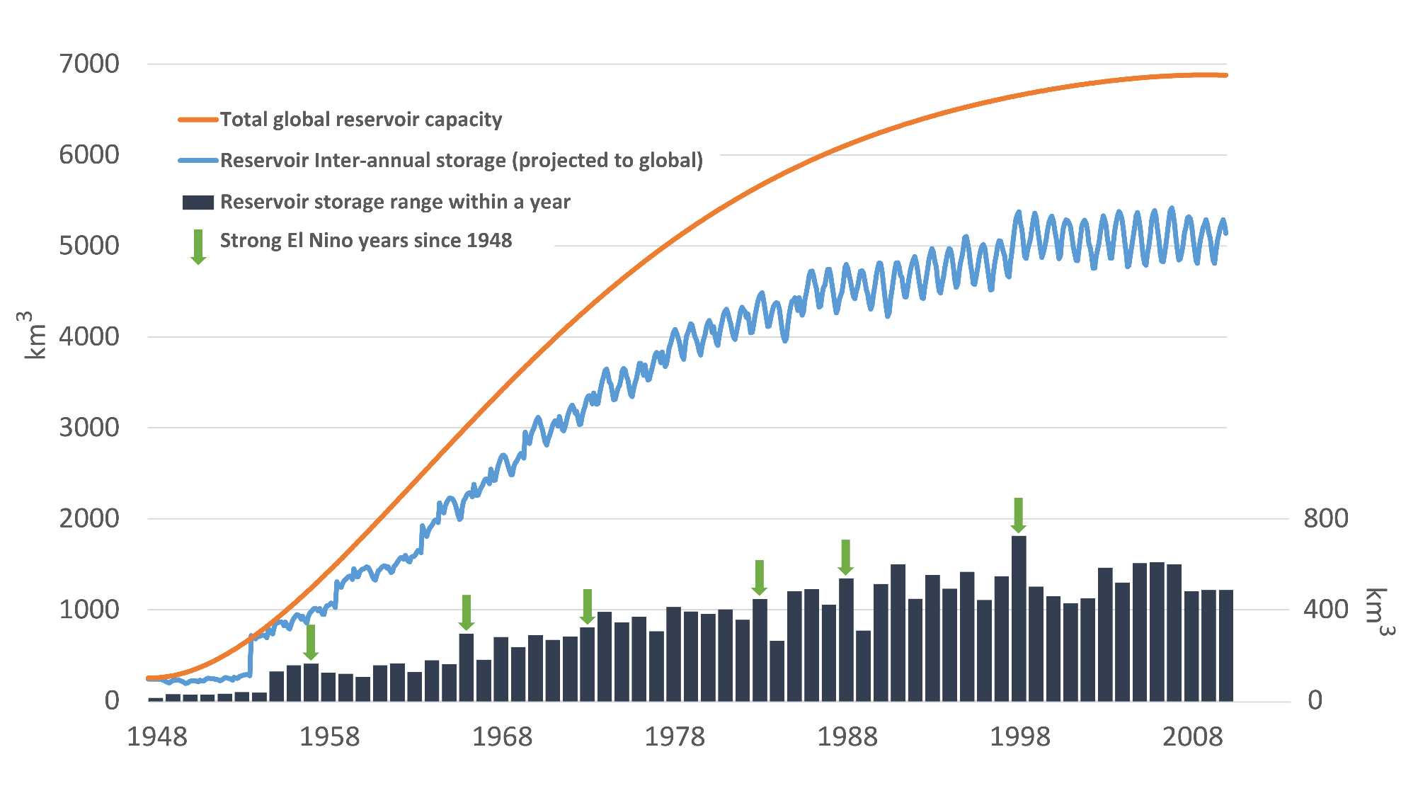
Global reservoir storage time series along with total reservoir capacity 1948-2010. Black bars show variation range within each year

Slide 18
Summary
At the global level, convergence to o(10-15%) level on primary water balance components
Consumptive use estimates vary widely, more recent model based estimates tend to be much lower than earlier published values
We’re only beginning to get a handle on reservoir storage variations at continental scales, but for the two continents with largest relative storage, variations appear to be o(20%) of soil moisture, 10% of snow

