Slide 1
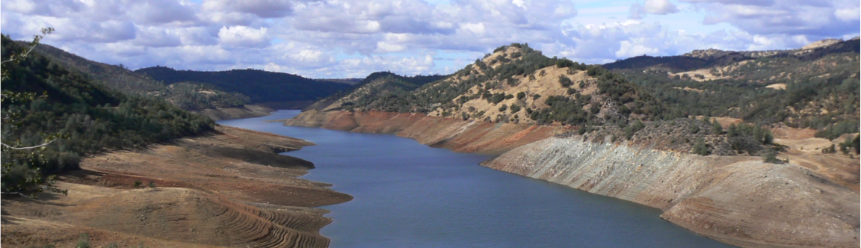
Implications of hydrologic predictability for the development of a global drought information system
Dennis P. Lettenmaier
Department of Geography
University of California, Los Angeles
American Geophysical Union Fall Meeting
Dec 15, 2014

Slide 2
1) The role of climatology and retrospective analysis in GDIS, and hydrologic initial conditions

Slide 3
Simulations – implementation for US Surface Water Monitor
~50-year spinup
recent
now
future
model climatology
model spin-up
forecast
~2100 long-term index stations up to ~ 1 month ago
ACIS real-time station data
Forecast Products
streamflow
soil moisture
runoff
snowpack
Notes:
important point(s):
after bias correcting and downscaling the climate model forecasts, the procedure for producing hydrologic forecasts is as follows:
we spin up the hydrologic model to the start of the forecast using observed met. data (from 2 sources: NCDC cooperator stations through 3-4 months before the start of the forecasts, then LDAS 1/8 degree gridded forcings thereafter).
The GSM forecasts comprise 2 sets of ensembles, one for climatology and one for the forecast. The climatology ensemble yields a distribution of the conditions we’ve seen over the period 1979-1999, while the forecast ensemble yields the distribution of the conditions we might see for the next 6 months. Although the climatology ensemble is nominally unbiased against a simulated climatology based on observed met. data (rather than bias-corrected, downscaled GSM met. forcings), we compare the forecast and GSM climatology so that any unforeseen biases (resulting, perhaps, from the downscaling method) occur in both climatology and forecast. Eventually this cautionary step may be eliminated, and we’ll compare directly to the simulated observed climatology.
at the end of the spin-up period and one month before month 1 (out of 6) of the forecasts, we save the hydrologic model state. The state is then used for initializing the forecast runs. Through the first month, the model runs on observed data to the last date possible, then switches to the forecast data. Usually, we process the observed forcings up through the 15th to 25th of this initialization month, then the forecast forcing data carries the run forward for the remaining days in the month, and throughout the following 6 month forecast period. Note, the state files used for the climatology runs correspond to the spin-up associated with the particular year (out of 1979-1999) from which the climatology ensemble member is drawn.
the spin-up period captures the antecedent land surface hydrologic conditions for the forecast period: in the Columbia basin, the primary field of interest is snow water equivalent.
forecast products are spatial (distributed soil moisture, runoff, snowpack (swe), etc.), and spatial runoff + baseflow is routed to produce streamflow at specific points, the inflow nodes for a management model, perhaps.

Slide 4
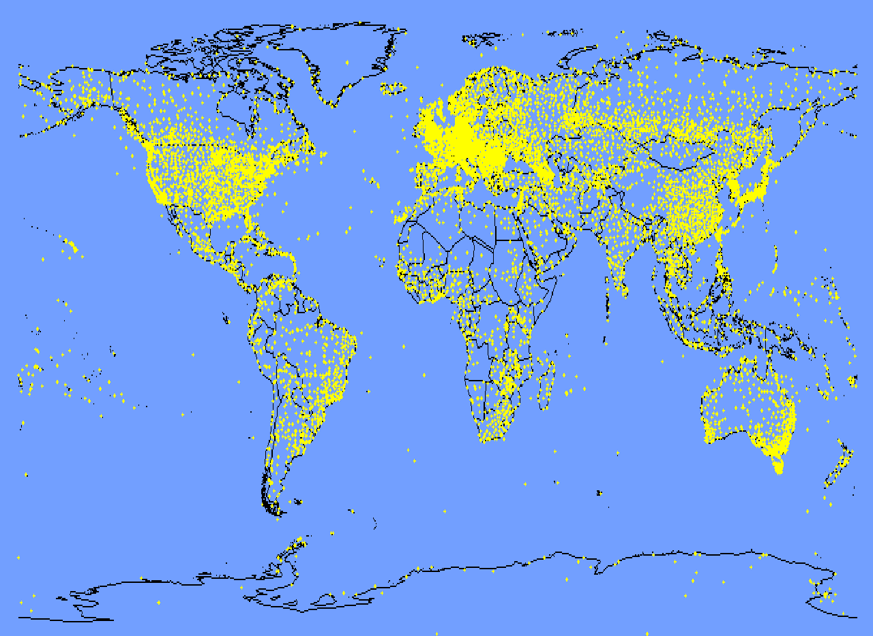
Challenge: Meteorological data
Three requirements:
- long term data record (climatology)
- near real-time reporting
- consistency
Stations that are part of
NCDC – Global Summary of the Day
http://www.ncdc.noaa.gov/; Global Summary of the Day

Slide 5
Consistency between TMPA RT and RP globally for 2000-2012. Panel a) statistically significant “drift” at α = 0.05; b) α = 0.05; c) rejections by climate category
from Zhou et al., JHM, 2014

Slide 6
2) The need for a multiple (LSM) perspective

Slide 7
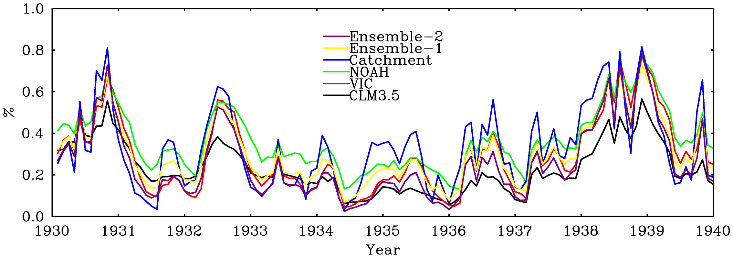
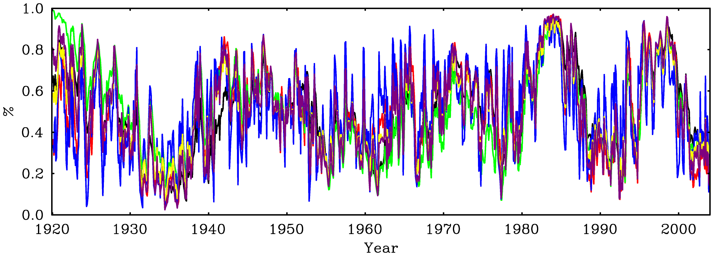
NW

Slide 8
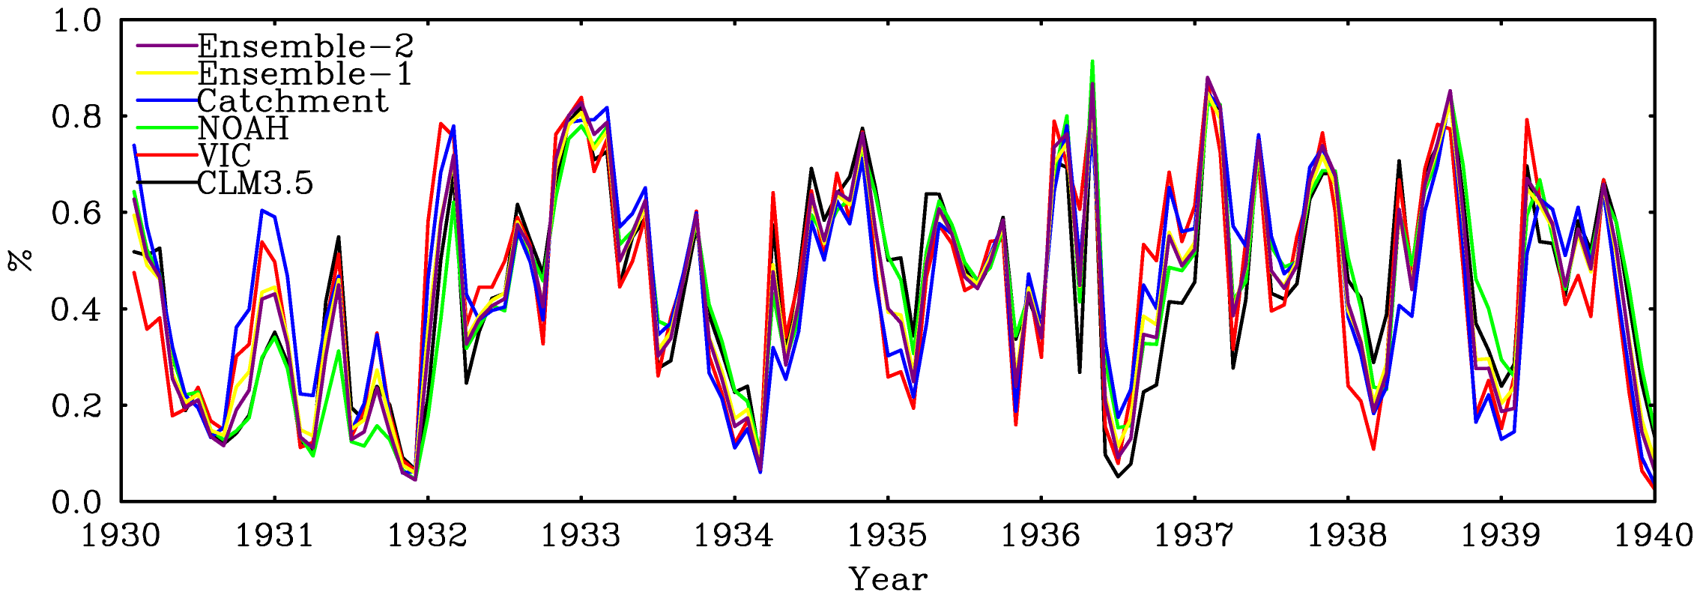
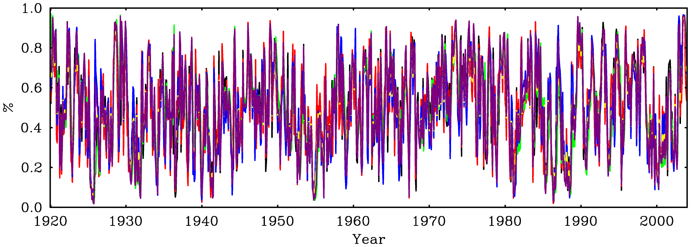
SE

Slide 9
Soil moisture percentile at time of drought onset – three LSMs and multimodel average
For details: Nijssen et al., poster A13H-3278

Slide 10
3) Predictability (mostly in the hydrologic initial conditions)

Slide 11
RMSE ratios (relative to ESP, left column, and
P analysis, right column) for CFSv2 forecasts
Jan 1 mo lead
Jan 2 mo lead
from Mo et al., GRL 2012

Slide 12
RMSE ratios (relative to ESP, left column, and
P analysis, right column) for CFSv2 forecasts
Jul 1 mo lead
Jul 2 mo lead
from Mo et al., GRL 2012

Slide 13
On the practical use of DIS output – the California drought as an (ongoing) case study

Slide 14
UW Surface Water Monitor for the CONUS and Mexico, effective 12/12/14 (total moisture)

Slide 16
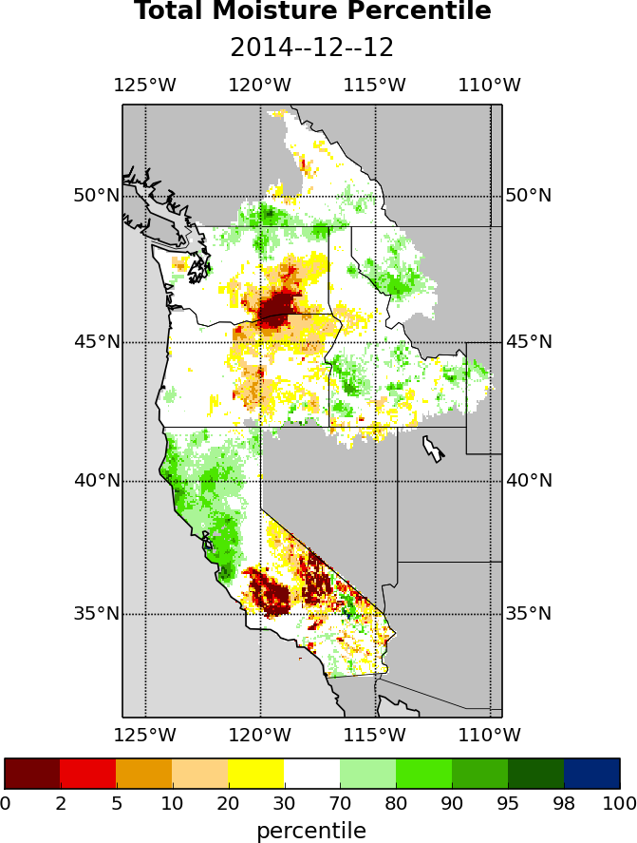
Total moisture (soil plus snow) from UW West Coast drought monitor, effective 12/12/14

Slide 17
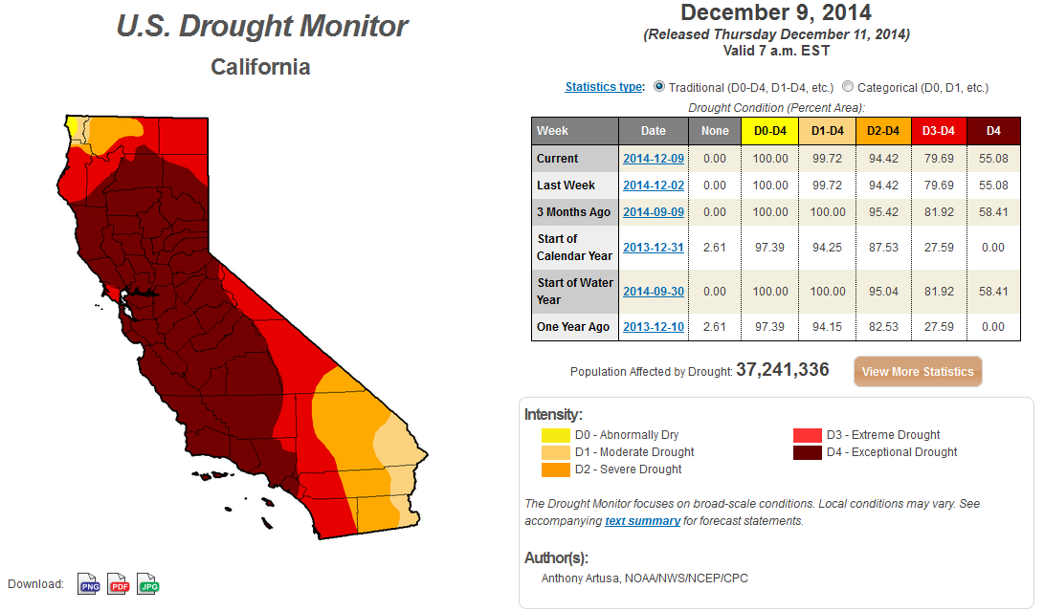

Slide 18
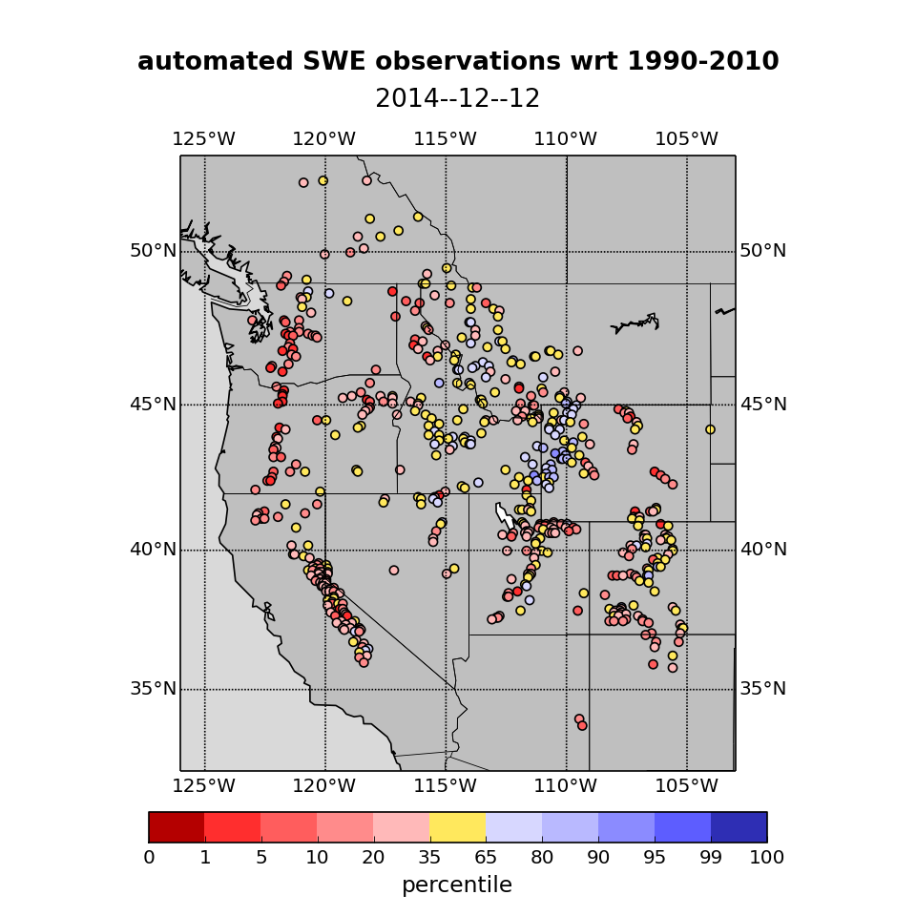

Slide 19
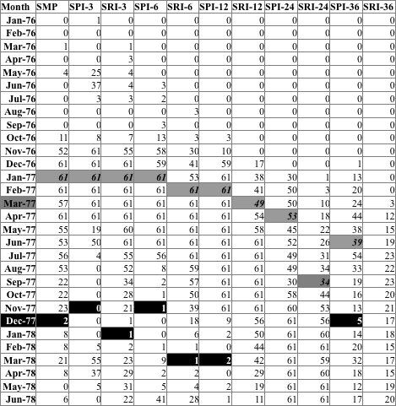
1976-77 Drought
Table 2: Number of WRIAs under class 3 or more severe drought according to DMS indicators during the 1976-77 drought.
Official Drought Onset
Official Drought Recovery

Slide 20
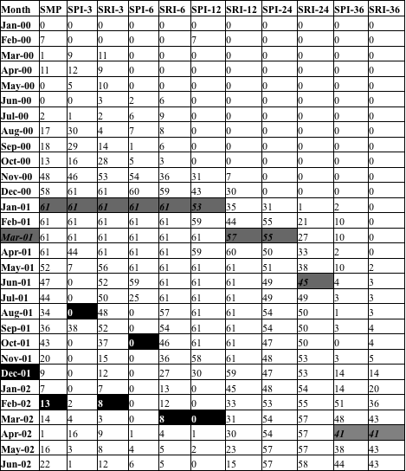
2000-01 Drought
Table 3: Number of WRIAs under class 3 or more severe drought according to DMS indicators during the 2000-2001 drought.
Official Drought Onset
Official Drought Recovery

Slide 21
Implications for GDIS: Resistance to top down approaches (but that is the norm for weather forecasts??)

Slide 22
In conclusion …
Critical importance of a) retrospective LSM forcings and analysis and b) statistically consistent real-time LSM forcings
Drought predictability is mostly governed by hydrologic initial conditions beyond weather forecast time scales (order 1 week)
Objective drought monitors can aid in detection of drought onset and termination, but other (non-physical) factors often govern

