Slide 1

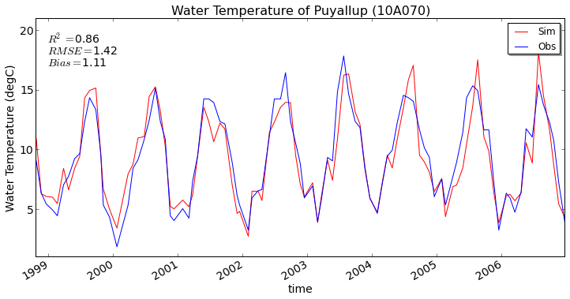
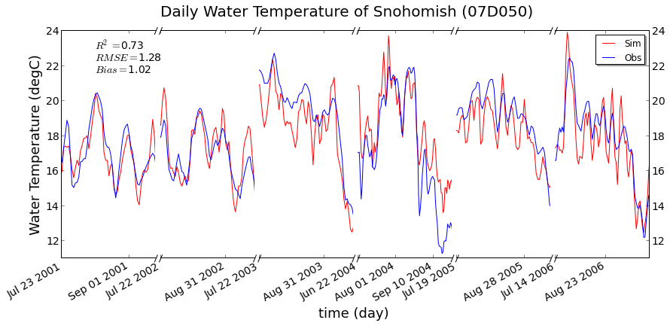
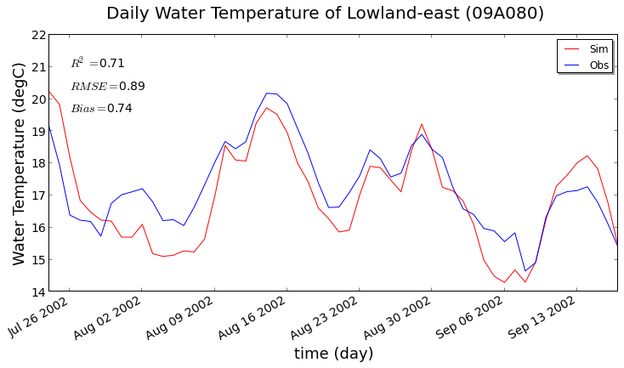
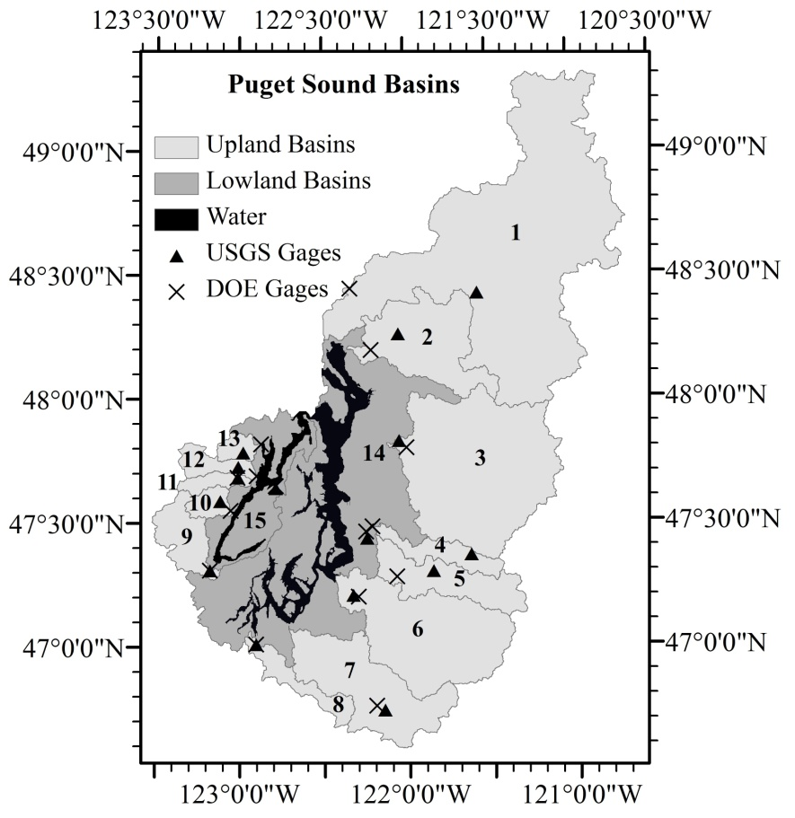
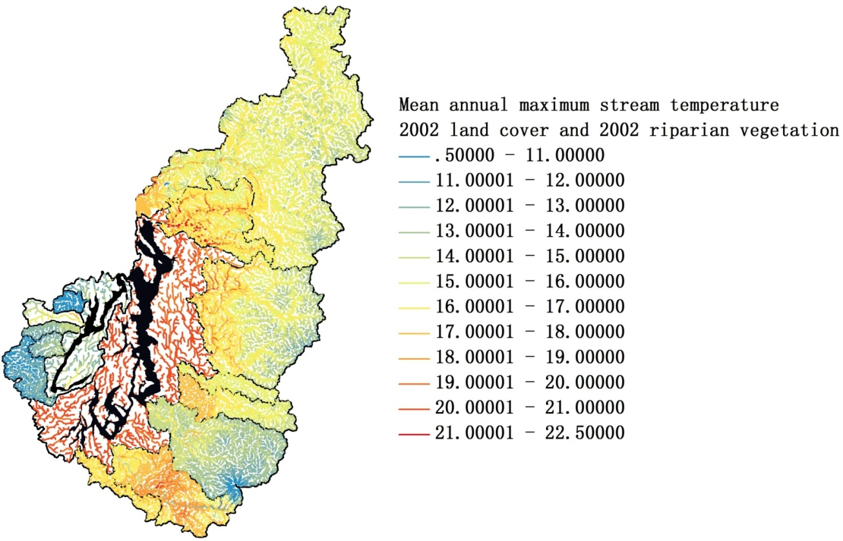
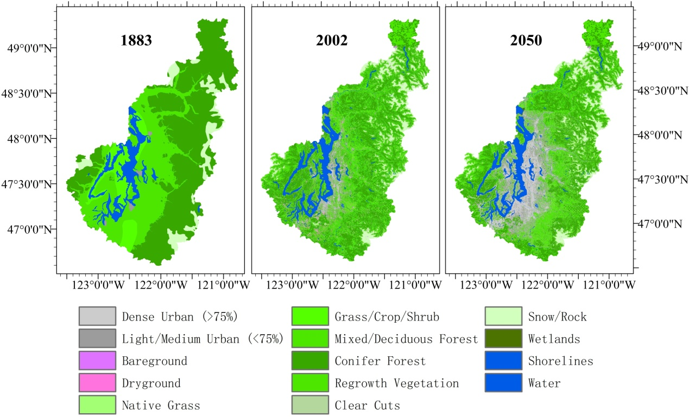
Modeling of effects of climate and land cover change
on thermal loading to Puget Sound
Qian Cao¹, Ning Sun², John Yearsley², Bart Nijssen², Dennis P. Lettenmaier¹
¹Department of Geography, University of California, Los Angeles, Los Angeles, CA
²Land Surface Hydrology, Civil and Environmental Engineering, University of Washington, Seattle, WA
1. Introduction
For all six scenarios, DHSVM-RBM was forced with the same detrended historical meteorological forcings from 1950 to 2006 with the air temperature adjusted to 2006 condition (Cuo et al, 2009) for the purpose of isolating land cover change effects from climate trends. In addition, we used identical parameters obtained from calibration for the hydrologic and stream temperature simulations for each subbasin.
Climate scenarios
Scenarios representing future climate were constructed separately for precipitation and temperature change to evaluate stream temperature sensitivity to climate change. Using the MACA downscaling method (Abatzoglou, Brown, 2012), the monthly mean precipitation and temperature, from 10 GCMs forced by two emission scenarios (a medium-low future scenario, RCP4.5 and a high future scenario, RCP4.5), were downscaled to the grid cells where historical forcing was used in historical model runs. For each combined GCM-Emission scenario, the mean monthly increase of temperature reflecting the change in temperature from mid-twenty-first century (2036‒2065), late-twenty-first-century (2070‒2099) climate relative to the historical period (1950‒2005) were calculated and subsequently applied on historical precipitation datasets to reflect future temperature change.
(a)
Stream temperature has a central role in the physical, biological and chemical processes of aquatic habitats. It is of particular importance in the life cycle of the eight species of salmon found in Puget Sound Basin, for which thermal and hydrologic regimes are limiting factors(Mantua et al, 2009).
The majority of the Puget Sound Basin is located in western Washington, with a small part in south-western British Columbia. It is bounded by the Cascade Mountains to the east and the Olympic Mountains to the west. The area of the basin is about 31,000 km². Its elevation ranges from sea level to 4400 m (top of Mt Rainier).
(b)
We represent the 15 major river basins and the discharge and temperature of the streams that drain them. Thermal loadings in these partially urbanized basins are highly influenced by climate and land use changes especially during periods of low flow.
We first show that our model construct is able to represent observed historic streamflow and stream temperature variations at sub-daily, seasonal, and interannual time scales. We then explore the relative effect of projected future climate and land cover change on Puget Sound riverine thermal loadings.
(c)
2. Methods
(d)
(e)
We used the DHSVM-RBM model to simulate streamflow and stream temperature at 150 m spatial resolution and sub-daily timescale. DHSVM-RBM (Sun et al., 2014) integrates the Distributed Hydrology-Soil-Vegetation Model, a semi-Lagrangian stream temperature model RBM (Yearsley, 2009), and a riparian shading module to provide spatially distributed predictions of streamflow and stream temperature applicable to a wide range of spatial scales from small catchment to regional watershed.
Coupled land use and riparian vegetation scenarios
We performed experiments based on six combined scenarios with different land cover and riparian shading conditions were conducted for exploring impact on stream temperature associated with changes in riparian shading and land use: (1) 2002 land use and 2002 riparian vegetation (the baseline, short for ‘lc2002_rv2002’); (2) 2002 land use and 1883 riparian vegetation (lc2002_rv1883); (3) 1883 land use and 1883 riparian vegetation (pristine conditions; lc1883_rv1883); (4) 1883 land use and 2002 riparian vegetation (lc1883_rv2002); (5) 2050 land use and 1883 riparian vegetation (lc2050_rv1883); (6) 2050 land use and 2002 riparian vegetation (lc2050_rv2002).
3. Results
4. Discussion
To evaluate DHSVM-RBM, we compared the model-generated hydrologic predictions with USGS observations, stream temperature predictions with Washington Department of Ecology observations in each subbasin. The model operated on a three-hourly time step using historical meteorological forcings, 2002 land cover and 2002 riparian vegetation. For streamflow calibration, the Nash-Sutcliffe value of daily streamflow ranges from 0.55 to 0.82 and for monthly flows from 0.61 to 0.9. For stream temperature calibration, the R² ranged from 0.25 to 0.89, the RMSE ranged from 0.63 to 2.03 degrees C, and the bias ranged from 0.5 to 1.62 degrees C.
There are two types of rivers in Puget Sound Basin, transient (mixed rain and snow) basins and rain dominated basins. We selected three subbasins to evaluate the simulation results, as summarized below.
According to figure (b), future climate influences are greater for historically transient basins, which will shift towards rain dominant basins and experience longer summer low flow period, with increase in winter streamflow and significant decrease in summer streamflow, primarily due to reduction in snow accumulation. The combined effects of warming stream temperatures and diminishing summer low flows will very likely reduce the fish populations. According to figure (c), the influence of riparian vegetation change on stream temperature is greater than land cover change in summer. The stream temperature increase caused by land cover change is around 0.2 degree C in summer, while that caused by riparian vegetation change is around 1~1.5 degree C, which implies the effect of future climate and land cover change could be mitigated by restoration of riparian vegetation. According to figure (e), land cover change shows nearly 3 times greater effect on thermal loading in Puget Sound Basin in winter than riparian vegetation, while riparian vegetation change shows nearly 16 times greater effect during summer low flow period than land cover change.
Basin name | Area (km²) | Basin Type | Urbanization percentage
 |  |  | 1883 | 2002 | 2050
Puyallup | 2588 | Transient | 0.00% | 7.76% | 20.01%
Snohomish | 3985 | Transient | 0.00% | 2.05% | 11.40%
Lowland East | 7055 | Rain dominated | 0.00% | 18.42% | 46.77%
Reference
The stream temperature calibration results of three subbasins are show in figure (a), mean monthly flow is shown in figure (b) and mean monthly stream temperature is shown in figure (c).
Thermal loadings were calculated for each subbasin based on the following equation: Thermal Load = Q_mouth×(T_mouth – T_obs_average)
The T_obs_average is from DOE site which is close to the outlet . The thermal loading to Puget Sound Basin is shown in figure (e).
Sun, Ning, et al. "A spatially distributed model for the assessment of land use impacts on stream temperature in small urban watersheds." Hydrological Processes (2014).
Yearsley, John R. "A semi‐Lagrangian water temperature model for advection ‐dominated river systems." Water resources research 45.12 (2009).
Cuo, Lan, et al. "Effects of a century of land cover and climate change on the hydrology of the Puget Sound basin." Hydrological Processes 23.6 (2009): 907-933.
Abatzoglou, John T., and Timothy J. Brown. "A comparison of statistical downscaling methods suited for wildfire applications." International Journal of Climatology 32.5 (2012): 772-780.
Mantua, Nathan, Ingrid Tohver, and Alan Hamlet. "Impacts of climate change on key aspects of freshwater salmon habitat in Washington State." Washington Climate Change Impacts Assessment: Evaluating Washington’s future in a changing climate. Climate Impacts Group, University of Washington, Seattle, Washington (2009).

