Slide 1


SWOT Data Assimilation for Operational Reservoir Management on the Upper Niger River Basin
S. Munier, A. Polebitski, C. Brown,
G. Belaud, D.P. Lettenmaier

Slide 2
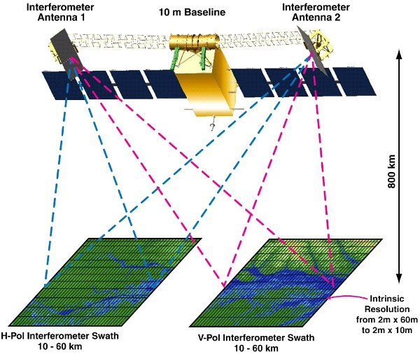
Surface Water and Ocean Topography (SWOT) satellite mission
SWOT will:
Provide a global inventory of all terrestrial surface water bodies (lakes, reservoirs, wetlands) whose surface area exceeds ~ 6 ha, and rivers whose width exceeds 100 m
Measure the storage change in resolved lakes, reservoirs, and wetlands, and the discharge of resolved rivers at subseasonal to annual time scales.

Slide 3
Outline
SWOT and water resources management
Study case and methodology
SWOT data assimilation
Operational reservoir management

Slide 4
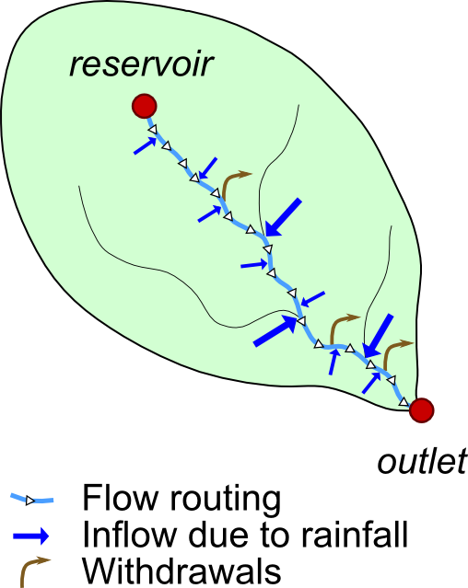
SWOT and water resources management
To maintain minimum streamflows at the outlet,
reservoir managers have to:
  Predict the influence of difference factors
  Decide when and how much water has to be released
  from the reservoir
Hydrology-Hydraulics-Reservoir modeling
  For definition of dam releases
  Depending on water demand, hydric state, available water in reservoirs
Main limitations of current approaches
  Model approximations
  Quality of datasets (data sparse regions,
  discontinuities, quality control, uniformity, delay)
  Transboundary basins (data sharing)
  Use of remote sensing data: SWOT

Slide 5
SWOT and water resources management
The SWOT mission: Surface Water and Ocean Topography
  French/American mission, launch planned in 2020
  2-D water elevation measurements over rivers (width: 100 m and more)
  21 days repetitivity
  Accuracy on water elevation: 10 cm on a 1 km x 1 km square
Questions:
How to integrate information from SWOT data into operational water management systems?
What are the performances of operational water management when only SWOT data are used in real time?

Slide 6
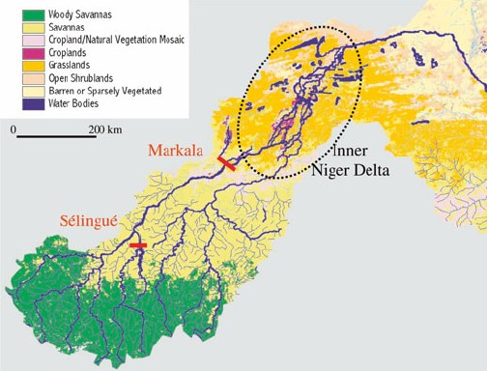
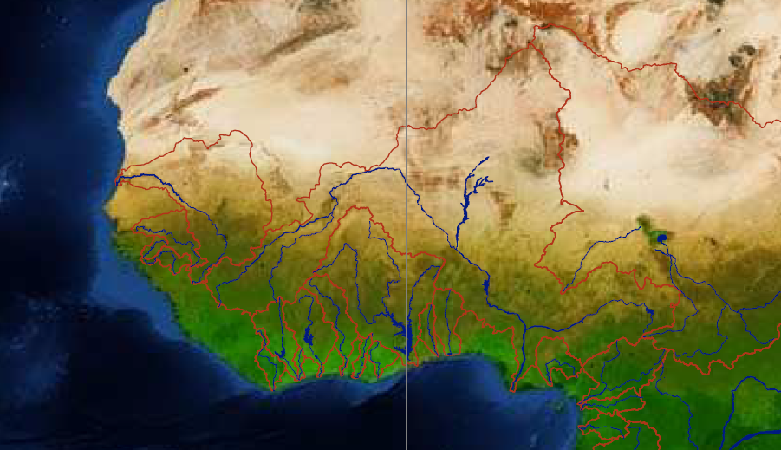
Study case and methodology
The upper Niger river basin
Climate dominated by the Western African monsoon
Large seasonal floodplains
  used for crop, livestock, fishing
Selingue reservoir (2 x 10⁹ m³) used for hydropower and low flow sustainability
=> Minimum streamflow requirement at Kirango (300 km downstream)
considered reach
Kirango

Slide 7
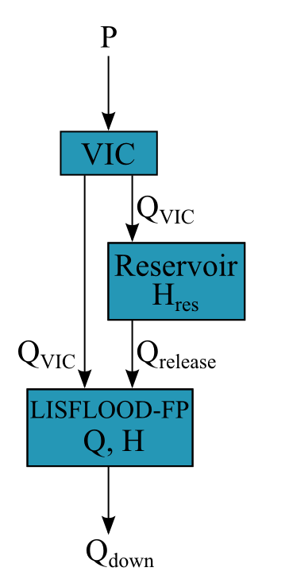
General framework: models
Hydrological inflows: VIC
  0.5 degree resolution, daily time step
Reservoir: water budget
  Hydrological inputs from VIC
  Min and max levels
Hydrodynamics: LISFLOOD-FP
  Inputs from VIC and reservoir
  1 km resolution, adaptive time step
  Evaporative losses
Meteo-rological forcings
Dam release
Downstream discharge

Slide 8
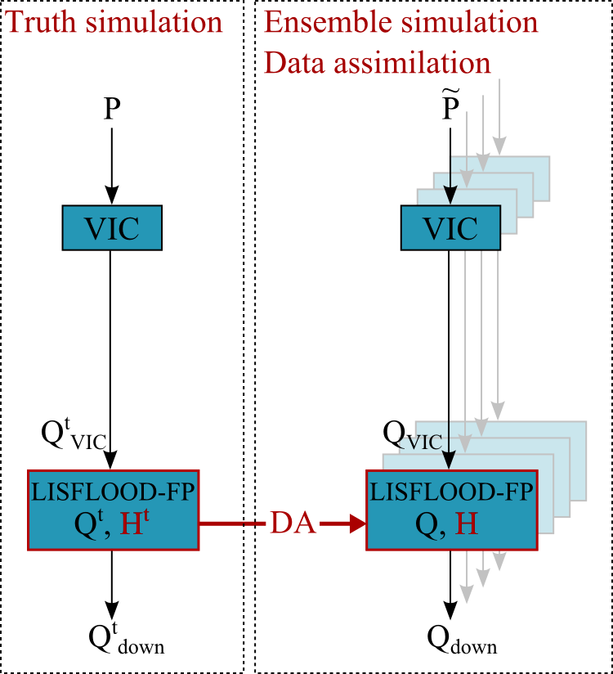
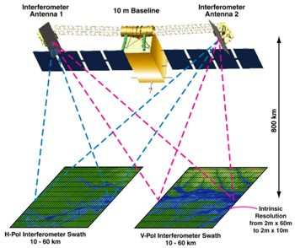
General framework: experiments
First experiment: evaluation of SWOT data assimilation
Corrupted forcings
SWOT data assimilation (DA)

Slide 9
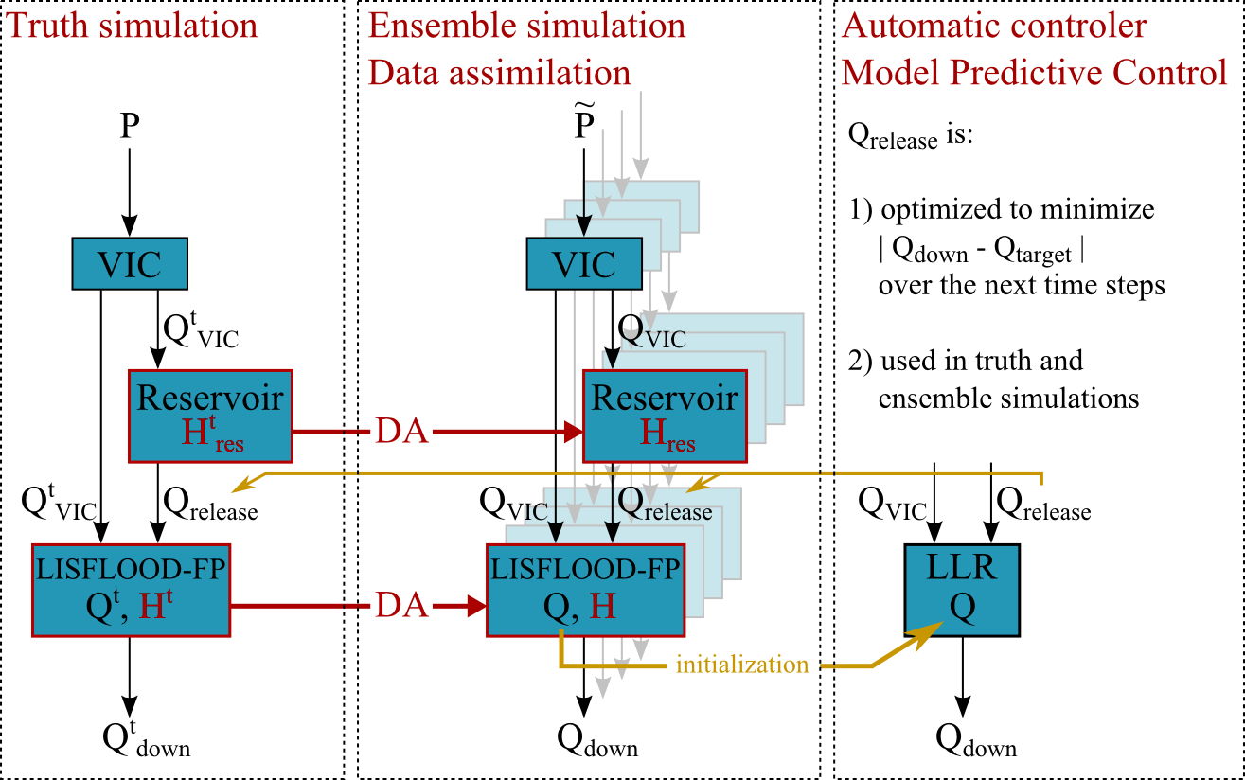
General framework: experiments
Second experiment: operational reservoir management
Routing model

Slide 10
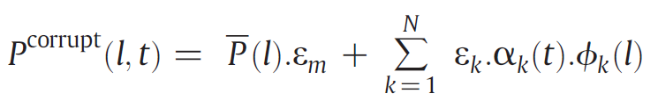
(a) SWOT data assimilation
Ensemble members generation
  VIC meteorological forcings are corrupted
  Principal Component Analysis (decomposition into spatial and temporal modes)
  Each mode corrupted with white noise (0.2 std)
  Spatiotemporal consistency maintained
first spatial mode

Slide 11
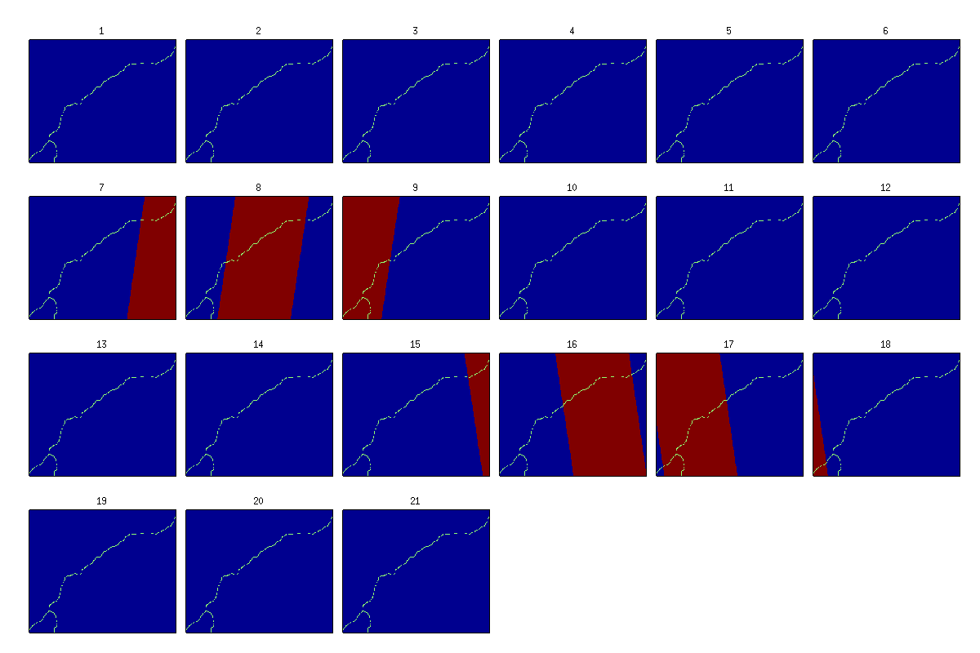
(a) SWOT data assimilation
Assimilation of SWOT water elevation
SWOT observations over a complete cycle (21 days)

Slide 12
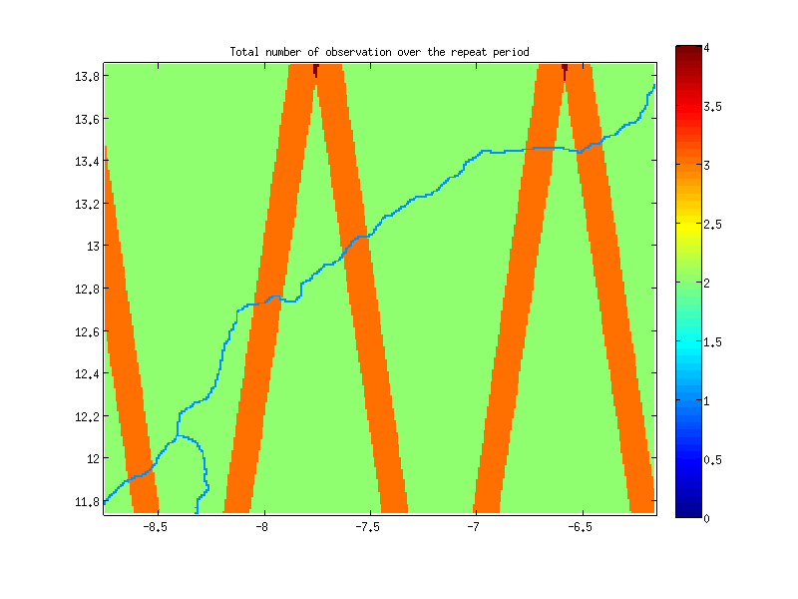
(a) SWOT data assimilation
Assimilation of SWOT water elevation
SWOT observations over a complete cycle (21 days)
Number of SWOT observation

Slide 13
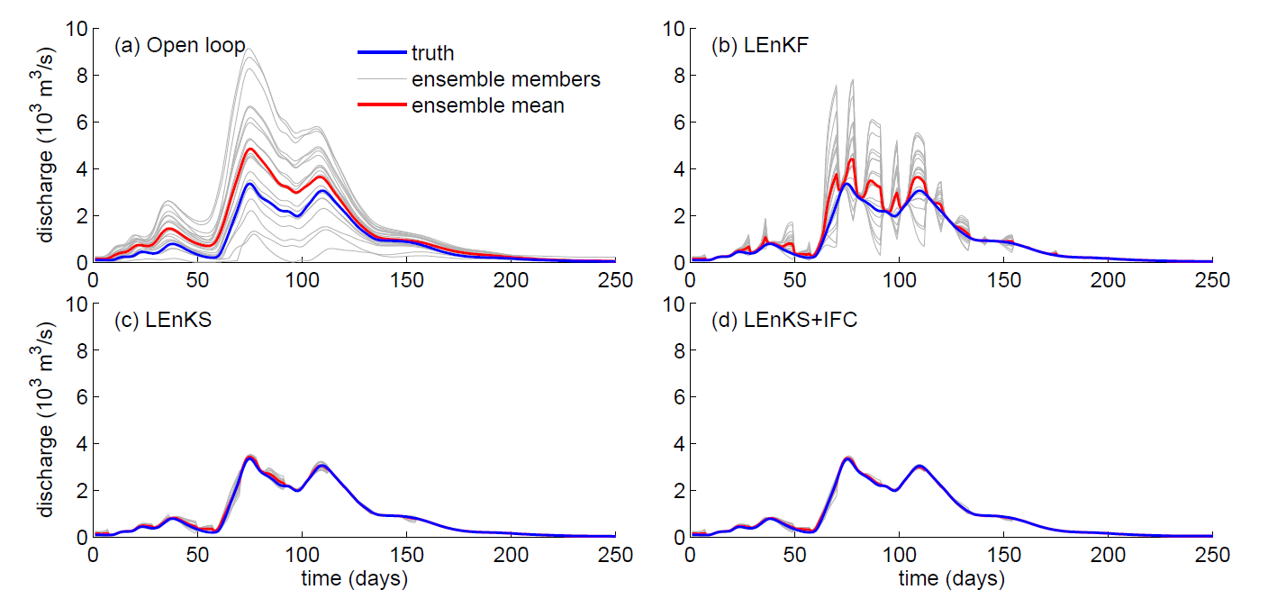
(a) SWOT data assimilation
Effect of the assimilation on the downstream discharge
(a) Open loop
(b) Local Ensemble Kalman Filter
(c) Local Ensemble Kalman Smoother (LEnKS)
(d) LEnKS + Inflow Correction

Slide 14
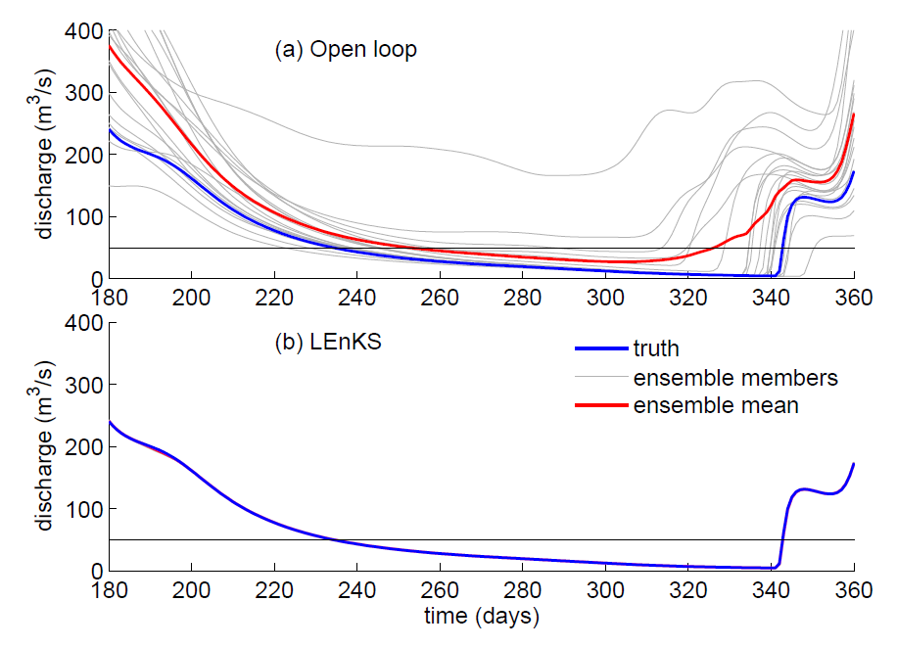
(b) Reservoir management
Minimum flow requirement: 50 m³/s
Need for water releases from the Selingue reservoir

Slide 15
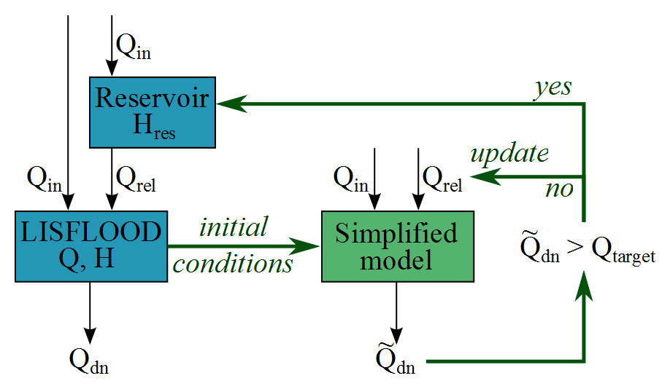
(b) Reservoir management
Model Predictive Control
  Optimizes the releases to satisfy the downstream requirement
  Allows to account for the flow propagation (about 25 days)
  Use of a simplified routing model (lag-and-route)
  Initialization using the updated discharge in the river reach (after SWOT data assimilation)
Model Predictive Control

Slide 16
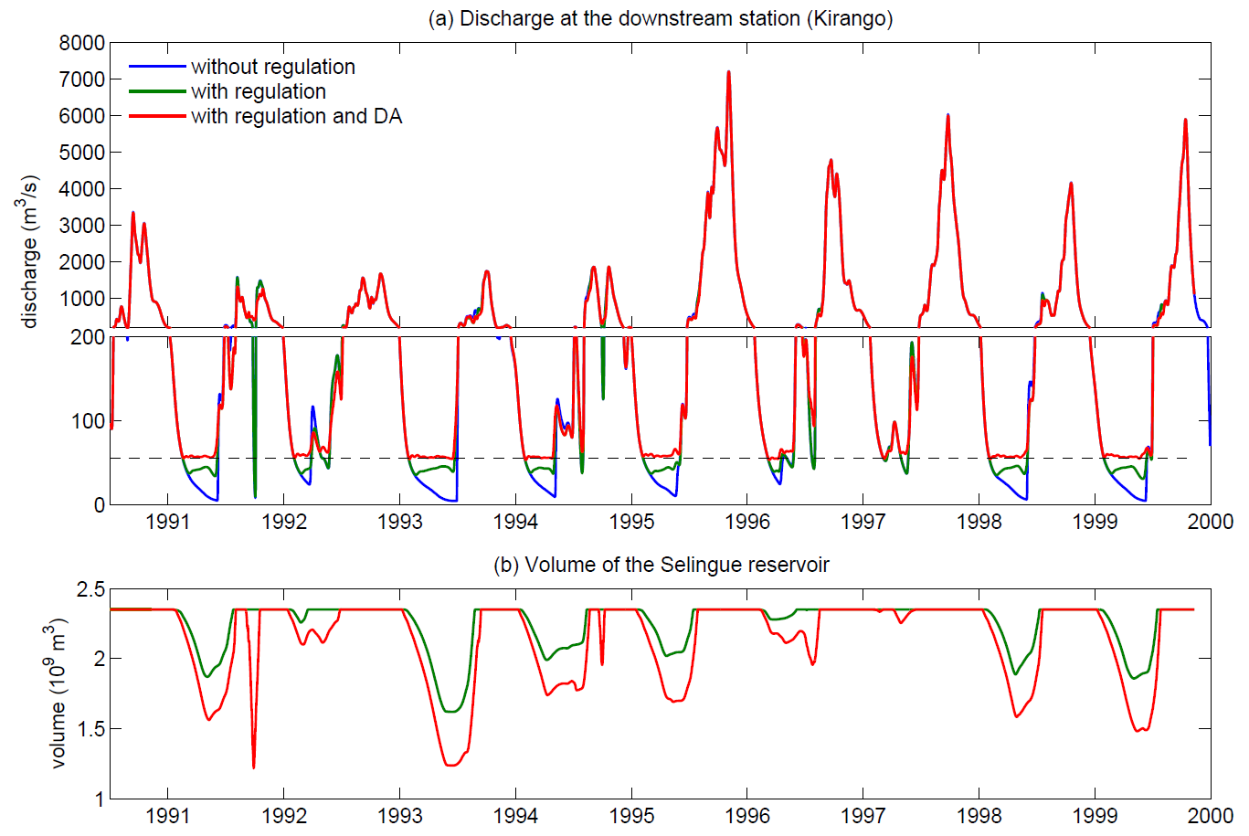
(b) Reservoir management
target
discharge
Munier et al. (2014)

Slide 17
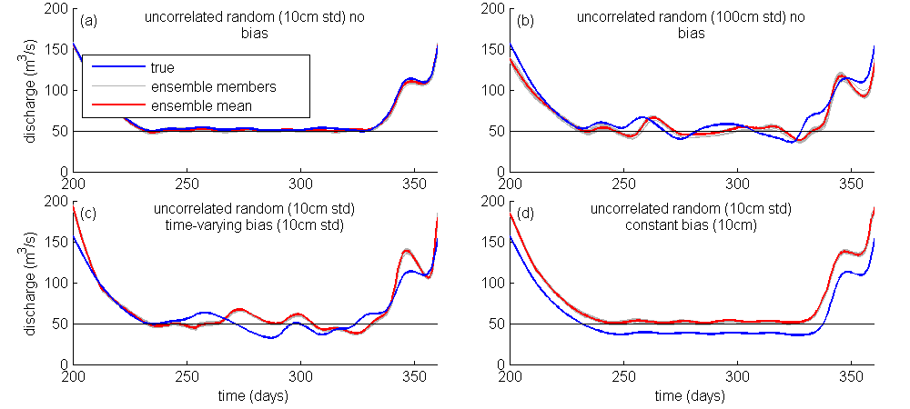
(b) Reservoir management
Effect of SWOT errors (random and bias)

Slide 18
Conclusions and perspectives
Conclusions
  Modeling framework adapted to SWOT data assimilation and operational water management
  Assimilation persistency high enough to overcome delays between SWOT measurements
Perspectives
  Niger Inner Delta (complex hydrodynamic and data sparse region with high flood extent variations)
  Multiple reservoir control (MPC well adapted)
  Multiple reservoir objectives (e.g., hydropower)
  Data latency and SWOT errors issues over smaller basins

