Slide 1
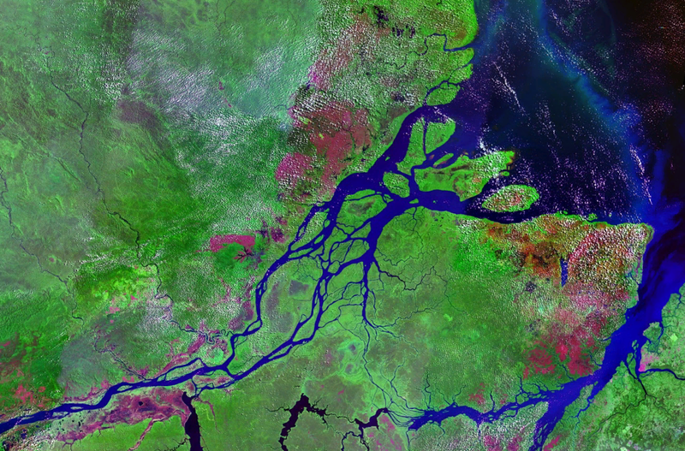
Transferability of land surface model parameters using remote sensing and in situ observations
By: Ben Livneh

Slide 2
Overview
Unified Land Model (ULM) was developed¹
Rigorous calibrations performed at 220 basins²
Regionalize/transfer calibrated parameters
Domain and catchment attribute data sets
Experimental set-up
Results
Conclusions
1. Livneh et al. 2011; 2. Livneh et al., 2012

Slide 3
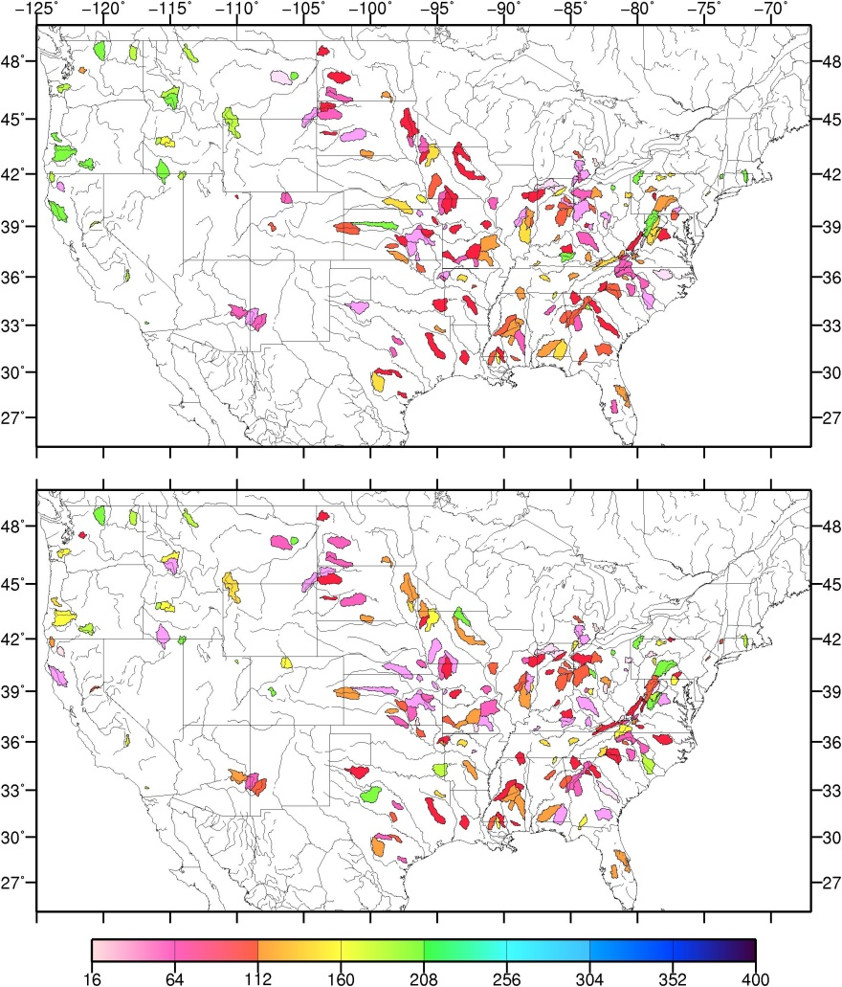
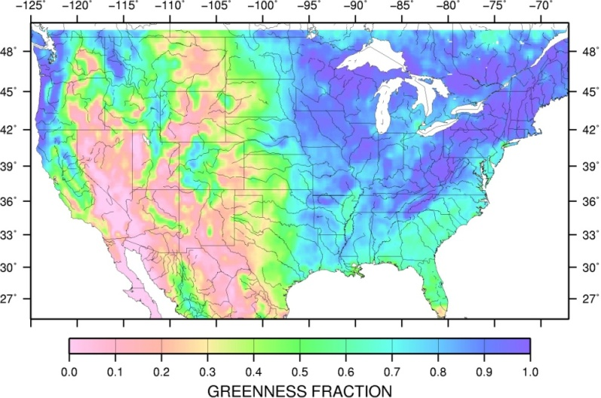
Unified Land Model (ULM) Regionalization
Goal: establish a predictive relationship between ULM parameters, Θ, and observable catchment features, η (e.g. θ= a + bη) for a new model, ULM.
Motivation: extend recent model calibrations to new domains; calibration is often impractical/impossible.
θ
η
ULM field capacity parameter
Greenness Fraction (satellite)
Notes:
geomorphic basis for interperating hydrologic behavior G.Grant)
My goal in this chapter (paper) will be to establish a predictive relationship between ULM parameters and land surface characteristics, and geomorphic and meteorological variables through the use of principal components analysis (PCA). Figure 4 shows a flowchart of the proposed procedure. First, following the optimization procedure described in section 4, I will estimate an optimal set of ULM parameters that will be calibrated to both streamflow and ET data over major river basins within the continental U.S. and their interior sub-basins which pass a data quality check. These basin/sub-basin sets will serve as the “training” domain. Next, I will use PCA to extract relationships between each model parameter and descriptor variables that include land surface characteristics, geomorphic, and meteorological variables. To ensure an adequate number of data points for the analysis, I will include sub-basins, a larger basin, and potentially the gridded data points in my analysis. The resulting principle components will then be applied to a number of validation basins that are not part of the training basins and the ensuing model performance will be assessed. These basins can be shuffled to test the robustness of the method and the possibility for broader use as a parameter estimation technique.
Many of the processes controlling runoff at both small and large scales are linked to the underlying geomorphology of a region. The interaction of geologic substrate, topography and climate determine overall surface water discharge regime. Drainage density, reflecting the hydrulic trnsmissivity of underlying rocks, influences the efficiency of the channel network to transmit water.

Slide 4
Experimental domain and predictands, Θ
220 MOPEX¹ basins, spanning a wide range of hydro-climatology
Calibrated model parameters, Θ, for each basin were obtained from a recent study² as inputs to the regionalization procedure (predictands).
1. Schaake et al., 2006; 2. Livneh et al., 2012

Slide 5
Summary of candidate catchment attributes, η
Meteorological attributes | Description | Quantity
Precipitation, Temperature, Wind – monthly, seasonal, annual means, standard deviations, minima, and maxima | Derived from station co-op data and reanalysis fields (wind only)¹ | 16
Geomorphic attributes
Basin area, mean elevation, maximum relief, approx. length of main stream, relief ratio, shape factor, length-to-width ratio, elongation ratio | Defined from DEM and USGS GIS HUC 250K database² | 8
Land surface characteristic attributes
Percentage of basin covered in forest; Satellite-based greenness fraction and albedo – monthly, seasonal, annual means, standard deviations, minimums, and maximums | Required as inputs into ULM³ | 22
Soil texture attributes
Tension and free water storages, hydraulic conductivities, impervious areas, percolation constant, recession slope. | Sacramento model a priori values from soil texture relationship⁴ | 13
Remote sensing attributes
Evapotranspiration – monthly, seasonal, annual means, standard deviations, minima, and maxima | Derived entirely from satellite data (MODIS, SRB)⁵ | 8
TWSC – monthly, seasonal, annual means, standard deviations, minima, and maxima | GRACE data, mean of 3 processing streams⁶ | 8
GAGES-II attributes
Soils data, climatic, land-use, morphology transitionary data, population density, drainage density classes, and anthropogenic disturbance factors | A single basin-average value for each field, only floating point data considered (i.e. no integer class data)⁷ | 313
1. Livneh et al. 2012b; 2. Seaber et al. 1987; 2. Gutman and Ivanov, 1998; 4. Koren et al. 2003; 5. Tang et al. 2009; 6. Swenson and Wahr, 2006, Falcone et al. 2010
Total: 388

Slide 6
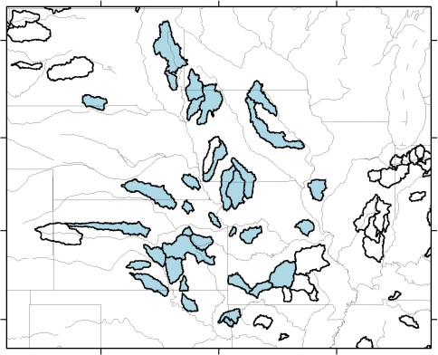
Regionalization methodology
Step-wise principal components regression (PCR) procedure^{1,2} was selected to maximize explanatory skill and minimize potential redundancy/inter-correlation. Jack-knifing validation chosen.
θ₁=a+b₁η₁+b₂η₂+…+b_{n}η_{n}
Additional experiment:
resample calibrated model parameters prior to developing the equation, based on their zonal representativeness, i.e. Zonalization
θ’₁=c+d₁η₁+d₂η₂+…+d_{n}η_{n}
θ_{1-LOCAL}=
“classic” regionalization
θ_{1-ZONAL}=
1. Garen, 1992; 2. Rosenberg et al. 2011

Slide 7
Zonalization procedure
10 calibrated parameter sets per basin¹ that are Pareto-optimal, Θ_{P}, i.e. non-dominant multiple-objective functions: streamflow correlation, R, diff. in means, α, diff in std. deviations, β.
Compute an additional objective function Nash-Sutcliffe Efficiency², NSE (-∞,1)
Exp 1: Select local optimum: based on highest NSE
θ_{i-LOCAL}=a+b₁η₁+b₂η₂+…+b_{n}η_{n}
Local performance ranking
Highest NSE
Θ_{P1}
Θ_{P2}
Θ_{P3}
Θ_{P4}
Θ_{P5}
Θ_{P6}
Θ_{P7}
Θ_{P8}
Θ_{P9}
Θ_{P10}
local optimum
Θ_{P,LOCAL} = Θ_{P1}
Lowest NSE
1. Livneh et al. 2012a; Nash and Sutcliffe, 1970

Slide 8
Zonalization procedure
10 calibrated parameter sets per basin¹ that are Pareto-optimal, Θ_{P}, i.e. non-dominant multiple-objective functions: streamflow correlation, R, diff. in means, α, diff in std. deviations, β.
Compute an additional objective function Nash-Sutcliffe Efficiency (NSE)
Exp 1: Select local optimum: based on highest NSE
Exp 2: Select zonal optimum, based on highest zonal $\overline{NSE}$
θ_{i-LOCAL}=a+b₁η₁+b₂η₂+…+b_{n}η_{n}
θ_{i-ZONAL}=c+d₁η₁+d₂η₂+…+d_{n}η_{n}
Local performance ranking
Zonal performance ranking
Re-run ULM with each Θ_{P}, at neighboring basins within a zoning radius (5°). Compute and rank the a mean statistic for each parameter set
local optimum
Θ_{P,LOCAL} = Θ_{P1}
Exp 1
Highest NSE
$$\overline{Θ\text{P}\text{1}}$$
$$\overline{Θ\text{P}\text{2}}$$
$$\overline{Θ\text{P}3}$$
$$\overline{Θ\text{P}4}$$
$$\overline{Θ\text{P}5}$$
$$\overline{Θ\text{P}6}$$
$$\overline{Θ\text{P}7}$$
$$\overline{Θ\text{P}8}$$
$$\overline{Θ\text{P}9}$$
$$\overline{Θ\text{P}\text{10}}$$
zonal optimum
Θ_{P,ZONAL} = $\overline{Θ\text{P}\text{1}}$
Exp 2
Highest NSE
Θ_{P1}
Θ_{P2}
Θ_{P3}
Θ_{P4}
Θ_{P5}
Θ_{P6}
Θ_{P7}
Θ_{P8}
Θ_{P9}
Θ_{P10}
$$\overline{NSE}$$
$$\overline{NSE}$$
5°
Lowest NSE
Lowest NSE
$$\overline{NSE}$$
1. Livneh et al. 2012a; Nash and Sutcliffe, 1970

Slide 9
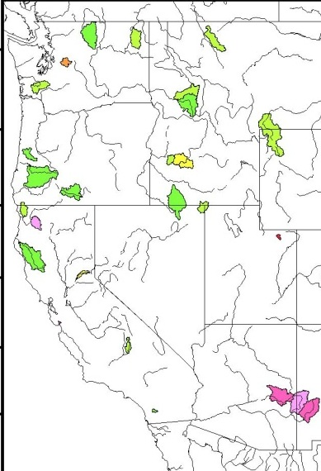
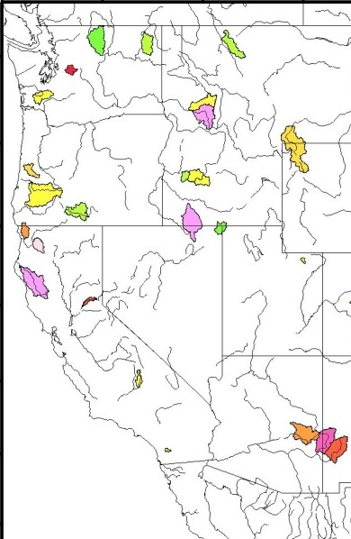
Zonalization increases spatial coherence
Spatial coherence increased. Verified visually and by variograms (not shown)
PCR derived relationships
zonal predictand
θ_{i-ZONAL}=c+d₁η₁+d₂η₂+…+d_{n}η_{n}
θ_{ZONAL}
local predictand
θ_{i-LOCAL}=a+b₁η₁+b₂η₂+…+b_{n}η_{n}
θ_{LOCAL}
ULM field capacity parameter, θ

Slide 10
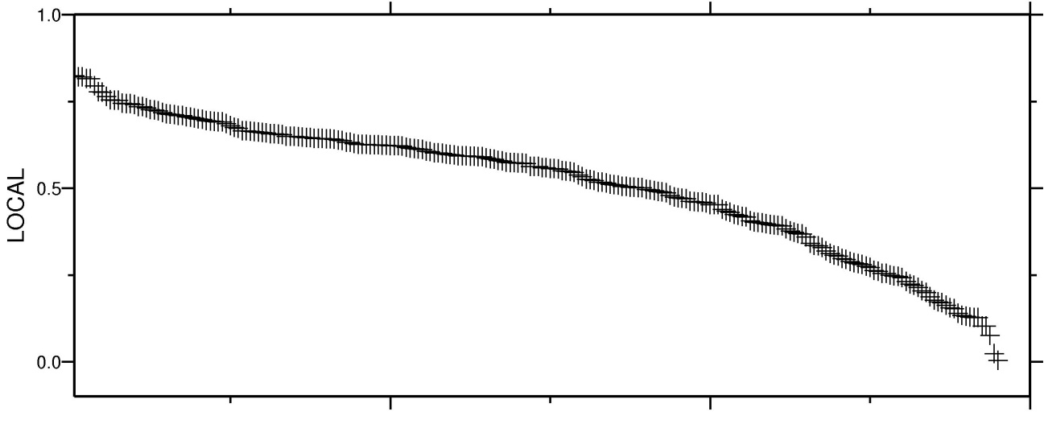
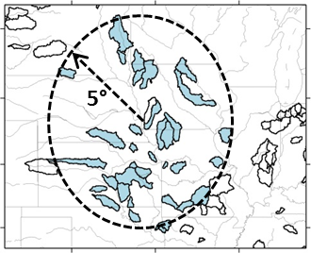
ULM skill (NSE) using zonal versus local parameters
Local NSE
local optima
zonal optima
Penalty in streamflow prediction skill for using zonal parameters at a given basin (i.e. locally) is comparatively smaller than the penalty for using local parameters zonally
220 basins ranked by NSE
Zonal NSE
Mean (5° radius)
zonal optima
local optima
Example of zoning radius

Slide 11
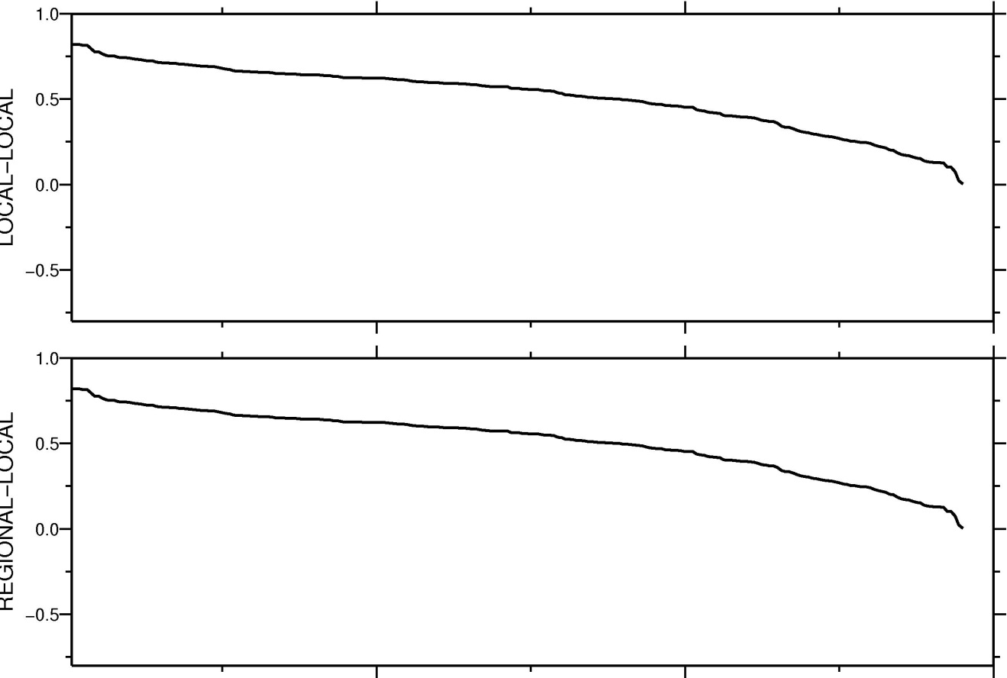
PCR regionalization results
Jack-knifing method to test regionalization.
local optima
Θ_{ZONAL}
LOCAL-ZONAL
Local basin NSE
ULM
Rank
local optima
Θ_{LOCAL}
Local basin NSE

Slide 12
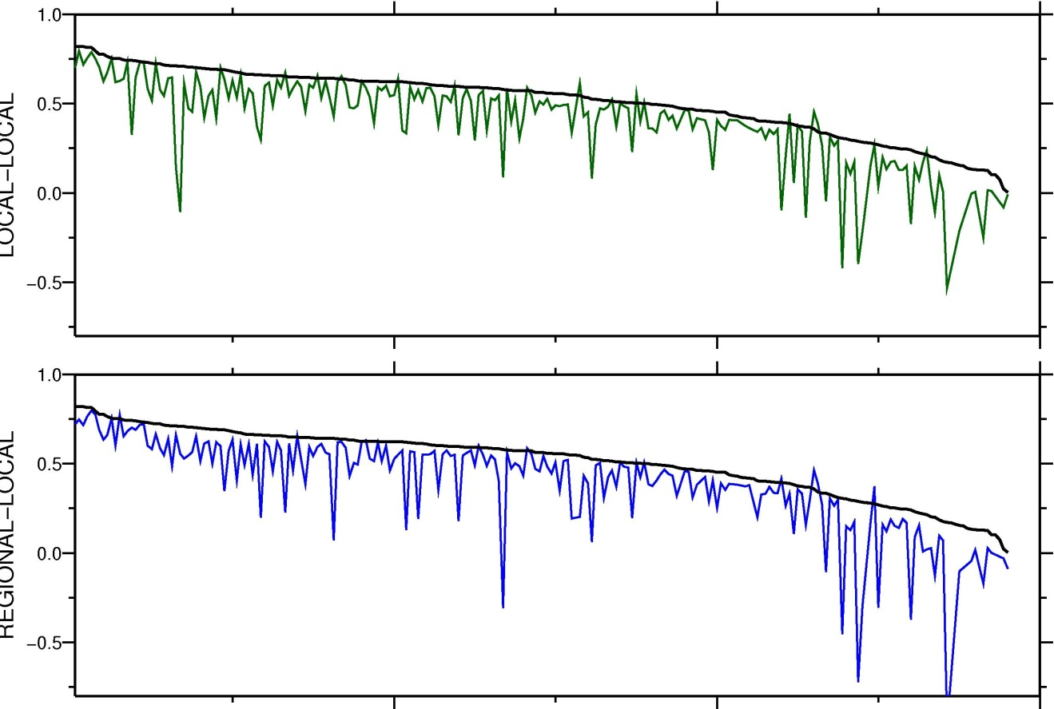
PCR regionalization results
Zonal predictands leads to best performance; exceeding local calibrations in a few places.
Jack-knifing method to test regionalization.
local optima
Θ_{ZONAL}
LOCAL-ZONAL
Local basin NSE
ULM
ULM regionalized
Rank
local optima
Θ_{LOCAL}
Local basin NSE
ULM regionalized

Slide 13
PCR regionalization results
Jack-knifing method to test regionalization.
Zonal predictands leads to best performance; exceeding local calibrations in a few places.
local optima
Θ_{ZONAL}
LOCAL-ZONAL
Local basin NSE
ULM
ULM regionalized
Rank
local optima
Repeated the experiment, using only those attributes available globally (i.e. remove GAGES-II variables).
Approach worked surprisingly well, when only globally-available data were used.
LOCAL Θ
Local basin NSE
ULM regionalized

Slide 14
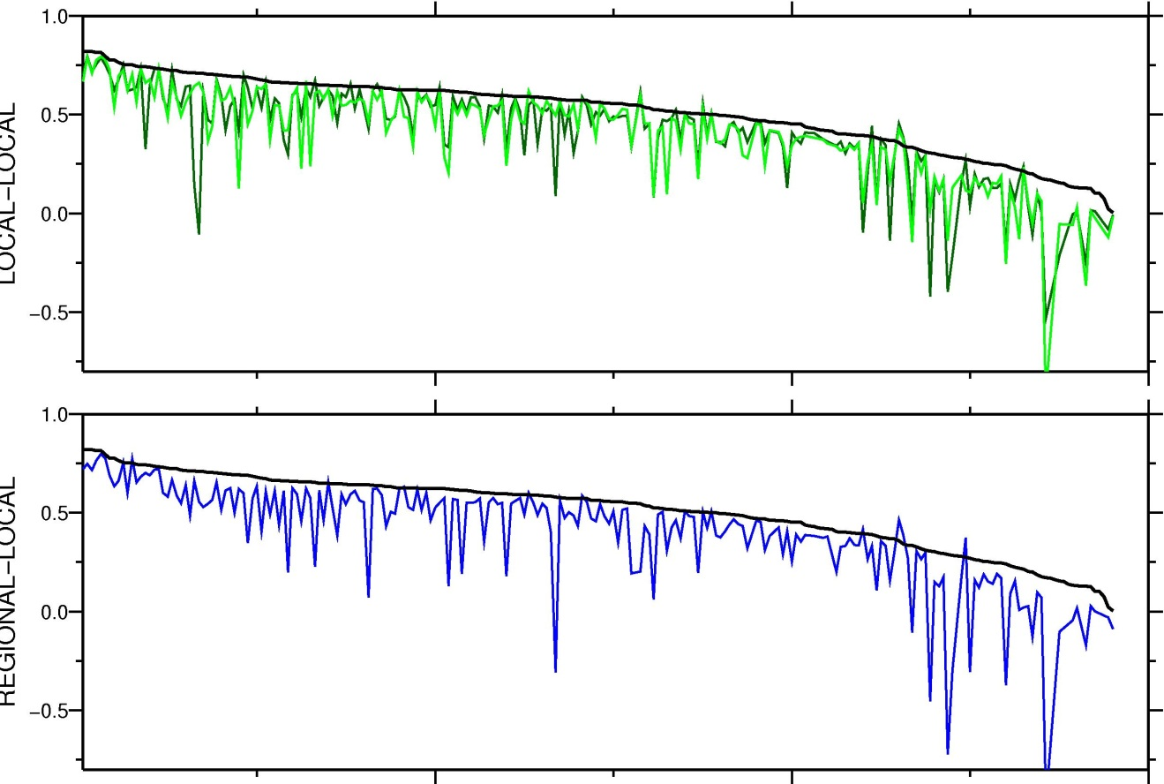
PCR regionalization results
Jack-knifing method to test regionalization.
Zonal predictands leads to best performance; exceeding local calibrations in a few places.
Nash-Sutcliffe Efficiency (NSE) over 220 basins
local optima
Θ_{ZONAL}
 | Calibration period (20 yrs) |  | Validation period (20 yrs)
 | Mean | Sdv. | Mean | Sdv.
ULM | 0.5385 | 0.5662 | 0.5228 | 0.5526
ULM_{R} | 0.4385 | 0.4903 | 0.4466 | 0.4847
ULM_{RG} | 0.4148 | 0.4698 | 0.4323 | 0.4741
LOCAL-ZONAL
Local basin NSE
ULM
ULM regionalized
ULM regionalized-Global
Rank
local optima
Repeated the experiment, using only those attributes available globally (i.e. remove GAGES-II variables).
Approach worked surprisingly well, when only globally-available data were used.
LOCAL Θ
Local basin NSE
ULM regionalized

Slide 15
Conclusions/Recommendations
New data sets were incorporated into regionalization
Searching for zonally representative parameters proved to be the most effective regionalization.
Future work should continue searching for ways to re-sample model parameters prior to regionalization, as this was shown effective.
Modest loss in skill for the global experiment are a testament to the robustness of the step-wise PCR method.
Future work is underway looking at alternate domains, models, and catchment attributes.

Slide 16
Acknowledgements
Dennis Lettenmaier (co-author)
Dr Bart Nijssen, Eric Rosenberg for their advise and assistance
The work on which this paper is based was supported by NOAA Grant No. NA070AR4310210 to the University of Washington
This work has been submitted to Water Resources Research as:
Livneh.B, and D.P. Lettenmaier, 2012: Regional parameter estimation for the Unified Land Model, Water Resources Research (submitted).
Draft available on website: www.hydro.washington.edu/~blivneh

Slide 17
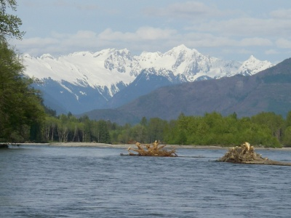
Thank you
Contact: Ben Livneh: blivneh@hydro.washington.edu

