Slide 1


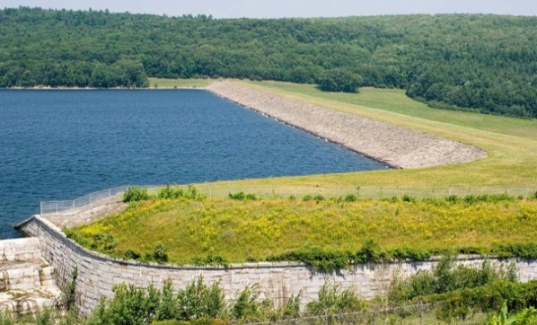
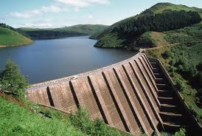
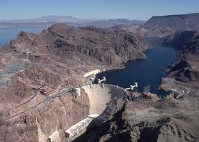
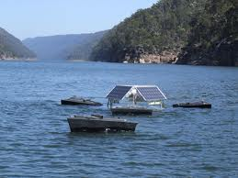

Global Monitoring of Large Reservoir Storage
from Satellite Remote Sensing
Huilin Gao¹, Dennis P. Lettenmaier¹, Charon Birkett²
¹Dept. of Civil and Environmental Engineering, University of Washington
² ESSIC, University of Maryland College Park

Slide 2
1
Outline
Background and challenges
Selecting retrievable reservoirs
Data and methodology
  Water classification using MODIS NDVI
  Level-area relationship
  Storage estimation
Validation of results for U.S. reservoirs
Satellite-based global reservoir product

Slide 3
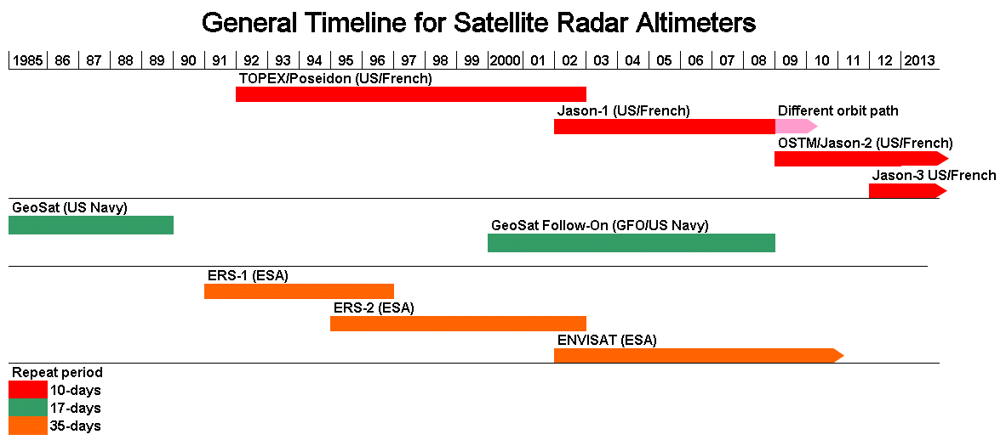
2
Background and Challenges
Water surface level
USDA Global Reservoir and Lake Elevation Database
French Space Agency’s Hydrology by Altimetry (LEGOS)
European Space Agency (ESA) River & Lake
Limitations of altimetry products
Only retrieve heights along a narrow swath determined by the footprint size
Satellite path must be at least 5km over the body of water
Complex topography causes data loss or non-interpretation of data
Future opportunity: The Surface Water Ocean Topography mission (SWOT)

Slide 4
3
Background and Challenges
Water surface area
× No dynamic water classification product available
?? Most currently available multi-reservoir surface area estimations are from a hybrid of sensors (Landsat, MODIS, ASAR)
lack of consistency lack of validation
Objective
A validated reservoir water area dataset which is based on observations from the same instrument and classified using the same algorithm is essential
MODIS 16-day global 250m vegetation index
Unsupervised classification
MODIS (or Moderate Resolution Imaging Spectroradiometer) is a key instrument aboard the Terra (2000~) and Aqua (2002~) satellites

Slide 5
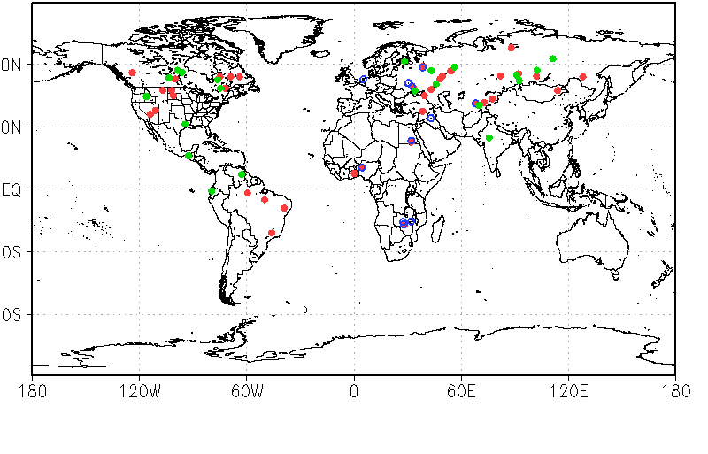
4
Reservoir Surface Levels from Altimetry
LEGOS: 36 USDA: 15 UW (T/P):20 Total: 62
T/P: Topex/Poseidon (1992-2002)

Slide 6
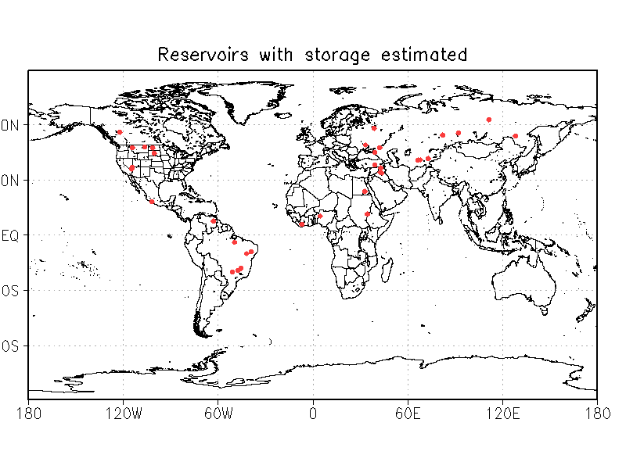
5
Reservoir Selection
A total of 34 reservoirs (1164 km³ , 15% of global capacity)
Good quality altimetry product
3+ years overlap between altimetry data and MODIS
Reservoir is not excessively surrounded by small bodies of water

Slide 7
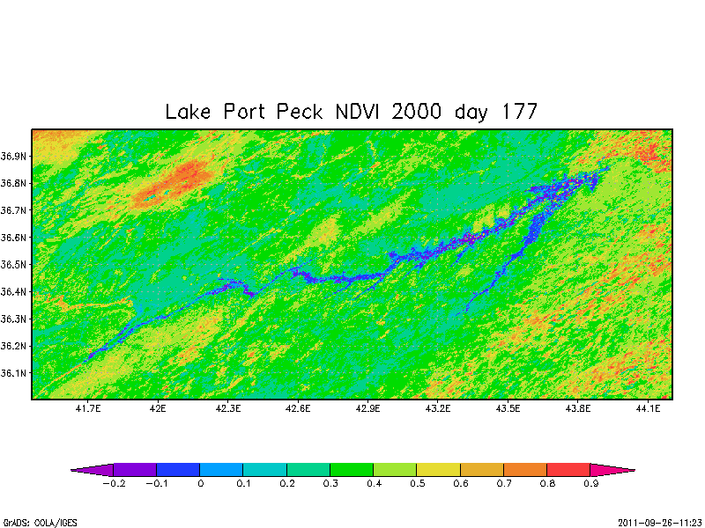
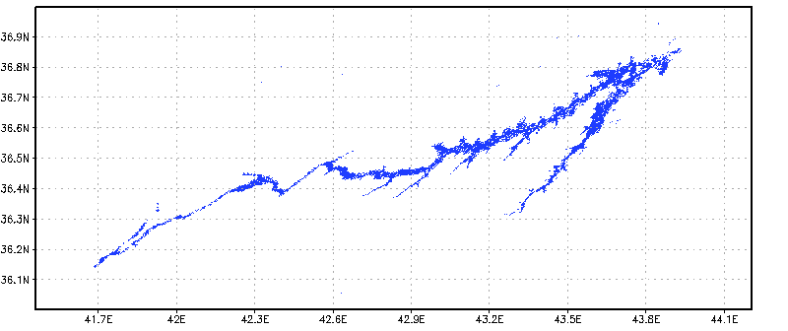
6
Method: Water Classification
2000~2010
250 images
Fort Peck Reservoir
NDVI
NDVI<0.1
water
land
Raw classification

Slide 8
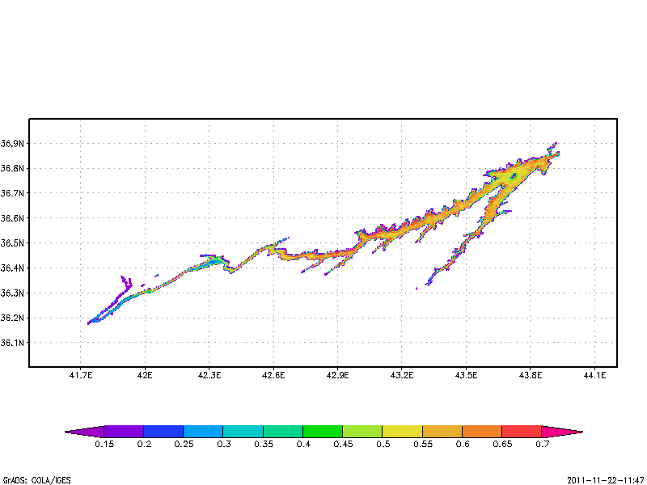
7
Method: Water Classification
2000~2010
250 images
Fort Peck Reservoir
NDVI<0.1
NDVI
frequency of the
250 classified images
Pixel frequency of the 250 images
10 15 20 25 30 35 40 45 50 55 60 65 70 (%)

Slide 9
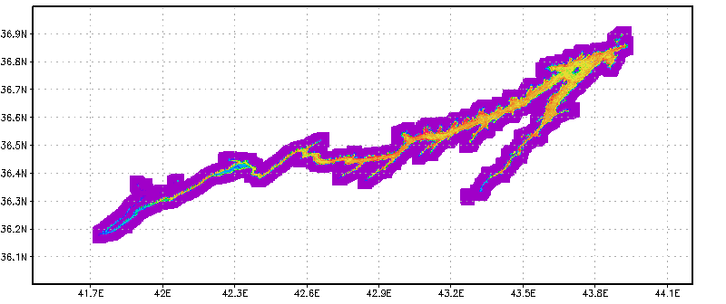
7
Method: Water Classification
2000~2010
250 images
Fort Peck Reservoir
NDVI<0.1
NDVI
Create a buffer area
Pixel frequency of the 250 images

Slide 10
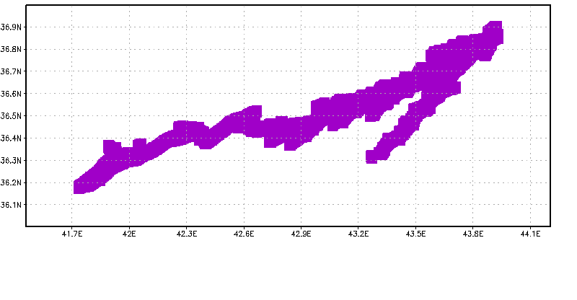
7
Method: Water Classification
2000~2010
250 images
Fort Peck Reservoir
NDVI<0.1
NDVI
A mask within which
classifications are to be made
Pixel frequency of the 250 images

Slide 11
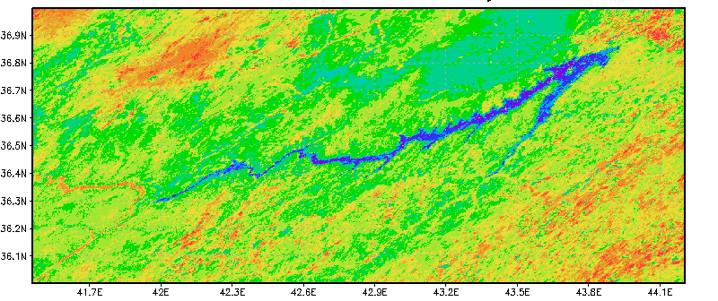
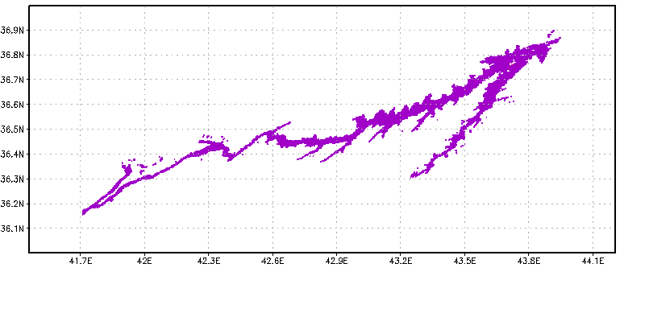
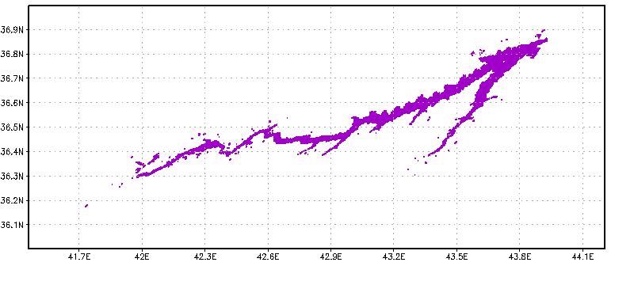
8
Method: Water Classification
Fort Peck NDVI 2000/06/26
Fort Peck NDVI 2005/06/26
NDVI
NDVI
-0.2 -0.1 0 0.1 0.2 0.3 0.4 0.5 0.6 0.7 0.8 0.9
-0.2 -0.1 0 0.1 0.2 0.3 0.4 0.5 0.6 0.7 0.8 0.9
Fort Peck water 2000/06/26
Fort Peck water 2005/06/26
wet
dry
Unsupervised classification
Majority filter

Slide 12
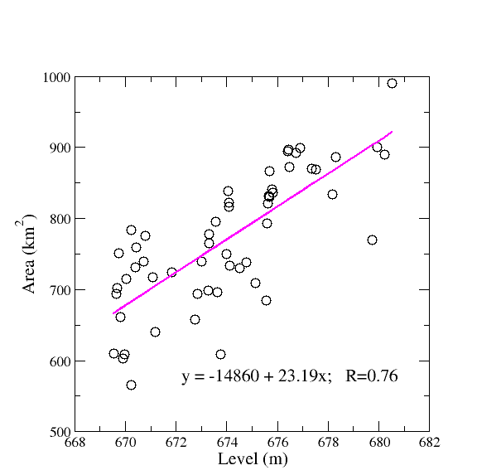
9
Method: Level-Area Relationship
Storage Estimation
V_{o} = V_{c} – (A_{c}+A_{o})(h_{c}-h_{o})/2
Fort Peck Reservoir
h_{o} A_{o}
A_{o} h_{o}
MODIS
V_{o} = f(h_{o}) or V_{o} = g(A_{o})
Variables at capacity from Global Reservoir and Dam database
(Lehner et al., 2011)
Altimetry

Slide 13
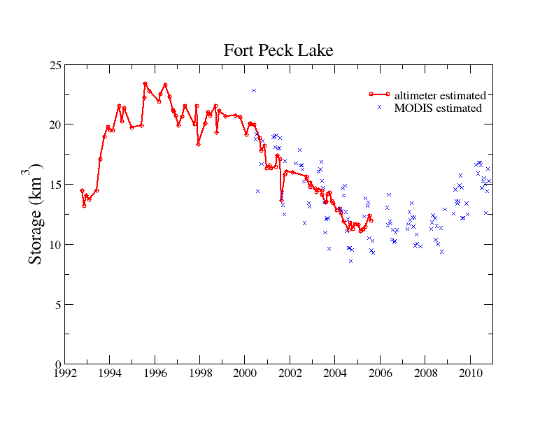
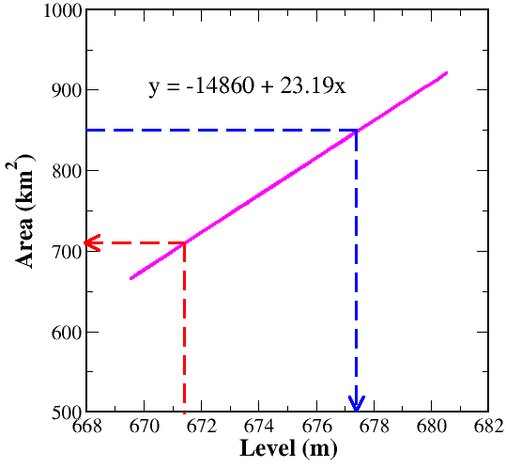
10
Method: Storage Estimation
Fort Peck Reservoir
altimetry estimated
MODIS estimated
V_{o}=f(h_{o})
A_{o} inferred from h_{o}(Altimetry)
MODIS
V_{o}=g(A_{o}):
h_{o} inferred from A_{o}(MODIS)
NDVI
Altimetry

Slide 14
11
Method: Storage Estimation
Fort Peck Reservoir
altimetry estimated
MODIS estimated
V_{o}=f(h_{o})
A_{o} inferred from h_{o}(Altimetry)
216 km
V_{o}=g(A_{o}):
h_{o} inferred from A_{o}(MODIS)
NDVI

Slide 15
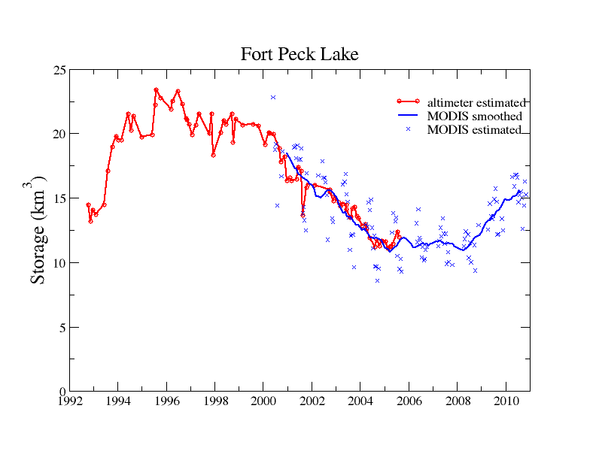
12
Method: Storage Estimation
Fort Peck Reservoir
altimetry estimated
MODIS smoothed
MODIS estimated
V_{o}=f(h_{o})
A_{o} inferred from h_{o}(Altimetry)
V_{o}=g(A_{o}):
h_{o} inferred from A_{o}(MODIS)

Slide 16
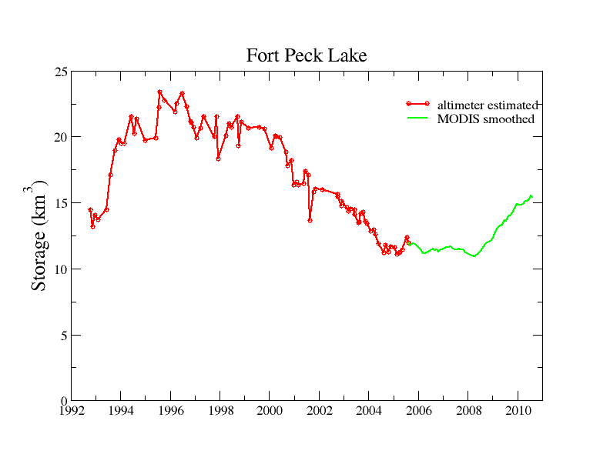
13
Method: Storage Estimation
Fort Peck Reservoir
altimetry estimated
MODIS smoothed
When there is an overlap, altimetry based storage estimation is chosen for the final product

Slide 17
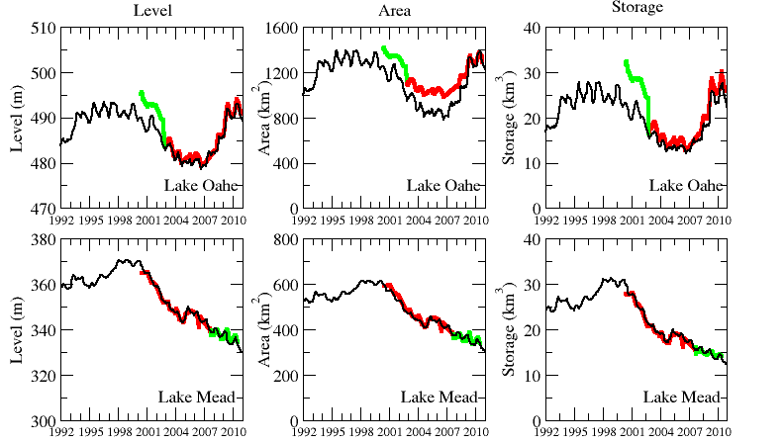
14
Evaluation of Results
observation
altimetry estimated
MODIS smoothed
Other validated reservoirs: Lake Powell, Lake Sakakawea, and Fort Peck reservoir
Altimetry level from http://www.legos.obs-mip.fr/soa/hydrologie/hydroweb
Observed area inferred from observed level and storage

Slide 18
15
Global Reservoir Product
60N
30N
EQ
30S
60S
160
120
80
40
0
(km³)
180 120W 60W 0 60E 120E 180
1992 1995 1998 2001 2004 2007 2010

Slide 19
16
Global Reservoir Product
60N
30N
EQ
30S
60S
200
160
120
80
40
0
(km³)
180 120W 60W 0 60E 120E 180
1992 1995 1998 2001 2004 2007 2010

Slide 20
17
Global Reservoir Product
60N
30N
EQ
30S
60S
100
75
50
25
0
(km³)
180 120W 60W 0 60E 120E 180
1992 1995 1998 2001 2004 2007 2010

Slide 21
18
Conclusions
An unsupervised classification method was applied to the MODIS vegetation index data to estimate reservoir surface area from 2000 to 2010
Level-area relationships were derived for each of the 34 reservoirs, such that the remotely sensed depth and area can be used jointly to maximize observation length
The estimated reservoir storage, surface area, and water level were validated by gauge data over the five largest US reservoirs
A 19-year consistent global reservoir dataset (including storage, surface area, and water level) was derived
The remotely sensed reservoir storage estimations can be used for operational applications and hydrologic modeling of water management

Slide 22
^{Acknowledgements}
For altimetry products
USDA Global Reservoir and Lake Elevation Database
French Space Agency’s Hydrology by Altimetry (LEGOS)
For reservoir configurations
Global Reservoir and Dam (GRanD) database
For gauge observations
US Army Corps of Engineers, Bureau of Recreation
This research was supported by NASA grant No. NNX08AN40A to the University of Washington under subcontract from Princeton University
^{Contact: hgao@uw.edu}

